Slide 1
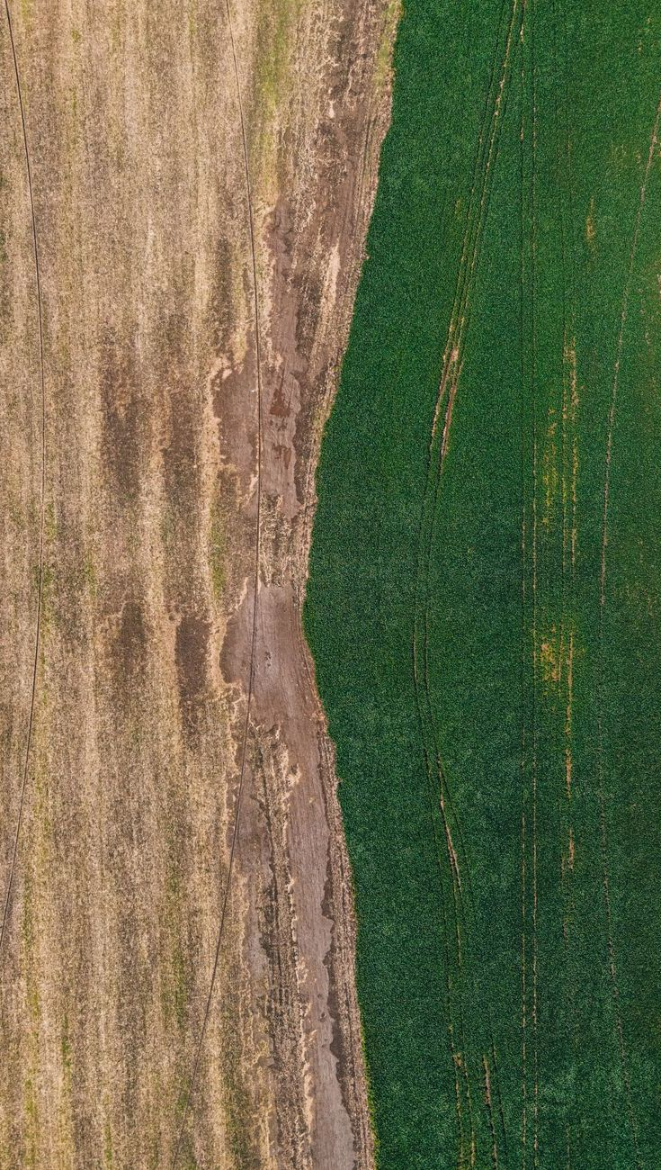
AI-Driven Satellite Remote
Sensing for Field-Scale Soil
Nutrient (NPK) and Health
Assessment
CAPSTONE ENGINEERING PROJECT PROPOSAL (PHASE 1) — Department of Computer Science & Engineering, Academic Year 2025–2026.
Project Guide: Dr. Pramod T. C. | Team: 4 Specialized Roles (Data Engineering, ML Modeling, Soil Chemistry, Web GIS).
Problem: Farmers and agronomists often lack timely, affordable, field-scale visibility into soil nutrient variability, making it difficult to detect NPK deficiencies early and optimize interventions.
Key innovation: This project combines Sentinel-2 satellite imagery, geospatial preprocessing, and machine learning to estimate soil NPK status and broader field health indicators from remote sensing signals.
Expected impact: The system aims to support faster, data-driven soil management decisions, reduce unnecessary sampling and input use, and improve crop productivity through more precise advisory recommendations.

Slide 2


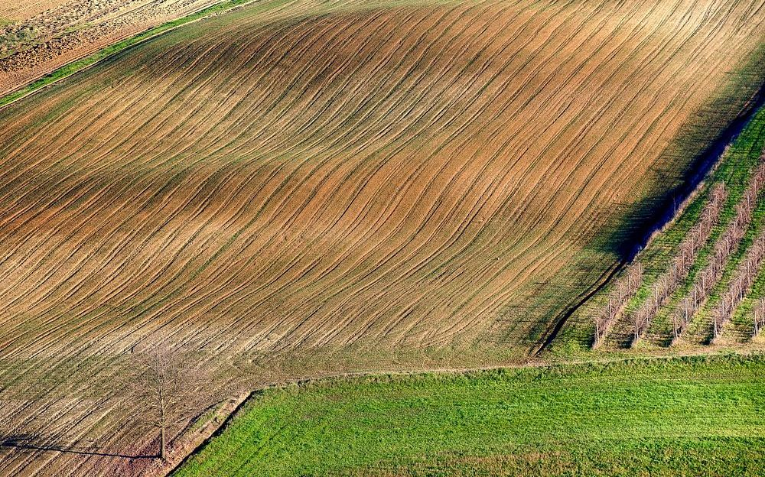

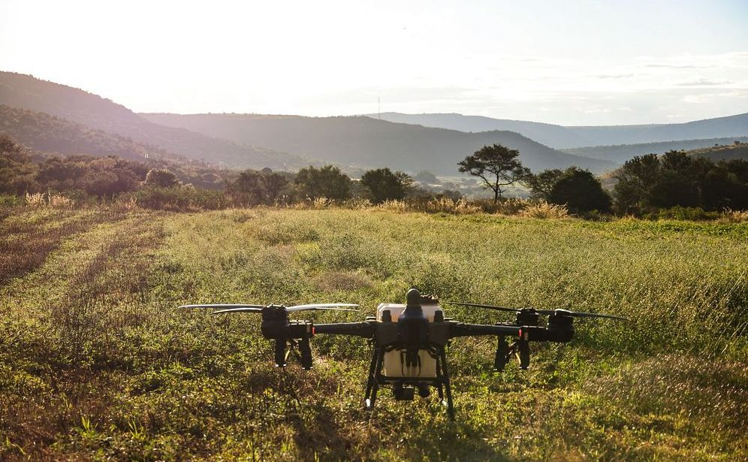
PROBLEM CONTEXT
CAPSTONE 2025–26 | DR. PRAMOD T. C.
Why This Matters — The Critical Need for Soil Testing
Soil Drives
Agriculture
Smallholder
Constraints
Economic Impact of
Soil Degradation
Climate Resilience
Through Soil Health
Precision
Agriculture ROI
Healthy soil fertility (N, P, K, SOC, pH) directly dictates crop yield, food security, and farm profitability.
Precision agriculture shifts practice from blanket fertilization to site-specific variable-rate management.
Less than 15% of farmers regularly test soil due to long turnaround (2-4 weeks), lab inaccessibility, and high per-sample costs—creating a pressing need for low-cost, rapid alternatives.
Soil nutrient depletion, erosion, and pH imbalance reduce yields, increase fertilizer waste, and raise production costs.
Without testing, farmers overapply in some zones while starving others.
Well-managed soils retain more moisture, support stronger root systems, and buffer crops against drought, heavy rain, and temperature stress.
Testing helps protect organic matter season after season.
Targeted nutrient application improves input efficiency, reduces unnecessary fertilizer spend, and increases yield consistency.
Soil testing provides the data foundation for viable precision agriculture.

Slide 3
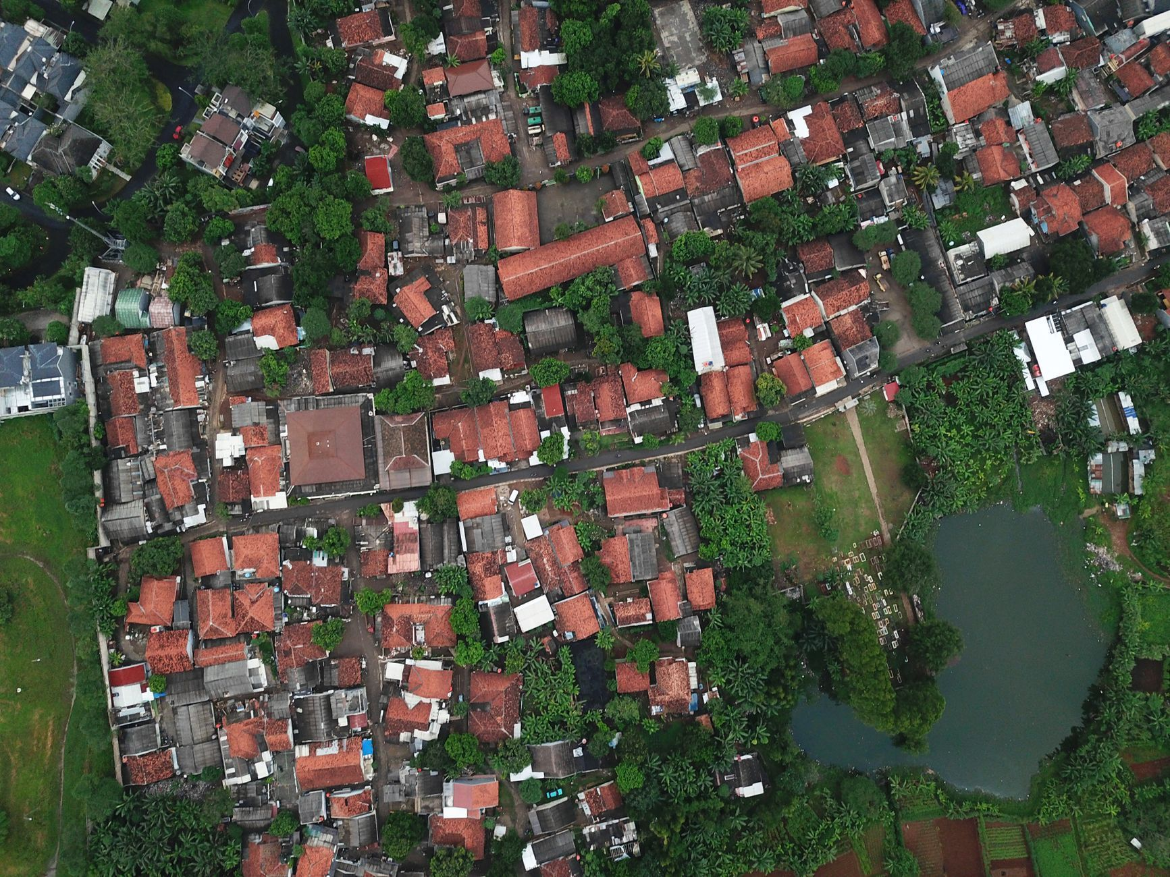
SYSTEM OVERVIEW
CAPSTONE 2025–26 | DR. PRAMOD T. C.
Proposed Solution — Remote Sensing + Chemometrics + AI
We combine ESA Copernicus Sentinel-2 multispectral satellite imagery with chemometric feature engineering and AI regression to estimate soil properties without physical sampling at every point. Sentinel-2 captures reflected light across visible, red-edge, near-infrared, and short-wave infrared bands at 10–20 m spatial resolution with a 5-day revisit cycle.
Chemometrics means extracting quantitative, physically meaningful predictors from spectral data. Instead of using raw pixels alone, we derive indices and band ratios sensitive to soil background, moisture, organic matter, and clay/mineral composition. Key features include BSI (Bare Soil Index), NDRE (Normalized Difference Red Edge), and Clay Ratio (B11/B12).
The AI layer uses supervised regression models such as XGBoost and LightGBM. These models learn the mapping from spectral features and indices to ground-truth soil chemistry measurements, predicting continuous nutrient values to produce high-resolution 2D fertility heatmaps and variable-rate fertilizer schedules.
Sentinel-2 Data
Multispectral imagery provides repeatable field coverage across visible, red-edge, NIR, and SWIR bands.
Chemometric Features
Engineered indices such as BSI, NDRE, and Clay Ratio convert raw reflectance into soil-relevant predictors.
AI Regression
XGBoost / LightGBM learn nonlinear relationships between spectral features and laboratory measurements.
Decision Outputs
Predictions are turned into fertility heatmaps and prescription layers for precision agriculture.

Slide 4

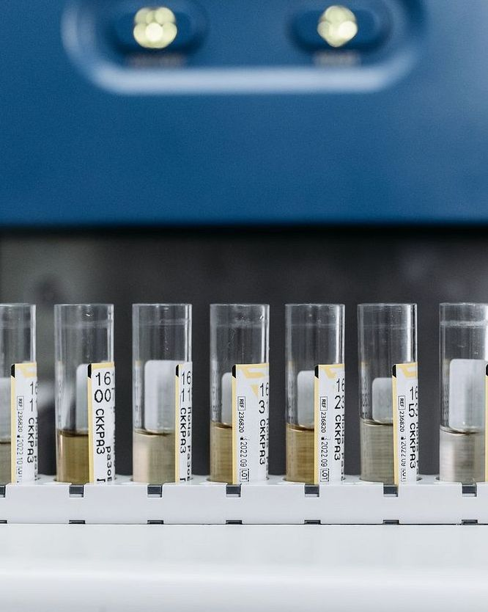

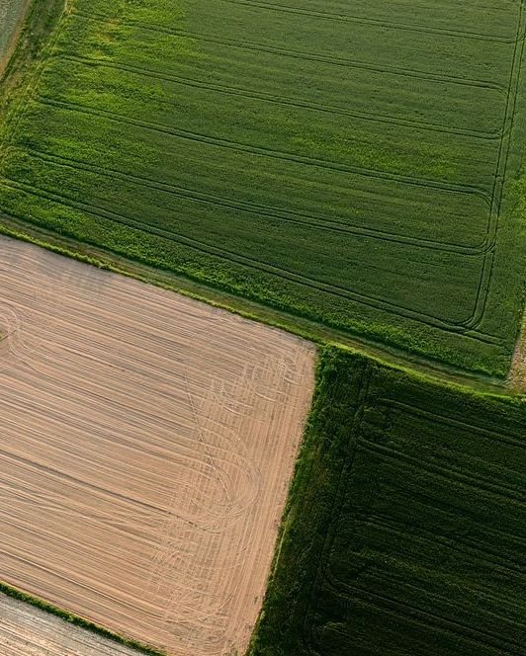
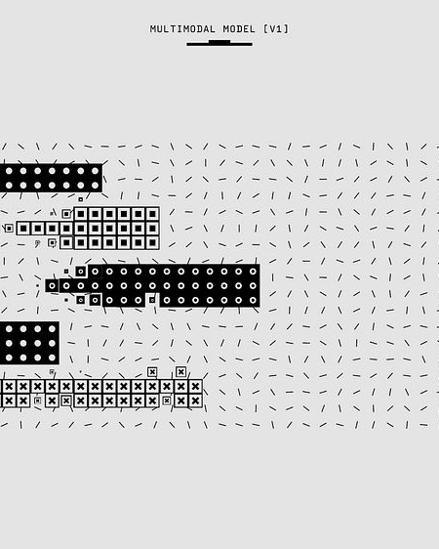
LITERATURE SURVEY (1/3)
CAPSTONE 2025–26 | DR. PRAMOD T. C.
Literature Foundations — Data Engineering & Soil Spectroscopy
Sentinel-2 for Soil Mapping
Castaldi et al. (2019) and Gholizadeh et al. (2021) demonstrate Sentinel-2 multispectral fidelity and multi-temporal compositing effectively map topsoil properties and cancel ephemeral noise.
[🔗 View Paper / DOI]
Spectral Libraries
Demattê et al. (2018) and Dotto et al. (2018) characterize absorption overtones for clay, organic matter, and moisture; fusing spectral data with terrain/climate improves P and K prediction.
[🔗 View Paper / DOI]
Soil Moisture Effects
Piccoli et al. (2023) show moisture strongly suppresses reflectance, especially in visible and NIR. Requires moisture-aware preprocessing and stratified modeling across soil moisture regimes.
[🔗 View Paper / DOI]
Temporal Compositing
Recent studies compare median and percentile-based seasonal composites to build cleaner inputs, reducing atmospheric noise and residue while preserving true soil signals.
[🔗 View Paper / DOI]
Validation Methodology
Recent work emphasizes rigorous validation: spatial blocking and independent holdouts to avoid spatial autocorrelation that falsely inflates accuracy in naive random splits.
[🔗 View Paper / DOI]

Slide 5
LITERATURE SURVEY (2/3)
CAPSTONE 2025–26 | DR. PRAMOD T. C.
Literature Foundations — Machine Learning & Spatial Modeling
🌲
Ensemble Models Lead
Kammerlander et al. (2025) and Vohland et al. (2018) benchmark tree-based ensembles (Random Forest, XGBoost), demonstrating they outperform neural nets on tabular spectral data when properly engineered. [🔗 View Paper]
📋
Feature & Validation Strategies
Meta-analyses (Frontiers 2024; MDPI 2021) emphasize feature selection, moisture normalization, PCA/indices, and robust spatial cross-validation to avoid overfitting and inflated metrics. [🔗 View Paper]
🎛️
Hyperparameter Tuning
Strong performance depends on careful tuning of complexity, learning rate, depth, and regularization. Bayesian optimization and nested CV balance accuracy with generalization. [🔗 View Paper]
⚖️
Class Imbalance in Soil Data
Soil datasets overrepresent common ranges while extreme nutrient deficiencies are under-sampled. Prior work supports stratified sampling and focal loss to improve minority-class recall. [🔗 View Paper]
🧠
Transfer Learning & Domain Adaptation
When local field data are limited, transfer learning from larger spectral libraries (e.g. LUCAS) improves robustness, adapting across landscapes to reduce local ground truth collection costs. [🔗 View Paper]
🎯
Uncertainty Quantification
For mapping and decision support, point predictions are not enough. Ensemble variance and quantile regression provide uncertainty estimates that expose unreliable predictions. [🔗 View Paper]

Slide 6
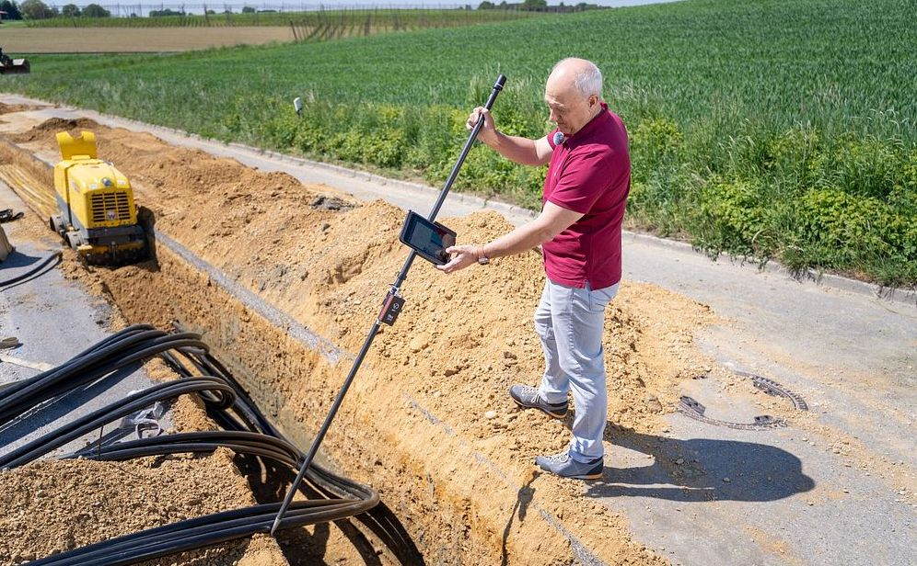
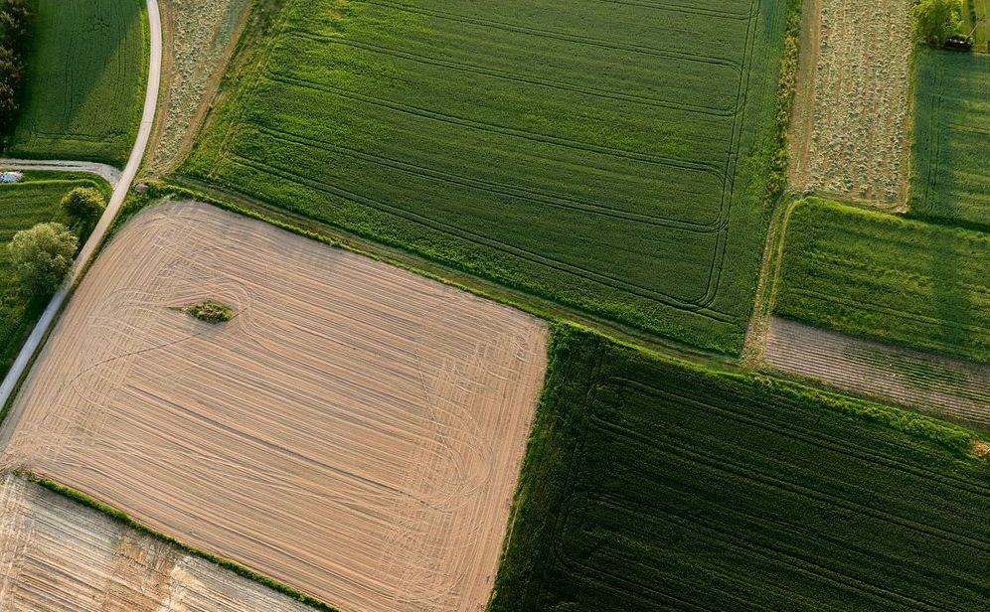
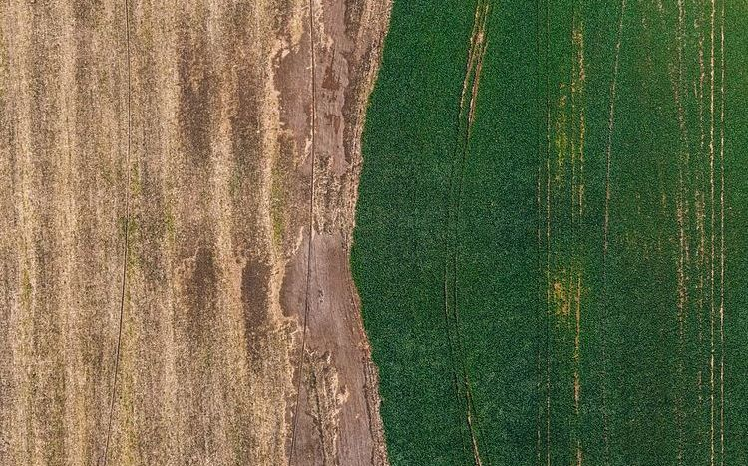

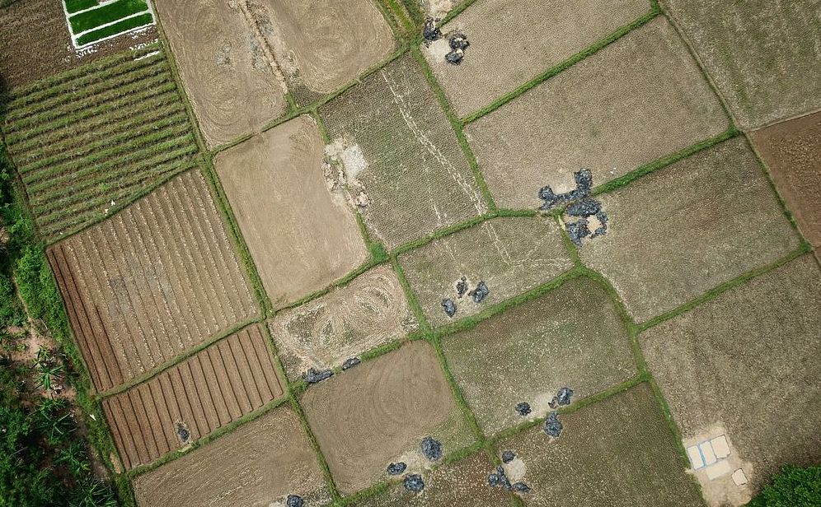
LITERATURE SURVEY (3/3)
CAPSTONE 2025–26 | DR. PRAMOD T. C.
Target Variables & Spatial Mapping Evidence
Topsoil Targets
Studies (Charishma et al. 2024; Ng et al. 2019) demonstrate Sentinel-2 band combos and SWIR indices correlate with top 0–20 cm N, SOC, and available P/K when crop residue is masked.
[🔗 View Paper / DOI]
Actionable Tiering
Models convert continuous ppm predictions into Low/Medium/High soil-health tiers and enable regionally calibrated fertilizer recommendations (Bhargavi & Anitha 2026; CIGR Journal 2025).
[🔗 View Paper / DOI]
Seasonal Variation
Soil moisture, residue cover, and crop growth stage shift reflectance. Mapping is stronger when imagery is matched to consistent plowing windows or modeled with seasonal covariates (Wang et al. 2021).
[🔗 View Paper / DOI]
Depth Profiles
Target variables must be defined by sampling depth; nutrient concentration declines with depth. Plowing homogenizes 0–20 cm, while canopy signals reflect deeper root-zone uptake.
[🔗 View Paper / DOI]
Mixed Crop Types
In heterogeneous fields, crop type confounds spectral signatures. Stratifying by crop class, masking crop canopies, or using crop-aware models prevents confusing crop signals with soil variation.
[🔗 View Paper / DOI]

Slide 7
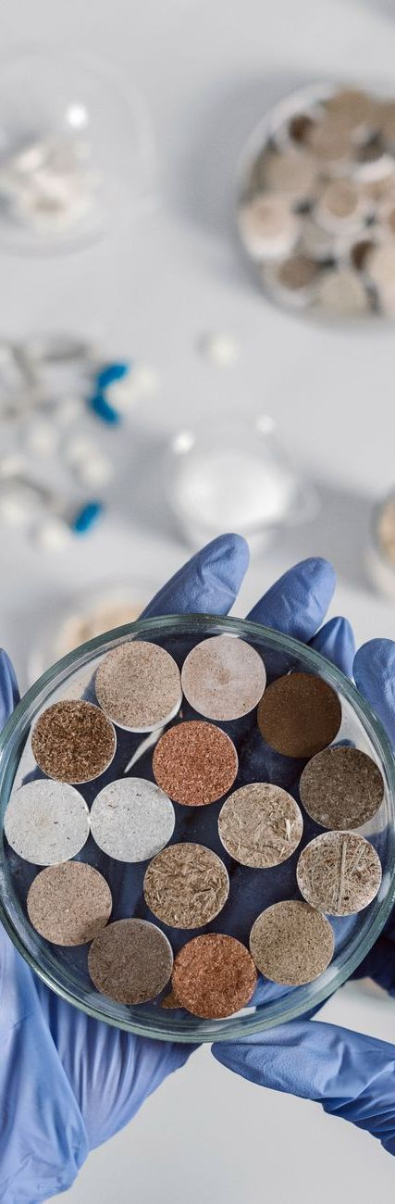
EXISTING SYSTEM LIMITATIONS
CAPSTONE 2025–26 | DR. PRAMOD T. C.
Known Limitations & Methodological Pitfalls
1
Wet-Chemical Testing Constraints
Lab tests are time-intensive (2–4 weeks), costly (₹500–₹2,500/sample), spatially sparse (composite samples erase intra-field variability), and destructive/manual.
2
Naive Satellite Model Risks
Vegetation cover confounds soil signals; naive assumptions ignore sensor physics (P/K depend on mineral covariance); random splits cause spatial leakage and inflated R².
3
Atmospheric Effects on Satellite Data
Clouds, haze, aerosols, water vapor, and variable illumination can distort reflectance values. Residual atmospheric noise obscures subtle soil differences if uncorrected.
4
Calibration Drift Over Time
Sensor aging, platform transitions, and changing acquisition conditions introduce calibration drift that weakens model reliability across seasons and years.
5
Weak Transferability Across Regions
Models trained in one agro-ecological zone fail elsewhere because soil mineralogy, texture, and climate differ. Local fine-tuning and spatial stratification are essential.

Slide 8
PROBLEM STATEMENT
CAPSTONE 2025–26 | DR. PRAMOD T. C.
Problem Statement & Research Challenges
Conventional laboratory soil testing is financially inaccessible, slow, and spatially sparse for smallholders, so most farmers make fertilizer decisions with incomplete information. The result is indiscriminate nutrient application, lower yields, avoidable input costs, and long-term soil degradation. Across smallholder farming systems, this challenge affects millions of farmers and has a direct economic impact through wasted fertilizer spend and missed precision nutrient management.
This project asks three core research questions: (1) Can Sentinel-2 imagery be used to reliably estimate topsoil N, P, K, SOC, and pH at field-relevant 10m resolution? (2) Which spectral, spatial, and terrain-related signals are most predictive across highly variable cropping conditions? (3) How can predictions be translated into an automated, cloud-native advisory pipeline that is robust enough for operational use by farmers and agronomists?
Resolve Depth Paradox — Tillage plow layer & canopy RedEdge proxies
Isolate Bare Soil — SCL cloud mask & multi-temporal Barest Earth composite
Model Secondary Covariance — P & K binding to iron oxides & clay absorption lattices
The technical hurdles are substantial: soil properties are not directly visible from space, vegetation cover obscures the signal, and nutrient responses vary by soil type, season, and management history. The model must also handle limited ground truth, eliminate spatial autocorrelation leakage via Spatial GroupKFold, generalize across fields, and produce outputs that are interpretable and actionable rather than just statistically accurate.

Slide 9
SYSTEM DESIGN (1/2)
CAPSTONE 2025–26 | DR. PRAMOD T. C.
System Architecture & End-to-End Pipeline Flow
The system operates as an end-to-end cloud-native pipeline converting Sentinel-2 imagery into farm-scale agronomic advisory. Streaming only required pixels via STAC API range requests, it enforces multi-temporal bare-soil compositing, extracts 17+ chemometric predictors, and runs spatial multi-target regression.
STAGE 1: INGESTION
STAGE 2: FILTERING
STAGE 3: MODELING
STAGE 4: ADVISORY
Cloud STAC & COG Stream
Bare Soil Compositing
Spatial Multi-Target ML
10m Heatmaps & Dosage
• Microsoft Planetary Computer STAC
• Sentinel-2 L2A BOA reflectance
• HTTP range requests on COGs
• Sub-second bounding box crop
• Zero local full-tile storage
• SCL mask (clouds, shadow, cirrus)
• Vegetation down-weight (NDVI < 0.25)
• Bare Soil Index filter (BSI > 0.0)
• Multi-temporal median composite
• Ephemeral surface noise cancelled
• 10 Science Bands + 7 Indices + DEM
• Supervised XGBoost & LightGBM
• Spatial GroupKFold validation
• Models N, P, K, pH, and SOC
• Spatial leakage strictly eliminated
• Georeferenced 10m nutrient rasters
• Intra-field management zonation
• Low / Medium / High Soil Card tiers
• Precision fertilizer split (Urea, DAP, MOP)
• Web GIS interactive interface

Slide 10
SYSTEM DESIGN (2/2)
CAPSTONE 2025–26 | DR. PRAMOD T. C.
Data Pipeline & Chemometric Feature Engineering
STAGE 1: 10 Science Bands Extraction
STAGE 2: Geochemical Index Engine
STAGE 3: ML Model & Validation Suite
• B02 (Blue 490nm): Iron oxide baseline
• B03 (Green 560nm): Residue separation
• B04 (Red 665nm): Soil line baseline
• B05, B06, B07 (Red Edge 705-783nm): Nitrogen & Chlorophyll proxy
• B08, B8A (NIR 842-865nm): Biomass & Hematite/Goethite
• B11 (SWIR-1 1610nm): Organic Carbon & Soil Moisture
• B12 (SWIR-2 2190nm): Clay minerals, P, K & Calcite (pH)
• Bare Soil Index (BSI):
((B11+B4)-(B8+B2)) / ((B11+B4)+(B8+B2))
• Clay Mineral Ratio (CMR):
B11 / B12 (Proxy for Clay, P, and K CEC)
• Ferric Iron Index (FII):
B4 / B2 (Phosphate adsorption sites)
• Carbonate Index (CI):
B12 / B11 (Calcite at 2340nm for pH)
• Red Edge Nitrogen (NDRE):
(B8-B5) / (B8+B5) (Canopy RuBisCO N)
• Soil Brightness Index (SBI):
sqrt((B4² + B3² + B8²) / 3)
• Input Tensor: 10 Bands + 7 Indices + DEM
• Target Chemical Array:
[Available N, Available P, Exch. K, pH, SOC]
• Regression Algorithms:
XGBoost, LightGBM, Random Forest Regressors
• Spatial Block Cross-Validation:
GroupKFold by regional administrative
clusters to strictly eliminate spatial leakage
• Evaluation Metrics:
R² (Goodness of fit), RMSE, and RPIQ
(Ratio of Performance to InterQuartile distance)

Slide 11
PROJECT ROADMAP
CAPSTONE 2025–26 | DR. PRAMOD T. C.
Objectives, Execution Plan & Expected Outcomes
Objectives
Execution & Outcomes
• Automate STAC/COG ingestion for sub-second farm-level access.
• Isolate bare soil via temporal NDVI/BSI filters and SCL masks.
• Engineer spectral + geo indices; train XGBoost/LightGBM with spatial CV.
• Deliver 10m heatmaps and farmer-friendly Soil Health Card tiers.
• Phase 1 completed: literature survey, STAC access, benchmark datasets, spatial CV framework.
• Upcoming phases: feature extraction, ML benchmarking, raster inference engine, Web GIS advisory.
• Expected outcomes: validated regression suite for N/P/K/pH/SOC, continuous 10m intra-field maps, actionable fertilizer advisory engine.
Phase 1 — Foundations
Weeks 1–4 [COMPLETED]
Phase 2 — Feature Pipeline
Weeks 5–8 [UPCOMING]
Phase 3 — ML Benchmarking
Weeks 9–12 [UPCOMING]
Phase 4 — Inference & GIS
Weeks 13–16 [UPCOMING]
• Literature review & target definition
• STAC catalog access & COG retrieval
• Benchmark labels & spatial CV setup
• SCL cloud masking & temporal rules
• Bare-soil compositing (NDVI/BSI)
• Spectral, mineral, & geo indices
• Train XGBoost & LightGBM for NPK
• Spatial GroupKFold generalization
• Feature importance & error slicing
• Raster inference engine (10m surfaces)
• Zonation maps & fertilizer dosage
• Web GIS integration & farmer review
01 Validation approach
Validate data quality first, then accuracy, then advisory usefulness via spatial CV & holdouts.
02 KPIs
Ingestion latency (<2s), cloud-free compositing rate, cross-validated R² by nutrient, inference throughput.
03 Team responsibilities
Remote sensing lead (imagery), ML lead (models), GIS engineer (pipelines), Agronomist (advisory).
04 Resource requirements
Cloud object storage, compute for training, geospatial libraries (Rasterio), reference soil samples.

Slide 12
APPLICATIONS & IMPACT
CAPSTONE 2025–26 | DR. PRAMOD T. C.
Applications & Practical Relevance
Precision Agriculture & Variable Rate Application (VRA)
Enables modern tractor sprayers and drone spreaders to apply differential fertilizer dosages across high-deficiency and high-fertility zones within the same parcel, reducing input costs by up to 25%.
Accessible Digital Soil Health Cards for Smallholders
Provides instantaneous, free soil condition assessments for smallholder farmers who lack physical access to government soil testing laboratories or cannot afford private testing fees.
Environmental Protection & Groundwater Safeguards
Prevents indiscriminate nitrogen broadcasting, directly mitigating nitrate leaching into rural groundwater aquifers, soil acidification, and agricultural runoff eutrophication.
Carbon Sequestration & Regeneration Monitoring
Equips agrarian NGOs, carbon credit verifiers, and agricultural departments to monitor field-scale Soil Organic Carbon (SOC) regeneration over multi-year regenerative farming initiatives.
Micro-Finance & Agricultural Crop Insurance
Supplies rural lending institutions and insurance underwriters with verified, objective land fertility benchmarks to assess farm productivity potential and risk prior to loan disbursement.

Slide 13
REQUIREMENTS & SPECIFICATIONS
CAPSTONE 2025–26 | DR. PRAMOD T. C.
Hardware & Software Requirements
Hardware Specifications
Software & Development Stack
💻 Processor: Multi-core Intel Core i5/i7 (11th Gen+) or AMD Ryzen 5/7 for parallel geospatial raster window clipping.
💻 Memory (RAM): Minimum 16 GB DDR4/DDR5 RAM to handle multi-band satellite raster stacking in memory.
💻 GPU Acceleration: NVIDIA GTX/RTX GPU (or Google Colab / Kaggle Cloud T4/V100 GPU) for accelerated model cross-validation.
💻 Storage: 50 GB High-Speed NVMe SSD for local dataset caching and preprocessed training tables.
💻 Network: High-speed broadband connection (>20 Mbps) for streaming Cloud-Optimized GeoTIFFs via STAC API.
⚙️ Programming Language: Python 3.10 / 3.11 with virtual environment encapsulation.
⚙️ Cloud Earth APIs: Microsoft Planetary Computer STAC API (`pystac-client`, `planetary-computer`).
⚙️ Geospatial Stack: `rasterio`, `rioxarray`, `geopandas`, `shapely` for coordinate reprojection and COG windowing.
⚙️ Machine Learning Suite: `scikit-learn`, `xgboost`, `lightgbm` for regression modeling and spatial cross-validation.
⚙️ Visualization & Web GIS: `matplotlib`, `seaborn`, `folium` / `leaflet` for interactive intra-field heatmap rendering.

Slide 14
CONCLUSION & DELIVERABLES
CAPSTONE 2025–26 | DR. PRAMOD T. C.
Conclusion & Expected Outcomes
Key Takeaways from Phase 1
Expected Outcomes of Phase 2
✔ Scientific Feasibility Proven: Verified the physical and spectral mechanisms linking Sentinel-2 VNIR/SWIR reflectance to soil organic carbon, clay minerals, and indirect NPK covariance.
✔ Zero-Waste Cloud Architecture: Successfully implemented and verified Cloud-Optimized GeoTIFF streaming via STAC API, fetching farm-level data in 1.3 seconds without full-tile downloads.
✔ Defensible Validation Strategy: Overcame spatial autocorrelation hazards by formulating Spatial Block Cross-Validation, ensuring models generalize to unseen farms.
✔ Team Specialization: Distinct role allocation across Data Engineering, ML Modeling, Chemistry Targets, and GIS Mapping guarantees rapid Phase 2 execution.
🚀 Trained AI Regression Suite: Validated machine learning regressors predicting Nitrogen, Available Phosphorus, Exchangeable Potassium, pH, and SOC.
🚀 Continuous 2D Nutrient Heatmaps: High-resolution (10m) intra-field fertility maps showing exact management zones within farm boundaries.
🚀 Actionable Advisory Engine: Direct translation of chemical values into customized fertilizer dosage plans (Urea, DAP, MOP).
🚀 Empowerment of Smallholders: Democratizing soil health assessment by eliminating laboratory turnaround delays and testing expenses.

Slide 15
REFERENCES & CITATIONS
CAPSTONE 2025–26 | DR. PRAMOD T. C.
References (Journals & Conferences with Direct Access)
[1] Castaldi, F. et al. (2019). Sentinel-2 for soil organic carbon & texture.
Published in: Remote Sens. Environ.
🔗 Access
[9] Charishma, K. et al. (2024). Top soil properties by Sentinel-2 imaging.
Published in: Taylor & Francis
🔗 Access
[2] Gholizadeh, A. et al. (2021). Multi-Temporal Series to Estimate Topsoil.
Published in: MDPI Remote Sensing
🔗 Access
[10] Ng, W. et al. (2019). Utility of Sentinel-2 spectral data for SOC.
Published in: Geoderma
🔗 Access
[3] Piccoli, I. et al. (2023). Soil characteristics from Sentinel-3 & DEM.
Published in: MDPI Sensors
🔗 Access
[11] Bhargavi, P. & Anitha, S. (2026). Soil nutrient prediction using data mining.
Published in: IJSET
🔗 Access
[4] Demattê, J. A. M. et al. (2018). Soil spectral library & classification.
Published in: Revista Ciência Agron.
🔗 Access
[12] CIGR Journal (2025). Sensor framework for soil nutrients using DL.
Published in: CIGR Journal
🔗 Access
[5] Kammerlander, C. et al. (2025). ML models for soil parameter prediction.
Published in: arXiv:2503.22276
🔗 Access
[13] Taghizadeh-Mehrjardi, R. et al. (2020). Digital mapping of SOC using RS.
Published in: Geoderma
🔗 Access
[6] Vohland, M. et al. (2018). Mapping soil properties with Sentinel-2.
Published in: MDPI Remote Sensing
🔗 Access
[14] IEEE Access (2021). Estimating SOM Content Using Sentinel-2.
Published in: IEEE Access
🔗 Access
[7] Frontiers in Remote Sensing (2024). Prediction of soil texture review.
Published in: Frontiers in RS
🔗 Access
[15] Wang, J. et al. (2021). Soil salinity and nutrient mapping via Sentinel-2.
Published in: MDPI Remote Sensing
🔗 Access
[8] Dotto, A. C. et al. (2018). Predicting soil properties using ML & spectra.
Published in: Geoderma
🔗 Access

