Slide 1

A Study on Enhancing Metro Ride Experience using Path-finding Algorithms and Scheduling Efficiency
Balkishan Bajpay
220101025
Semester – V
Department of Computer Science and Engineering
Indian Institute of Information Technology Senapati,
Manipur
Under the Supervision of
Dr. Moirangthem Dennis Singh
Assistance Professor
Department of Computer Science and Engineering
Indian Institue of Information Technology Senapati,
Manipur

Slide 2
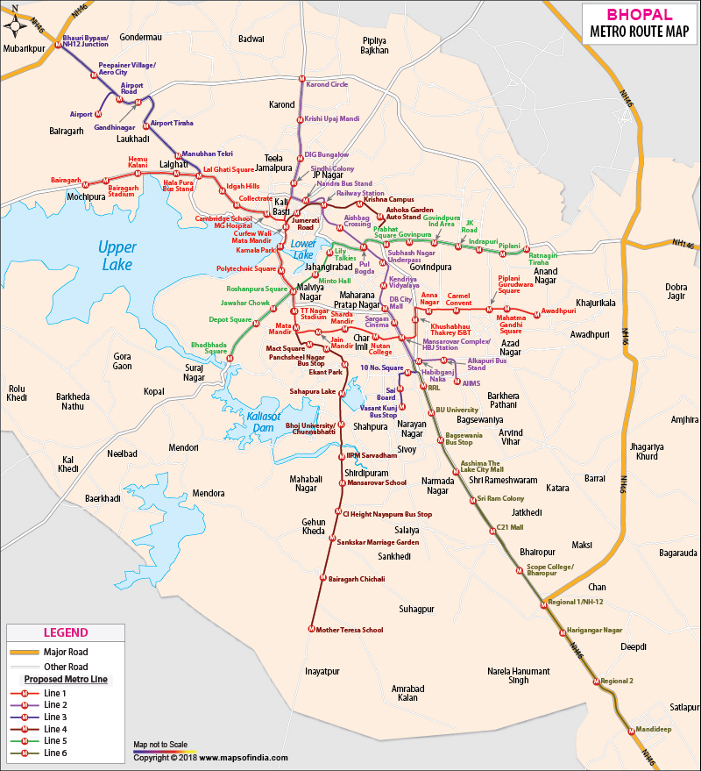
INTRODUCTION
The Metro Scheduling and Navigation System is designed to help commuters efficiently navigate complex metro networks. It automates the process of route planning, offering features such as identifying the shortest path between stations, calculating travel distances and times, and handling line changes seamlessly.
Problem Statement
As urban metro networks grow, passengers or travelers face increasingly difficult challenges in planning their trips, especially when the network have multiple lines, stations, and junctions. Some of the key difficulties that passengers face include:
Identifying the Shortest Route
Calculating Travel Distance and Time
Navigation between multiple lines
Assumption : Distance between any two stations is 800m to 1200m.

Slide 3
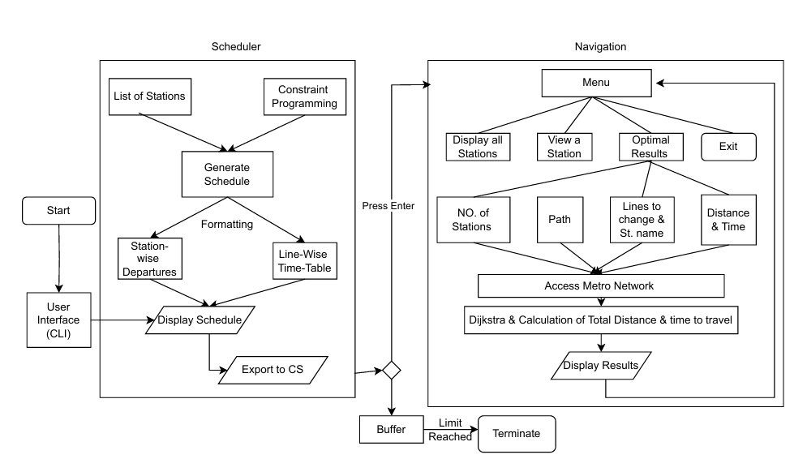
Proposed Solution
System architecture & Flow of Processes
Metro Scheduling and Navigation System :
It consists of two modules :
Scheduling module : which helps the passengers to get to know today's schedule of the metro lines for every station for smooth transition .
Navigation module : which helps the passengers to get to know which path is the shortest path , how much distance they have to travel in how much time and at which station they have to change metro and how many stations they have to cross to reach their destination station .
Other Approache
A* Algorithm for path finding , but it is not suitable because of not having a good heuristic .

Slide 4
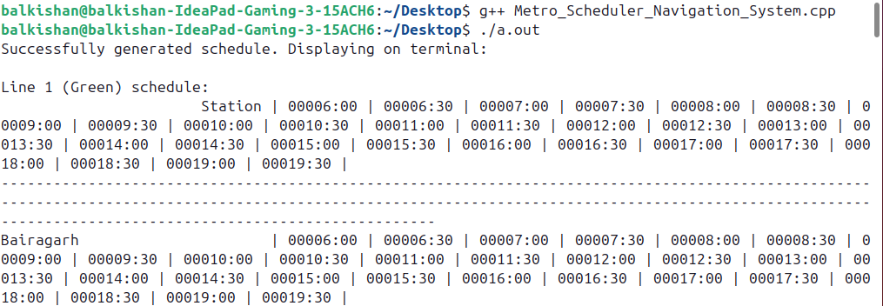
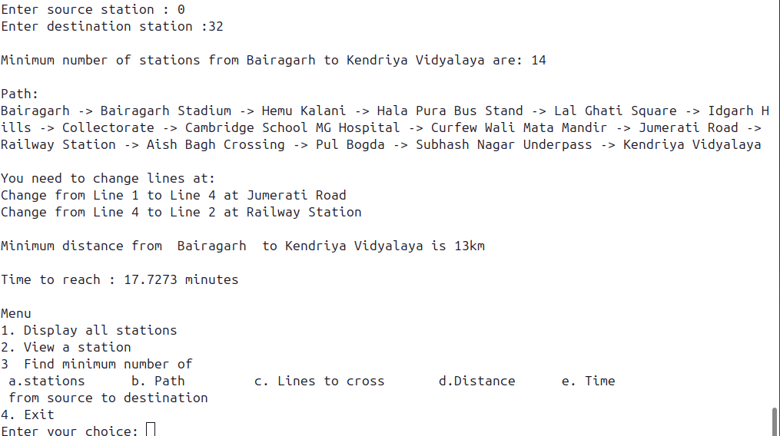
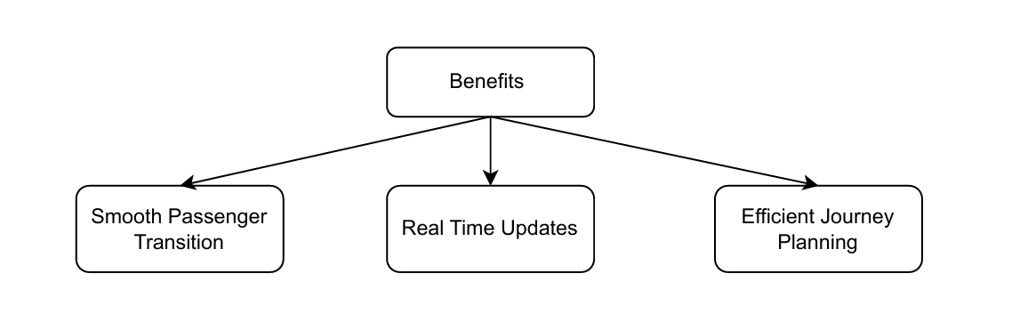
Result & Benefits
Scheduler Result
Navigation System Result
Scheduler Result: Displays the schedules for Line-1 (Green) and Line-2 (Red). It includes station codes, arrival, and departure times for each station. The scheduler generates similar results for all stations on every metro line.
Navigation System Result: Illustrates the system's functionality in finding the minimum number of stations and calculating the shortest distance between two specified stations. The result also provides information on required line changes and the estimated time to reach the destination.

Slide 5
Conclusion
This metro scheduling and navigation system efficiently addresses urban transit challenges by optimizing schedules and providing accurate route information. The implementation of Dijkstra’s algorithm ensures commuters can navigate easily, while the user-friendly interface enhances accessibility. The system's modular design allows for scalability, making it adaptable to future growth in urban transit networks.
Future Scope
New Algorithm Development: Hybrid A* and Dijkstra’s algorithm for enhanced pathfinding efficiency.
Real-Time Tracking: Integration of GPS for live train tracking and notifications.
Mobile App Development: Dedicated app for route planning, ticketing, and updates.
Predictive Scheduling: Use machine learning to optimize schedules based on passenger patterns.
Transport System Integration: Combine metro data with buses and ride-sharing services for seamless commuting.

Slide 6
Thank You!

