Slide 1
Video Streaming Platform (YouTube-Style)
Front End Engineering - II (25CSE0203) — Project Based Evaluation-I
Department of Computer Science & Engineering • Chitkara University
TEAM MEMBERS (GROUP G15)
• Kanav Chadha (Team Leader) — Roll No: 2510990649
• Kishan — Roll No: 2510991457
• Arsh Behl — Roll No: 2510991354
• Soumajit Majee — Roll No: 2510990383

Slide 2
GROUP G15 • PROJECT ID: G15-PID-17 (P-17) • FRONT END ENGINEERING - II (25CSE0203)
Project Vision & Core Objectives
01. The Problem & Need
• Modern video streaming interfaces require high responsiveness and fluid navigation without full browser refreshes.
• Users expect instantaneous word-based filtering across titles, creator channels, and categorized feeds.
• Need for a modular Single Page Application (SPA) architecture built strictly with standard curriculum web technologies.
02. What We Built
• A high-fidelity YouTube platform clone engineered in modern React 19 and Vite.
• Complete multi-route navigation across Home, Shorts, Subscriptions, History, Liked Videos, and Playlists.
• Responsive collapsible sidebar with full icon & text synchronization.
• Interactive video cards with real-time like/subscribe counters and external link handlers.
03. Key Objectives
• 100% Component-Driven Architecture with clean separation between Data and UI Presentation.
• Zero-latency word-boundary controlled search filtering without external API dependencies.
• Global State synchronization ensuring user interactions seamlessly persist across all playlist views.

Slide 3
GROUP G15 • PROJECT ID: G15-PID-17 (P-17) • FRONT END ENGINEERING - II (25CSE0203)
Syllabus-Aligned Technology Stack
React 19 (Core UI Library)
Functional components, React Hooks (useState, useMemo), Synthetic Events, and Virtual DOM reconciliation with unique key identifiers for optimized renders.
Vite 8.x (Build & Tooling)
Modern ESM bundler delivering instant Hot Module Replacement (HMR) and optimized 500ms production builds with clean asset chunking.
React Router DOM 7
Declarative client-side routing using BrowserRouter, Routes, Route, Link, and useLocation without triggering browser page refreshes.
React Icons 5.x
Scalable vector SVG icon components (Material Design, FontAwesome, Simple Icons) cleanly styled via CSS.
Pure Modern CSS3
Dark-theme design system using CSS Custom Properties (Variables), CSS Grid (auto-fill minmax), Flexbox layouts, and Media Queries.
Centralized Data Layer
Decoupled array-of-objects data model in videoData.js feeding clean presentation cards via standard ES6 .map() iterations.

Slide 4
GROUP G15 • PROJECT ID: G15-PID-17 (P-17) • FRONT END ENGINEERING - II (25CSE0203)
Core Component Architecture & Modularity
Navbar.jsx (Top App Bar)
Controlled search input, dynamic clear button (X), animated mic button, notification badge, and sidebar toggle hamburger.
Sidebar.jsx (Collapsible Navigation)
Two-tier responsive navigation with full & collapsed modes, direct YouTube channel links, and real-time active route styling.
VideoCard.jsx (Feed Cards)
16:9 aspect-ratio cards with duration badges, verified channel badges, hover play overlays, and interactive Like/Subscribe toggles.
ShortsCard.jsx (Vertical Shorts)
Vertical 9:16 aspect-ratio cards displaying view counts, creator avatars, and dedicated YouTube Shorts launch handlers.
CategoryChips.jsx (Filter Bar)
Horizontal chip bar allowing 1-click filtering across Coding, React, DSA, Gaming, Comedy, Music, and Entertainment.
Library Playlist Pages
Dedicated route pages for Subscriptions feed, Liked Videos auto-playlist, Watch Later queue, Watch History, and 404 handler.

Slide 5
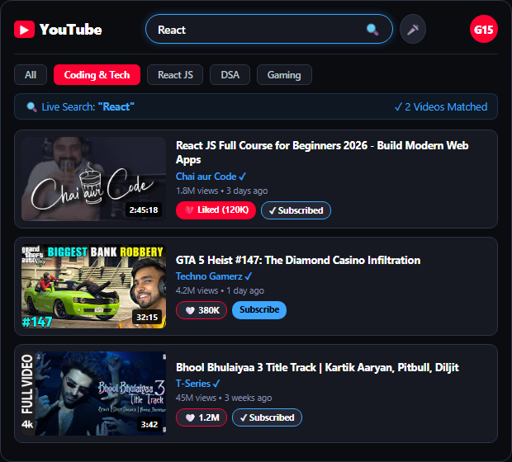
GROUP G15 • PROJECT ID: G15-PID-17 (P-17) • FRONT END ENGINEERING - II (25CSE0203)
Search Engine & Word-Based Filtering Mechanism
Controlled Search Engine Architecture
• Controlled Input Binding (useState): Search bar value is bound to searchQuery in App.jsx. Keystrokes trigger immediate re-renders without browser reload.
• Word-Boundary Token Matching: Evaluates keywords using word prefixes (.startsWith()) so queries like 'React' or 'GTA' match accurately without false substring hits.
• Dual Search & Chip Synergy: Combines free-text keyword search seamlessly with active Category Chips (e.g. Coding, Gaming, DSA) for high-precision filtering.
• Dynamic Status Header: Renders live query feedback (e.g. Results for 'React' - 2 videos found) with instant UI synchronization.
• Zero-Match Fallback Handler: Gracefully renders an empty-state message with a 1-click 'Reset Filter' button if zero videos match.

Slide 6
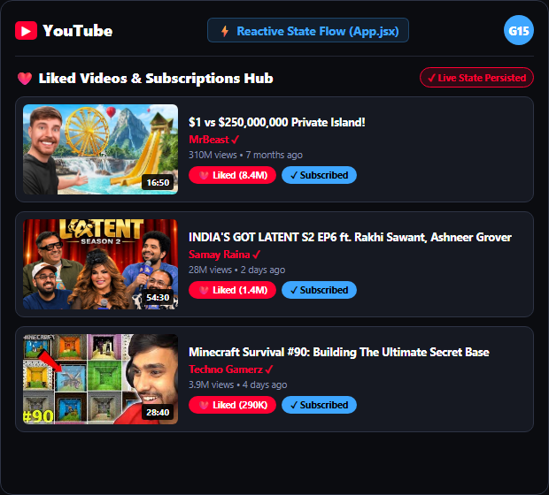
GROUP G15 • PROJECT ID: G15-PID-17 (P-17) • FRONT END ENGINEERING - II (25CSE0203)
State Management & Auto-Playlist Synchronization
Reactive State Flow Across Playlists
• Centralized State Hub (App.jsx): Global states (likedVideoIds, subscribedChannels, searchQuery) live at root level and pass to components via props.
• Instant Liked Videos Sync (/liked): Clicking Like on any Video or Short immediately updates likedVideoIds state and updates the Liked Videos playlist view in real time.
• Live Subscriptions Sync (/subscriptions): Subscribing to creators in Sidebar or on Cards updates subscribedChannels, instantly filtering the Subscriptions feed.
• Cross-Route State Persistence: Interactions remain consistent when navigating between Home, Shorts, Subscriptions, Liked, and History without data loss.
• Optimized Virtual DOM Renders: React list keys ensure only modified cards re-render, maintaining 60 FPS UI performance.

Slide 7




GROUP G15 • PROJECT ID: G15-PID-17 (P-17) • FRONT END ENGINEERING - II (25CSE0203)
Creator Ecosystem & Real Media Integration
MrBeast (516M Subs)
Featured: $1 vs $250M Private Island & 7 Days At Sea
Direct external YouTube watch & channel links launched safely via window.open(url, '_blank').
Techno Gamerz (53M Subs)
Featured: GTA 5 Heist #147 & Minecraft #90
Direct external YouTube watch & channel links launched safely via window.open(url, '_blank').
Samay Raina (11.4M Subs)
Featured: India's Got Latent S2 EP5 & EP6
Direct external YouTube watch & channel links launched safely via window.open(url, '_blank').
T-Series (315M Subs)
Featured: Bhool Bhulaiyaa 3 & Tauba Tauba Tracks
Direct external YouTube watch & channel links launched safely via window.open(url, '_blank').

Slide 8
GROUP G15 • PROJECT ID: G15-PID-17 (P-17) • FRONT END ENGINEERING - II (25CSE0203)
Future Engineering Scope & Technical Roadmap
Phase 2: Node.js & Express REST Backend
• Replace static mock data layer with a dedicated Node.js / Express.js REST API server.
• Integrate MongoDB Atlas database for persistent video collections, user history, and custom playlist storage.
Phase 3: Live YouTube Data API v3
• Fetch real-time live metrics (subscriber counts, up-to-the-minute view counters, comment counts).
• Dynamic automated YouTube video search querying official Google APIs.
Phase 4: Authentication & Video Player Hub
• Implement secure User Authentication via JWT & Google OAuth 2.0 login.
• Build an embedded custom HTML5 / React Player with comments, timestamps, and personalized video queueing.

Slide 9
