Slide 1
Experiential Learning Phase -I :
MULTIPLE-DISEASE-PREDICTION USING MACHINE LEARNING
BY:
HRUTHIK K K– 1RV22CS072
KIRAN V– 1RV22CS086
KISHAN KUMAR S D – 1RV22CS087
KISHOR PATIL – 1RV22CS088

Slide 2
PRESENTATION CONTENTS
1.Introduction
2. Objectives
3. Methodologies
4. ML model
5. Results

Slide 3
INTRODUCTION
The project focuses on developing a machine learning (ML) model capable of predicting multiple diseases: diabetes, heart disease, and Parkinson's disease.
The goal is to leverage ML algorithms to analyze patient data and provide early detection of these diseases, potentially aiding in timely intervention and treatment.

Slide 4
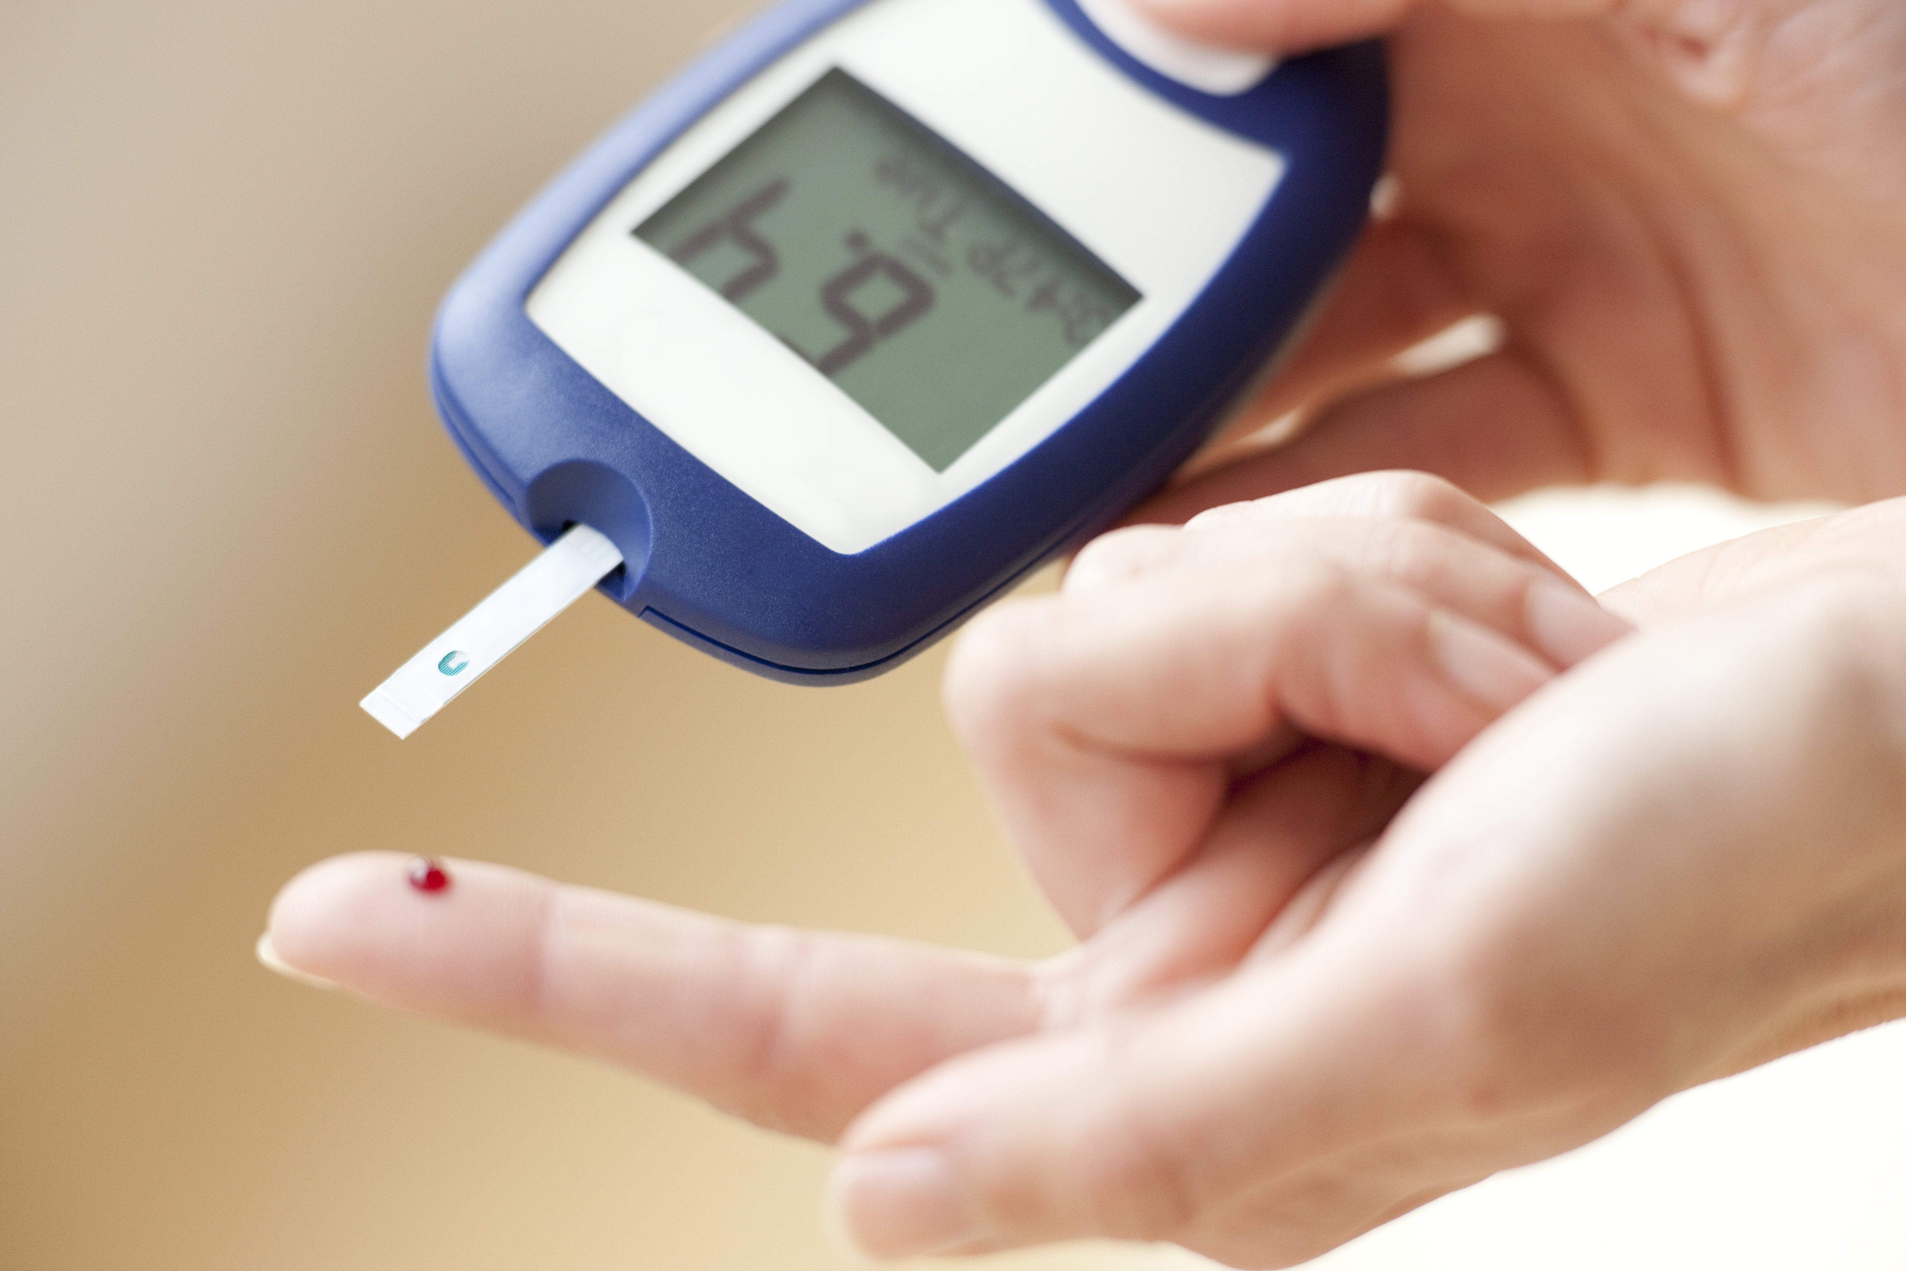
INTRODUCTION
Diabetes
Diabetes is a chronic condition characterized by high levels of glucose in the blood. It occurs either when the pancreas does not produce enough insulin or when the body cannot effectively use the insulin it produces.

Slide 5
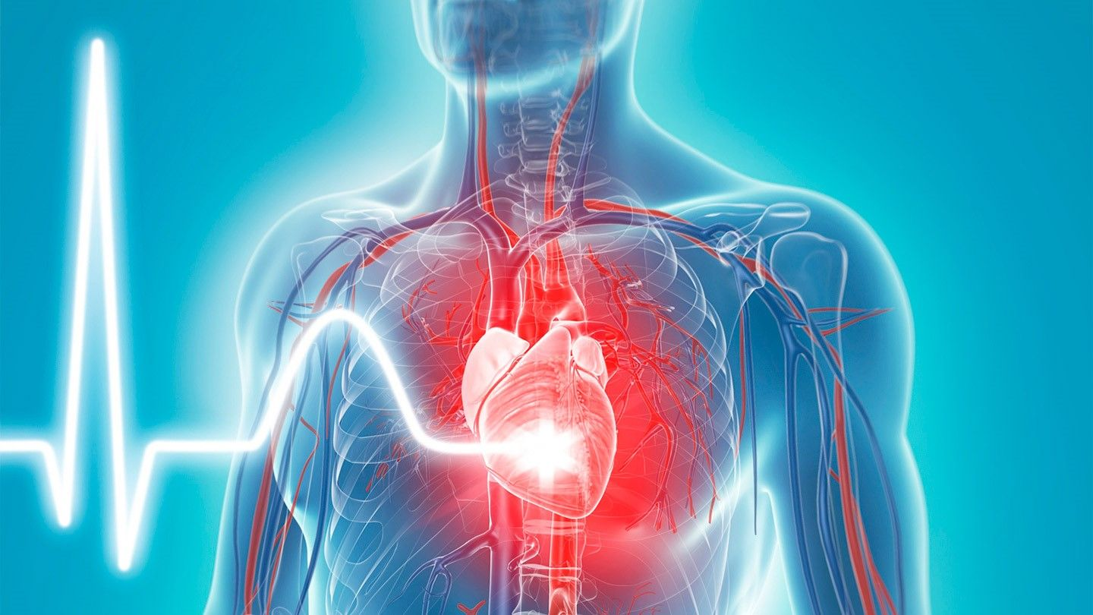
INTRODUCTION
Heart Disease
Heart disease encompasses various conditions affecting the heart, including coronary artery disease, arrhythmias, heart failure, and congenital heart defects. It is a leading cause of death worldwide.

Slide 6
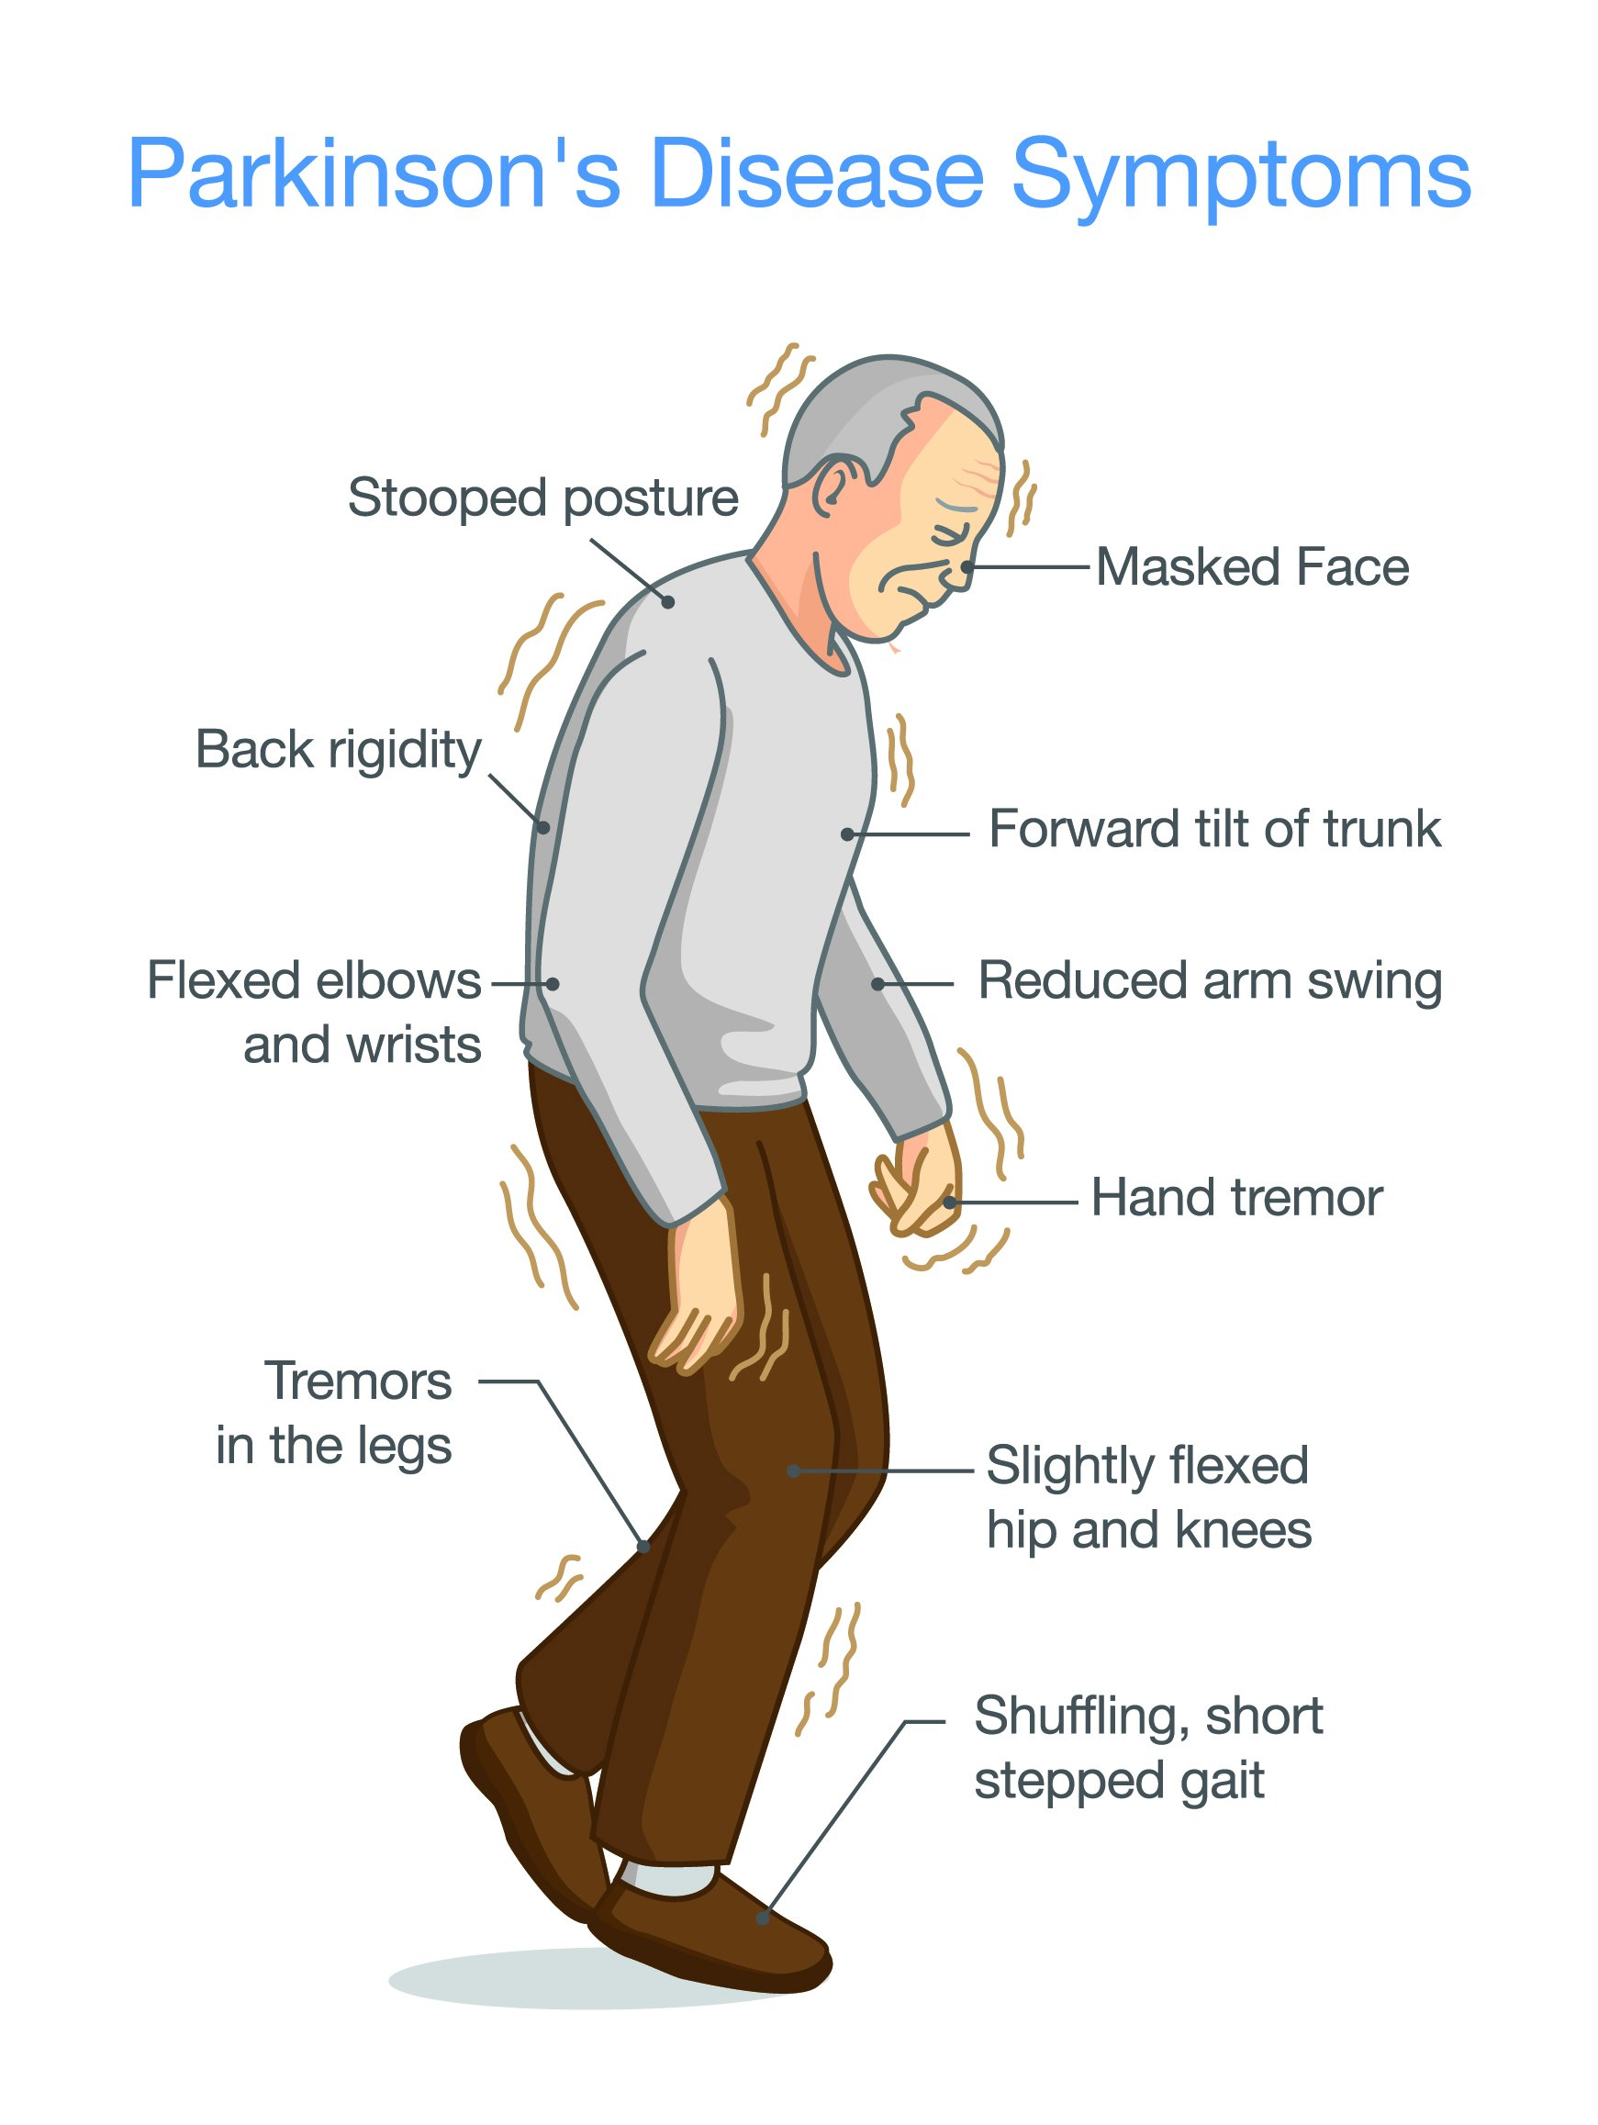
INTRODUCTION
Parkinson's Disease
Parkinson's disease is a progressive neurological disorder that affects movement. It results from the degeneration of dopamine-producing neurons in the substantia nigra, a part of the brain that controls movement.

Slide 7
OBJECTIVES
To build and train ML models for each disease prediction.
To evaluate the performance of the models using appropriate metrics.
To integrate the models into a unified system that can predict the likelihood
of each disease based on patient input.
To collect and preprocess relevant datasets for diabetes, heart disease,
and Parkinson's disease.

Slide 8
MOTIVATION
1. Personal and Public Health Impact
Early Detection and Prevention:
Personalized Healthcare:
2. Technological Advancements
Leveraging Big Data:
Advancements in ML Algorithms:
3. Societal and Economic Benefits
Reducing Healthcare Costs:
Enhancing Public Health:

Slide 9
METHODOLOGY
Datasets Collection
Data Preprocessing
Training the model
Testing the model

Slide 10
METHODOLOGY
1. Datasets
Diabetes Dataset: Typically includes features like age, BMI, blood pressure, insulin levels, and glucose concentration.
Heart Disease Dataset: Contains attributes such as age, sex, chest pain type, resting blood pressure, cholesterol levels, and maximum heart rate.
Parkinson's Disease Dataset: Comprises voice measurements, including jitter, shimmer, and harmonicity.

Slide 11
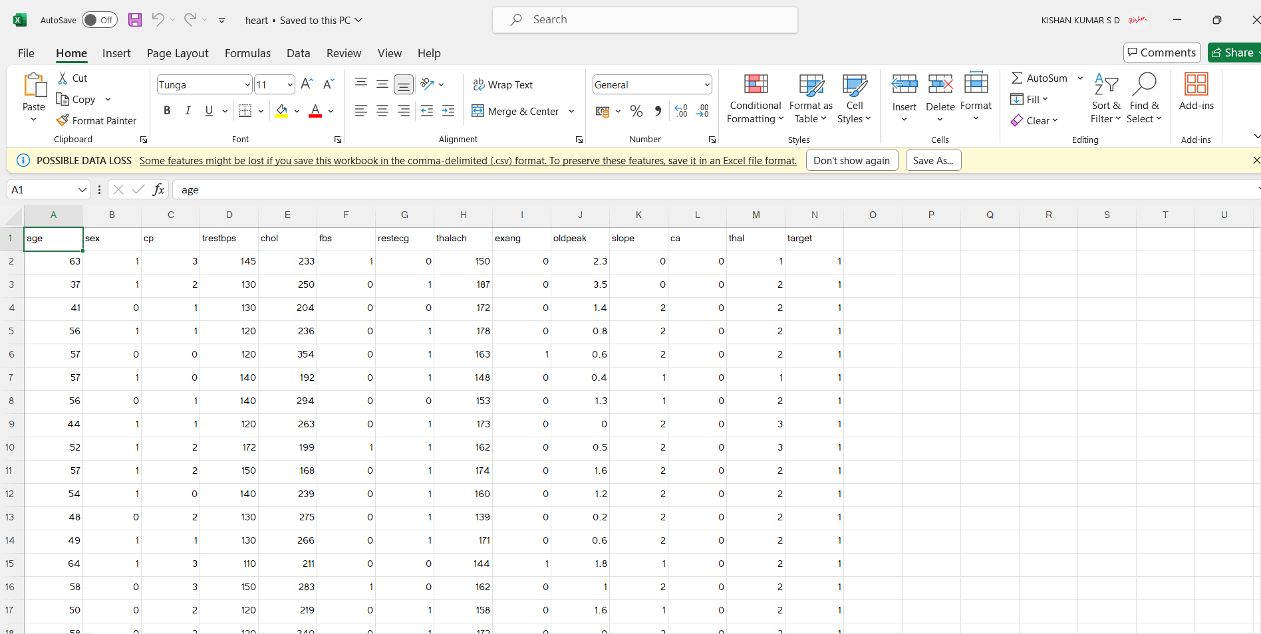
1. Dataset Image

Slide 12
METHODOLOGY
2. Data Preprocessing
Data Cleaning: Handling missing values, removing duplicates, and correcting erroneous entries.
Feature Scaling: Standardizing features to ensure uniformity across the dataset.
Feature Selection: Identifying and selecting the most relevant features for each disease to improve model accuracy and reduce complexity.
Splitting Data: Dividing the data into training and testing sets to evaluate the model performance.

Slide 13
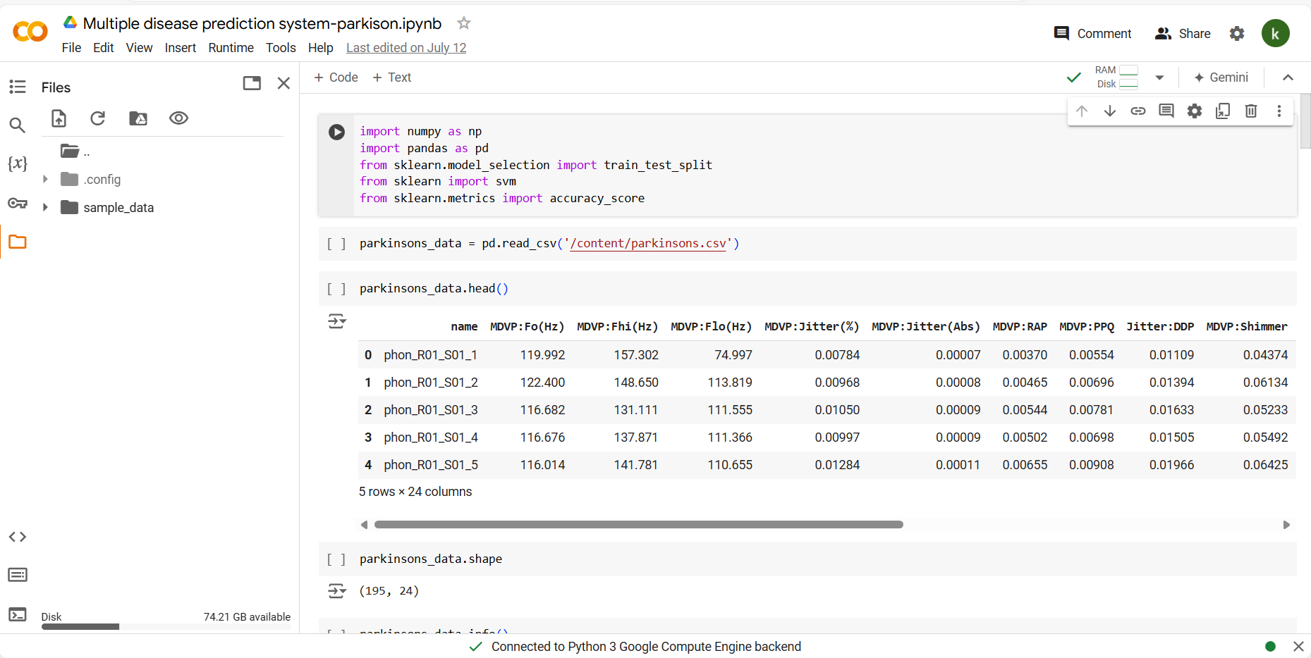
2. Data Preprocessing in colab

Slide 14
METHODOLOGY
3. ML based Models
Logistic Regression: Used for its simplicity and effectiveness in binary classification problems.
Decision Trees: Provide clear insights into the decision-making process of the model.
Random Forests: An ensemble method that improves prediction accuracy by combining multiple decision trees.
Support Vector Machine (SVM): Effective in high-dimensional spaces and useful for both regression and classification tasks.
Neural Networks: For more complex patterns and relationships within the data.
Model Training and Evaluation
Training: Each model is trained on the training dataset using cross-validation to optimize the parameters.
Evaluation Metrics: Accuracy, precision, recall, F1-score, and area under the ROC curve (AUC-ROC) are used to evaluate the model performance.
Comparison: Models are compared based on their performance metrics to select the best one for each disease.

Slide 15
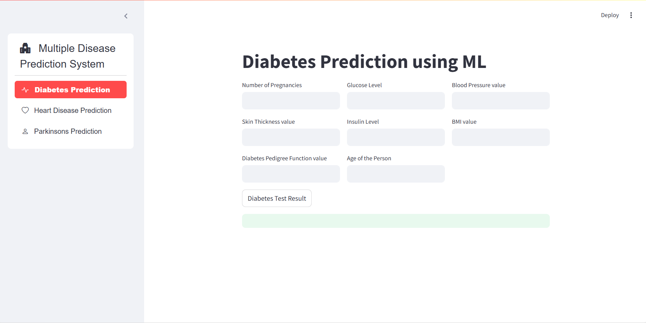
3. ML model

Slide 16
REFERENCES
American Diabetes Association. (2024). Standards of Medical Care in Diabetes. Retrieved from https://www.diabetes.org
2. Mayo Clinic. (2024). Diabetes. Retrieved from https://www.mayoclinic.org/diseases-conditions/diabetes
3. American Heart Association. (2024). Heart Disease and Stroke Statistics. Retrieved from https://www.heart.org
4. Mayo Clinic. (2024). Heart Disease. Retrieved from https://www.mayoclinic.org/diseases-conditions/heart-disease
5. National Heart, Lung, and Blood Institute (NHLBI). (2024). Coronary Heart Disease. Retrieved from https://www.nhlbi.nih.gov/health-topics/coronary-heart-disease
6. National Institute of Neurological Disorders and Stroke (NINDS). (2024). Parkinson's Disease Information Page. Retrieved from https://www.ninds.nih.gov/Disorders/All-Disorders/Parkinsons-Disease-Information-Page

Slide 17
THANK YOU

Slide 18


Slide 19
TOOLS / API USED
Programming Language: Python
Web Framework: Streamlit
Machine Learning Libraries: Scikit-learn, XGBoost
Data Analysis and Visualization: Pandas, NumPy, Matplotlib, Seaborn

Slide 20
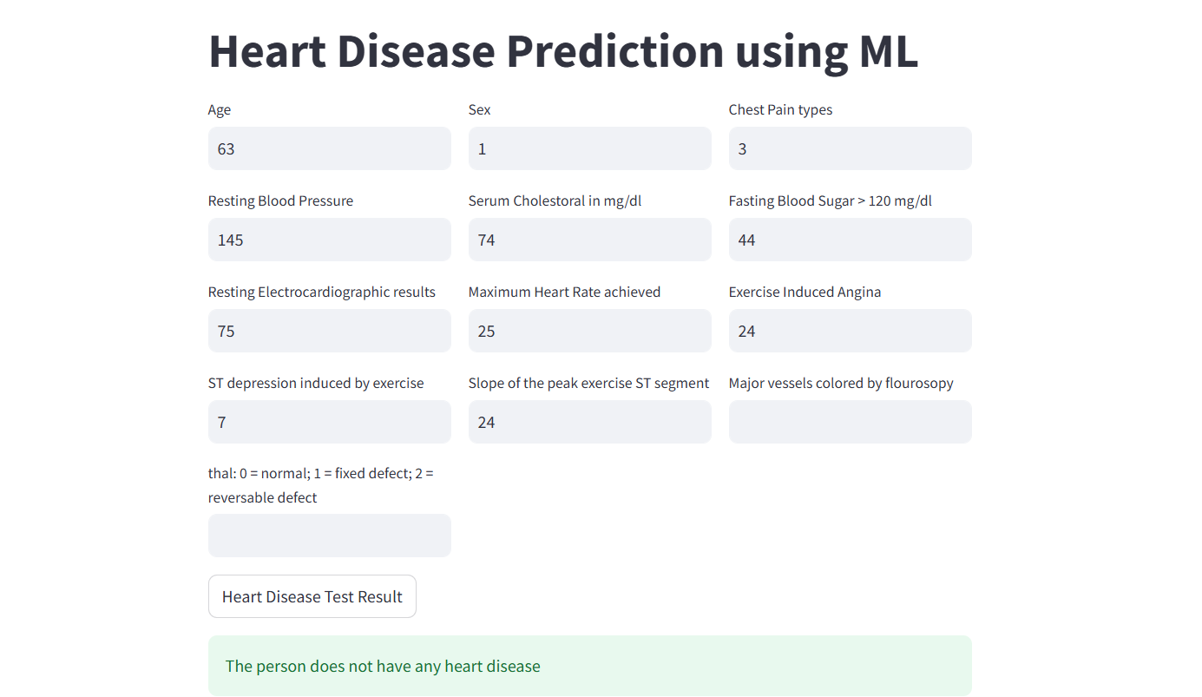
MODEL RESULTS

Slide 21
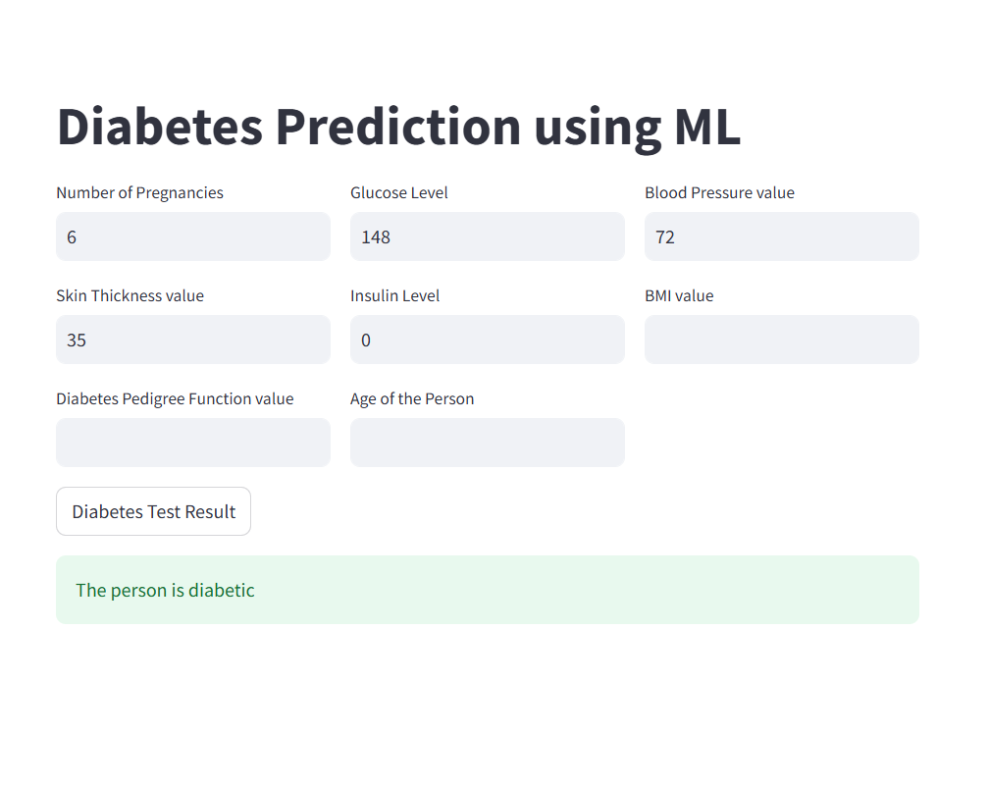
MODEL RESULTS

Slide 22
CONCLUSION
The project successfully demonstrates the potential of ML in predicting multiple diseases using patient data.
By identifying individuals at high risk, the system can facilitate early intervention and improve patient outcomes.
Future work may involve incorporating more diseases, improving model accuracy with larger datasets, and enhancing the system's user interface for better accessibility.

