Slide 1
Hashing
1

Slide 2
Hash Tables
Hash table ADT which supports only a subset of the operations allowed by binary search trees.
The implementation of hash tables is called hashing.
Hashing is a technique used for performing insertions, deletions and finds in constant average time (i.e. O(1))
This data structure, however, is not efficient in operations that require any ordering information among the elements, such as findMin, findMax and printing the entire table in sorted order.
1

Slide 3
General Idea
The ideal hash table structure is merely an array of some fixed
size, containing the items.
A stored item needs to have a data member, called key, that will
be used in computing the index value for the item.
Key could be an integer, a string, etc
e.g. a name or Id that is a part of a large employee structure
The size of the array is TableSize.
The items that are stored in the hash table are indexed by values from 0 to TableSize – 1.
Each key is mapped into some number in the range 0 to
TableSize – 1.
The mapping is called a hash function.
Number of keys or elements is N
1

Slide 4










Example
Hash Table
0
1
2
3
4
5
6
7
8
9
Items john 25000
Hash Function
Phil 31250
dave 27500
mary 28200
john 25000
key
phil 31250
dave 27500
mary 28200
key
1

Slide 5
Hash Function
The hash function (map keys to indices):
must be fast and easy to compute.
equal keys should yield equal hash codes
must distribute the keys evenly among the cells.
Be in range 0 to TableSize – 1.
Hash Function consists of :
Hash Code map (keys to integer values) +
Compression map (next to indices of table)
1

Slide 6
Hash function
Problems:
Keys may not be numeric.
Number of possible keys is much larger than the space available in table.
Different keys may map into same location
Hash function is not one-to-one => collision.
If there are too many collisions, the performance of the hash table will suffer dramatically.
1

Slide 7
Hash Functions
If the input keys are integers then simply
Key mod TableSize is a general strategy.
Unless key happens to have some undesirable properties. (e.g. all keys end in 0 and we use mod 10)
If the keys are strings, hash function needs more care.
First convert it into a numeric value (hash code).
1

Slide 8
Binning
Key Range 0 to 999, uniformly distributed
TableSize : 10
int hash(int i) {return i % 100;}
0-99 will hash to 0
101-199 will hash to 1 and so on
In general for any TableSize :
Key/(1000/TableSize).
CENG 213 Data Structures
8

Slide 9
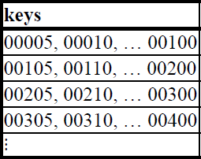
Simple Hash Function
Now assume TableSize = 100 and keys are distributed in wide range.
int hash(int i) {return i % 100;}
Data Structures
9

Slide 10
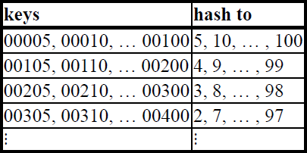
Power of prime
preserves the uniform distribution if already present in a
set of keys
tends to increase the uniformity in a set of keys if TableSize is a prime number
So try to use prime number for the TableSize
int hash (int i) { return i % 101;}
1

Slide 11
Some Hash Code methods
Truncation:
e.g. 123456789 map to a table of 1000 addresses by picking 3 digits of the key.
Folding:
e.g. 123|456|789: add them and take mod.
Key mod TableSize:
size of the table, better if it is prime.
Squaring and mid-Squaring:
Square the key and then truncate
Radix conversion:
e.g. 1 2 3 4 treat it to be base 11, truncate if necessary.
1

Slide 12
Folding
Shift Folding
Key (as integer) is divided into segments, each segment except possibly the last having the same number of digits. These segments are then added to obtain the index (or mod TableSize)
Key = 76123451001214 with segments of size 3 digits. The segments for our key are 761, 234, 510, 012, and 14.
The index is 761 + 234 + 510 + 012 + 14 = 1531.
Folding at Boundaries : , the digits in alternate segments are reversed before adding
Segments after digit reversal are 761, 432, 510, 210, and 14;
The index is 761 + 432 + 510 + 210 + 14 = 1927.
CENG 213 Data Structures
13

Slide 13
Hash Function 1
Add up the ASCII values of all characters of the key.
int hash(const string &key, int tableSize)
{
int hasVal = 0;
for (int i = 0; i < key.length(); i++)
hashVal += key[i];
return hashVal % tableSize;
}
Simple to implement and fast.
Words differing by transposing of chars have same value.
If table size is large, the does not distribute the keys well.
e.g. Table size =10000, key length <= 8, the hash function can assume values only between 0 and 1016
1

Slide 14
Hash Function 2
Examine only the first 3 characters of the key.
int hash (const string &key, int tableSize)
{
return (key[0]+27 * key[1] + 729*key[2]) % tableSize;
}
In theory, 26 * 26 * 26 = 17576 different words can be generated. However, English is not random, only 2851 different combinations are possible.
Thus, this function although easily computable, is also not
appropriate if the hash table is reasonably large.
1

Slide 15
Hash Function 3
∑ Key[KeySize− i −1]⋅ 37^{i}
i=0
KeySize−1
hash(key) =
int hash (const string &key, int tableSize)
{
int hashVal = 0;
for (int i = 0; i < key.length(); i++) hashVal = 37 * hashVal + key[i];
hashVal %=tableSize;
if (hashVal < 0) /* in case overflows occurs */ hashVal += tableSize;
return hashVal;
};
1

Slide 16
Hash function for strings:
98 108 105
key[i]
key
a | l | i
Step 1: Reverse the given string
Step 2: Compute hashvalue
0 1 2
KeySize = 3;
i
hash(“ali”) = (105 * 1 + 108*37 + 98*37²) % 10,007 = 8172
……
ali
……
0
1
2
hash function
“ali”
8172
10,006 (TableSize)
1

Slide 17
Compression Functions
Compress hash(key) or Hash Code to bucket size N
The Division Method
| i | mod N, (N prime)
Eg. N=100 with Hash Codes (200, 205, 210 …. 600)
The MOD Method
| ai + b | mod N ( a mod N not 0)
1

Slide 18
Collision Resolution
If, when an element is inserted, it hashes to the same value as an already inserted element, then we have a collision and need to resolve it.
There are several methods for dealing with this:
Separate chaining
Open addressing
Linear Probing
Quadratic Probing
Double Hashing
1

Slide 19
Separate Chaining
The idea is to keep a list of all elements that hash to the same value.
The array elements are pointers to the first nodes of the lists.
A new item is inserted to the front of the list.
Advantages:
Better space utilization for large items.
Simple collision handling: searching linked list.
Overflow: we can store more items than the hash table size.
Deletion is quick and easy: deletion from the linked list.
1

Slide 20
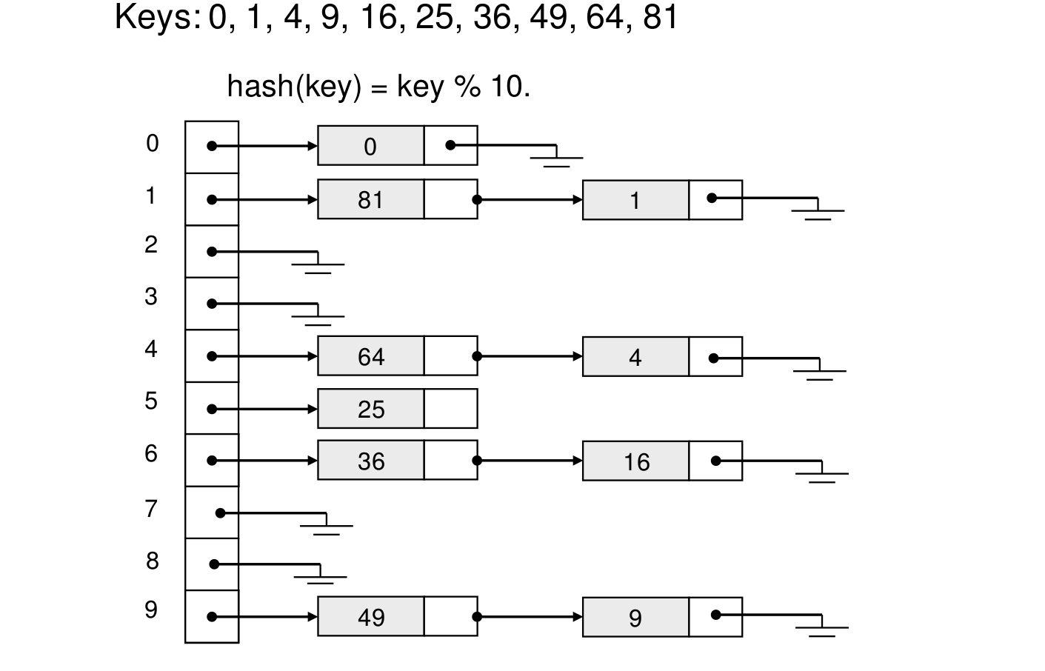
Example

Slide 21
Operations
Initialization: all entries are set to NULL
Find:
locate the cell using hash function.
sequential search on the linked list in that cell.
Insertion:
Locate the cell using hash function.
(If the item does not exist) insert it as the first item in
the list.
Deletion:
Locate the cell using hash function.
Delete the item from the linked list.
1

Slide 22
Hash Table Class for separate chaining
template <class HashedObj> class HashTable
{
public:
HashTable(const HashedObj & notFound, int size=101 ); HashTable( const HashTable & rhs )
:ITEM_NOT_FOUND( rhs.ITEM_NOT_FOUND ),
theLists( rhs.theLists ) { }
const HashedObj & find( const HashedObj & x ) const; void makeEmpty( );
void insert( const HashedObj & x ); void remove( const HashedObj & x );
const HashTable & operator=( const HashTable & rhs ); private:
vector<List<HashedObj> > theLists; // The array of Lists
const HashedObj ITEM_NOT_FOUND;
};
int hash( const string & key, int tableSize ); int hash( int key, int tableSize );
1

Slide 23
Insert routine
/**
Insert item x into the hash table. If the item is
already present, then do nothing.
*/
template <class HashedObj>
void HashTable<HashedObj>::insert(const HashedObj & x )
{
List<HashedObj> & whichList = theLists[ hash( x,
theLists.size( ) ) ]; ListItr<HashedObj> itr = whichList.find( x );
if( !itr.isValid() )
whichList.insert( x, whichList.zeroth( ) );
}
1

Slide 24
Remove routine
/**
* Remove item x from the hash table.
*/
template <class HashedObj>
void HashTable<HashedObj>::remove( const HashedObj & x )
{
theLists[hash(x, theLists.size())].remove( x );
}
1

Slide 25
Find routine
/**
Find item x in the hash table.
Return the matching item or ITEM_NOT_FOUND if not found
*/
template <class HashedObj>
const HashedObj & HashTable<HashedObj>::find( const HashedObj & x ) const
{
ListItr<HashedObj> itr;
itr = theLists[ hash( x, theLists.size( ) ) ].find( x ); if(!itr.isValid())
return ITEM_NOT_FOUND; else
return itr.retrieve( );
}
1

Slide 26
Analysis of Separate Chaining
Collisions are very likely.
How likely and what is the average length of lists?
Load factor λ definition:
Ratio of number of elements (N) in a hash table to the hash TableSize.
i.e. λ = N/TableSize
The average length of a list is also λ.
For chaining λ is not bound by 1; it can be > 1.
1

Slide 27
Cost of searching
Cost = Constant time to evaluate the hash function
+ time to traverse the list.
Unsuccessful search:
We have to traverse the entire list, so we need to compare λ nodes on the average.
Successful search:
List contains the one node that stores the searched item + 0 or more other nodes.
Expected # of other nodes = x = (N-1)/M which is essentially λ, since M is presumed large.
On the average, we need to check half of the other nodes while searching for a certain element
Thus average search cost = 1 + λ/2
1

Slide 28
Summary
The analysis shows us that the table size is not really important, but the load factor is.
TableSize should be as large as the number of expected elements in the hash table.
– To keep load factor around 1.
TableSize should be prime for even distribution of keys to hash table cells.
1

Slide 29
Hashing: Open Addressing
1

Slide 30
Collision Resolution with Open Addressing
Separate chaining has the disadvantage of using linked lists.
Requires the implementation of a second data structure.
In an open addressing hashing system, all the data go inside the table.
Thus, a bigger table is needed.
Generally the load factor should be below 0.5.
If a collision occurs, alternative cells are tried until an empty cell is found.
1

Slide 31
Open Addressing
More formally:
Cells h₀(x), h₁(x), h₂(x), …are tried in succession where
h_{i}(x) = (hash(x) + f(i)) mod TableSize, with f(0) = 0.
The function f is the collision resolution strategy.
There are three common collision resolution strategies:
Linear Probing {f(i) = i }
Quadratic probing { f(i) = i² }
Double hashing { f(i) = i * hash₂(x) }
1

Slide 32
Linear Probing
In linear probing, collisions are resolved by sequentially scanning an array (with wraparound) until an empty cell is found.
i.e. f is a linear function of i, typically f(i)= i.
Example:
Insert items with keys: 89, 18, 49, 58, 9 into an empty hash table.
Table size is 10.
Hash function is hash(x) = x mod 10.
f(i) = i;
1

Slide 33
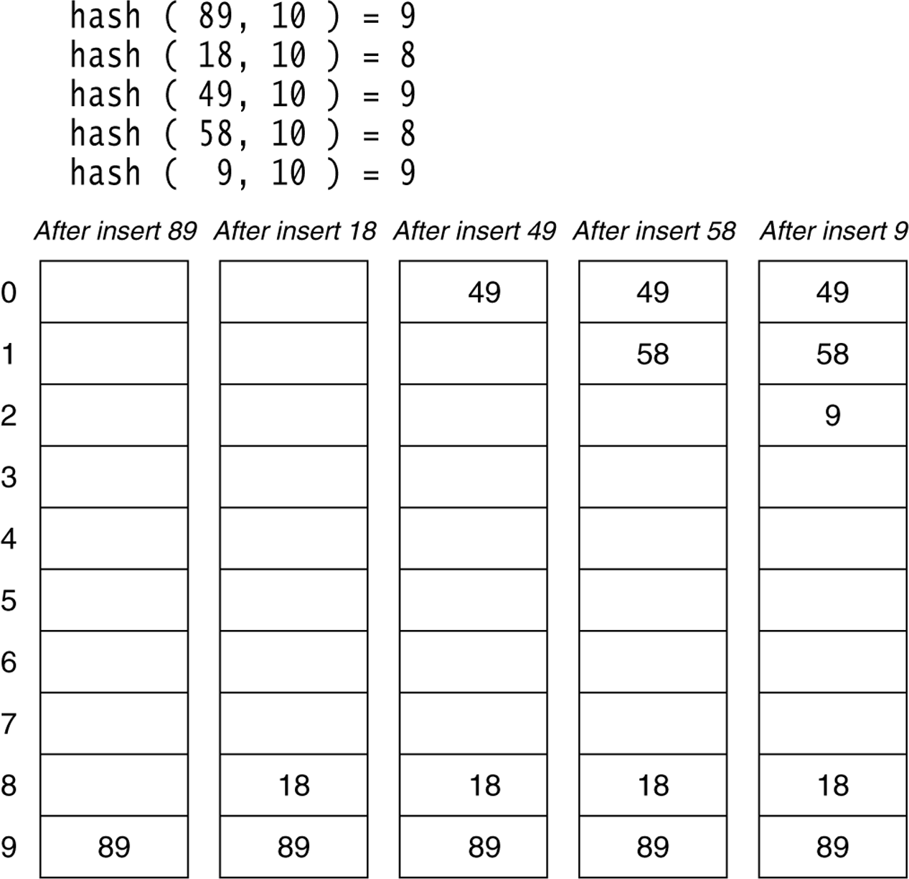
Figure 20.4 Linear probing hash table after each insertion
1

Slide 34
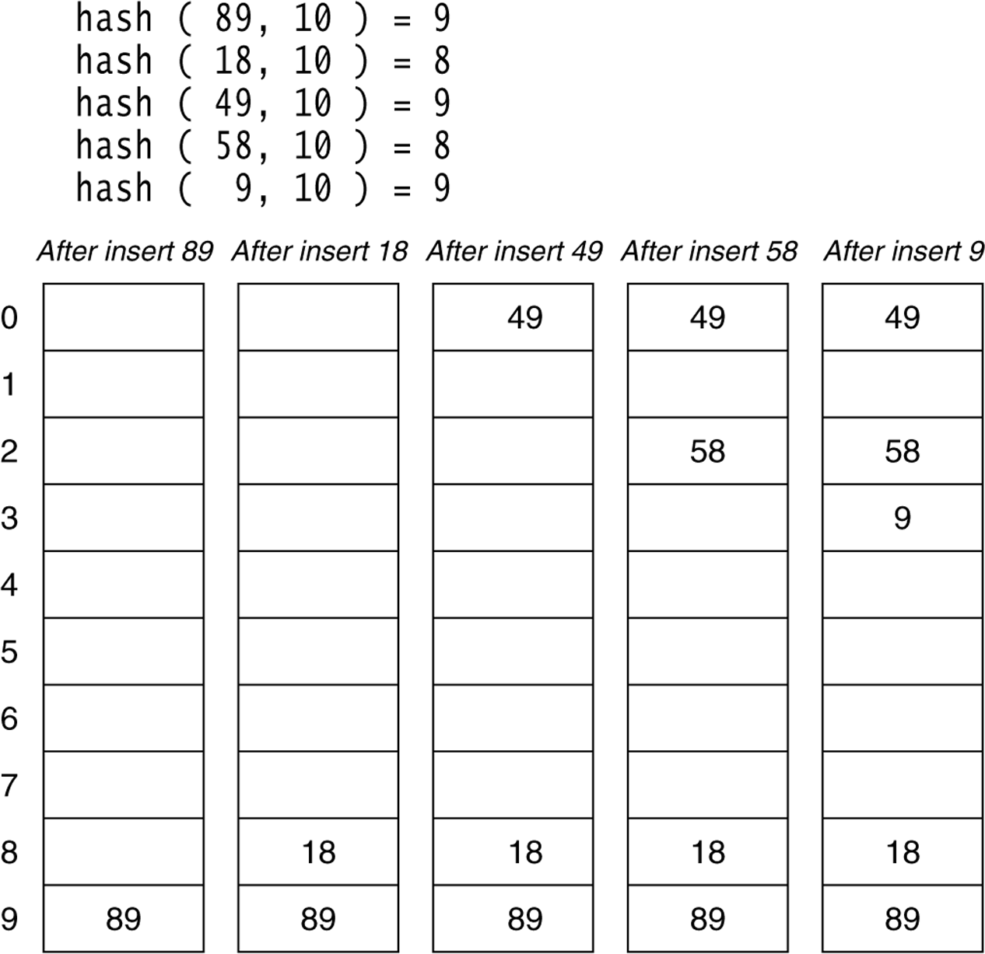
Figure 20.6
A quadratic probing hash table after each insertion (note that the table size was poorly chosen because it is not a prime number).
CENG 213 Data Structures
1

Slide 35
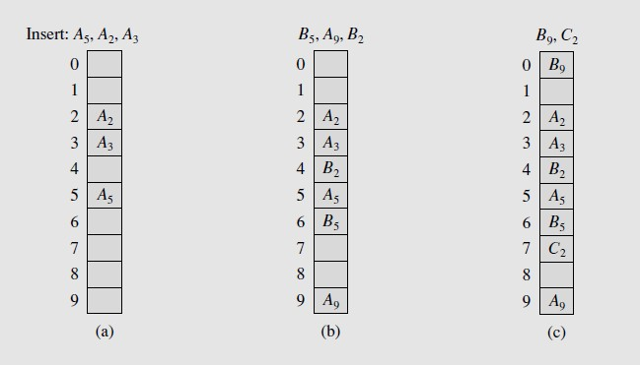
Linear Probing
1

Slide 36
Quadratic Probing
Quadratic Probing eliminates primary clustering problem of linear probing.
Collision function is quadratic.
The popular choice is f(i) = i².
If the hash function evaluates to h and a search in cell h is inconclusive, we try cells h + 1², h+2², … h + i².
i.e. It examines cells 1,4,9 and so on away from the
original probe.
Remember that subsequent probe points are a quadratic number of positions from the original probe point.
1

Slide 37
Figure 20.6
A quadratic probing hash table after each insertion (note that the table size was poorly chosen because it is not a prime number).
1

Slide 38
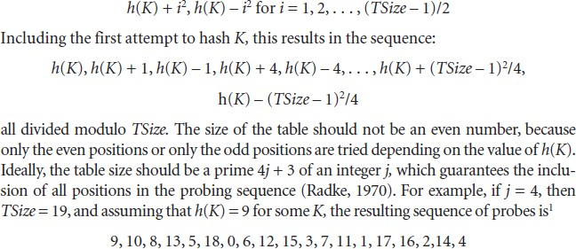
Quadratic Probing
1

Slide 39
Double Hashing
A second hash function is used to drive the collision resolution.
f(i) = i * hash₂(x)
We apply a second hash function to x and probe at a distance hash₂(x), 2*hash₂(x), … and so on.
The function hash₂(x) must never evaluate to zero.
e.g. Let hash₂(x) = x mod 9 and try to insert 99 in the
previous example.
A function such as hash₂(x) = R – ( x mod R) with R a prime smaller than TableSize will work well.
e.g. try R = 7 for the previous example.(7 - x mode 7)
1

Slide 40
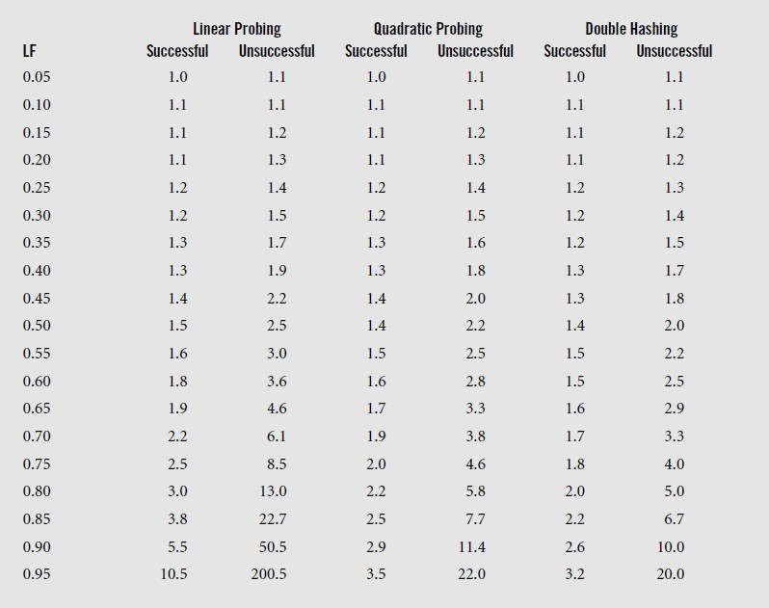
Open Addressing Methods
1

Slide 41
Find and Delete
The find algorithm follows the same probe sequence as the insert algorithm.
A find for 58 would involve 4 probes.
A find for 19 would involve 5 probes.
We must use lazy deletion (i.e. marking items as deleted)
Standard deletion (i.e. physically removing the item) cannot be performed.
e.g. remove 89 from hash table.
1

Slide 42
Clustering Problem
As long as table is big enough, a free cell can always be found, but the time to do so can get quite large.
Worse, even if the table is relatively empty, blocks of occupied cells start forming.
This effect is known as primary clustering.
Any key that hashes into the cluster will require several attempts to resolve the collision, and then it will add to the cluster.
1

Slide 43
Analysis of insertion
The average number of cells that are examined in an insertion using linear probing is roughly
(1 + 1/(1 – λ)²) / 2
Proof is beyond the scope of text book.
For a half full table we obtain 2.5 as the average number of cells examined during an insertion.
Primary clustering is a problem at high load factors. For half empty tables the effect is not disastrous.
1

Slide 44
Analysis of Find
An unsuccessful search costs the same as insertion.
The cost of a successful search of X is equal to the cost of inserting X at the time X was inserted.
For λ = 0.5 the average cost of insertion is 2.5. The average cost of finding the newly inserted item will be 2.5 no matter how many insertions follow.
Thus the average cost of a successful search is an average of the insertion costs over all smaller load factors.
1

Slide 45
Average cost of find
The average number of cells that are examined in an unsuccessful search using linear probing is roughly (1 + 1/(1 – λ)²) / 2.
The average number of cells that are examined in a successful search is approximately
(1 + 1/(1 – λ)) / 2.
– Derived from:
1
λ
λ
∫
x=0
1 ⎛ 1
⎞
⎜1+
⎟dx
2
⎝
(1− x)
2
⎠
1

Slide 46
Linear Probing – Analysis -- Example
What is the average number of probes for a successful search and an unsuccessful search for this hash table?
– Hash Function: h(x) = x mod 11
Successful Search:
– 20: 9 -- 30: 8 -- 2 : 2 -- 13: 2, 3
– 24: 2,3,4,5 -- 10: 10 -- 9: 9,10, 0
0 | 9
1
2 | 2
3 | 13
4 | 25
5 | 24
6
7
8 | 30
9 | 20
10 | 10
-- 25: 3,4
Avg. Probe for SS = (1+1+1+2+2+4+1+3)/8=15/8
Unsuccessful Search:
– We assume that the hash function uniformly distributes the keys.
– 0: 0,1 -- 1: 1 -- 2: 2,3,4,5,6 -- 3: 3,4,5,6
– 4: 4,5,6 -- 5: 5,6 -- 6: 6 -- 7: 7 -- 8: 8,9,10,0,1
– 9: 9,10,0,1 -- 10: 10,0,1
Avg. Probe for US = (2+1+5+4+3+2+1+1+5+4+3)/11=31/11
47

Slide 47
Quadratic Probing
Quadratic Probing eliminates primary clustering problem of linear probing.
Collision function is quadratic.
The popular choice is f(i) = i².
If the hash function evaluates to h and a search in cell h is inconclusive, we try cells h + 1², h+2², … h + i².
i.e. It examines cells 1,4,9 and so on away from the
original probe.
Remember that subsequent probe points are a quadratic number of positions from the original probe point.
48

Slide 48
Figure 20.6
A quadratic probing hash table after each insertion (note that the table size was poorly chosen because it is not a prime number).
CENG 213 Data Structures
49

Slide 49
Quadratic Probing
Problem:
We may not be sure that we will probe all locations in the table (i.e. there is no guarantee to find an empty cell if table is more than half full.)
If the hash table size is not prime this problem will be much severe.
However, there is a theorem stating that:
If the table size is prime and load factor is not larger than 0.5, all probes will be to different locations and an item can always be inserted.
1

Slide 50
Theorem
If quadratic probing is used, and the table size is prime, then a new element can always be inserted if the table is at least half empty.
1

Slide 51
Proof
Let M be the size of the table and it is prime. We show that the first
⎡M/2⎤ alternative locations are distinct.
Let two of these locations are h + i² and h + j², where i, j are two probes s.t. 0≤ i,j ≤ ⎣M/2⎦. Suppose for the sake of contradiction, that these two locations are the same but
i ≠ j. Then
h + i² = h + j² (mod M) i² = j² (mod M)
i² - j² = 0 (mod M) (i-j)(i+j) = 0 (mod M)
Because M is prime, either (i-j) or (i+j) is divisible by M. Neither of these possibilities can occur. Thus we obtain a contradiction.
It follows that the first ⎡M/2⎤ alternative are all distinct and since there are at most ⎣M/2⎦ items in the hash table it is guaranteed that an insertion must succeed if the table is at least half full.
1

Slide 52
Some considerations
How efficient is calculating the quadratic probes?
Linear probing is easily implemented. Quadratic probing appears to require * and % operations.
However by the use of the following trick, this is overcome:
H_{i} = H_{i-1}+2i – 1 (mod M)
1

Slide 53
Some Considerations
What happens if load factor gets too high?
Dynamically expand the table as soon as the load factor reaches 0.5, which is called rehashing.
Always double to a prime number.
When expanding the hash table, reinsert the new table by using the new hash function.
1

Slide 54
Analysis of Quadratic Probing
Quadratic probing has not yet been mathematically analyzed.
Although quadratic probing eliminates primary clustering, elements that hash to the same location will probe the same alternative cells. This is know as secondary clustering.
Techniques that eliminate secondary clustering are available.
– the most popular is double hashing.
1

Slide 55
Double Hashing
A second hash function is used to drive the collision resolution.
f(i) = i * hash₂(x)
We apply a second hash function to x and probe at a distance hash₂(x), 2*hash₂(x), … and so on.
The function hash₂(x) must never evaluate to zero.
e.g. Let hash₂(x) = x mod 9 and try to insert 99 in the
previous example.
A function such as hash₂(x) = R – ( x mod R) with R a prime smaller than TableSize will work well.
e.g. try R = 7 for the previous example.(7 - x mode 7)
1

Slide 56
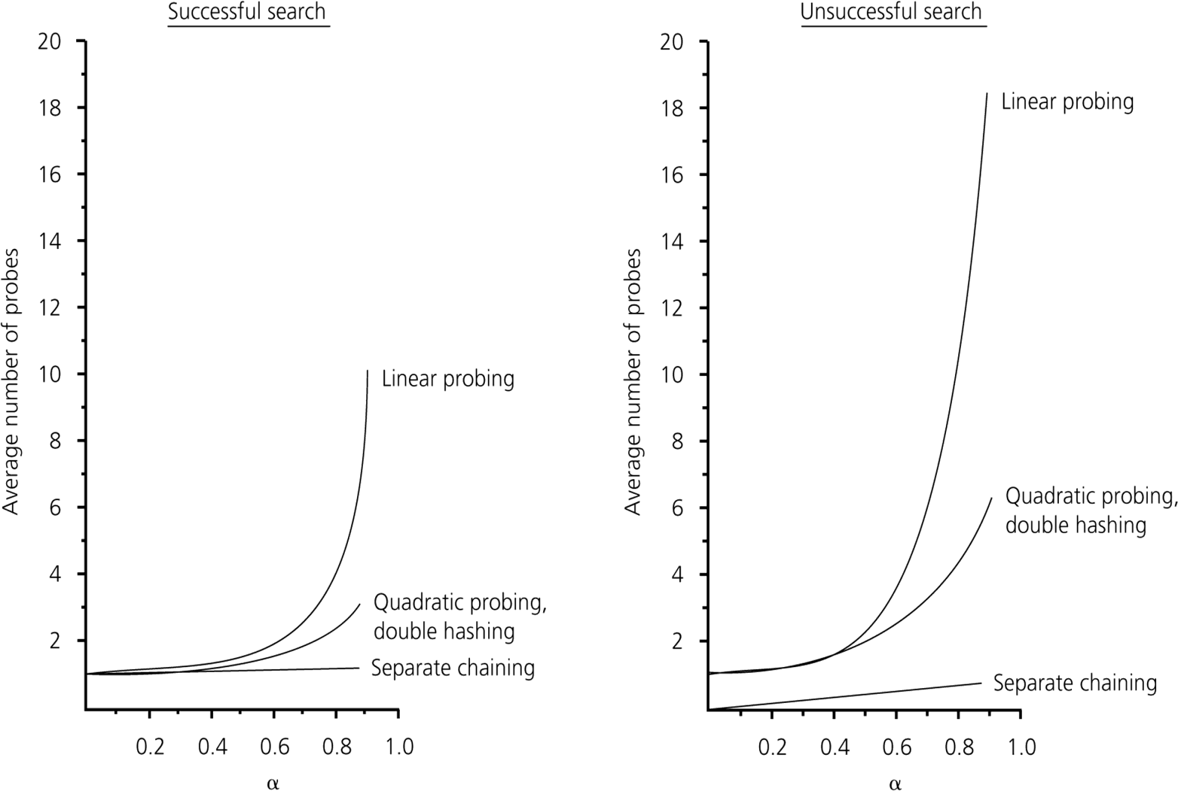
The relative efficiency of four collision-resolution methods
57

Slide 57
Hashing Applications
Compilers use hash tables to implement the symbol table (a data structure to keep track of declared variables).
Game programs use hash tables to keep track of positions it has encountered (transposition table)
Online spelling checkers.
1

Slide 58
Summary
Hash tables can be used to implement the insert and find operations in constant average time.
– it depends on the load factor not on the number of items
in the table.
It is important to have a prime TableSize and a correct choice of load factor and hash function.
For separate chaining the load factor should be close to 1.
For open addressing load factor should not exceed
0.5 unless this is completely unavoidable.
– Rehashing can be implemented to grow (or shrink) the
table.
1

