Slide 1
Springboard Project
Case Study
Confidential

Slide 2
01
Emerging Business oppotunities

Slide 3
Topics/Agenda
01
｜
About Case Study
02
｜
Exploratory Data Analysis
03
｜
Model Building

Slide 4
About the case study
Our client (Manufacturer A) is a leading Food & Beverage manufacturer. Client wants to understand the growth patterns of consumer preferences (themes) and evaluate positioning of their brand across different themes. Client also wants to know the sales drivers of their products.
We have the 6 different datasets of :
Sales Data
Social Media Data
Google Search Data
Theme Product List
Product Manufacturer List
Theme List

Slide 5
Exploratory Data Analysis
List of themes available across all data sources.
Unique themes in sales Data is : 49
No Claim | Soy foods | no additives preservatives | American gumbo | gingerbread | cocoa | cherry
chicken | blueberry | buckwheat | crab | beans | red raspberry | sea salt
salmon | American southwest style | low carb | Energy alertness | vegetarian | mackerel | bone health
apple cinnamon | herbs | gmo free | low sugar | prebiotic | scallop | cumin
pollock | poultry | low sodium | beef hamburger | tilapia | Low calorie | tuna
pizza | ethnic & exotic | French bisque | High source of protein | peanut | convenience easy to prepare | halal
cookie | stroganoff, | ethical packaging | brown ale | nuts | peach | ethical not specific

Slide 6
Unique themes in google search data is : 160
[gluten free, low carb, natural, digestive gut health, high source of protein, no additives preservatives, allergy, convenience packaging, oral health, dry, traditional, antioxidant, skin health, immune health, convenience ready prepared, indulgent & premium, organic, low fat, vitamin mineral fortified, low calorie, high source of fiber, low sodium, no added sugar, omega3, bone health, heart health, weight management, prebiotic, ethical packaging, eye health, economy, ethical animal fish & bird, low sugar, joint health, dha, brain health, no trans fats, sugar free, diabetic, hfcs free, low cholesterol, low gi, lactose free, wholegrain, added calcium, added fiber, added protein, added iron, anti aging aging well, energy alertness, sports & recovery……..]
Unique themes in social media data is : 193
[protein, cod, sole, sea salt, peach, butter, fruit, nuts, anti aging aging well, seeds, milk chocolate, gluten free, parmesan cheese, carob, energy alertness, sports & recovery, white cheddar cheese, low carb, snickerdoodle, functional, not specified, hemp seeds, convenience consumption, kosher, soy foods, sticks, microwaveable, refill, gingerbread, single shot, seasonal in-out products, gmo free, ethical environment, brownie, convenience time saving, convenience easy to prepare, cobranding, ethical human, vegan, garlic, vegetarian, red tomato, probiotic, ethnic & exotic, ethical not specific, halal, cloves, natural, vanilla, health, health, convenience, others, rosemary, pleasure, ethical, beans, butterscotch, choice, pepper, anchovy, herbal, fish, liver, cream…]

Slide 7
List of common unique themes across all data sources:30
mackerel | low carb | sea salt | convenience easy to prepare | tuna | low sodium
low sugar | chicken | ethical packaging | high source of protein | no additives preservatives | soy foods
gingerbread | vegetarian | ethnic & exotic | blueberry | bone health | prebiotic
poultry | ethical not specific | french bisque | Energy alertness | gmo free | halal
salmon | beef hamburger | low calorie | peach | crab | nuts

Slide 8
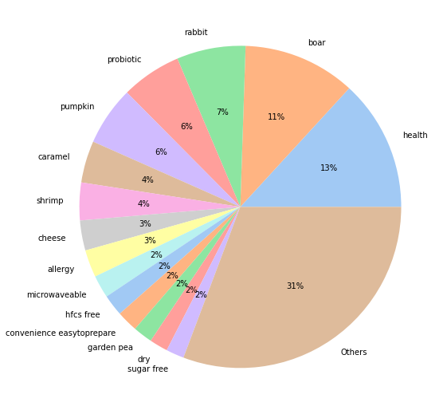
consumer preference(themes) in data sources:- Total Social Media post preferences
Social media posts had been highlighting the foods and beverages with health advantages.
More posts have been made to promote non-vegetarian food items like boar, shrimp, rabbit etc.
69% post made to promote 15 themes and 31% of social media posts were made to advertise other 178 theme names.

Slide 9
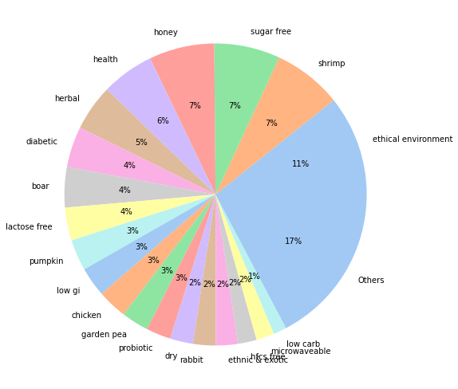
Consumer preferences on search engine-
The majority of searches have been made for themes with health advantages which is similar to social media posts but searches themes are different from posts.
Ethical environment claim unexpectedly has higher search on platforms.
Less than 2% of social media posts and 1% of searches to advertise the low carb claim.

Slide 10
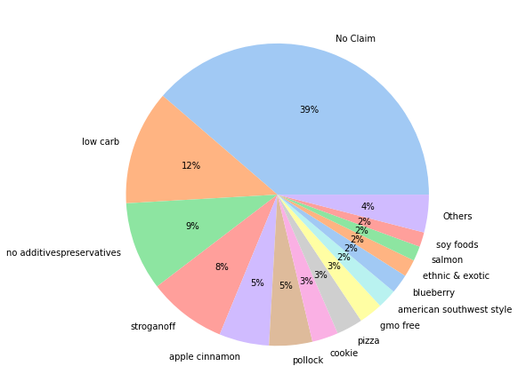
Consumer preferences in sales-
Consumer preferences as per sales data is very different from the social media data and search volume but still consumers prefers the health benefits claims like low carbs, No additives preservatives.
No claim has very large market share.

Slide 11
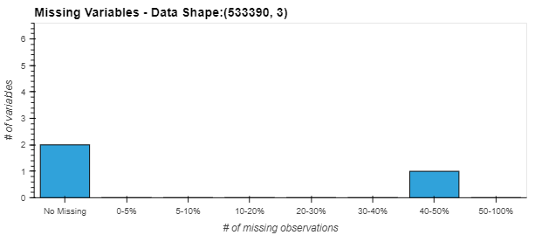
Provide a report for data sufficiency, sparsity and anomalies in each data source
Sparsity-
About 40% of the Theme ID entries in the Social Media Dataset are missing.
Social Media dataset has ~5% duplicate data in the table.
Data sufficiency-
Data is not consistent through out the year .
If we aggregate data weekly, about 40-50% percent data missing for certain common themes which can not be taken for model building.

Slide 12
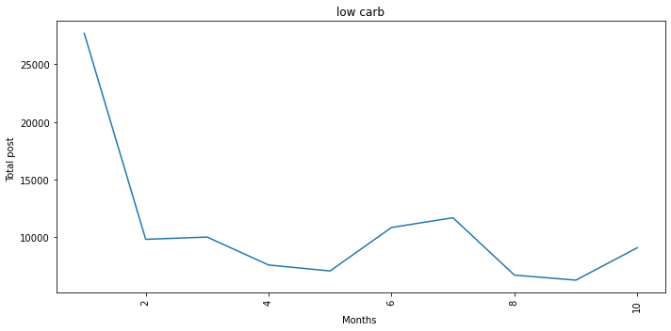
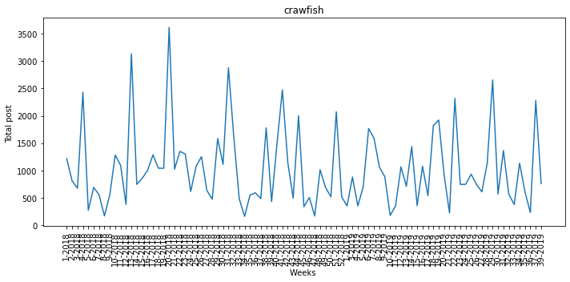
Time granularity for the analysis:
We have taken time granularity for our analysis on weekly basis.
For the Weekly time granularities model also performs better .

Slide 13
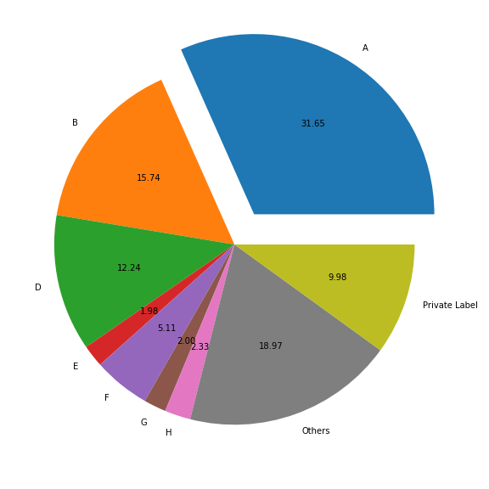
Overall market share of Manufacturer-
Manufacturer A has the highest market share with approx. 32% of overall.
Manufacturer B & D seems to be the leading competitors of our clients.

Slide 14
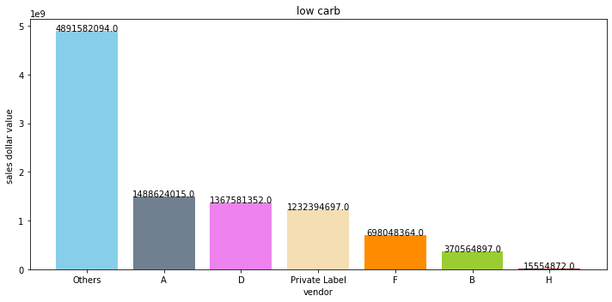
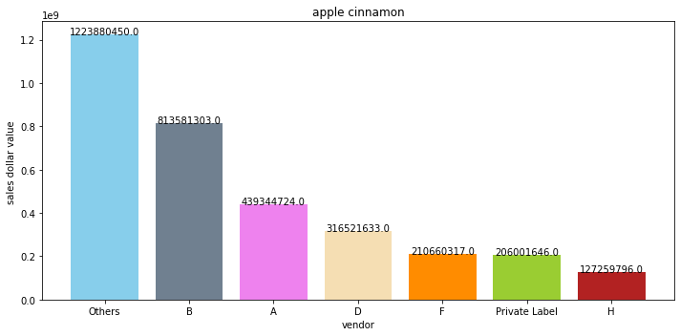
Potential competitors for our client in each theme-
In low carb theme which highest Sales also, our client’s potential competitor is manufacturer D and private label .
In apple cinnamon having close competition with B,F and D.

Slide 15
Potential competitors for our client in each theme:
Theme Name | Competitors
No Claim | B, Private label, D(low competitor)
American Southwest style | Private label
Apple Cinnamon | B,F,D
Blueberry | Private label
Buckwheat | D, B, Private Label
Chicken | Private Label, D, Others(70%)
Cookie | B, D
Ethnic & exotic | B, F, H, D, Others(34%)
High source of protein | Others(79%) or small market players
Low Carb | F, D, Private Label, B
Stronan off | F, D ,B
Soy foods | B
Poultry | Others
Pollock | B, D, private label

Slide 16
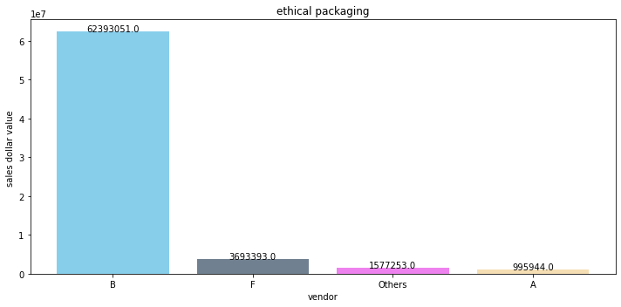
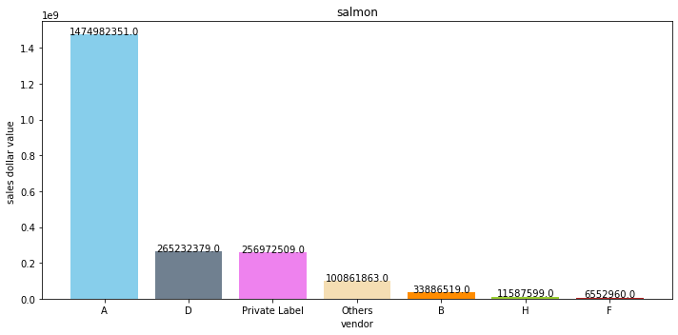
Client market share is low:
American Gumbo,
Beans,
Beef hamburger,
Brown ale, Crab,
Ethical packaging,
French bisque,
Gingerbread,
Gmo free,
vegetarian,
Low Sugar,
Low Sodium
Client is market leader or only player on particular theme:
Tuna
Tilapia
Salmon
Herbs

Slide 17
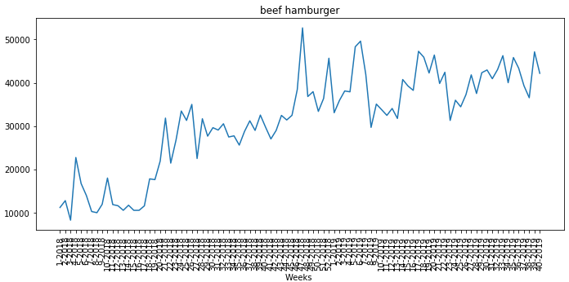
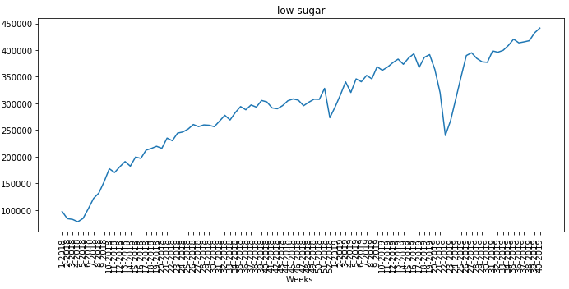






Emerging themes in Sales:
Themes | Growth in % (with respect to starting of 2018)
Bone health | 1156.13
Poultry | 494.46
Low sugar | 353.96
Beef hamburger | 277.54
Vegetarian | 191.1
Convenience easy to prepare | 122.55
Herbs | 94.62
Low Sodium | 94.62
Nuts | 55.73
Prebiotic | 54.12
Chicken | 52.61
Blueberry | 52.61
High source of protein | 39.71

Slide 18
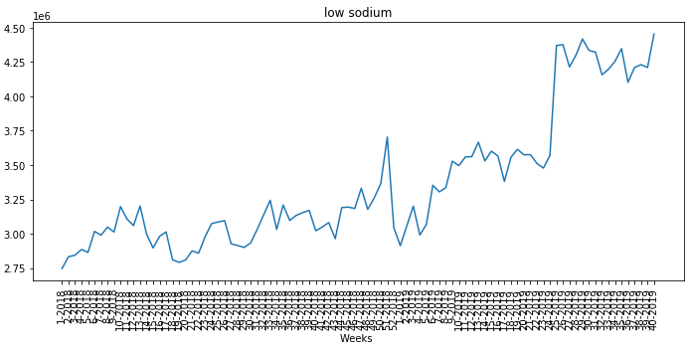
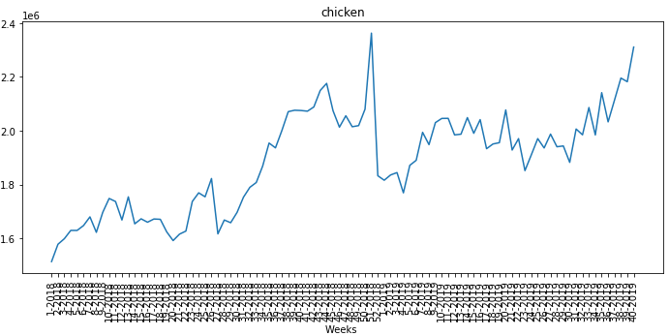
Emerging themes in Google search:
Theme | Growth in % with respect to starting of 2018
Sardine | 4980.0
Ethical animal fish & bird | 1192.95
Poultry | 566.67
Fruit | 550.0
Toffee | 460.54
Choice | 414.34
Celery | 320.06
Green tea | 319.23
Orange | 250.0
cheddar cheese | 237.5
parmesan cheese | 200.0
Vitamin mineral fortified | 181.51
Parsley | 181.42

Slide 19
Emerging themes in Social media
Theme | Growth in % with respect to starting of 2018
Broccoli | 147.67
Dandelion greens | 144.83
Carob | 133.33
Meat | 98.37
Brownie | 60.71
Salmon | 53.6
Heart health | 40.02
Mango | 38.1
Lamb | 31.02
Halal | 25.0
Crab | 12.0
No additives preservatives | 10.71
Convenience ready prepared | 9.64

Slide 20
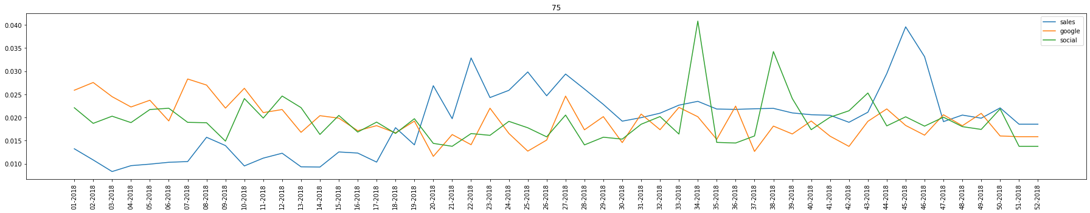
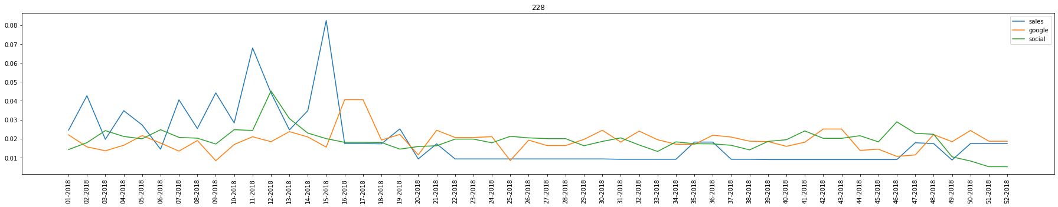
Latency: Social -> Search -> Sales
Latency observed from social media to google search is 1 week .
Latency observed from google search to sales is 2 weeks.
Latency from social media to sales is 3 weeks

Slide 21
Data Aggregation-
Segregated the data sources based on 30 common theme list .
While merging the sales data with theme product list there is one to many mapping between theme id and product id .
Fake growth of sales, unit and weight is handled by creating additional feature of length of theme and dividing with it.
Sales data, social media data, google search data, aggregated on the weekly, monthly and yearly basis.
Finally Data for only manufacturer A (our client) is segregated for the model building.

Slide 22
Final merged Data:-
We took data of only those themes which have 90% + weeks of Data.
Final themes id- [low carb, French bisque, gmo free, low sodium, low sugar, chicken, blueberry, salmon, beef hamburger, soy foods, ethnic and exotic]
Total no. of rows is 2156 for weekly data.
Dependent Variable – Sales dollars value
Independent variable- search volume, total post, Dummies of themes.

Slide 23
Model Performance-
Train R2 0.9881476482444833
Test R2 0.9741988158863004
--------------------------------------------------
Train MAPE: 6.931288778514695
Test MAPE: 6.743817934752695
Cross Val Score of MAPE:
CV_scores: [61.822295 39.81740822 47.9400386 27.76714199 10.95622561]
Bias : 37.660621885923405
Variance: 19.397875579171682

Slide 24
We can increase sales by increasing total post, search volume.
Client can control the total post factor to increase sales but search volume can’t.
Themes with high business opportunity-
Themes | Sales % in total sales | Growth %
Blueberry | 2.33 | 43.42
pollock | 4.84 | 26.12
Gmo free | 2.479 | 18.93
No additives preservatives | 9.265 | 4.1
Pizza | 2.80 | 19.0

Slide 25
Thank You

