Slide 1
Bus Booking System
Kishanraj m mori

Slide 2
Table Of Contents
Organization Details
Definition
Requirements specification
Modules Of Online Bus Booking
Database Tables
Data Flow Diagram
System Design
Conclusion

Slide 3
Organization Details
Name of the Organization | ARK Infosoft
Organization Address : | 421, Zion Z1, Nr. Avalon Hotel, Sindhu Bhavan Marg, Bodakdev, Ahmedabad, Gujarat 380054
Contact Number/Company Website : | https://arkinfosoft.com
Working Hours : | 09 Hours

Slide 4
Definition
Bus Booking System is Web Based application, that works with in centralized network, It Provides facility to reserved seats, different type of enquiry which need an instant and quick reservation. Buses may be used for scheduled bus transport, scheduled coach transport, school transport, private hire, or tourism; promotional buses may be used for political campaigns and others are privately operated for a wide range of purposes, including rock and pop band tour vehicles.

Slide 5
Requirements specification
Hardware Specification :-
PROCESSOR | Any Processor like AMD-Ryzen , intel etc
OPERATING SYSTEM | WINDOWS 10, WINDOWS 11
MEMORY | Minimum 2GB RAM
DATABASE | MS SQL SERVER

Slide 6
Requirements specification
Software Specification :-
Backend:
Programming Language: C# for server-side scripting.
Framework: ASP.NET for web application development.
Database: MS SQL Server for storing bus routes, schedules, bookings, user data, etc.
Frontend:
HTML, CSS, JavaScript for client-side development.
JavaScript frameworks/libraries for building interactive user interfaces.
Responsive Design: Ensure the application is accessible across various devices and screen sizes.

Slide 7
Modules Of Online Bus Booking
Management of Route
Trip Details
Bus Details
Bus Ticketing

Slide 8
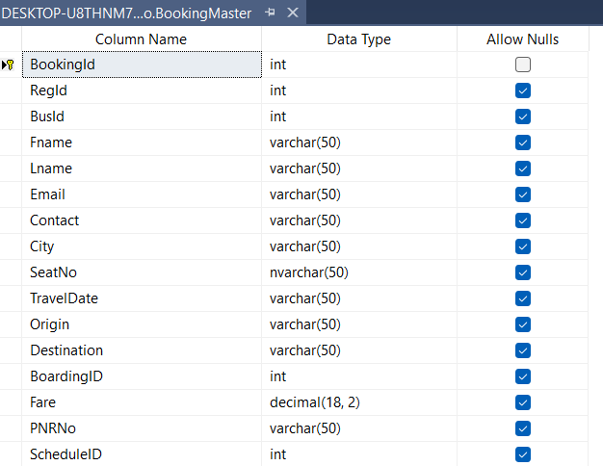
Database Tables Database Tables
Booking Table :-

Slide 9
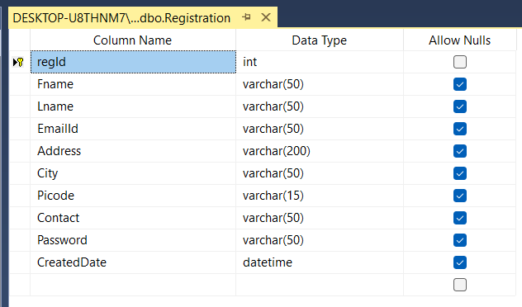
Database Tables
Registration:-

Slide 10
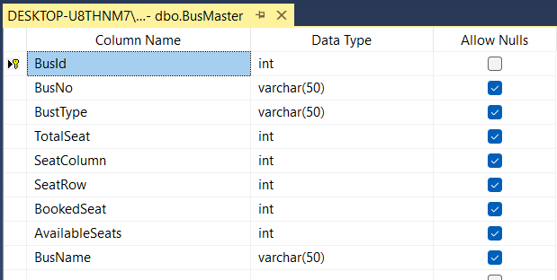
Database Tables
Add Bus :-

Slide 11
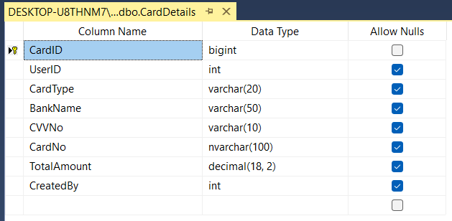
Database Tables
Card Details :-

Slide 12
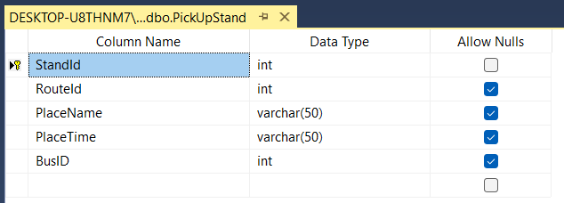
Database Tables
Add Pickup Stand :-

Slide 13
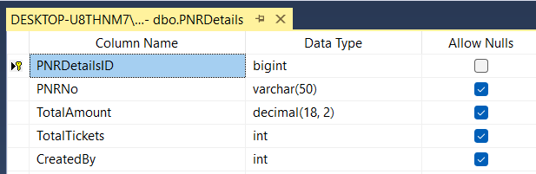
Database Tables
PNR Details:-

Slide 14
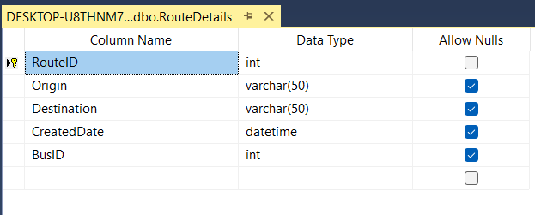
Database Tables
Route Details :-

Slide 15
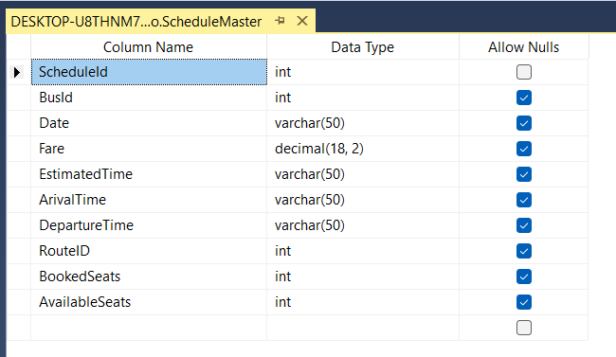
Database Tables
Bus Schedule Details :-

Slide 16
Data Flow Diagram
DFD: 0 LEVEL DIAGRAM :-
Admin
User
Bus Booking System

Slide 17
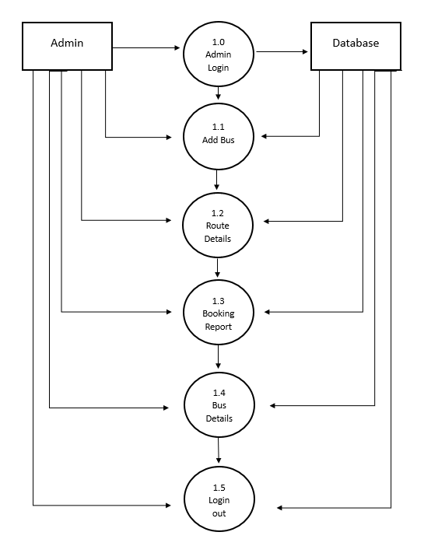
Data Flow Diagram
DFD: 1st LEVEL DIAGRAM Admin:-

Slide 18
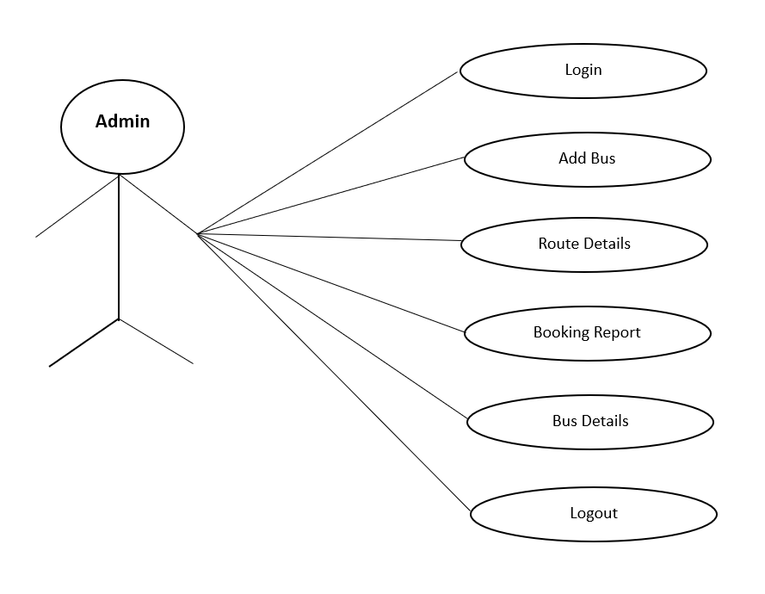
Data Flow Diagram
DFD: USECASE DIAGRAM:-

Slide 19
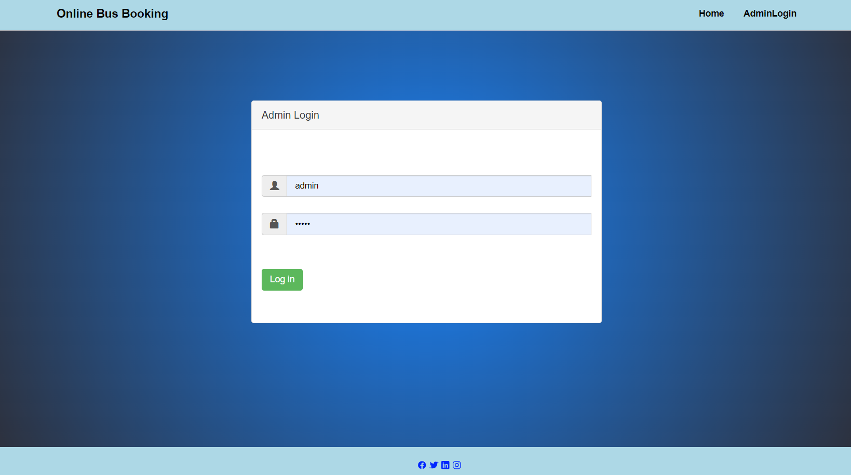
System Design
Admin Login:-

Slide 20
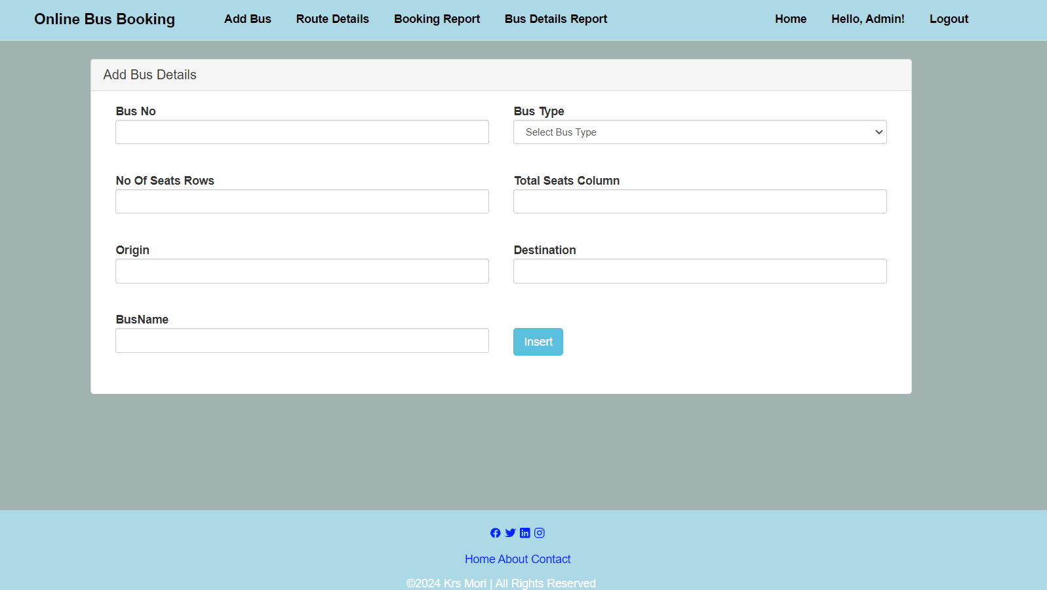
System Design
Add Bus Details:-

Slide 21
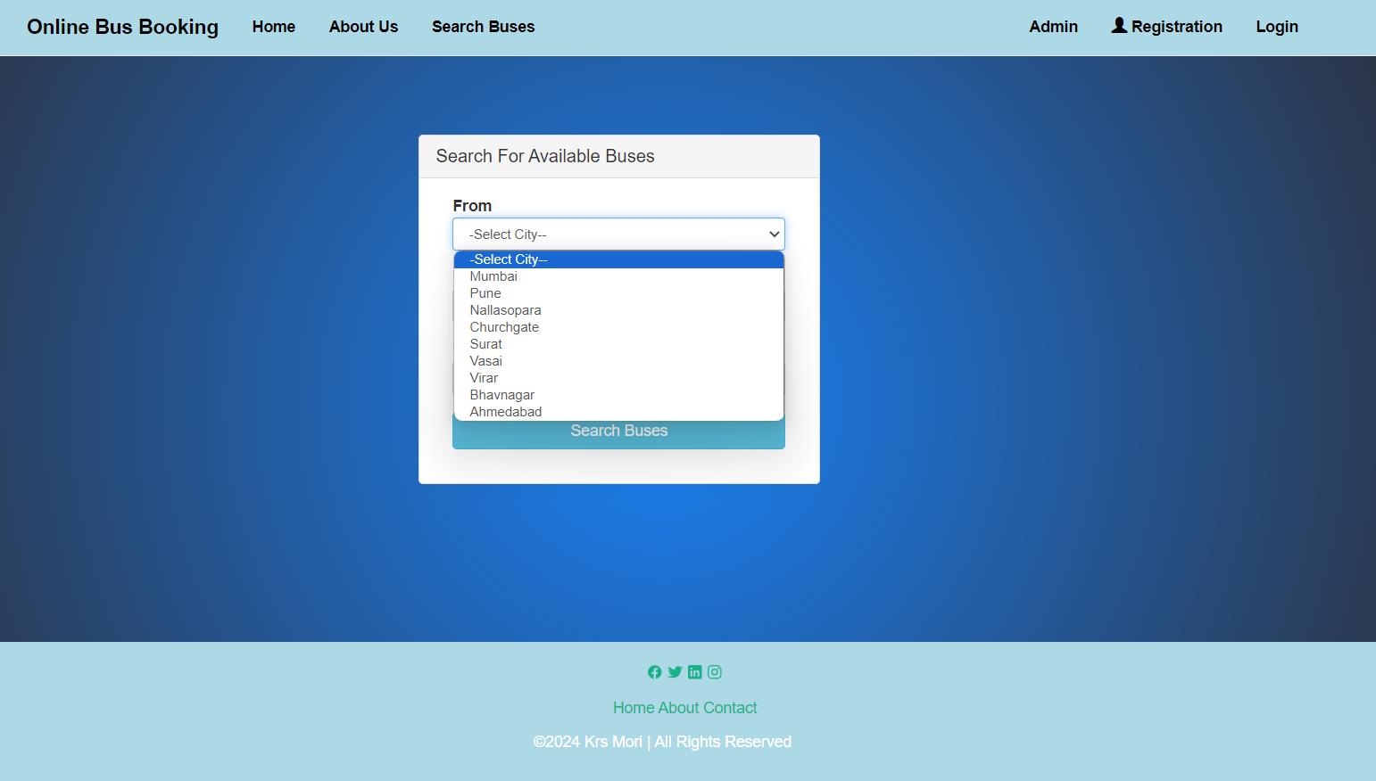
System Design
Search Buses:-

Slide 22
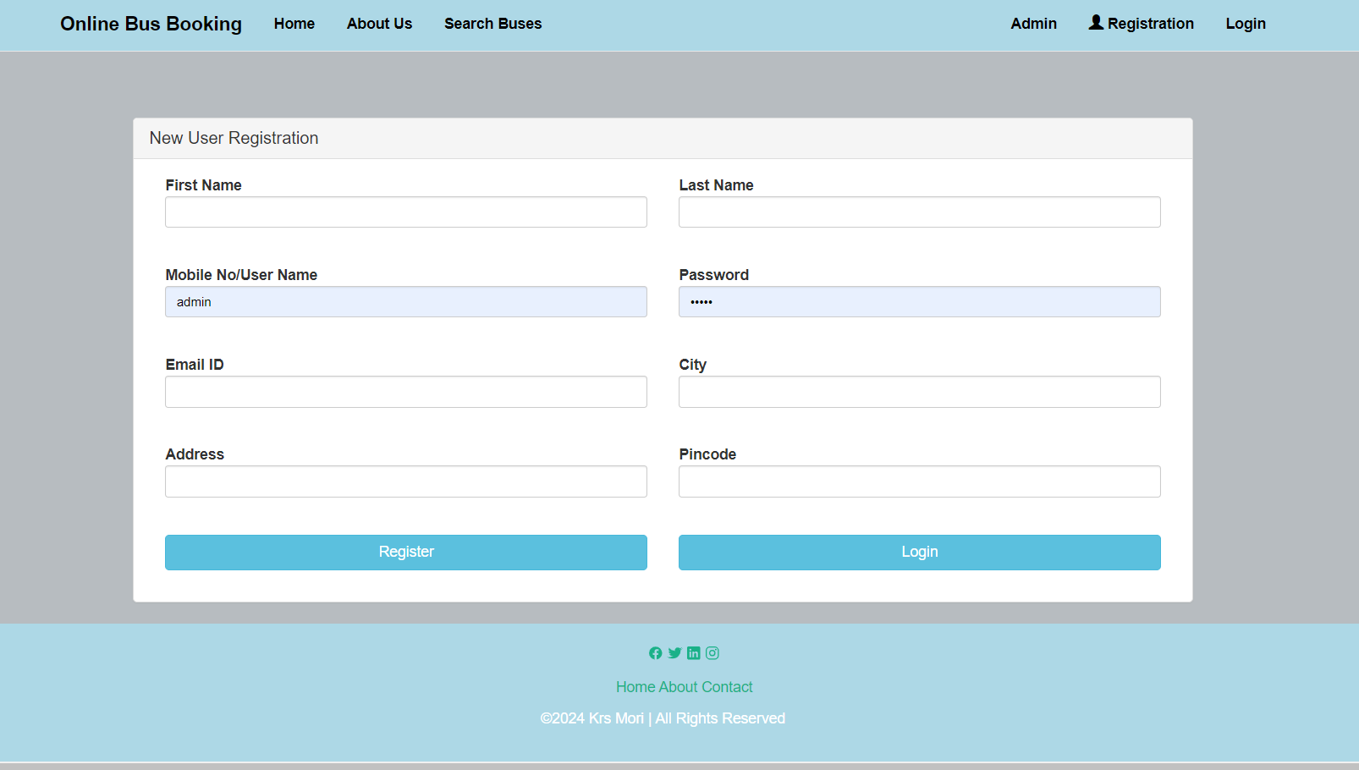
System Design
User Registration:-

Slide 23
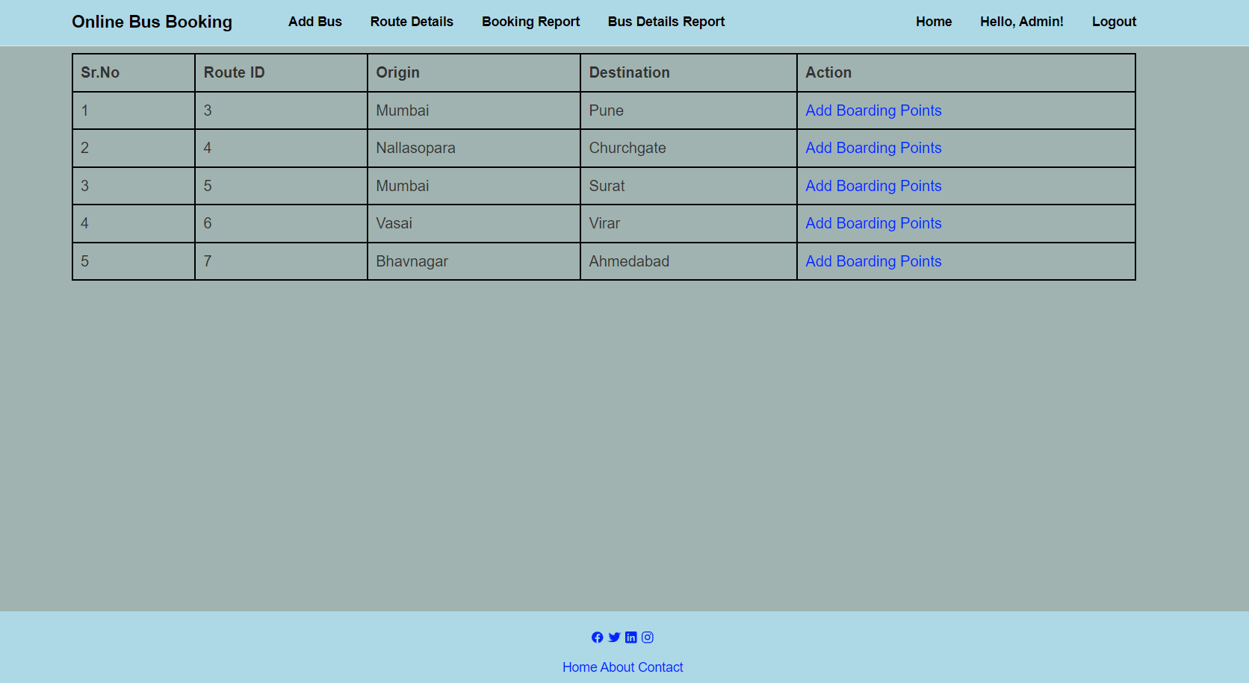
System Design
Route Details:-

Slide 24
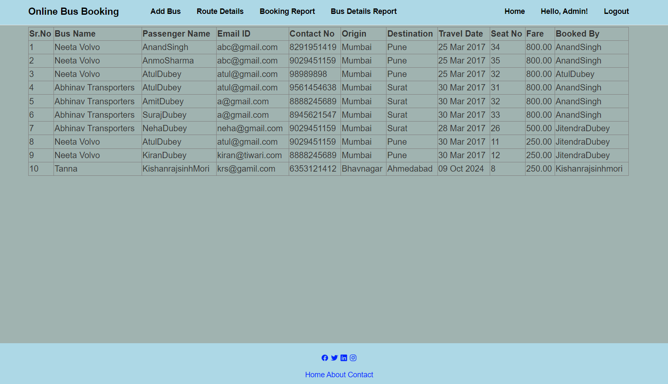
System Design
Booking Report:-

Slide 25
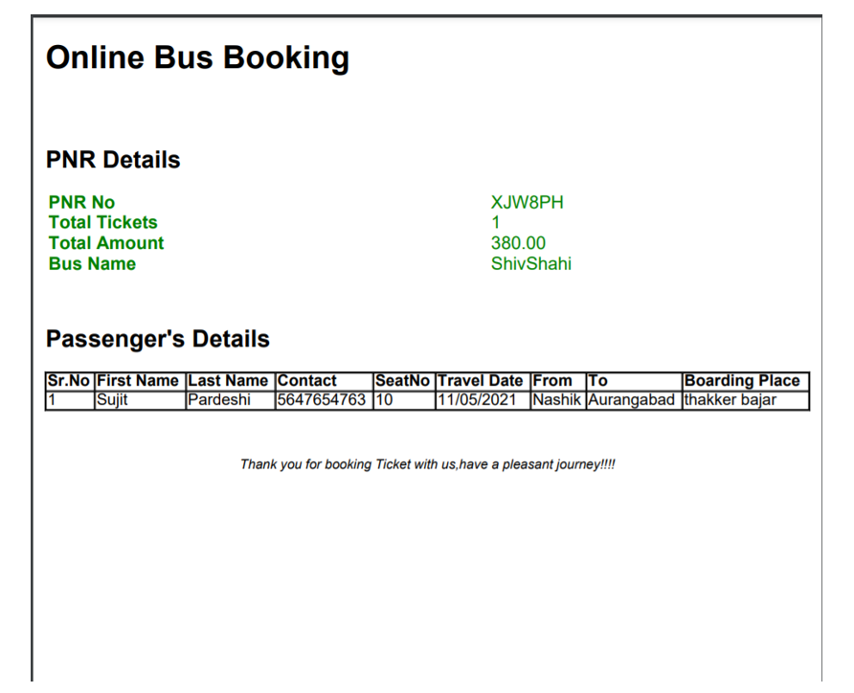
System Design
Booking Confirm :-

Slide 26
Conclusion
The bus booking system offers numerous advantages, streamlining the process of reserving seats and managing travel plans for passengers. Through its user-friendly interface and convenient features, it enhances the overall experience for both customers and bus operators.

