Slide 1

Department of Computer Engineering
Mini Project
Semester - VII
“AI-Base Travel Itinerary Planner”
Guided By: Ashvini Vaidya
Prepared By: Shingarakhiya Kishan (220002070)

Slide 2
Outline
Introduction
Project Overview
Objectives and Scope
Challenges and Solutions
Diagrams
Implementation and Roadmap
Future Plans
Conclusion
Thank You

Slide 3
Introduction
Project Title: AI-Based Travel Itinerary Planner
Developed as a mini-project (Semester VII, Computer Engineering)
Combines AI, route optimization, and mobile/web apps
Provides personalized itineraries & travel assistance
Two main modules:
Admin Panel (Web): Manage places, hotels, history, virtual views
Mobile App: Trip planner, chatbot, route finder, hotel details

Slide 4
Project Overview
Current travel apps are fragmented (separate apps for maps, hotels,
and itineraries).
This project integrates all features in one platform.
Admin Panel: Adds/updates tourist data, hotels, history, and 360° views.
Mobile App:
Explore destinations
AI chatbot assistance Optimized route planning with OpenRouteService
OTP-based secure login using Twilio API
Backend powered by Flask + Firebase for real-time updates.

Slide 5
Objectives and Scope
Objectives
Provide AI-powered personalized itineraries.
Suggest tourist spots, hotels, and optimized routes.
Enable secure OTP login for users.
Integrate history, hotels, and virtual tours.
Deliver a user-friendly mobile experience.
Scope
Admin Panel (Web): Manage and update tourist data.
User App (Mobile): Explore destinations, get AI chatbot assistance, and plan trips.
Support for real-time travel planning and optimized routes.
Useful for both travelers & administrators.

Slide 6
Challenges and Solutions
Challenges:
Manual trip planning lacks personalization.
Existing apps do not provide AI-based optimization.
Real-time updates (traffic, weather) missing in current systems.
Reliability concerns with OTP authentication.
Solutions:
AI chatbot integration for personalized trip recommendations.
Optimized routing via OpenRouteService + Dijkstra Algorithm.
OTP login using Twilio API ensures secure access.
Firebase for real-time data & cloud sync.
Integrated platform combining maps, hotels, history, and tours.

Slide 7
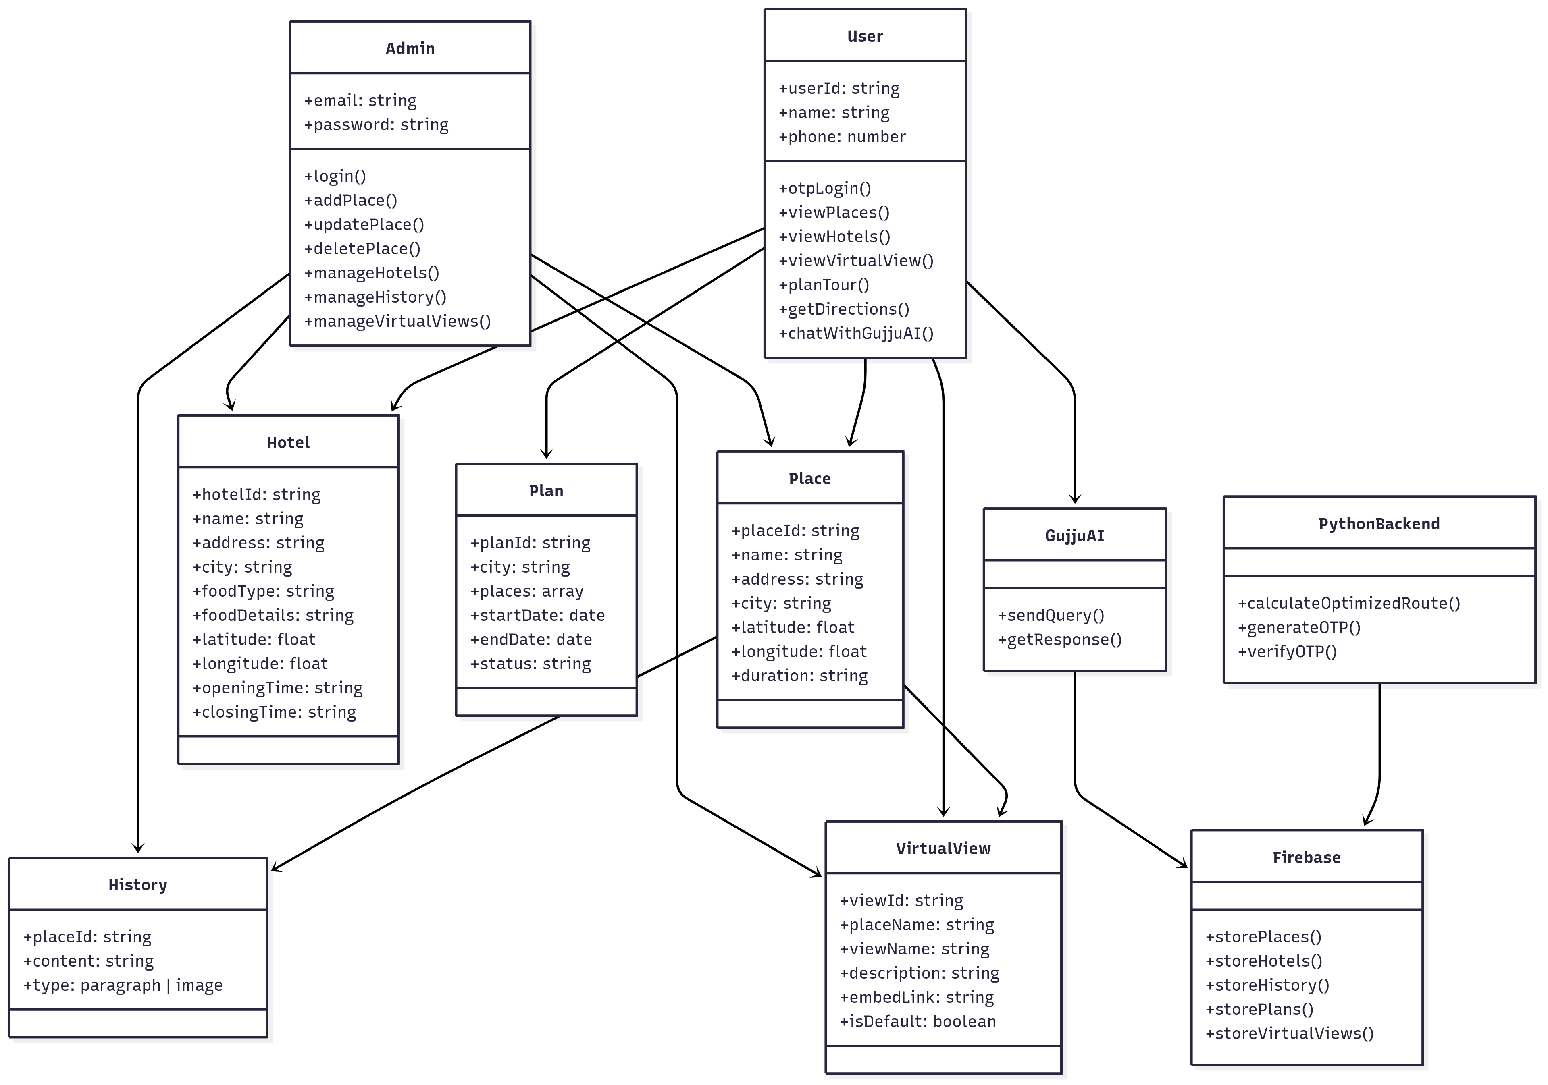
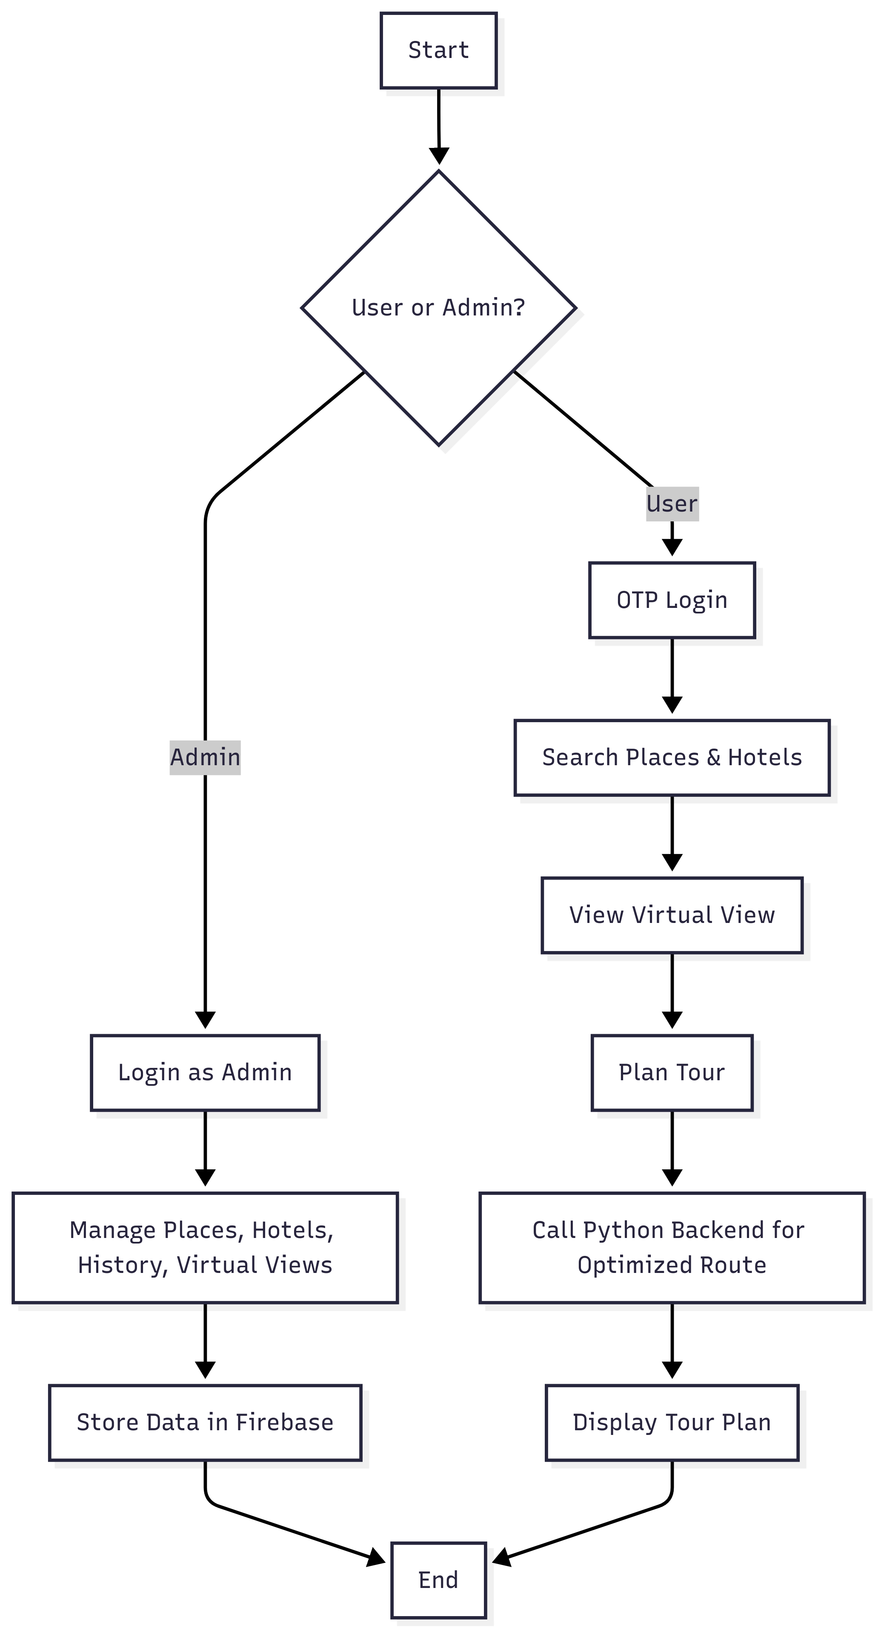
Diagrams
1. Class Diagram:
2. Activity Diagram:

Slide 8
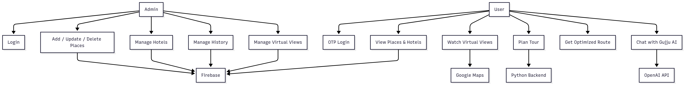
Diagrams
3. Use Case Diagram:

Slide 9
Future Plans and Roadmap
Future plan:
Add offline mode (cached maps & itineraries).
Extend support to iOS & desktop platforms.
Real-time traffic & weather updates.
Budget-based itinerary planning.
Multi-language support for global travelers.
AI to auto-update plans if attractions are closed.
Group/social trip planning with collaboration.

Slide 10
Future Plans and Roadmap
Roadmap
Week 1–2: Requirement gathering, architecture planning
Week 3–4: Flask backend (OTP, APIs)
Week 5–6: Web Admin Panel (React.js)
Week 7–8: Mobile App UI (React Native + Firebase auth)
Week 9: Route optimization (OpenRouteService API)
Week 10: OTP login with Twilio
Week 11–12: Testing & final deployment

Slide 11
Conclusion
Built a cross-platform AI-powered travel planner.
Provides personalized, optimized, and secure itineraries.
Integrates chatbot, route optimization, and real-time data.
Solves major issues of manual trip planning.
Strong foundation for future smart tourism apps.

Slide 12


