Slide 1
H1B APPLICATIONS
Kishan L R
UNDER GUIDENCE OF
MANOJ SHAH Tech Mentor NIIT
SANDEEP AGARWAL Faculty Big Data NIIT

Slide 2
BIG DATA
Extremely large data sets that may be analysed computationally to reveal patterns, trends, and associations, especially relating to human behaviour and interactions.
Big data analytics is used to handle huge volumes to data with varying formats and complexity from structured data, semi-structured data, weblogs, device data and unstructured format.
To develop complex analytical models like Market Basket Analysis, pricing and fraud detection.
It is often described using 5 vs.

Slide 3
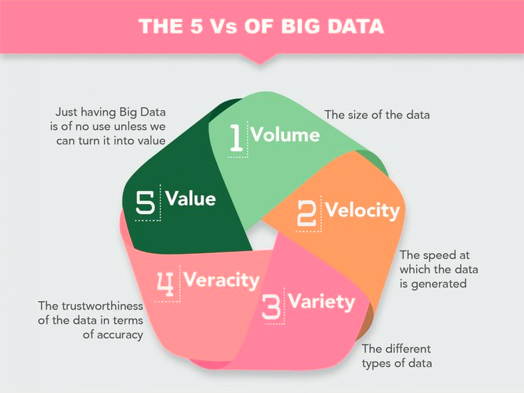
Five V's of Big Data

Slide 4
HADOOP
Apache Hadoop is an open-source software framework used for distributed storage and processing of big data sets using the MapReduce programming model. It consists of computer clusters built from commodity hardware. All the modules in Hadoop are designed with a fundamental assumption that hardware failures are common occurrences and should be automatically handled by the framework. It is part of the Apache project sponsored by the Apache Software Foundation.
Apache Hadoop MapReduce and HDFS components were inspired by Google papers on their MapReduce and Google File System.he processing part is called MapReduce programming model.

Slide 5
Apache Hadoop framework modules and ecosystem.
Hadoop Common – contains libraries and utilities needed by other Hadoop modules.
Hadoop Distributed File System (HDFS) – a distributed file-system that stores data on commodity machines, providing very high aggregate bandwidth across the cluster.
Hadoop YARN – a resource-management platform responsible for managing computing resources in clusters and using them for scheduling of users' applications.
Hadoop MapReduce – an implementation of the MapReduce programming model for large scale data processing.
It’s ecosystem consists of projects such as: Apache Pig, Apache Hive, Apache HBase, Apache Phoenix, Apache Spark, Apache Zookeeper, Cloudera Impala, Apache Flume, Apache Sqoop, Apache Oozie, and Apache Storm.

Slide 6
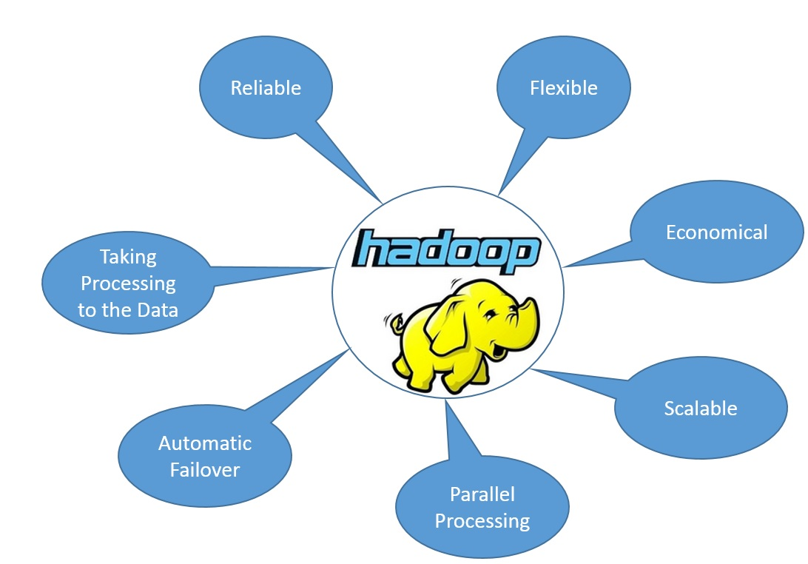
ADVANTAGES OF HADOOP

Slide 7
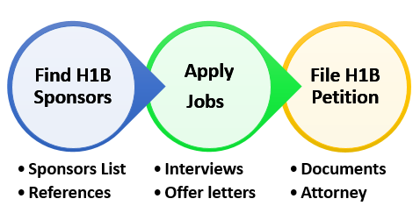
H1B APPLICATIONS
The H-1B is a non-immigrant visa in the United States under the Immigration and Nationality Act, section 101(a)(17)(H).
It allows U.S. employers to temporarily employ foreign workers in specialty occupations.

Slide 8
WHY H1B APPLICATIONS ?
Lot of Indian IT giants are having offices at USA.
New government policies have created a stir in the immigrant hiring section.
Majority of immigrants working for IT sectors are from India, China.

Slide 9
TECHNOLOGIES USED
Hadoop MapReduce in java
Pig Latin scripts
Hive

Slide 10
WHY MAPREDUCE ?
MapReduce is a processing technique and a program model for distributed computing based on java.
The MapReduce algorithm contains two important tasks, namely Map and Reduce.
Definite driver program control.
Optimization at a particular stage of processing
Good amount of Testability when combining lots of large data sets.

Slide 11
Why Hive?
Simple query language
It resides on top of Hadoop to summarize Big Data, and makes querying and analysing easy.
Hive queries are converted to MapReduce programs in the background by hive compiler for the jobs to be executed parallel across Hadoop cluster.
It eliminates tricky coding of MapReduce.

Slide 12
WHY PIG?
Apache Pig is an abstraction over MapReduce.
It is a tool/platform which is used to analyze larger sets of data representing them as data flows.
Pig is generally used with Hadoop, we can perform all the data manipulation operations in Hadoop using Apache Pig.

Slide 13
Flow Of Project
Load the data into HDFS.
Run required analysis by writing MapReduce or Hive or Pig programs.
Get the required output.
Visualize the data by drawing graphs for more in-depth understanding.

Slide 14
Questions that were answered after performing analysis.
Is the number of petitions with Data Engineer job title increasing over time?
Find top 5 job titles who are having highest growth in applications.
Which part of the US has the most Data Engineer jobs for each year?
Find top 5 locations in the US who have got certified visa for each year.
Which industry has the most number of Data Scientist positions?
Which top 5 employers file the most petitions each year?
Find the most popular top 10 job positions for H1B visa applications for each year?

Slide 15
Find the percentage and the count of each case status on total applications for each year. Create a graph depicting the pattern of all the cases over the period of time.
Create a bar graph to depict the number of applications for each year
Find the average Prevailing Wage for each Job for each Year (take part time and full time separate).Arrange the output in descending order.
Which are employers along with the number of petitions who have the success rate more than 70% in petitions and total petitions filed more than 1000?
Which are the job positions along with the number of petitions which have the success rate more than 70% in petitions and total petitions filed more than 1000?

Slide 16
Sample codes and output.
Create a bar graph to depict the number of applications for each year
Hive code.
select h1b.year,count(h1b.year) as no_of_applications from h1b where h1b.year is not NULL group by h1b.year order by h1b.year;
Output:
h1b.year | no_of_applications
2011 | 358767
2012 | 415605
2013 | 442110
2014 | 519426
2015 | 618727
2016 | 647803

Slide 17
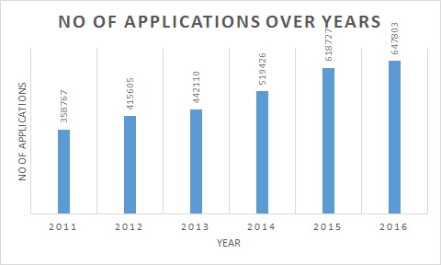

Slide 18
Find the percentage and the count of each case status on total applications for each year. Create a graph depicting the pattern of all the cases over the period of time.
Hive Code.
create table if not exists total(total int,year string)
row format delimited fields terminated by ',';
insert overwrite table total select count(*),year from h1b where h1b.case_status is not NULL group by year;
select a.case_status,count(*) as case_total, a.year,ROUND((count(*)/b.total)*100,2) as perOfCase_status from h1b a left outer join total b on (a.year=b.year) where a.year is not NULL group by a.case_status,b.total,a.year order by a.year;

Slide 19
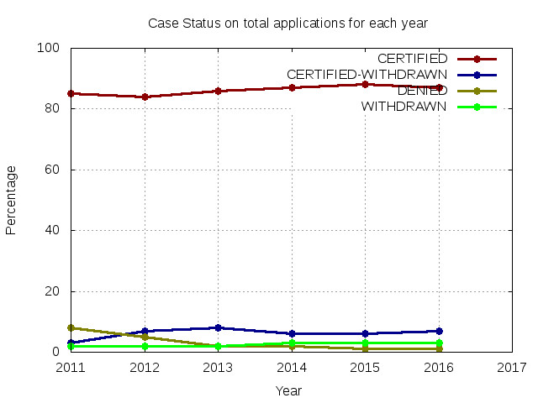
Output:
Row Labels | CERTIFIED | CERTIFIED-WITHDRAWN | DENIED | WITHDRAWN
2011 | 85.83 | 3.23 | 8.12 | 2.82
2012 | 84.86 | 7.49 | 5.08 | 2.58
2013 | 86.62 | 8.01 | 2.74 | 2.62
2014 | 87.62 | 7 | 2.29 | 3.09
2015 | 88.45 | 6.64 | 1.77 | 3.14
2016 | 87.94 | 7.27 | 1.42 | 3.38

Slide 20
Is the number of petitions with Data Engineer job title increasing over time?
MapReduce Code.
//Mapper Class
import java.io.IOException;
import org.apache.hadoop.io.*;
import org.apache.hadoop.mapreduce.Mapper;
public class MapClass extends Mapper<LongWritable,Text,Text,IntWritable>{
public void map(LongWritable key,Text value,Context context) throws IOException, InterruptedException{
String[] parts = value.toString().split(“\t");
String year = parts[7];
String job = parts[4];
int count = 1;
if(job.equals("\"DATA ENGINEER\"")){
context.write(new Text(year),new IntWritable(count));
}
}
}

Slide 21
//Reducer Class
import java.io.IOException;
import org.apache.hadoop.io.*;
import org.apache.hadoop.mapreduce.Reducer;
public class ReduceClass extends Reducer<Text,IntWritable,Text,Text>{
int yearbefore = 0;
String growth = "N.A";
String output = " ";
public void reduce(Text key,Iterable<IntWritable> value,Context context) throws IOException, InterruptedException{
int count = 0;
double growthper= 0;
for (IntWritable val:value){
count += val.get();
}
if(yearbefore!=0){
growthper = ((double)(count-yearbefore)/yearbefore)*100;
String.format("%.2f %%",growthper);
}
output = String.format("%d", count)+","+growth;
yearbefore = count;
context.write(key,new Text(output));
}
}

Slide 22
//Driver Class import java.io.IOException;
import org.apache.hadoop.conf.Configuration;
import org.apache.hadoop.fs.Path;
import org.apache.hadoop.io.*;
import org.apache.hadoop.mapreduce.Job;
import org.apache.hadoop.mapreduce.lib.input.FileInputFormat;
import org.apache.hadoop.mapreduce.lib.input.TextInputFormat;
import org.apache.hadoop.mapreduce.lib.output.FileOutputFormat;
import org.apache.hadoop.mapreduce.lib.output.TextOutputFormat;
public class Q1 {
public static void main(String[] args) throws IOException, ClassNotFoundException, InterruptedException {
Configuration conf = new Configuration();
conf.set("mapreduce.output.textoutputformat.separator", ",");
Job job = Job.getInstance(conf, "Q1a");
job.setJarByClass(Q1.class);
job.setMapperClass(MapClass.class);
job.setReducerClass(ReduceClass.class);
job.setOutputKeyClass(Text.class);
job.setMapOutputKeyClass(Text.class);
job.setMapOutputValueClass(IntWritable.class);
job.setOutputValueClass(Text.class);
job.setInputFormatClass(TextInputFormat.class);
job.setOutputFormatClass(TextOutputFormat.class);
FileInputFormat.addInputPath(job, new Path(args[0]));
FileOutputFormat.setOutputPath(job, new Path(args[1]));
System.exit(job.waitForCompletion(true) ? 0 : 1);
}
}

Slide 23
Find top 5 job titles who are having highest growth in applications.
Pig Code.
h1b = load '/home/hduser/h1bproject/h1bdata' using PigStorage(‘\t') as (s_no:int,case_status:chararray, employer_name:chararray, soc_name:chararray, job_title:chararray, full_time_position:chararray,prevailing_wage:int,year:chararray, worksite:chararray, longitute:double, latitute:double);
h1b1 = filter h1b by $1 != 'CASE_STATUS';
h1b_required = foreach h1b1 generate $4,$7;
h1b_2011 = filter h1b_required by $1=='2011';
h1b_2012 = filter h1b_required by $1=='2012';
h1b_2013 = filter h1b_required by $1=='2013';
h1b_2014 = filter h1b_required by $1=='2014';
h1b_2015 = filter h1b_required by $1=='2015';
h1b_2016 = filter h1b_required by $1=='2016';
h1b_group1 = group h1b_2011 by $0;
h1b_group2 = group h1b_2012 by $0;
h1b_group3 = group h1b_2013 by $0;
h1b_group4 = group h1b_2014 by $0;
h1b_group5 = group h1b_2015 by $0;
h1b_group6 = group h1b_2016 by $0;

Slide 24
h1b_count1 = foreach h1b_group1 generate COUNT(h1b_2011.$0),group;
h1b_count2 = foreach h1b_group2 generate COUNT(h1b_2012.$0),group;
h1b_count3 = foreach h1b_group3 generate COUNT(h1b_2013.$0),group;
h1b_count4 = foreach h1b_group4 generate COUNT(h1b_2014.$0),group;
h1b_count5 = foreach h1b_group5 generate COUNT(h1b_2015.$0),group;
h1b_count6 = foreach h1b_group6 generate COUNT(h1b_2016.$0),group;
h1b_join = join h1b_count1 by $1,h1b_count2 by $1,h1b_count3 by $1,h1b_count4 by $1,h1b_count5 by $1,h1b_count6 by $1;
h1b_count = foreach h1b_join generate $1,ROUND_TO((((float)($2-$0))*100/$0),2),ROUND_TO((((float)($4-$2))*100/$2),2),ROUND_TO((((float)($6-$4))*100/$4),2),ROUND_TO((((float)($8-$6))*100/$6),2),ROUND_TO((((float)($10-$8))*100/$8),2);
h1b_avg = foreach h1b_count generate $0,($1+$2+$3+$4+$5)/5;
h1b_order = order h1b_avg by $1 desc;
h1b_top5 = limit h1b_order 5;
store h1b_top5 into '/home/hduser/h1bproject/projectout/' using PigStorage(',');

Slide 25
Using Sqoop to load data into RDBMS(MySQL)
Bash script to load data into MySQL
echo "Please enter your MySQL database details"
read -p 'username: ' user # get username
read -sp 'password: ' password # get password
echo
mysql -u $user -p"$password" -e 'create database if not exists project;use project;drop table if exists h1b_analysis12;create table h1b_analysis12(employee_name varchar(100),total_application int,success_rate varchar(40)); # Create a database and table.
exit;‘
sqoop export --connect jdbc:mysql://localhost/project --username $user --password "$password" --table h1b10 --update-mode allowinsert --update-key employee_name --export-dir /niit/projout10/p*
--input-fields-terminated-by '\t' ; # sqoop export
mysql -u $user -p"$password" -e 'use project;select * from h1b_analysis12;‘ # MySQL command to show the output

Slide 26
CODE REPOSITORY
https://github.com/kishan9886767771/H1-B-BigData-Project

Slide 27

Knowledge is Free! Happy Surfing!

