Slide 1
Predictive Forecasting of Care Load & Placement Demand
Data Analytics & Machine Learning Project
Prepared by: Kishan Masura
1

Slide 2
Project Objective
Forecast future HHS care occupancy using historical care-load data.
Understand historical occupancy patterns and temporal variation.
Identify important predictive factors for care occupancy.
Compare machine learning models using MAE, RMSE and R².
Support capacity planning, resource allocation and operational decision-making.
2

Slide 3
Dataset & Analytical Workflow
HHS Program
Source domain
Children in HHS Care
Prediction target
3 Models
Evaluated
Raw Dataset → Data Cleaning → EDA → Feature Engineering → Train/Test Split → Model Training → Model Evaluation → Best Model Selection → Future Forecasting
Technologies: Python • Pandas • NumPy • Matplotlib • Seaborn • Scikit-learn
3

Slide 4
Historical Care Occupancy Trend
HHS care occupancy shows substantial variation across the historical period.
Higher occupancy levels were observed during parts of 2023 and 2024.
A pronounced decline occurred during 2025, followed by stabilization at a lower level.
Key historical pattern
Elevated care load in earlier periods
Sharp reduction entering 2025
Lower and more stable levels afterward
4

Slide 5
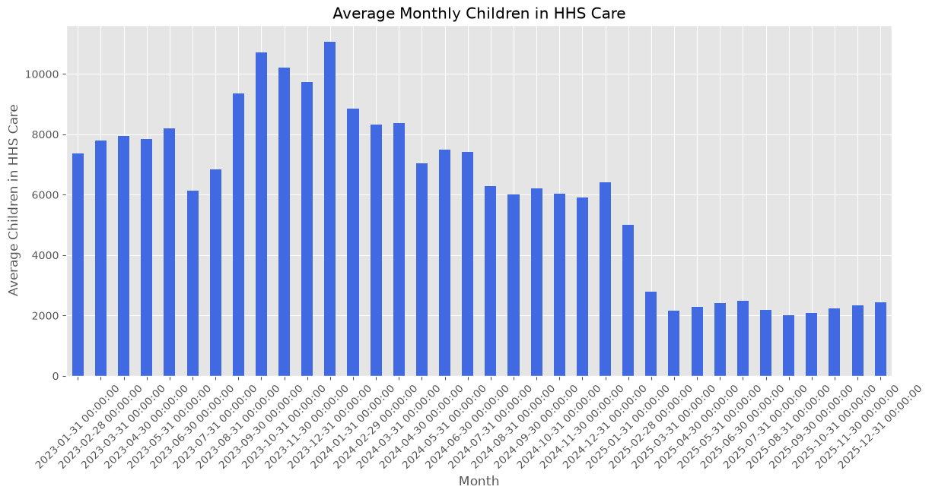
Monthly Care Occupancy
Average occupancy was substantially higher during earlier periods.
The monthly averages decline sharply around the transition into 2025.
Later monthly levels remain much lower than the earlier peaks.
5

Slide 6
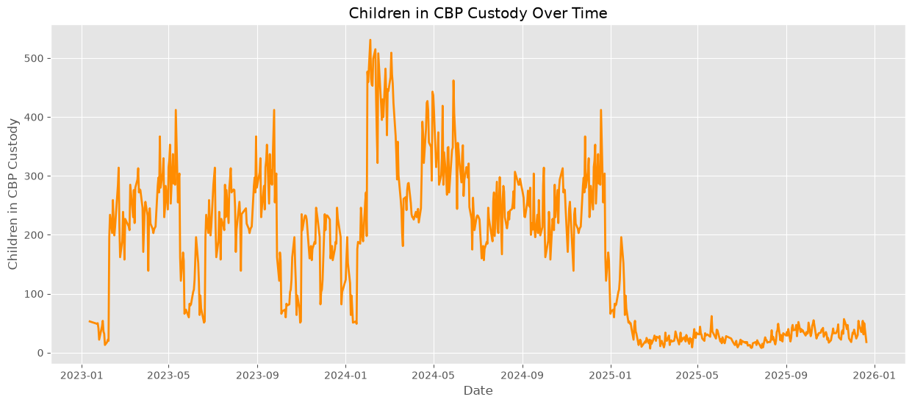
CBP Custody Trend
CBP custody also exhibits strong temporal variation.
The series reaches its highest levels around early 2024.
Custody levels fall substantially during 2025.
6

Slide 7
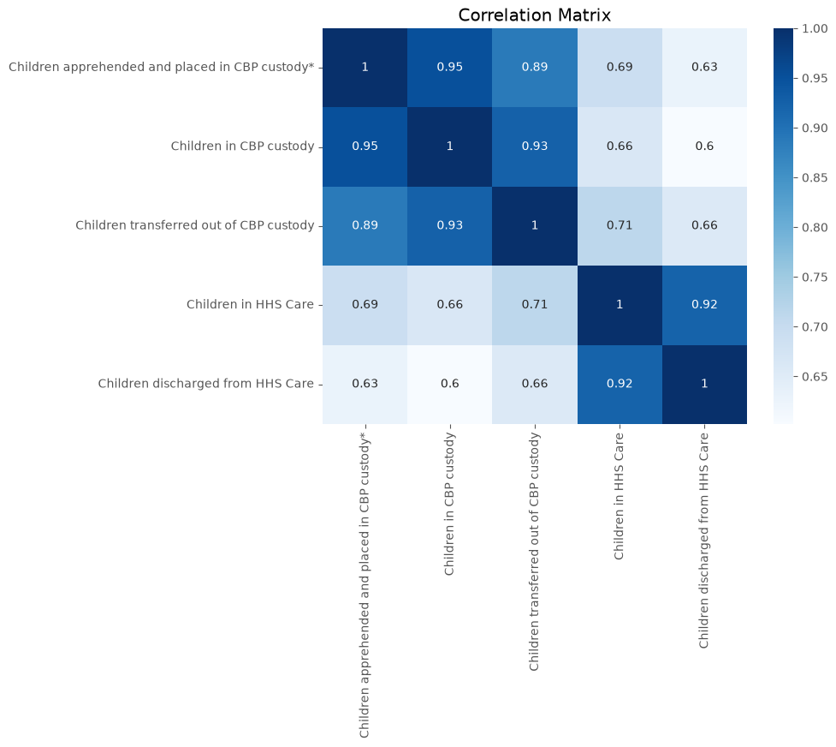
Correlation Analysis
HHS care and HHS discharges show a strong positive relationship (0.92).
CBP custody and transferred children are also strongly related (0.93).
Children transferred out of CBP custody correlates 0.71 with HHS care.
Historical operational indicators provide useful predictive information.
7

Slide 8
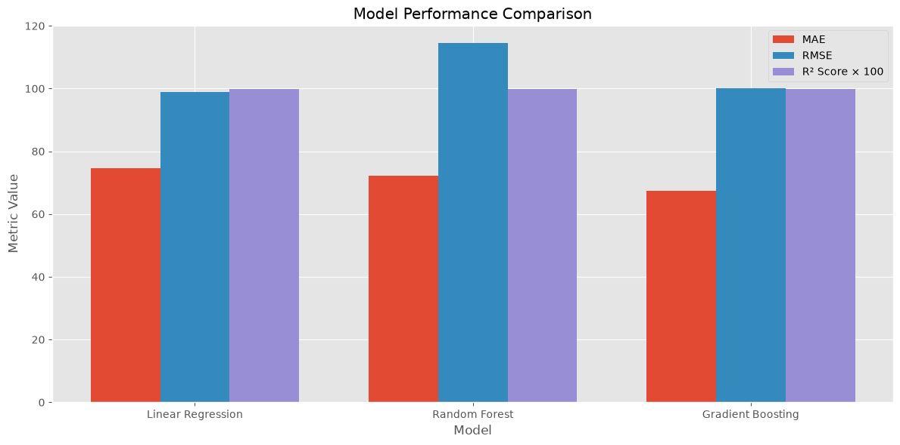
Model Performance Comparison
67.37
Gradient Boosting MAE
0.998791
Gradient Boosting R²
Linear Regression — MAE 74.55; RMSE 98.89; R² 0.998823
Random Forest — MAE 72.21; RMSE 114.45; R² 0.998424
Gradient Boosting — MAE 67.37; RMSE 100.21; R² 0.998791
Gradient Boosting selected based primarily on the lowest MAE.
8

Slide 9
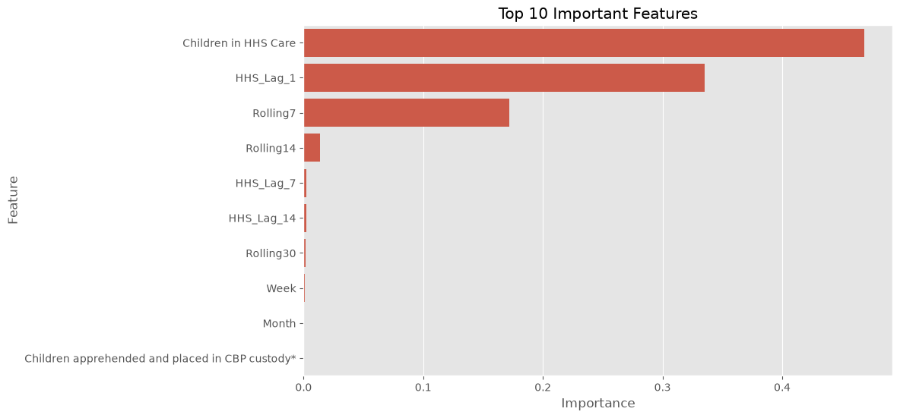
Feature Importance
Children in HHS Care — 0.468840
HHS_Lag_1 — 0.334926
Rolling7 — 0.172212
Rolling14 — 0.013689
Recent care-load history is the dominant predictive signal.
9

Slide 10
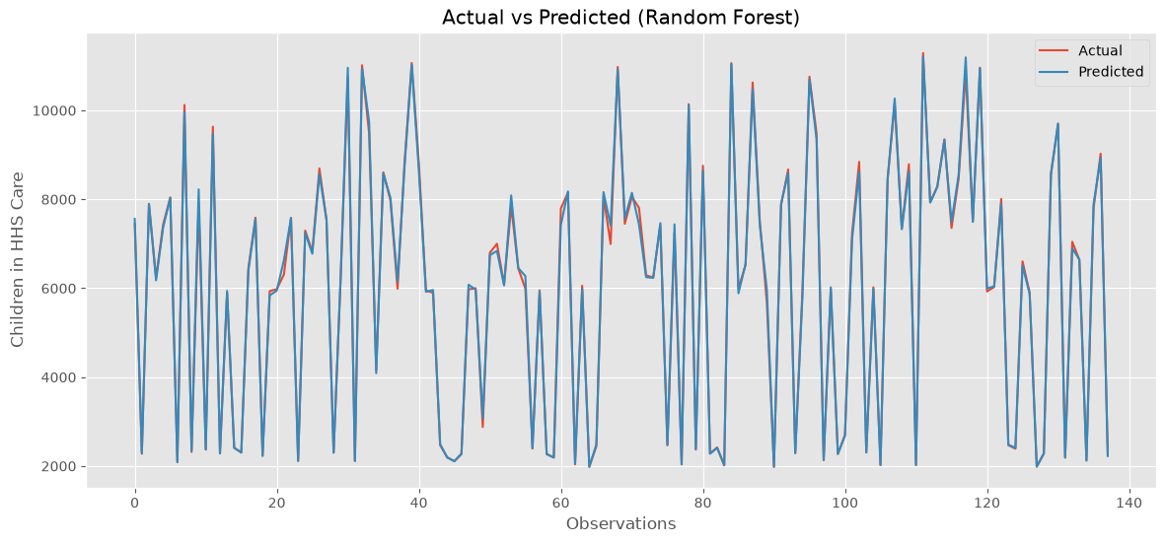
Actual vs Predicted
The report's visualization shows predictions closely following observed HHS care values.
The close alignment supports the strong predictive performance indicated by the evaluation metrics.
The embedded chart is labelled “Actual vs Predicted (Random Forest)” in the source report.
10

Slide 11
Future Forecast
Lower
Predicted occupancy level
Stable
After the sharp decline
Moderate
Expected fluctuations
The future forecast indicates a substantial reduction in predicted HHS care occupancy compared with earlier elevated levels.
Following the decline, predicted occupancy stabilizes at a substantially lower level with moderate fluctuations.
The forecast is a model-based estimate and should not be interpreted as a guaranteed outcome.
11

Slide 12
Business Recommendations & Conclusion
Recommendations
Capacity planning using forecast outputs.
Resource allocation for staffing, facilities and operations.
Continuous monitoring of recent care-load trends.
Periodic forecast review in planning workflows.
Ongoing model-performance monitoring as new data arrives.
Conclusion
The project demonstrates an end-to-end predictive analytics workflow for HHS care occupancy.
Gradient Boosting was selected primarily because it achieved the lowest MAE.
The framework provides a foundation for future operational dashboards, automated forecasting pipelines and capacity-planning applications.
12

