Slide 1

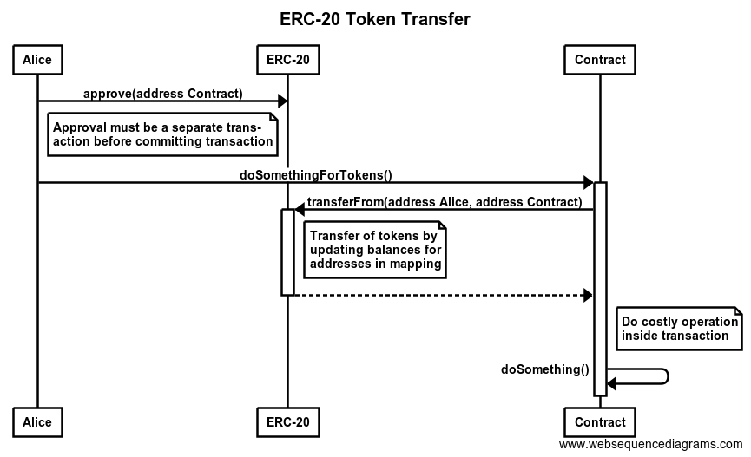
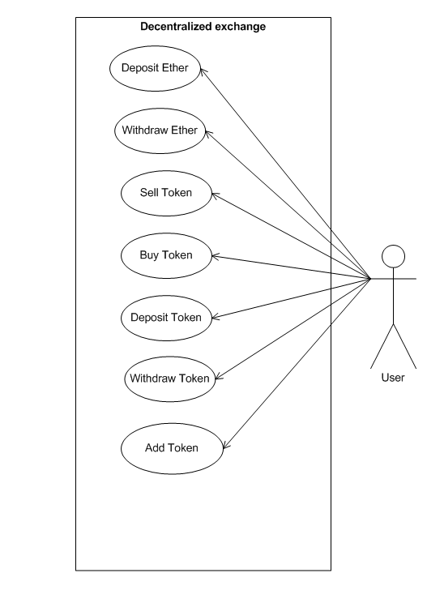
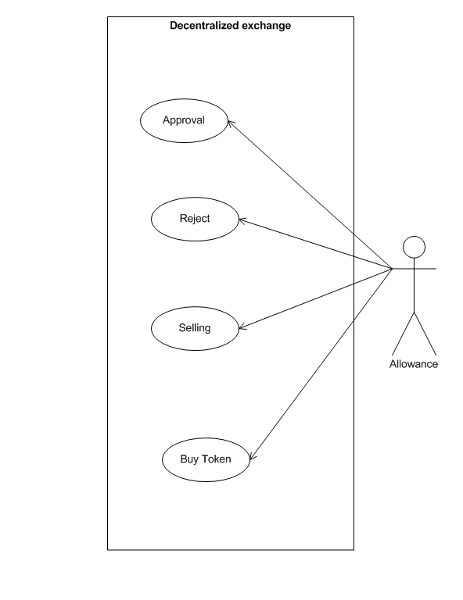
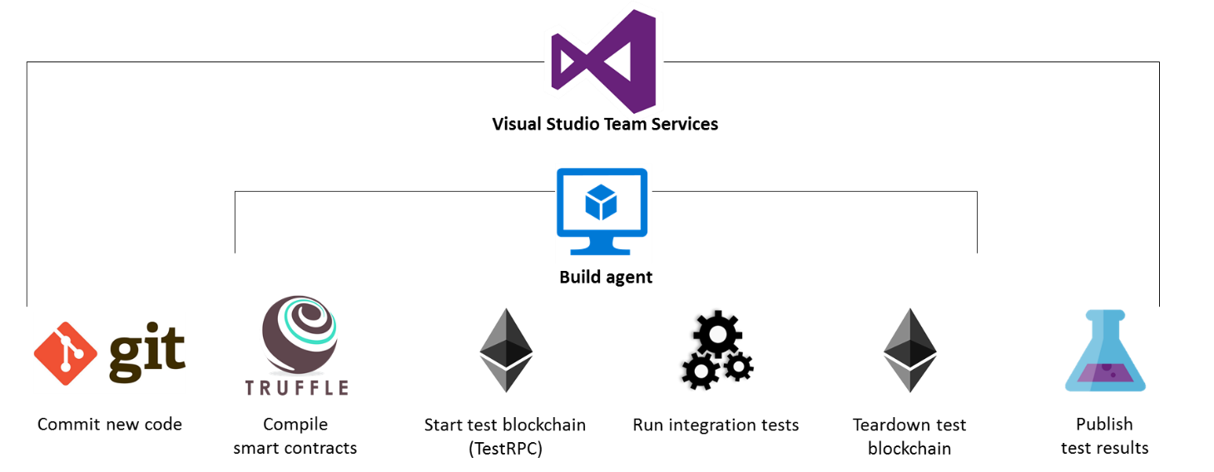
Ethereum Based Decentralized Exchange
16MCA028 -MAJOR PROJECT
Guided by:Prof. Rasendru Mishra
About The System
ERC 20 TOKENS
USE DIAGRAMS
end user who are
willing to invest in the crypto currency by giving the ether
in exchange of our token. The token value are decided
and kept appropriately.
Crypto currency exchanges or digital currency exchanges (DCE) are businesses that allow customers to trade crypto currencies or digital currencies for other assets, such as conventional money, or different digital currencies.
They can be market makers that typically take the bid/ask spreads as transaction commissions for their services or simply charge fees as a matching.
SCOPE
FLOWCHART
It an website based on Crypto currency exchange (Bitcoin currency) using ethers to transfer using meta mask an extension of Google Chrome.
It stores information related to Bit Coin.
It contains features like safe and secure to transfer ethers and token.
It allows to deposit, transfer and to withdraw tokens and also allows to deposit, transfer and to withdraw ethers which is being approved by allowance.
It Allows to buy and sell token on the basics of the trading and which holds the sell Order and the order Book according to the market prices and the implementation of the limit orders.
ACTIVITIES
System Modules Functionalities
User Options:
1)Deposit/Withdrawal Funds
2)Exchange Ethers For tokens.
Admin Options:
1)Owned
2)Add tokens to trade
Limit Order:
1)Sell and buy order executed
Exchange ERC20 Tokens:
1)Limit Order
2)Market Order
3)Buy Order
4)Sell Order
TOOLS AND TECHNOLOGY
Notes:
<number>

