Slide 1

Presented by : Kishan Barochiya Batch no : Internship 22
MALIGNANT COMMENT CLASSIFIER

Slide 2
TOPICS WE ARE GOING TO COVERED
PROBLEM STATEMENT
GOAL
DATA EXPLANATION
LIBRARIES USED FOR EDA
EDA WITH CONCLUSION
DATA PRE PROCESSING
MODEL DEVELOPING
MODEL TESTING
MODEL SELECTION

Slide 3
Problem Statement
The proliferation of social media enables people to express their opinions widely online. However, at the same time, this has resulted in the emergence of conflict and hate, making online environments uninviting for users. Although researchers have found that hate is a problem across multiple platforms, there is a lack of models for online hate detection.
Online hate, described as abusive language, aggression, cyberbullying, hatefulness and many others has been identified as a major threat on online social media platforms. Social media platforms are the most prominent grounds for such toxic behaviour. There has been a remarkable increase in the cases of cyberbullying and trolls on various social media platforms. Many celebrities and influences are facing backlashes from people and have to come across hateful and offensive comments. This can take a toll on anyone and affect them mentally leading to depression, mental illness, self-hatred and suicidal thoughts.
Internet comments are bastions of hatred and vitriol. While online anonymity has provided a new outlet for aggression and hate speech, machine learning can be used to fight it. The problem we sought to solve was the tagging of internet comments that are aggressive towards other users. This means that insults to third parties such as celebrities will be tagged as unoffensive, but “u are an idiot” is clearly offensive. Our goal is to build a prototype of online hate and abuse comment classifier which can used to classify hate and offensive comments so that it can be controlled and restricted from spreading hatred and cyberbullying.

Slide 4
GOAL
Our goal is to build model which can detect the bad, abuse words which makes comments malignant. After detecting them author can control that comments which leads to improve is public content, quality review, social quality improvisation etc.

Slide 5
Data Explaination
The data set includes:
Malignant: It is the Label column, which includes values 0 and 1, denoting if the comment is malignant or not.
Highly Malignant: It denotes comments that are highly malignant and hurtful.
Rude: It denotes comments that are very rude and offensive.
Threat: It contains indication of the comments that are giving any threat to someone.
Abuse: It is for comments that are abusive in nature.
Loathe: It describes the comments which are hateful and loathing in nature.
ID: It includes unique Ids associated with each comment text given.
Comment text: This column contains the comments extracted from various social media platforms.

Slide 6
LIBRARIES
We will use below libraries to reach at goal:
For data loading and data understanding
Pandas and Numpy
For Data visualization
Sea born
Matplotlib
For Pre processing
Standard scaler, Balancing technique, WordNetLemmatizer, stopwords,string, WordCloud,TfidfVectorizer

Slide 7
Data understanding
Here we have 159571 comments in training data and it contain 8 variables. In testing set, we have 153164 comments.
There is no null values in data set and from 8 variables, 6 are in int form and 2 in objective form.

Slide 8
Road map of project
First we will load dataset
Check basic statistics of dataset.
Then clear comment’s text where emoji, short words, repeated words, un-usefull words.
We will loc malignant comments and find out frequent words used in that type comments.
Consider that words as malignant words and proceed for model building.
Convert text into vector to build model.
Build model and check accuracy
Dump accurate model and check on testing set.

Slide 9
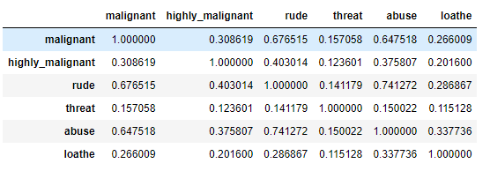
Data pre-processing
Once check that there is no null values in dataset, we will check co-relation between each variable.
As we can see that malignant comment have high co-relation with rude and abuse. Where rude and abuse words found in comment then it have higher chances that comment is malignant.

Slide 10
EDA conclusion
144277 comments are normal while 15294 are malignant.
157976 comments are normal while 1595 comments are highly malignant. it means from 15294 malignant comments 1595 are highly malignant.
158166 comments are not loathe and 1405 comments are loathe.
8449 comments have rude words which leads to malignant chances higher.
7877 comments have 7877 abuse words and this have highest chances of malignant catagory.
478 comments have threated.
rude and abuse have higher chances of malignant.

Slide 11
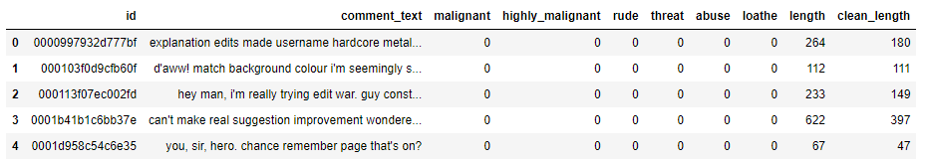
Data cleaning
First we added length column where we count the length of comment and then clear it with replace function then add clean_length.
We can clearly see difference between clean and normal length.
Now our comment is ready for analysis.

Slide 12
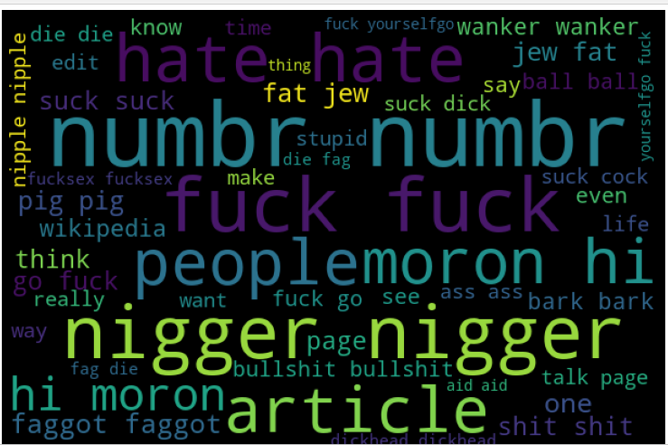
WORD CLOUD
Using word cloud libraries, we are getting below frequent words, now we will consider it words as malignant and treat it as input keywords.

Slide 13
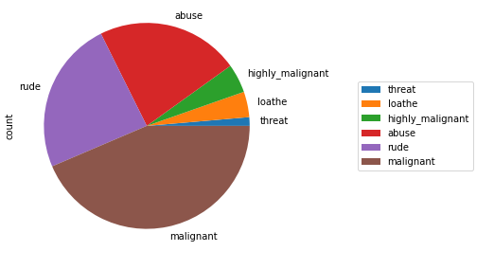
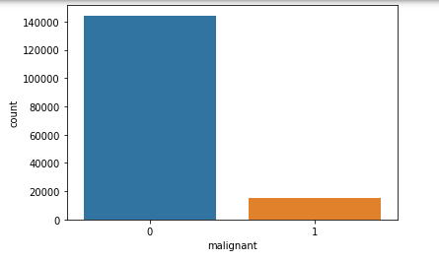
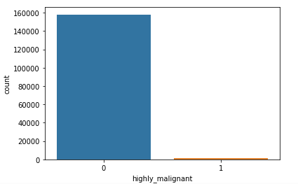
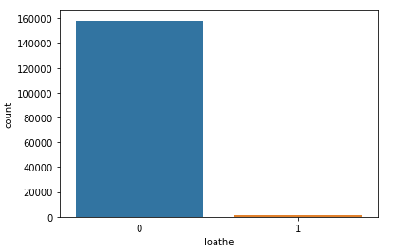
Graphical view

Slide 14
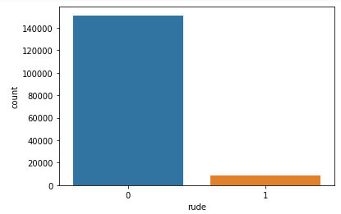
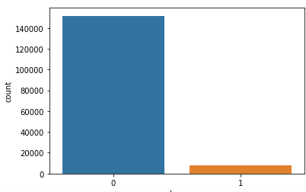
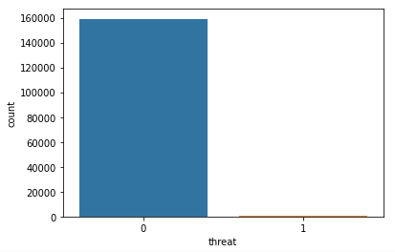

Slide 15
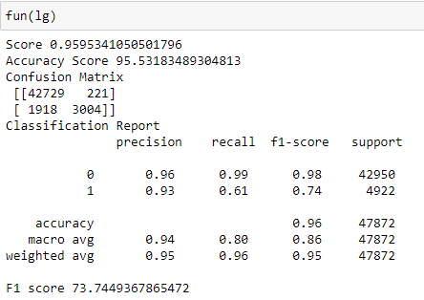
Algorithm
Logistic Regression
REMARKS:
We are getting 95.95% accuracy in training dataset.
95.53% accuracy in testing dataset.
Precision and recall is good and f1 score is also good with 73.74

Slide 16
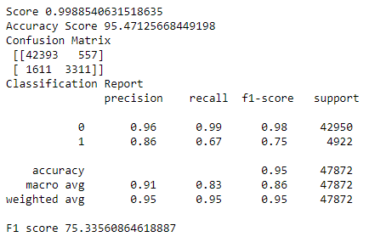
Algorithm
RANDOM FOREST CLASSIFIER
REMARKS:
We are getting 99.88% accuracy in training dataset.
95.47% accuracy in testing dataset.
Precision and recall is good and f1 score is also good with 75.33

Slide 17
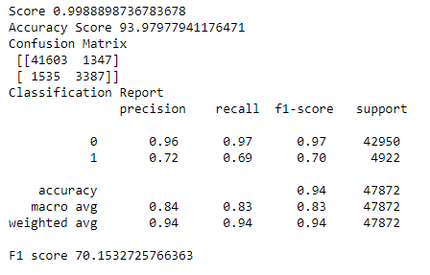
Algorithm
DECISIONTREE CLASSIFIER
REMARKS:
We are getting 99.88% accuracy in training dataset.
93.47% accuracy in testing dataset.
Precision and recall is quite low and f1 score is also low with 70.15

Slide 18
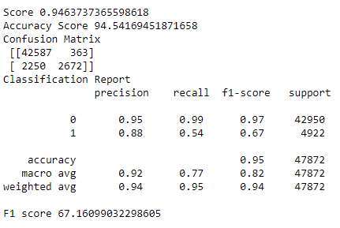
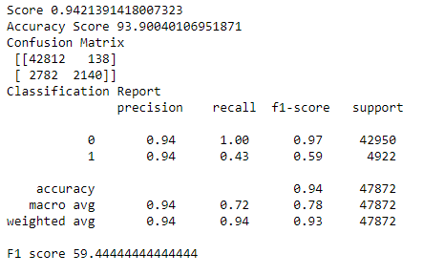
Algorithm
ADABOOST CLASSIFIER & GRADIENTBOOST CLASSIFIER
REMARKS:
We are getting lower f1 score, accuracy is also comparatively low.

Slide 19
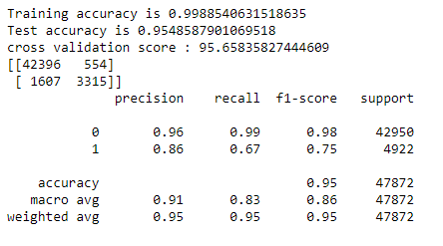
Algorithm
Randomforest classifier with cv
REMARKS:
After cv, we are getting higher accuracy so we will consider it as best fit model.

Slide 20
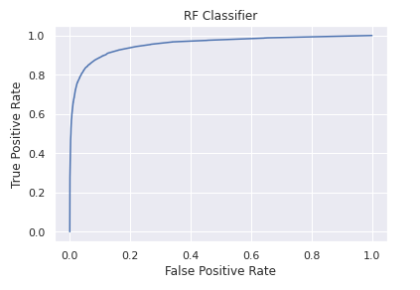
Auc-roc curve
Our dumped model, covering 72% variance as per below graph.

Slide 21
THANK YOU

