Slide 1

Presented by : Kishan Barochiya Batch no : Internship 22
Comment-rating prediction

Slide 2
TOPICS WE ARE GOING TO COVERED
PROBLEM STATEMENT
GOAL
DATA EXPLANATION
LIBRARIES USED FOR EDA
EDA WITH CONCLUSION
DATA PRE PROCESSING
MODEL DEVELOPING
MODEL TESTING
MODEL SELECTION

Slide 3
Problem Statement
We have a client who has a website where people write different reviews for technical products. Now they are adding a new feature to their website i.e. The reviewer will have to add stars(rating) as well with the review. The rating is out 5 stars and it only has 5 options available 1 star, 2 stars, 3 stars, 4 stars, 5 stars. Now they want to predict ratings for the reviews which were written in the past and they don’t have a rating. So, we have to build an application which can predict the rating by seeing the review.

Slide 4
GOAL
Our goal is to build model which can detect the rating based on comments. So we can easily get how much customer like the product or not. This will leads to improvement in e-commerce platform, social media etc

Slide 5
Data Explaination
We scraped the data from Flipkart.com. We scraped almost 23k comments data for mobile phones. In scraped data we have 2 columns.
1) Rating
2) Comments

Slide 6
LIBRARIES
We will use below libraries to reach at goal:
For data loading and data understanding
Pandas and Numpy
For Data visualization
Sea born
Matplotlib
For Pre processing
WordNetLemmatizer, stopwords,string, WordCloud,TfidfVectorizer

Slide 7
Road map of project
First we will load dataset
Check basic statistics of dataset.
Then clear comment’s text where emoji, short words, repeated words, un-usefull words.
We will loc comments ratingwise.
Consider the frequent words used for that particular rating
Convert text into vector to build model.
Build model and check accuracy
Dump accurate model and check on testing set.

Slide 8
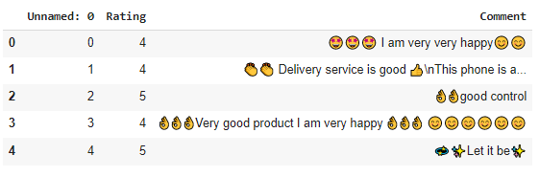
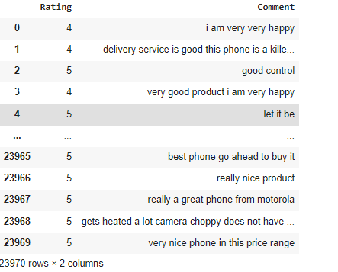
Data pre-processing
Once check that there is no null values in dataset, we will check co-relation between each variable.
Now we clean the data by replacing space, emoji, repetitive words, sort words etc and clean the data
We can see difference clearly.

Slide 9
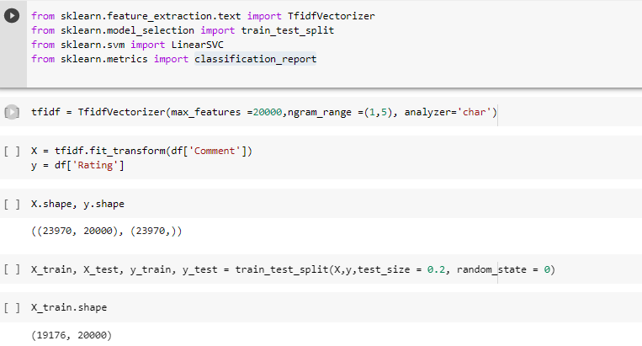
Text to vector
Now we convert text data into vector for processing for model building and then divide data in train and test dataset

Slide 10
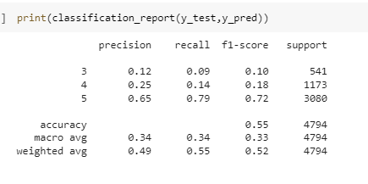
RESULt Linear regression

Slide 11
THANK YOU

