Slide 1
HOUSING: PRICE PREDICTION
NAME : Barochiya Kishankumar Vinodbhai
BATCH NO : INTERNSHIP 22

Slide 2
TOPICS WE ARE GOING TO COVERED
PROBLEM STATEMENT
GOAL
DATA EXPLANATION
LIBRARIES USED FOR EDA
EDA WITH CONCLUSION
DATA PRE PROCESSING
MODEL DEVELOPING
MODEL TESTING
MODEL SELECTION

Slide 3
Problem Statement
Houses are one of the necessary need of each and every person around the globe and therefore housing and real estate market is one of the markets which is one of the major contributors in the world’s economy. It is a very large market and there are various companies working in the domain. Data science comes as a very important tool to solve problems in the domain to help the companies increase their overall revenue, profits, improving their marketing strategies and focusing on changing trends in house sales and purchases. Predictive modelling, Market mix modelling, recommendation systems are some of the machine learning techniques used for achieving the business goals for housing companies. Our problem is related to one such housing company.

Slide 4
Problem Statement
A US-based housing company named Surprise Housing has decided to enter the Australian market. The company uses data analytics to purchase houses at a price below their actual values and flip them at a higher price. For the same purpose, the company has collected a data set from the sale of houses in Australia. The data is provided in the CSV file below. The company is looking at prospective properties to buy houses to enter the market. You are required to build a model using Machine Learning in order to predict the actual value of the prospective properties and decide whether to invest in them or not. For this company wants to know:
Which variables are important to predict the price of variable?
How do these variables describe the price of the house?

Slide 5
GOAL
OUR GOAL IS TO BUILT A MODEL WHICH CAN STUDY AND ANALYSE THE PAST DATA OF SOLD HOUSES IN AUSTRALA. BY STUDYING THIS DATA, CREATE A PREDICTION MODEL WHICH CAN FIND OUT IMPORTANT PARAMETERS TO PREDICT SALES PRICE AND BASED ON GIVEN PARAMETER IT WILL REVERT WITH BEST MARKET COMPETATIVE PRICE AND ALSO LOOKING TO FEATURS WHICH ARE MOST IMPORTANT TO PREDICT OR CHANGES THE PRICE.

Slide 6
Data Explaination
Here , we have 81 features on based of it we will predict the price. This data have featurs like SQFT, build year, building condition, bath area, garage area, zone, facility, living area, no of bedroom, furniture etc.
We have 1168 observation of sold houses and based on it we will make prediction model.

Slide 7
LIBRARIES
We will use below libraries to reach at goal:
For data loading and data understanding
Pandas and Numpy
For Data visualization
Sea born
Matplotlib
For Pre processing
Standard scaler, Feature selection, PCA

Slide 8
Basics of data
Shape of Data : Formula Used = df1.shape
(1168,81)
Null values in Data : Formula Used : df1.isnull().sum()
Yes
Columns Datatype : Formula Used :
objt = ['object']
my_df1 = df1.select_dtypes(include=objt)
my_df1.shape

Slide 9
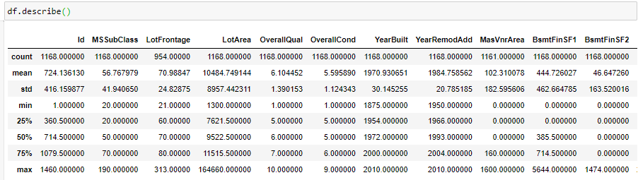
Statatics of Data
Describe is the best way to understand data plotting. Here we can see that in km column, avg km is 45531 but lower range is 58 and maximum is 353288. Thus, we can understand all column; here is not much to need that as we have low unique values in it.

Slide 10
Exploratory Data Analysis

Slide 11
Exploratory Data Analysis

Slide 12
Exploratory Data Analysis

Slide 13
Exploratory Data Analysis

Slide 14
Exploratory Data Analysis

Slide 15
Exploratory Data Analysis

Slide 16
Exploratory Data Analysis

Slide 17
Exploratory Data Analysis

Slide 18
CONCLUSION
60, 75 and 120 have high sales price while 30 and 180 have low sales price.
• Slightly slope to sqft to sales, where we can say that as SQFT goes high then sales price also inreasing
• RL and FV zone have high house selling price, as demand is high in that zone while in C zone selling
value is low.
Utilities have only single variable so we can remove it because it does not matter with result.
Landslope have also 3 variable but all 3 have same effect with number of sales.
Overall quality increases leads to increase in sales price.
Overall quality play an important role in sales price of house.
Grlivarea have good co relation with selling price as it parallel increase to sales price.
Garagecars and garage area have similar co-relation with Sales price. Both are parallel increase to
sales price.
Garage year built, 1st floor sf,year remod add, total basement sqft,full bath, year built, garage
area, garage cars, grlivearea,overall quality are TOP 10 features which effect to sales price.
Enclosed porch, kitchenabvgr, overall condition, miscval, yrsold are not much co-related featurs
to predict price.

Slide 19
Data Pre-processing
SKEWNESS REMOVEL:
Skewness is a silent killer which destroy model as no of data are lying at one side . Skewness has two type: negative and positive.
Here we use cube-root and power transformation method to remove skewness

Slide 20
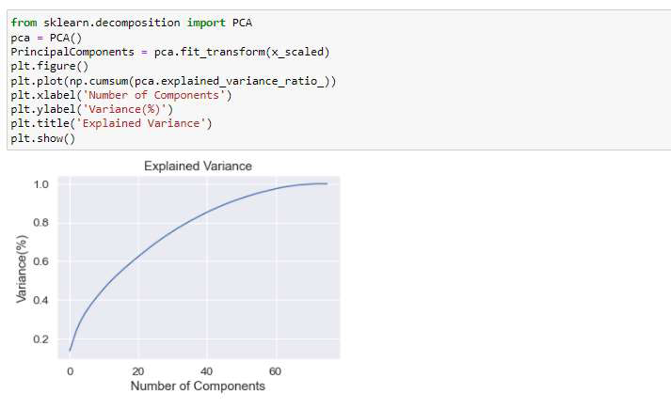
Data pre-processing
PCA is a method to dimension reduction technique where we can find that variance cover at no of components. Here we can see that at 60 components we can cover 90% variance so we can proceed with it to reduct e dimension of data

Slide 21
Data Pre-processing – Standard Scaler
Standard scaling method to reduce error of data set as it scale down all data point towards best fit line. If distance between actual value and predicted value is lower than error ratio is also going to lower.

Slide 22
Linear Regression
Conclusion for linear regression:
On training data, accuracy score is 84%
On testing data, accuracy score is 76%
We got R2 score 76%, which is not good for model.

Slide 23
DecisionTree Regressor
Conclusion for Decision Tree Regressor:
On training set accuracy score is 100% but on testing, set it 55%, which is not good for dataset
because model is not much success to predict testing data accurately.
In Decision Tree Classifier, R2 score is 55%.

Slide 24
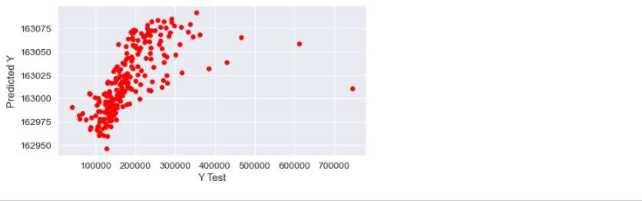
svr
Conclusion on SVR:
Here we can see that accuracy is in minus so this model is not perfect for this data and we will neglect it.

Slide 25
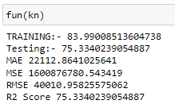
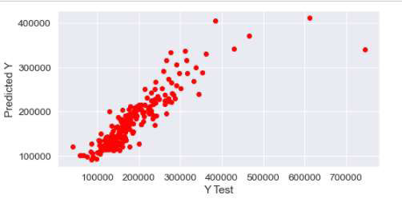
Knn regressor
Conclusion on KNN:
Training score is 84% while testing 75% and R2 score is 75%. Its looking better for prediction compare to
other and as per visualise we can see that data are predicted on one line.

Slide 26
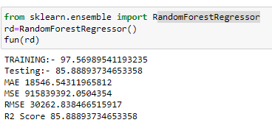
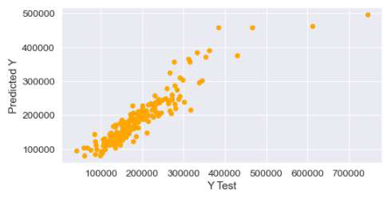
Random Forest Regression
Conclusion on Random Forest Regressor:
We can mark that 86% accuracy in testing dataset and 97% training accuracy. R2 score is 86%.

Slide 27
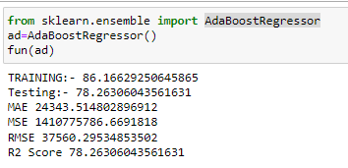
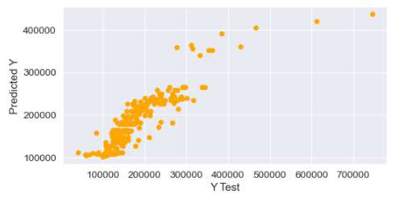
adaboost Regressor
Conclusion on Adaboost Regressor:
We got accuracy of 86% in raining and in testing 78% accuracy.

Slide 28
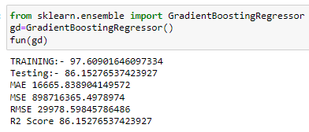
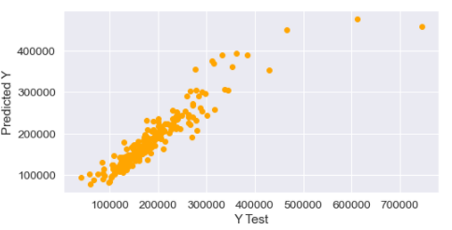
Gradient boost Regressor
Conclusion on gradientboost Regressor:
We got accuracy of 97% in raining and in testing 86% accuracy.
R2 score is 86% and here we can mark that random forest and gradientboost have good accuracy.

Slide 29
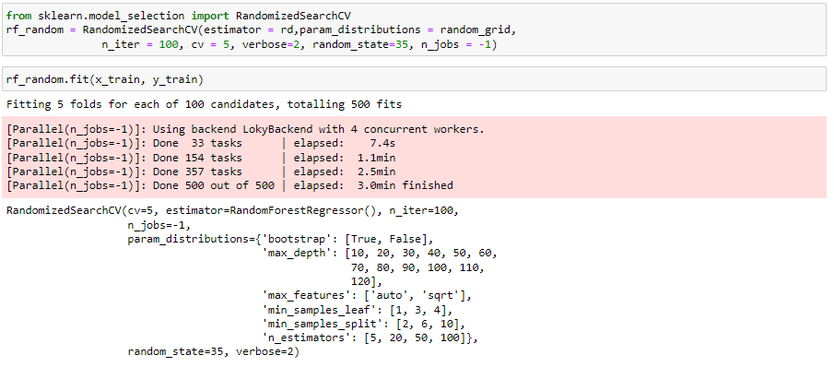
Hyper parameter tuning

Slide 30
Hyper parameter tuning

Slide 31
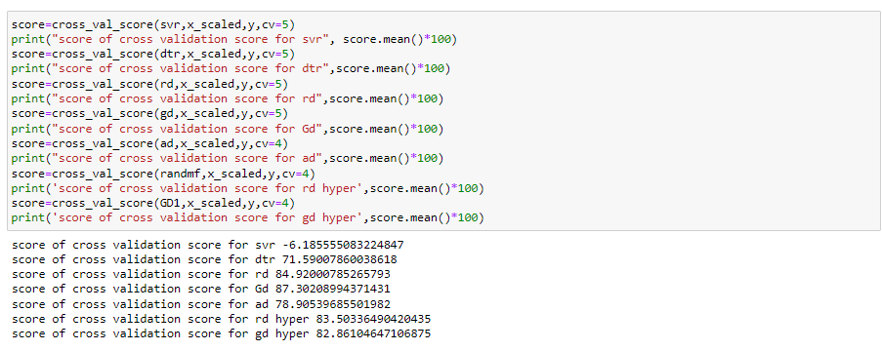
Cross validation technique

Slide 32
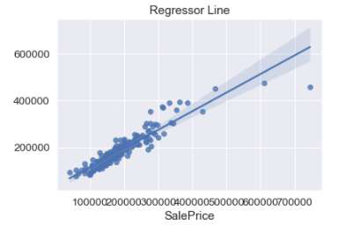
Conclusion

Slide 33
Conclusion
We are getting 87% accuracy in generated model, which is the best model. It will help much to clients to
predict best price of house with concluding all parameters. Top important parameters are OVERALL
QUALITY, LIVING AREA, GARAGE AREA,YEAR BUILT. We need to re-modify this model over the time
with data to cover the trend of market with time.

Slide 34
THANK YOU

