Slide 1
PROJECT TITLE :- CROP RECOMMENDATION
PIP103 University Project-II
Final Review
Batch Number: COM-G29
Roll Number | Student Name
20191COM0211 | UDAY V
20191COM0203 | KISHAN CHAND.T
20191COM0189 | SIDDA REDDY GARI DILLI
20191COM0220 | VELLAMPALLI VISHNU SAI
Under the Supervision of,
Dr.Alamelu Mangai Jothidurai ,Professor
School of Computer Science & Engineering
Presidency University

Slide 2
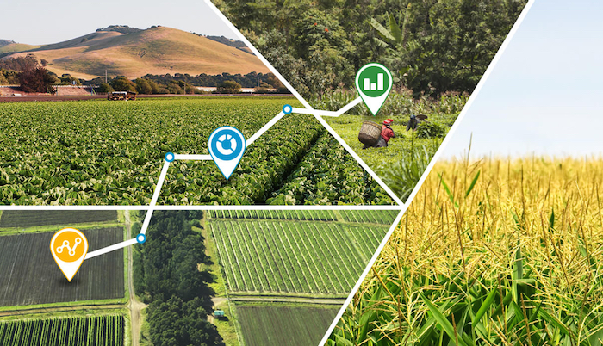
Introduction
INTRODUCTION
India has the Highest Net Cropped Area In The World So It Is Important That The Land Under Cultivation Is Used Efficiently And Extract Maximum Crop Yield, It Is Important To Make Efforts To Use The Resources Effectively And Sustainably. Precision Agriculture Is One Such Concept That Has Revolutionized Agriculture. Precision Agriculture Is An Agriculture Management Strategy That Helps In Improving Crop Yields And Assists In Decision-making Using Large Amounts Of Sensorial Data And Information As Well As Analysis Tools. Technologies Like Iot, Artificial Intelligence, And Cloud Computing Are Deployed For The Collection Of Data Related To Land, Weather Conditions, Fertilizers Water Management, And Soil Fertility

Slide 3
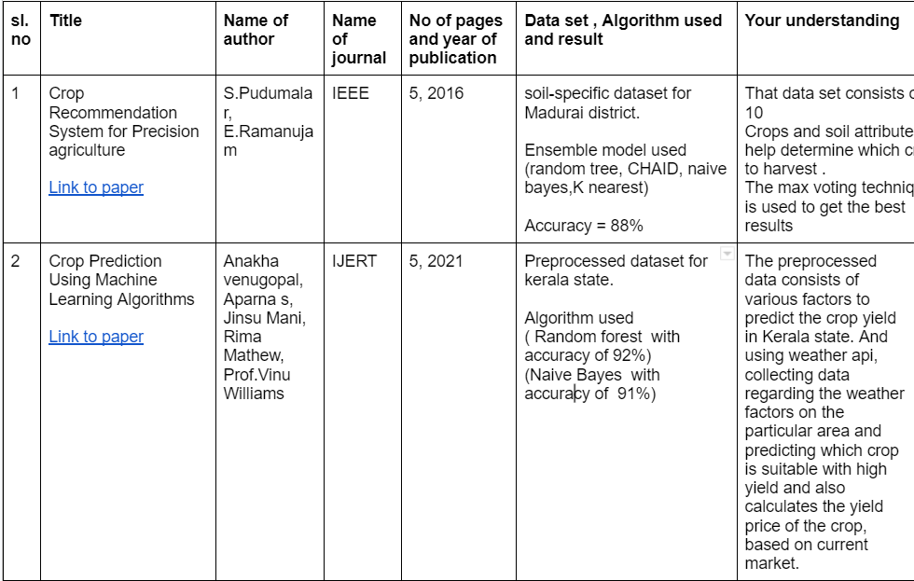
Literature Review

Slide 4
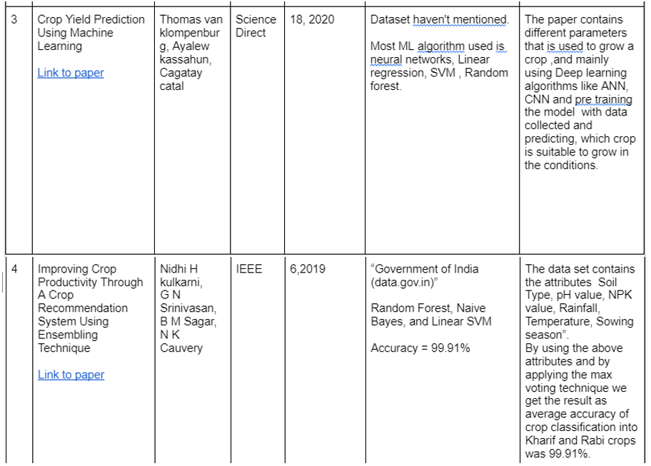

Slide 5
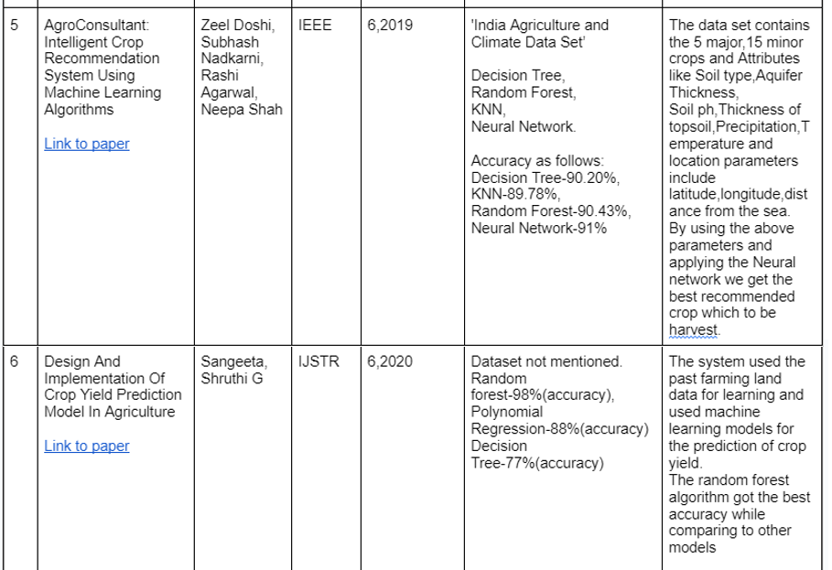
Literature Survey document --->
click here

Slide 6
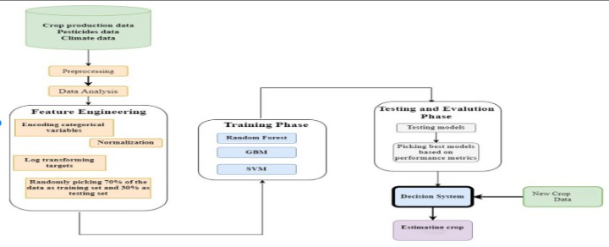
Proposed Method

Slide 7
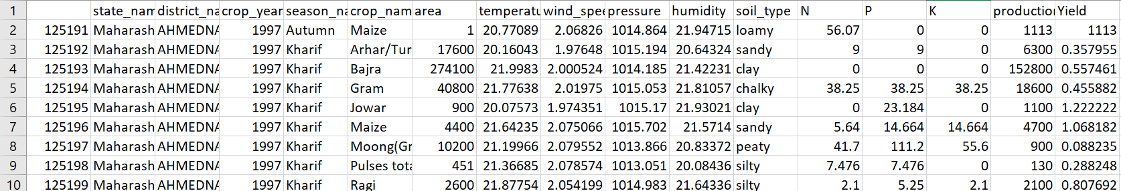
Data Description
Fig.1 Small Snippet of Data
Dataset consists of total 12,629 records with 17 attributes

Slide 8
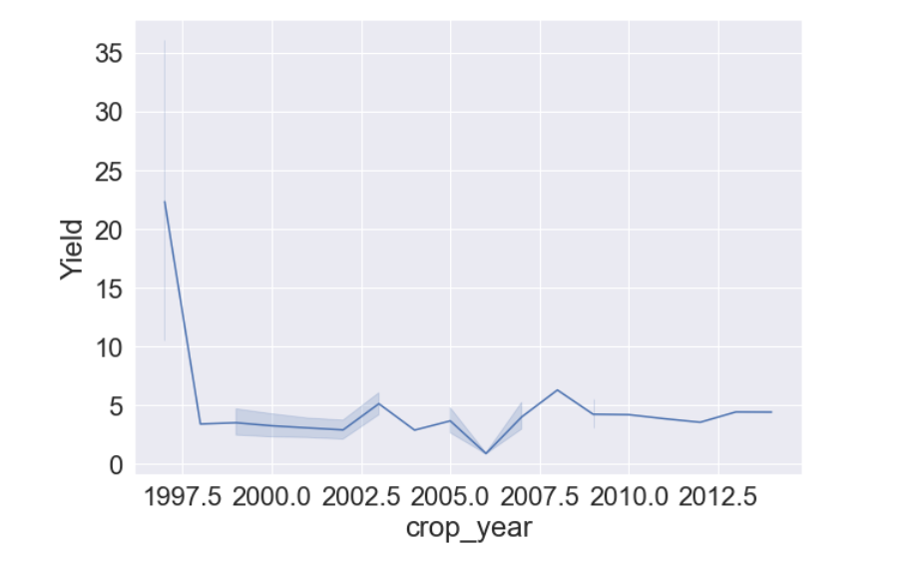
Considering the data from the year 2000, By this we can get rid off high Variance and low bias.
Fig 2. Yield distribution across the years

Slide 9
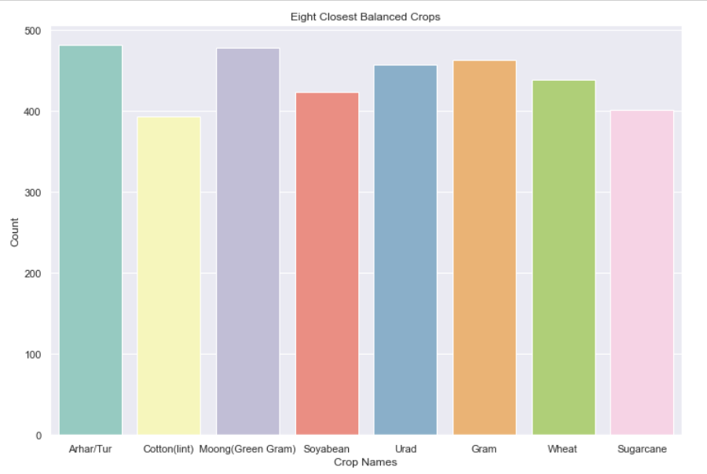
Data Pre-Processing
Removing Null Values
Performing Feature Engineering & Feature Selection
Out of 34 crops we are only performing Classification for the best 8 balanced crops

Slide 10
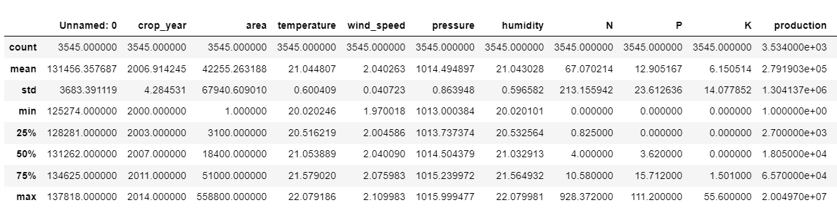
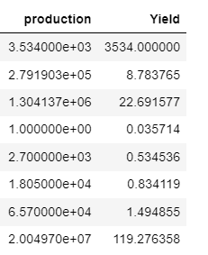
Fig. 3 Stats of 8 crops data

Slide 11
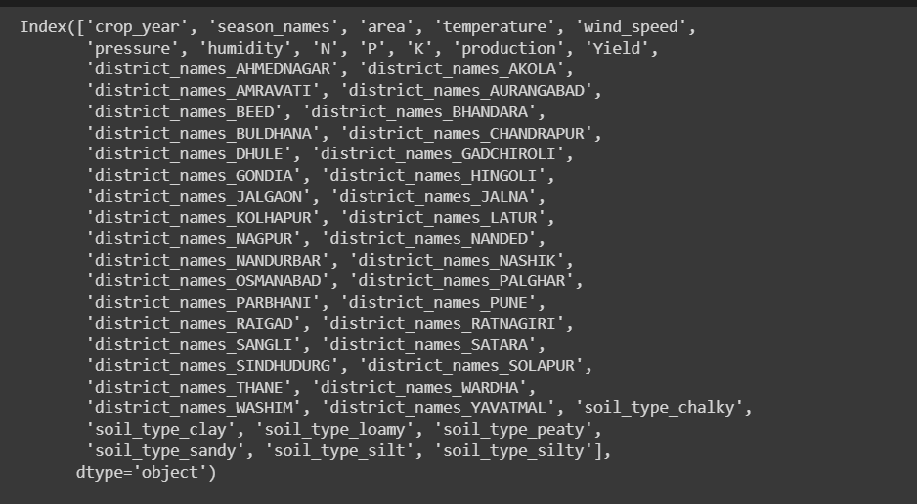

Results Achieved
One-hot encoded data columns
Shape of this data set

Slide 12
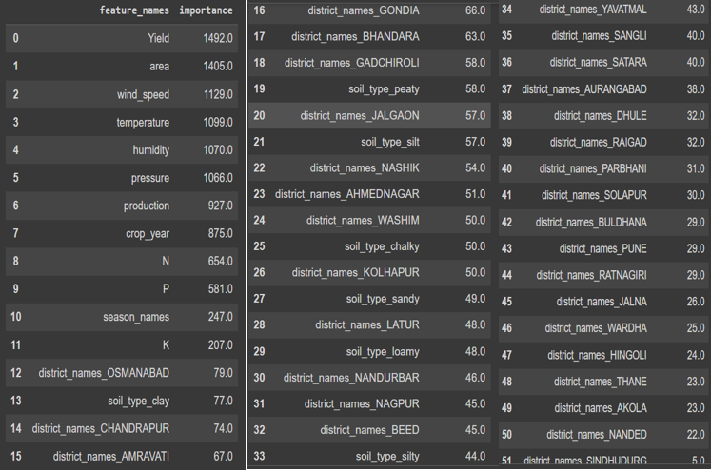
Results Achieved
XGB Classifier Feature importance

Slide 13
Results Achieved
Algorithm | Accuracy | Precision | Recall | AUC
Decision Tree | 0.62 | 0.63 | 0.62 | 0.81
Random Forest | 0.66 | 0.67 | 0.66 | 0.93
XG Boost | 0.70 | 0.71 | 0.70 | 0.95
KNN | 0.47 | 0.49 | 0.47 | 0.84
Naïve Bayes | 0.33 | 0.40 | 0.33 | 0.71
XGBoost is the better performing algorithm compared to others trained.
This Decision is made mainly because of its AUC value, and Accuracy.

Slide 14
Advantages
Improved decision making
Data driven approach
Scalability of the project
Accessibility

Slide 15
Hardware Requirements
A computer with a multi-core processor (at least 2 cores) and a minimum of 8 GB of RAM.
A GPU (Graphics Processing Unit) with a minimum of 4GB of memory for faster training of deep learning models.
Sufficient storage space for the dataset and trained models.

Slide 16
Software Requirements
An operating system such as Windows, Linux or macOS.
Python, which is the most commonly used language for ML projects.
ML libraries like Scikit-learn, TensorFlow, PyTorch, Keras, and Pandas.
IDE (Integrated Development Environment) like Jupyter Notebook or PyCharm for writing and testing code.
Version control software like Git and Github for collaboration and code management.

Slide 17
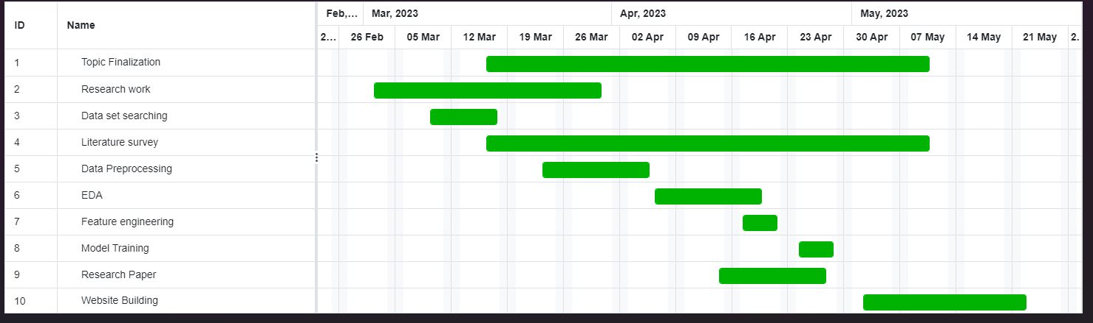
Timeline of Project

Slide 18
Conclusion
Finally, our crop recommendation project has demonstrated the effectiveness of using machine learning algorithms to provide crop selection recommendations to farmers.
XGBoost being the better performing algorithm with an accuracy of 70% and AUC of 0.95, there is still room for improvement.
The findings and future work outlined above serve as a road map for additional research and development in this field, with the goal of providing farmers with reliable and effective crop recommendation solutions.

Slide 19
References
[1] Z. Doshi, S. Nadkarni, R. Agrawal and N. Shah,"Agro Consultant: Intelligent Crop Recommendation System Using Machine Learning Algorithms," 2018 Fourth International Conference on Computing Communication Control and Automation (ICCUBEA), Pune, India, 2018, pp. 1-6, doi: 10.1109/ICCUBEA.2018.8697349
[2] S.Pudumalar, E. Ramanujam, R. H. Rajashree, C. Kavya, T. Kiruthika and J. Nisha, "Crop recommendation system for precision agriculture," 2016 Eighth International Conference on Advanced Computing (ICoAC), Chennai, India, 2017, pp. 32-36, doi: 10.1109/ICoAC.2017.7951740
[3] N. H. Kulkarni, G. N. Srinivasan, B. M. Sagar and N. K. Cauvery, "Improving Crop Productivity Through A Crop Recommendation System Using Ensembling Technique," 2018 3rd International Conference on Computational Systems and Information Technology for Sustainable Solutions (CSITSS), Bengaluru, India, 2018, pp. 114-119, doi: 10.1109/CSITSS.2018.8768790
[4] Anakha Venugopal, Aparna S, Jinsu Mani, Rima Mathew, Vinu Williams, 2021, Crop Yield Prediction using Machine Learning Algorithms, International Journal Of Engineering Research & Technology (Ijert) Ncreis – 2021 (Volume 09 – Issue 13).
[5] A Hybrid Approach For Crop Yield Prediction Using Machine Learning And Deep Learning Algorithms Citation Sonal Agarwal and Sandhya Tarar 2021 J. Phys.: Conf. Ser. 1714 012012 DOI 10.1088/1742-6596/1714/1/012012
[6] Design And Implementation Of Crop Yield Prediction Model In Agriculture Sangeeta, Shruthi G, International Journal Of Scientific & Technology Research Volume 8, Issue 01, January 2020.
[7] "Crop Recommendation System using Machine Learning" Dhruvi Gosai, Chintal Raval, Rikin Nayak, Hardik Jayswal, Axat Patel. International Journal of Scientific Research in Computer Science, Engineering and Information Technology
[8] N. N. Thilakarathne, M. S. A. Bakar, P. E. Abas, and H. Yassin, “A Cloud Enabled Crop Recommendation Platform for Machine Learning-Driven Precision Farming,” Sensors, vol. 22, no. 16, p. 6299, Aug. 2022,
[9] Crop Recommendation System To Maximize Crop Yield Using Deep Neural Network Vol 12,Issue 11, Nov /2021 Issn No:0377-9254
[10] Dighe, Deepti, Harsh H. Joshi, Aishwarya Katkar, Snehal S. Patil and Shrikant Kokate. “Survey of Crop Recommendation Systems.” (2018).

Slide 20
References
[11] Improvement of Crop Production Using Recommender System by Weather Forecasts Bangaru Kamatchi, R. Parvathi
[12] Data Mining Techniques and Applications to Agricultural Yield Data D Ramesh , B Vishnu Vardhan, International Journal of Advanced Research in Computer and Communication Engineering Vol. 2, Issue 9, September 2013
[13] N. N. Jambhulkar Modeling of Rice Production in West Bengal International Journal of Scientific Research, Vol: 2, Issue: 7 July 2013
[14] Li Hong-ying, Hou Yan-lin, Zhou Yong-juan, Zhao Hui-ming, Crop Yield Forecasted Model Based on Time Series Techniques, Journal of Northeast Agricultural University (English edition),Volume 19, Issue 1,2012,Pages 73-77,ISSN 1006-8104,https://doi.org/10.1016/S1006-8104(12)60042-7
[15] Masood, M. A., Raza, I. ., & Abid, S. . (2019). Forecasting Wheat Production Using Time Series Models in Pakistan. Asian Journal of Agriculture and Rural Development, 8(2), 172 177.
[16] Enrichment of Crop Yield Prophecy Using Machine Learning AlgorithmsR. Kingsy Grace, K. Induja and M. Lincy
[17] Thomas van Klompenburg, Ayalew Kassahun, Cagatay Catal, Crop yield prediction using machine learning: A systematic literature review, Computers and Electronics in Agriculture, Volume 177,2020,105709,ISSN 0168-1699
[18] Data analytics for crop management: a big data view Nabila Chergui and Mohand Tahar Kechadi
[19] "Crop Yield Prediction In Agriculture Using Data Mining Predictive Analytic Techniques", Ijrar - International Journal Of Research And Analytical Reviews (Ijrar), E-Issn 2348-1269, P- Issn 2349-5138, Volume.5, Issue 4, Page No Pp.783-787, December 2018,
[20] Champaneri, Mayank & Chachpara, Darpan & Chandvidkar, Chaitanya & Rathod, Mansing. (2020). CROP YIELD PREDICTION USING MACHINE LEARNING. International Journal of Science and Research (IJSR). 9. 2.
[21] Crop Variety Selection Method using Machine Learning G. Vishwa, J. Venkatesh, Dr. C. Geetha, http://dx.doi.org/10.21172/ijiet.124.05
[22] Crop Prediction using Machine Learning N.L. Chourasiya, P. Modi , N. Shaikh3 , D. Khandagale, S. Pawar, IOSR Journal of Engineering (IOSR JEN) ISSN (e): 2250-3021, ISSN (p): 2278-8719 PP 06-10

Slide 21

Thank You

