Slide 1

EXECELERATE DATA DASHBOARD : UNVEILING USER BEHAVIOR AND ENGAGEMENT TRENDS

Slide 2


TEAM MEMBERS
KISHAN CHAND
ANIKET GALANDE
Team Lead & Project Manager
Project Lead & Project Scribe

Slide 3
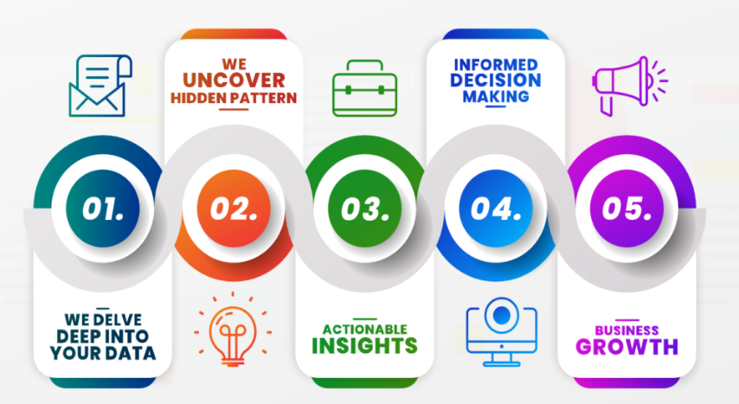
THE JOURNEY - FROM DATA TO INSIGHT

Slide 4
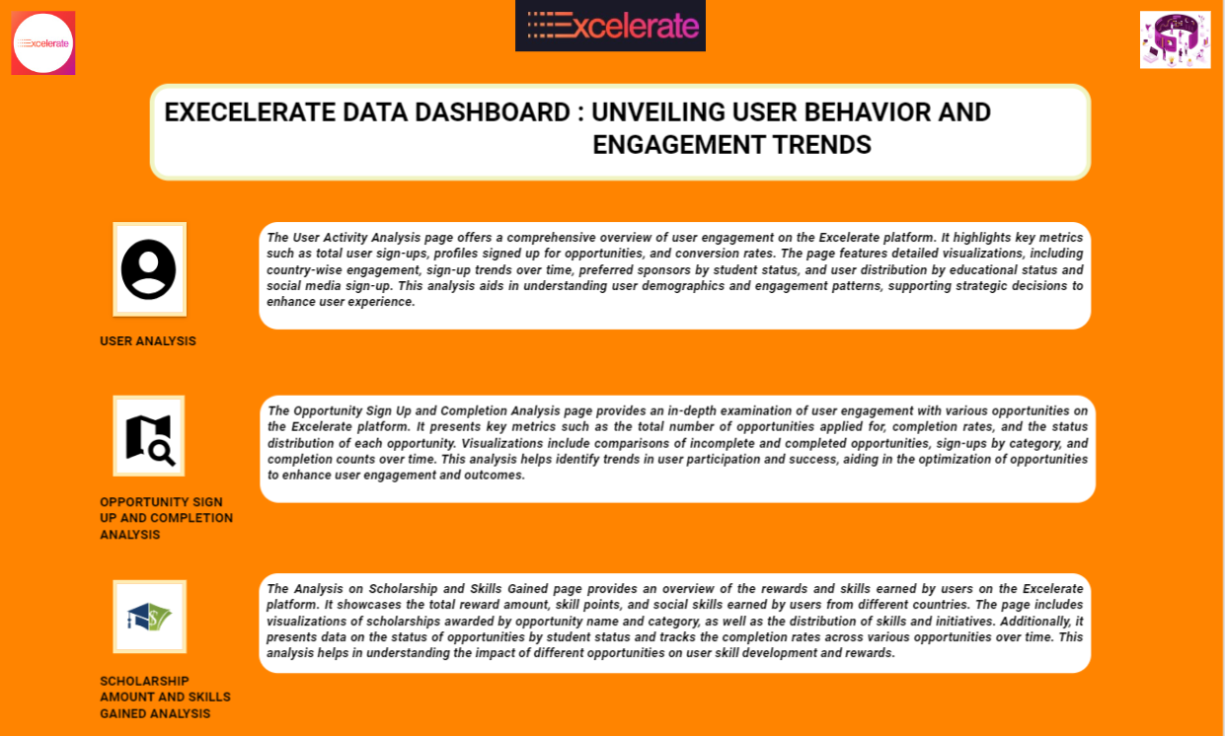
DASHBOARD OVERVIEW

Slide 5
KEY DECISIONS MADE DURING THE DASHBOARD CREATION PROCESS:
Focused Segmentation:
The dashboard is segmented into three key areas: User Analysis, Opportunity Sign Up and Completion Analysis, and Scholarship Amount and Skills Gained Analysis. This segmentation allows for targeted analysis and clearer insights into specific aspects of user engagement.
Data Granularity:
We chose to present detailed metrics such as total user sign-ups, profiles signed up for opportunities, Completion rate %, conversion rates ,Total scholarship Amount Rewarded and Skil points Earned. This granularity helps stakeholders understand the effectiveness of various initiatives and user behaviors in a comprehensive manner.
Time-Based Trends:
Incorporating time-based visualizations, such as sign-up trends over time, enables stakeholders to identify patterns and the impact of different periods on user activity. This helps in planning and optimizing future campaigns or initiatives.

Slide 6
CHALLENGES FACED
USER DATASET:
Date and Time Formatting: Mixed formats in a single column.
Preferred Sponsors: Inconsistent data with varying numbers of sponsors.
Primary Key Absence: No primary key for linking records.
Blank Spaces and Invalid Entries: Issues in gender, city, country, zip, and degree columns.
OPPORTUNITY DATASET:
Date Columns: Improperly formatted apply, start, and end dates.
Current Student Status and Intended Major: Blank spaces and invalid entries.
Badge ID, Badge Name, and Skill Points Earned: Contained blank spaces.
Zip, Gender, City, Country, and State Columns: Similar issues as the user dataset.
Reward Amount Column: Blank cells.
Skills Earned Column: Inconsistent entries.

Slide 7
SOLUTIONS IMPLEMENTED
1.USER DATASET:
Date and Time Formatting: Separated into distinct columns and standardized.
Preferred Sponsors: One-hot encoded.
Primary Key Addition: Added a serial number column.
Handling Blank Spaces and Invalid Entries: corrected entries in gender, city, country, zip, and degree columns
2. OPPORTUNITY DATASET:
Date Columns: Separated and standardized.
Current Student Status and Intended Major: Corrected blank spaces and invalid entries.
Badge ID, Badge Name, and Skill Points Earned: Replaced blank spaces.
Zip, Gender, City, Country, and State Columns: Applied same fixes as the user dataset.
Reward Amount Column: Replaced blank cells with 0.
Skills Earned Column: One-hot encoded.

Slide 8
INSIGHTS DERIVED
1. User Engagement:
- Total Sign-ups: The platform has 27,562 users.
- Opportunity Sign-ups: 11,481 users have signed up for opportunities, resulting in a 41.66% conversion rate.
2. Geographical Insights:
- Top Countries: The majority of users are from India (11,893), followed by Nigeria (4,357), and the USA (3,691).
3. Opportunity Popularity:
- Most Popular: Opportunities like Data Visualization, Project Management, and Digital Marketing have the highest sign-ups.
- Completion Rate: Out of 20,322 sign-ups, 2,521 opportunities were completed, indicating a 12.41% completion rate.
4. Demographics:
- Student Status: Users are primarily undergraduate students (6,527), followed by graduate students (6,015), and those not in education (2,646).
- Gender Split: The gender distribution is nearly equal with 50.1% female and 49.9% male users.
5. Skills and Scholarships:
- Most Gained Skills: Users have primarily gained skills in critical thinking , communication, and creative thinking.
- Total Scholarships: A total of 2,725,860 has been awarded, with the highest amounts going to India (1,459,070), USA
(427,980), and Nigeria (414,830).

Slide 9
ADDRESSING KEY QUESTIONS
1. Total Platform and Opportunity Sign-ups:
- Answer: 27,562 platform sign-ups, 11,481 opportunity sign-ups.
- Dashboard Contribution: Metrics displayed on the homepage.
2. Top 10 Countries:
- Answer: India, Nigeria, USA, Pakistan, Ghana, Egypt, Bangladesh, Kenya, Vietnam, Nepal.
- Dashboard Contribution: Listed in the "User Activity Analysis" section.
3. US Cities:
- Answer: St louis, Chicago, Naperville, Maryland
- Dashboard Contribution: Detailed geographical analysis via filter options.
4. Most Popular Opportunity:
- Answer: Data Visualization and Project Management.
- Dashboard Contribution: Shown in the "Learners Signed Up by Opportunity" section.

Slide 10
ADDRESSING KEY QUESTIONS
5. Most Popular Completed Opportunity:
- Answer: Data Visualization and Project Management.
- Dashboard Contribution: Highlighted in the "Completion Count by Opportunity" section.
6. Demographics of Sign-ups and Completions:
- Answer: Majority are undergraduate students, nearly equal gender split.
- Dashboard Contribution: "Users Split By Student Status" and gender distribution charts.
7. Most Gained Skills:
- Answer: critical thinking, communication, creative thinking.
- Dashboard Contribution: Detailed in the "Skill Points Earned" section.
8. Total Scholarship Awarded:
- Answer: 2,725,860 awarded, highest amounts to India.
- Dashboard Contribution: Detailed in the "Scholarship Awarded by Opportunity Name" section.

Slide 11
USER INTERACTION AND GUIDANCE FEATURES:
NAVIGATION MENUS:
Provide clear menus or tabs to categorize different sections of the dashboard, such as User activity, opportunity sign up and completion analysis And Scholarship And Skills Gained Analysis .
INTERACTIVE FILTERS:
Implement filters that allow users to dynamically adjust data based on criteria like date ranges, geographic regions, or user segments.

Slide 12
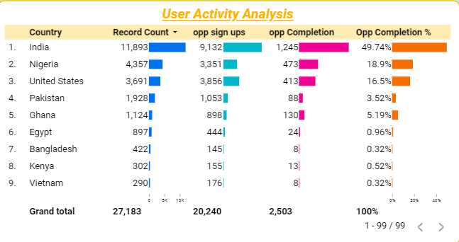
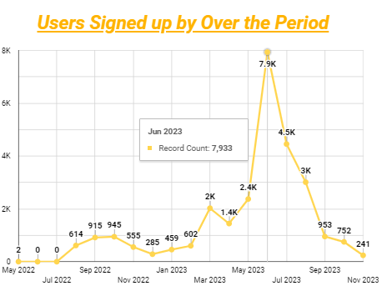
VISUAL HIGHLIGHTS
User Distribution Highlights the top countries by user count (India, Nigeria, USA), essential for understanding geographical market penetration.
Enables the creation of targeted engagement strategies based on user location.
significant trends in user engagement, highlighting peaks during June 2023 and other key periods, which can be linked to successful events or campaigns.
It aids in identifying effective strategies and periods of high engagement for future planning while also pointing out times of low sign-ups for potential improvement. This information is crucial for optimizing marketing campaigns, feature releases, and overall user retention strategies.

Slide 13
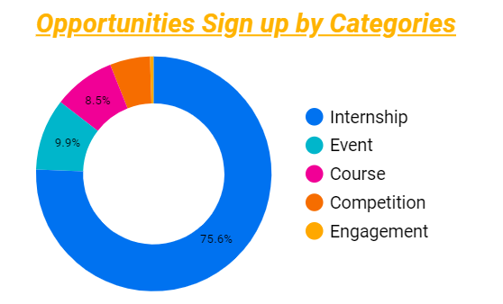
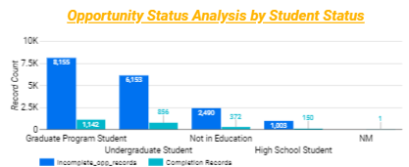
Demonstrates user interest across various opportunity categories, allowing for targeted improvements and promotions in popular categories to boost engagement further.
Compares engagement and success rates among different student statuses, helping to identify which groups are most engaged and which may need additional support.

Slide 14
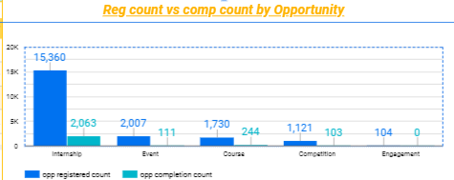
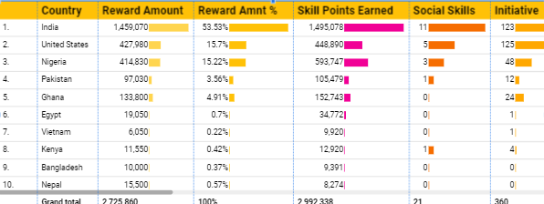
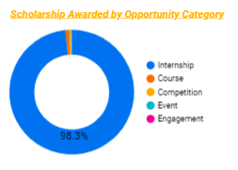
Highlights the disparity between registrations and completions for each opportunity, identifying opportunities that may need intervention to improve completion rates.
Provides a detailed breakdown of rewards across different countries and student statuses, showcasing the platform's impact on users and helping to tailor future reward strategies.
Highlights which categories are most associated with scholarships, guiding the allocation of resources and development of new opportunities to maximize scholarship impact.

Slide 15
IMPACT ON DECISION-MAKING
Strategic Planning: Optimize marketing and resource allocation.
Informed Decisions: Focus on popular opportunities.
Targeted Engagement: Tailor outreach based on demographics.
Performance Tracking: Identify and fix issues.

Slide 16


