Slide 1
N-Queen Game
The eight rulers riddle
By,
Patel Vishal B. (1054821)
Kishan Gabani (1116169)
Sanket Lad (1131716)
Prof. Dr. Wenjia lee
Spring 2016-M02
Programming Languages CSCI_621

Slide 2
What is all about
The eight rulers riddle is the issue of putting eight chess rulers on a 8×8 chessboard so that no two rulers debilitate each other.
This riddle was published as a 8x8 matrics, but it is expanded to N-Queen riddle.
Where person has to enter the dimension and the queen numbers, and have to arrange that queens.

Slide 3
Let’s see the past
Was first introduced by Chess arranger, Max Bezzel ans distributed the eight rulers riddle in 1848.
From that point forward, numerous mathematicians, including Carl Friedrich Gauss, have taken a shot at both the eight rulers riddle and it’s summed up n-rulers form.
In 1972 Edsger Dijkstra utilized this issue to show the force of what he called organized programming.

Slide 4
Take it to the Solution
This issue can be very computationally costly as there are 4,426,165,368 game plans “and that’s a lot”.
The eight rulers riddle has 92 particular arrangements
On the off chance that arrangements that contrast just by symmetry operations (revolutions and reflections) of the board are considered one, the riddle has 12 crucial arrangements.

Slide 5
Cont..
On the off chance that arrangements that contrast just by symmetry operations (revolutions and reflections) of the board are considered one, the riddle has 12 crucial arrangements.
Of the 12 essential answers for the issue with eight rulers on a 8x8 board, precisely one is equivalent to its own particular 180 degree turn, and none are equivalent to their 90 degree revolution, along these lines the quantity of unmistakable arrangements is 11*8 + 1*4 = 92!

Slide 6
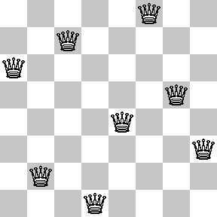
Cont..
Figure shows the arrangements of
8 queens on a 8x8 chessboard

Slide 7
Cont..
Inconsequentially, there is stand out answer for a 1 x 1 board, and it's not hard to see that there are no conceivable answers for a 2 x 2 or 3 x 3 measured board.
It's fascinating that, whilst there are 10 answers for a 5 x 5 board.
But what with 10x10, with 15x15 even more with 26x26, kind of shocking! And that gives 22,317,699,616,364,000 total solutions with 2,789,712,466,510,280 unique ones.

Slide 8
Our approach
This riddle is for 8x8 matric, we are building up a JAVA application in which we can choose the estimation of n, attempting to make it dynamic.
Where n can be up to player and from the estimation of n, the board will be made in jpanel.
We are additionally giving an answer catch which demonstrates the all conceivable positions to the player, so player can take an assistance of PC to get the answer.

Slide 9
Algorithm
1) Start in the furthest left segment
2) If all rulers are set
return true
3) Try all lines in the present segment. Do taking after for each attempted column.
a) If the ruler can be set securely in this line then stamp this [row, column] as a major aspect of the arrangement and recursively check if putting ruler here prompts an answer.
b) If setting ruler in [row, column] prompts an answer then return true.
c) If setting ruler doesn't prompt an answer then unmark this [row, column] (Backtrack) and go to step (a) to attempt different lines.
3) If the sum total of what lines have been attempted and nothing worked, return false to trigger backtracking.

Slide 10
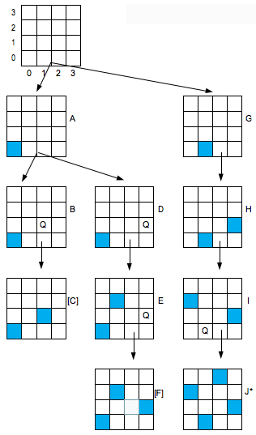
How it really goes
Each ruler is doled out an other section, so the primary concern left to check is whether two rulers are in the same corner to corner.

Slide 11
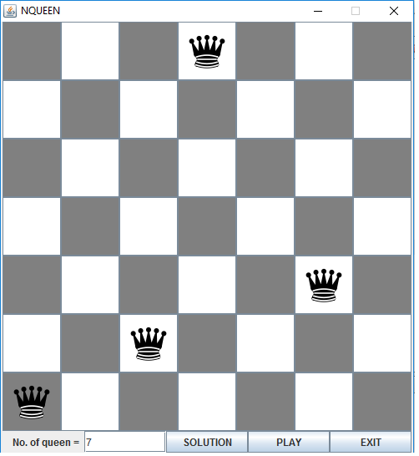
Working
As the image shows the 7x7 chessboard is ready to be poted by 7 queens after giving it input as a 7
All queens are potted one by one on its location but should not be in a row, column or in a diagonal.

Slide 12
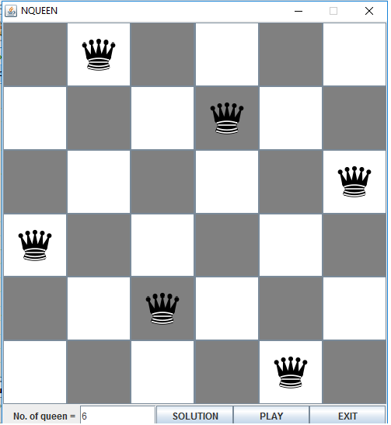
Shows the solution of 6x6 matrics with all potted queens on the perfect locations, user can put by himself or can be it done by computer (can be said by java program) by pressing solution button too

Slide 13
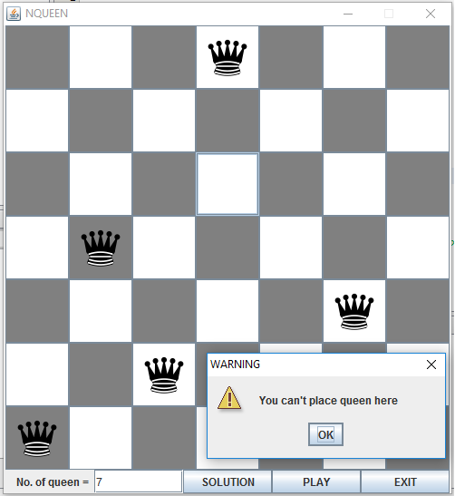
Shows a message when queen is placed on the same column, which is not possible.

Slide 14
Conclsion
N-Queen is proposed to illuminate the riddle to pt 8 rulers on a chessboard without collaborating with each other in a solitary line, section or being in a corner to corner.
What was it before ?
how it is unraveled
How we tackled it utilizing java project.

Slide 15
References
http://en.literateprograms.org/Eight_queens_puzzle_%28C%29
http://en.wikipedia.org/wiki/Eight_queens_puzzle
Y.Daniel Liang “Introduction to Java Programming, 7th edition”,Prentice Hall,2008.
Big Java ,2nd edition, Cay Horstman, Wiley Student Edition , Wiely India Private Limited.
Herbert Schildt “The Complete Reference Java, J2SE 5th edition”, Tata McGraw Hill Edition,2007.
Bitner, J.R. and E.M. Reingold (1975), "Backtracking programming techniques," Communications of the ACM, Vol. 18, No. 11, pp. 651-56.
Bitner, J.R. and E.M. Reingold (1975), "Backtracking programmingtechniques," Communications of the ACM, Vol. 18, No.11, pp. 651-56. Herbert Schildt “The Complete Reference Java, J2SE 5th edition”, Tata McGraw Hill Edition,2007.
http://www.java.ahchuthan.org/2012/02/n-queens-problem-in-java.html

