Slide 1
ProcureIntel
Procurement intelligence on World Bank open data
A chat-first, AI-assisted platform built as a micro-frontend demo
KISHAN K C
Live deployment: https://procurement-intelligence-p7q751lm8-kishans-projects-3ea8dea8.vercel.app/
React 19 · TypeScript · Module Federation · TanStack Query · CopilotKit
Notes:
Open by saying what this is: a front-end demo over real, ingested World Bank snapshots. It is an independent demonstration, not an official World Bank product.

Slide 2
Contents
Select a topic to jump to its first slide
1
Overview
Slides 3 to 6
2
Architecture
Slides 7 to 8
3
Trust and evidence
Slides 9 to 13
4
Analysis and monitoring
Slides 14 to 16
5
Ingestion
Slides 17 to 18
6
Your own procurement
Slides 19 to 20
7
Learning
Slides 21 to 22
8
Quality and wrap-up
Slides 23 to 27
ProcureIntel Procurement intelligence on World Bank open data
Notes:
Topic headings with the slide ranges. Each heading links to the first slide of its range.

Slide 3
A chat that answers with live cards
Ask in plain words; the assistant draws the lifecycle from stored data
1
Planning
2
Tender design
3
Monitoring
4
Learning
stored: Plans executed
stored: Tenders published
stored: Evaluation
stored: Feedback
Plans, timeline, country context, plan rows read from World Bank plans
Published tenders; clauses compared with plans and public contracts
Disbursement vs. time, warning signals, schedule Gantt
Feedback queue, data readiness, update log
Two modes. Review shows only what is on record for a stored project. Suggest estimates a plan, tender clauses and monitoring for your own new procurement, from medians of similar real projects.
ProcureIntel Procurement intelligence on World Bank open data
Notes:
The four stages keep their planning names for your own lifecycle and the generic donut. For a stored project the tabs read Plans executed, Tenders published, Evaluation, Feedback. The ids stay planning, tender-design, monitoring, learning in code.

Slide 4
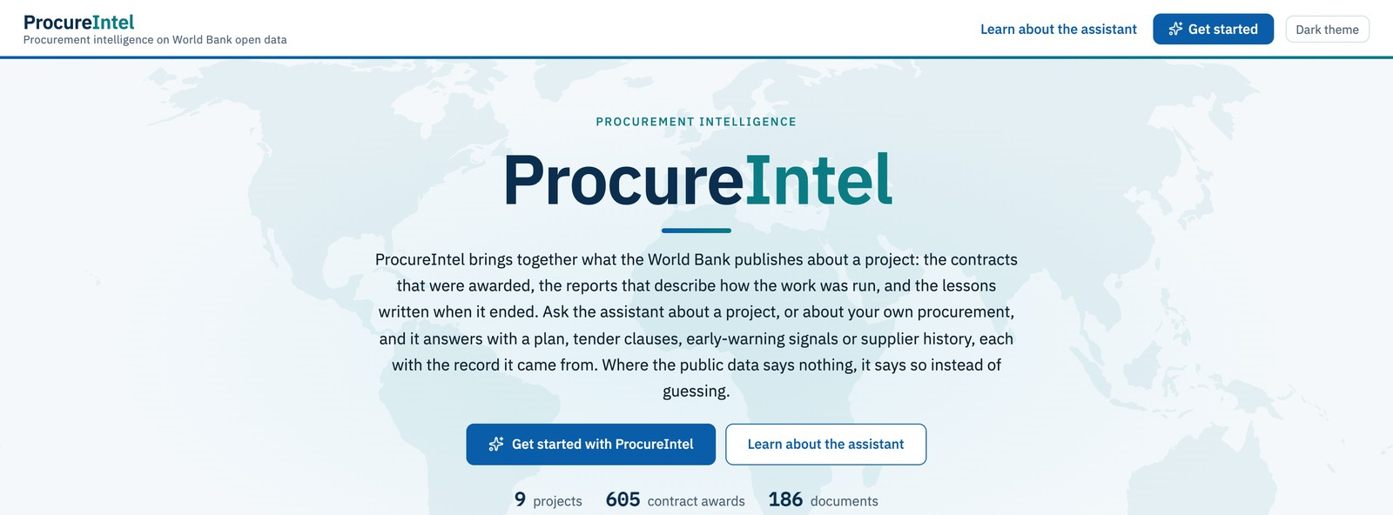
Where users start
Counts come from the stored data
Counted, not typed
9 projects, 605 contract awards and 186 documents, read from the data.
Independent demo
Not an official World Bank product; no World Bank logos.
Landing page of the running app
ProcureIntel Procurement intelligence on World Bank open data
Notes:
Screenshot from the running app on 2026-11-05. The footer on every page says it is an independent demonstration.

Slide 5
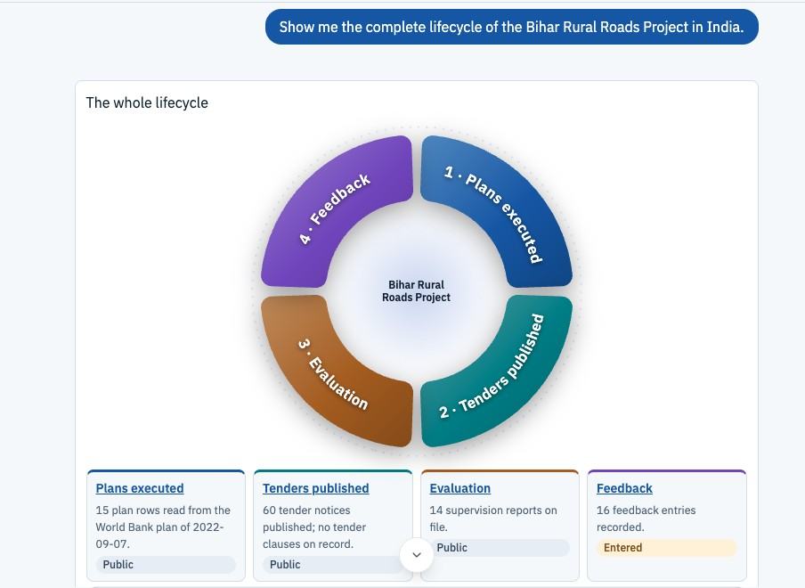
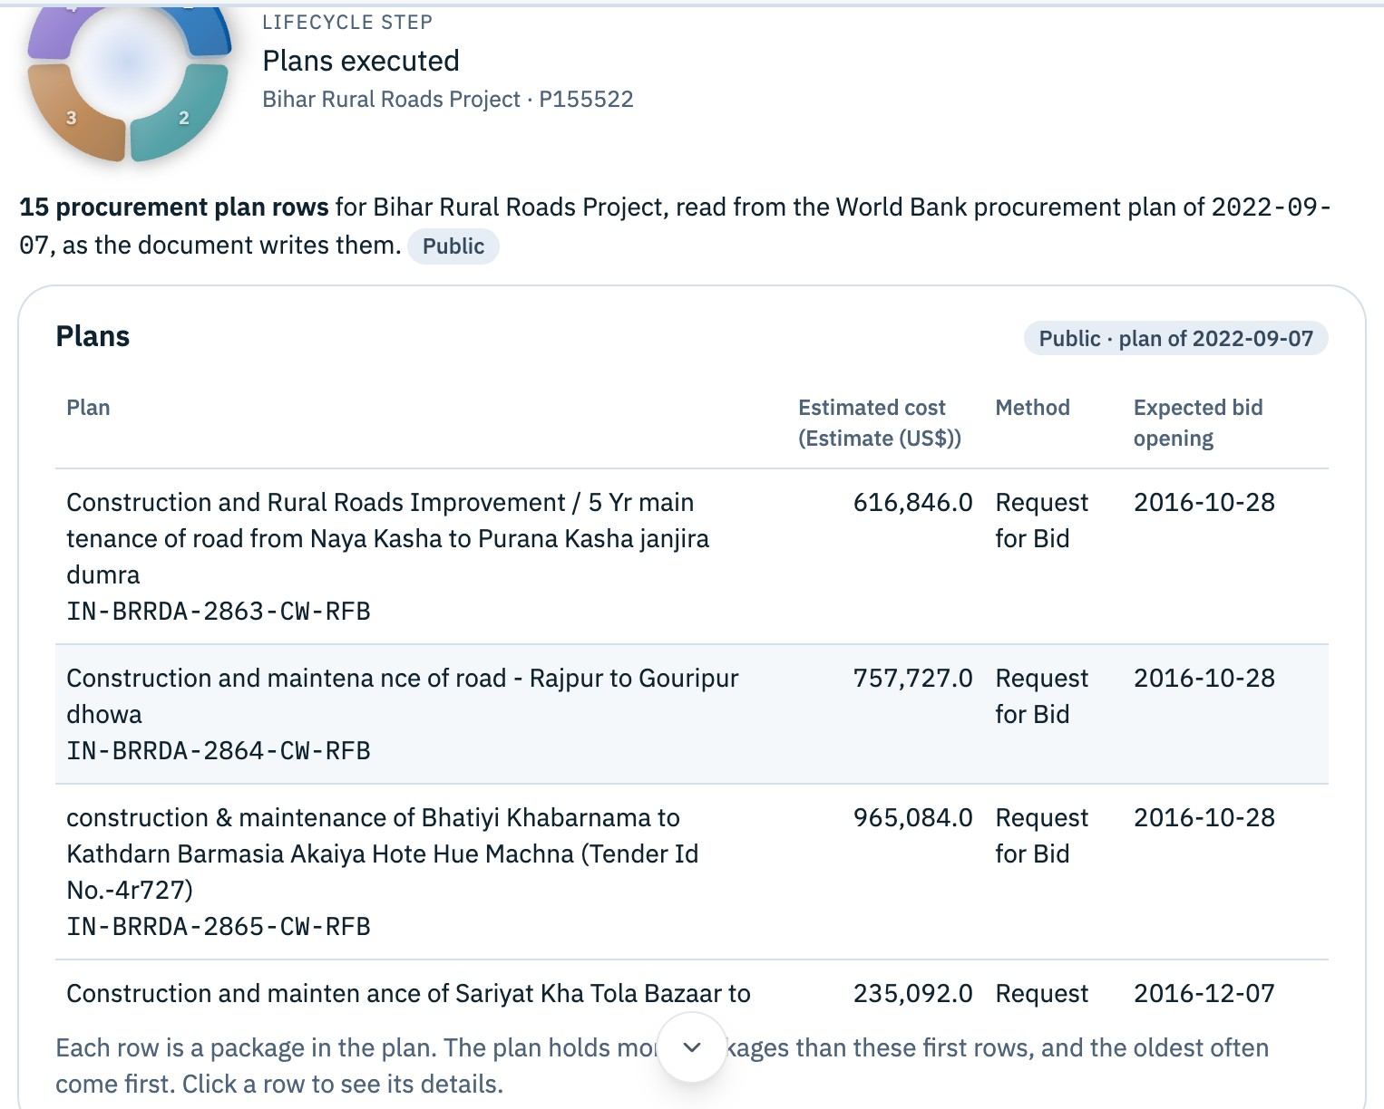
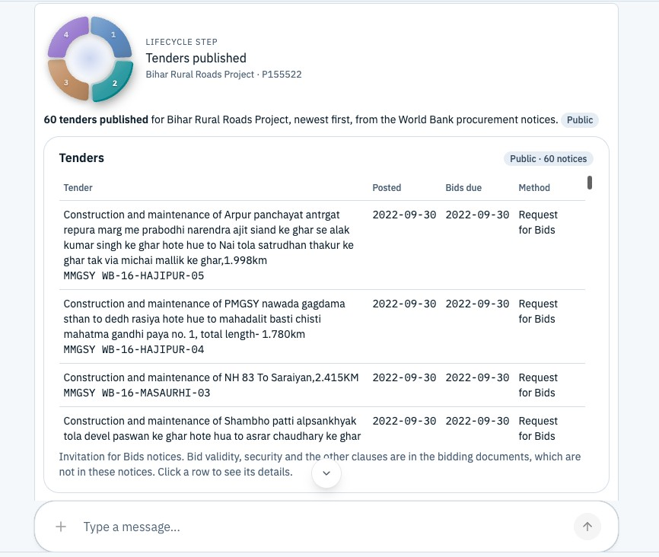
Review a stored project
Everything shown is on record; where there is nothing, it says so
The whole lifecycle of a real project
Plans executed: 15 plan rows from the World Bank plan
Tenders published: 60 notices
ProcureIntel Procurement intelligence on World Bank open data
Notes:
Bihar Rural Roads Project (P155522). In review mode nothing is estimated: the cards show plan rows read from the World Bank procurement plan and Invitation for Bids notices, each with a Public chip.

Slide 6
What is stored today
Counted from the stored data on 2026-11-05
9
605
186
115
road projects
contract awards
documents
published tenders
Cambodia, India, Lao PDR, Liberia, Vietnam
455 suppliers
2,445 text chunks
88 plan rows read from procurement plans
Four public sources
Projects, Contract Awards, Documents and Procurement Notices APIs.
22 assistant tools
Server tools that read this data, and browser tools that draw it.
ProcureIntel Procurement intelligence on World Bank open data
Notes:
Counts are for the real World Bank projects in the stored data: 9 projects, 605 contracts, 455 distinct suppliers, 186 documents, 2,445 chunks, 115 tender notices, 88 plan rows. They move when a project is ingested. 22 server tools is from docs/architecture/copilot-engine.md.

Slide 7
One host, four remotes, shared singletons
SHELL (host, :5173)
Data API
json-server on :3001 serves the stored data: ingested World Bank snapshots. A reset command rebuilds it.
Landing, chat page and its cards, routing, filter rail, theme, the one QueryClient
Planning
:5174
Monitoring
:5175
Learning
:5176
AI
:5177
Remotes expose pages and cards over Module Federation; each sits in its own error boundary and Suspense fallback
Assistant :3002
Copilot runtime (AG-UI over HTTP) and ingestion routes. On Vercel the same logic runs as plain JS functions.
Shared singletons: react, react-dom, react-router, react-query, zustand, @pi/data, @pi/events, @pi/config, @pi/ui, @pi/domain
ProcureIntel Procurement intelligence on World Bank open data
Notes:
Remotes never import from the shell or from each other, only @pi/* packages. ui and domain import nothing from apps, so they can be swapped for Bit components. Federation works; the lazy-package fallback (D2) was not needed. Adding an exposed module needs a restart of that remote's dev server.

Slide 8
A change in one remote shows in all
Four small mechanisms keep the micro-frontends consistent
Server state
One QueryClient in the shell. Every write appends to audit_log and invalidates all queries.
TanStack Query
UI state
Filter project, fiscal year, role, and chatProjectId: the project the conversation is about, empty until one is shown.
Zustand store
Events
project:selected, fiscalYear:changed, role:changed, enrichment:saved, alert:assigned, feedback:submitted.
Typed event bus
Auth seam
No real login. All role reads go through one hook, so real auth replaces it without touching components.
useCurrentUser()
ProcureIntel Procurement intelligence on World Bank open data
Notes:
The filter's project always has a value. chatProjectId starts empty on purpose, so the model never assumes a project. The model is told chatProjectId, not the filter.

Slide 9
Every value says where it came from
Four rules the types and the data layer enforce
Provenance chip on every field
Sample gates, thin-sample flags
Derived results need a minimum n from config. Suggestions under 3 samples are shown and flagged Thin sample.
Public
from a public source
Entered
typed in by a user, needs review
Each kind of data kept apart
Tools work on a scoped copy of the data, and every group says which kind it is.
Derived
computed, with its sample size
Missing
no source: empty state, action
Citations, not claims
Answers cite record and chunk ids. No support means "No supporting evidence found".
Never estimated, never filled with an average.
ProcureIntel Procurement intelligence on World Bank open data
Notes:
Thresholds live in packages/config and can be edited live. The thin-sample flag is a deliberate relaxation of the minimum-sample rule for suggestions, recorded in PROGRESS.md.

Slide 10
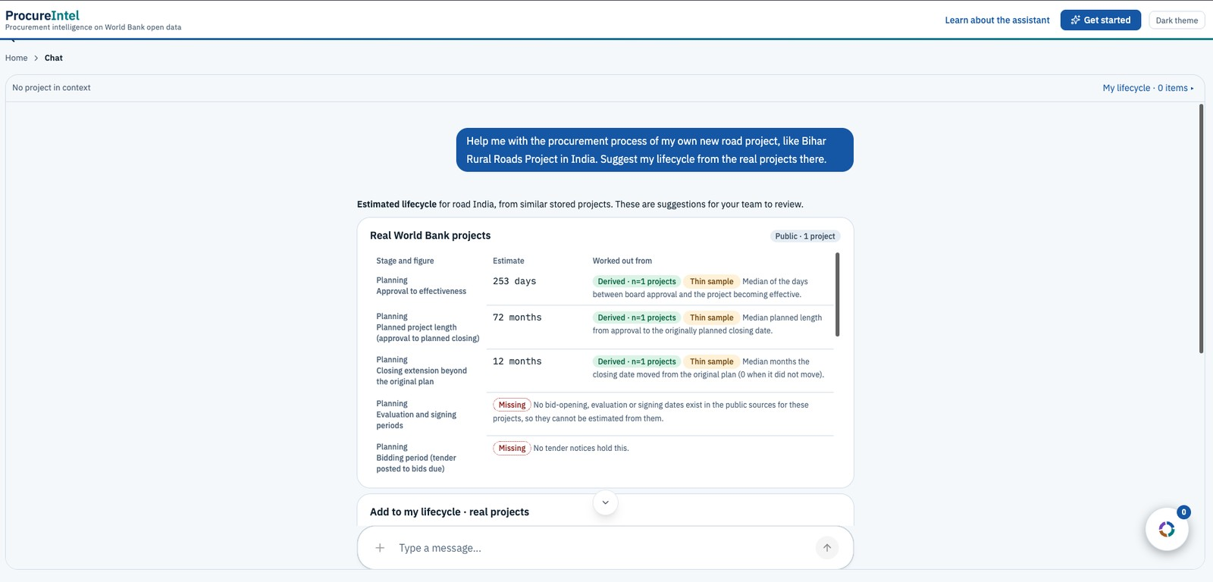
Provenance in practice
Derived with n, Thin sample, Missing and Public chips on live cards
Estimated lifecycle: each figure has its basis, or is Missing
Tenders: Public, from the World Bank notices
ProcureIntel Procurement intelligence on World Bank open data
Notes:
The thin-sample flag (n=1 projects) is the deliberate relaxation of the minimum-sample rule: suggestions are shown but flagged. Figures with no public source stay Missing, with the reason.

Slide 11
The Copilot engine behind the chat
CopilotKit over AG-UI: the model calls tools, the browser draws the result
Browser
CopilotChat, frontend tools, context on every turn
AG-UI / SSE
Messages, tool calls and results stream over HTTP
Runtime
One agent on gpt-4.1-mini, up to 10 tool rounds per turn
Server tools
22 tools read the stored data and ingested projects
Three kinds of tool
Server tools look up and compute. Frontend tools run in the page. Render tools draw a result as one of our cards.
Context each turn
The project in conversation, your own lifecycle, and what your own procurement is modelled on.
Fallback
No key, or no answer within 4 s: a rule-based assistant answers from the same data with the same cards.
ProcureIntel Procurement intelligence on World Bank open data
Notes:
Cards read live data through the same hooks as the rest of the app, so an edit or a new feedback shows everywhere. Every tool is wrapped in guard(): a failure becomes a sentence for the model, not a crash.

Slide 12
Rules in writing, certainty in code
Guardrails (A to M)
Show the view before describing it. Keep each kind of data separate. Review vs. suggest. Say "I don't know"; report tool errors and missing values plainly. Keep the project in context. Never claim a view was shown unless a tool drew it.
Analyst standard (N to T)
Understand the context first. Analyse, don't just display. Label documented vs. derived vs. interpretation. Treat gaps as findings with a kind. Argue every comparison. Keep planned, completed, observed and suggested apart.
Models are not deterministic, so code enforces what matters: scoped data per kind, guard() on every tool, the project context cleared after a suggestion, and ingestion that only the user can start.
ProcureIntel Procurement intelligence on World Bank open data
Notes:
A guard test fails if the instructions name a tool that does not exist. docs/ANALYST_STANDARD.md states the rules and seven questions to check the written answers. The model's written answers have not all been checked yet.

Slide 13
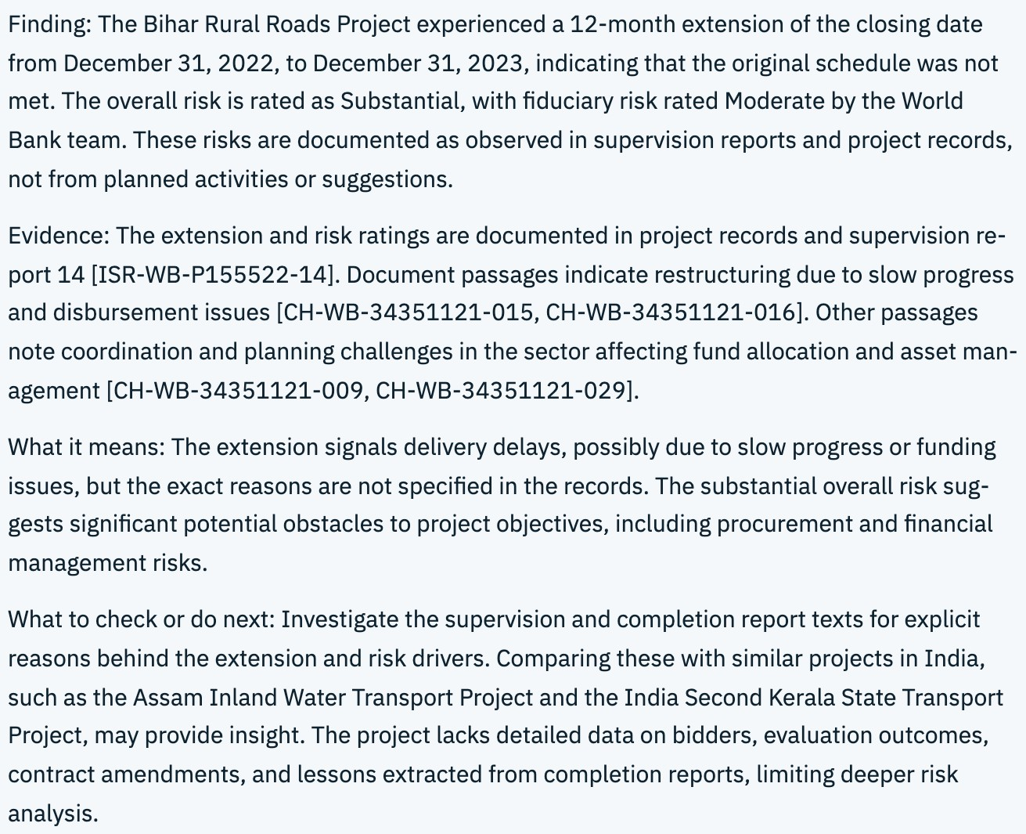
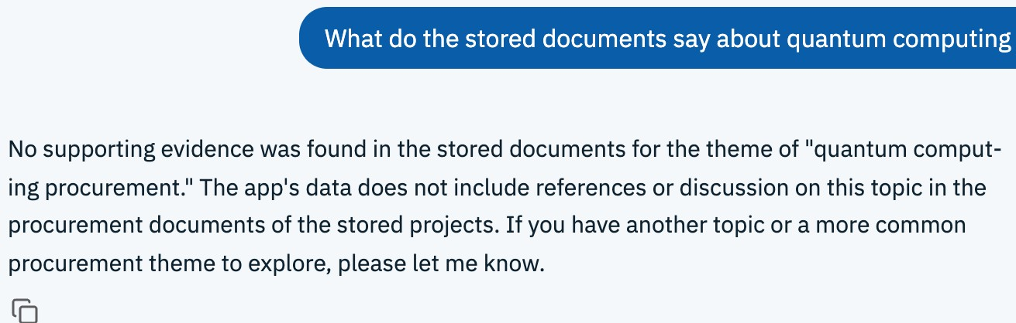
Citations, or no evidence
Answers cite record and chunk ids; with no support, the assistant says so
A question the documents cannot support
Why it matters
Semantic and keyword search with a similarity floor. Below it, the answer is No supporting evidence found.
A risk finding for a real project, with report and chunk ids
ProcureIntel Procurement intelligence on World Bank open data
Notes:
Left: finding, evidence, what it means, what to check next (the analyst standard). Right: the quantum-computing question returns no supporting evidence instead of an invented answer.

Slide 14
From signals to analysis
Rule-based, citing record and chunk ids; no probabilities or scores
Monitoring signals
Rating drop
Risk increase
Disbursement lag over 20 pts
Contract past end date
Amendments
Analyse
analyse_project, analyse_project_risks, find_comparable_projects and scan_risk_evidence. Priority and comparability rules are stated in the output.
Gaps are findings
get_data_gaps names a kind for every absence, for example no contract awards for a project, or an unreadable report.
Compare
Bar charts and a scatter plot for 2 to 5 projects. A figure with no source is Missing, never zero. Only comparable projects are compared.
ProcureIntel Procurement intelligence on World Bank open data
Notes:
Example from the stored data: the analysis output for P158504 shows a 40-month closing-date move and two restructurings; P102398 has no contract awards at all and says so. Real projects have no amendments in the public data, so that figure is Missing.

Slide 15
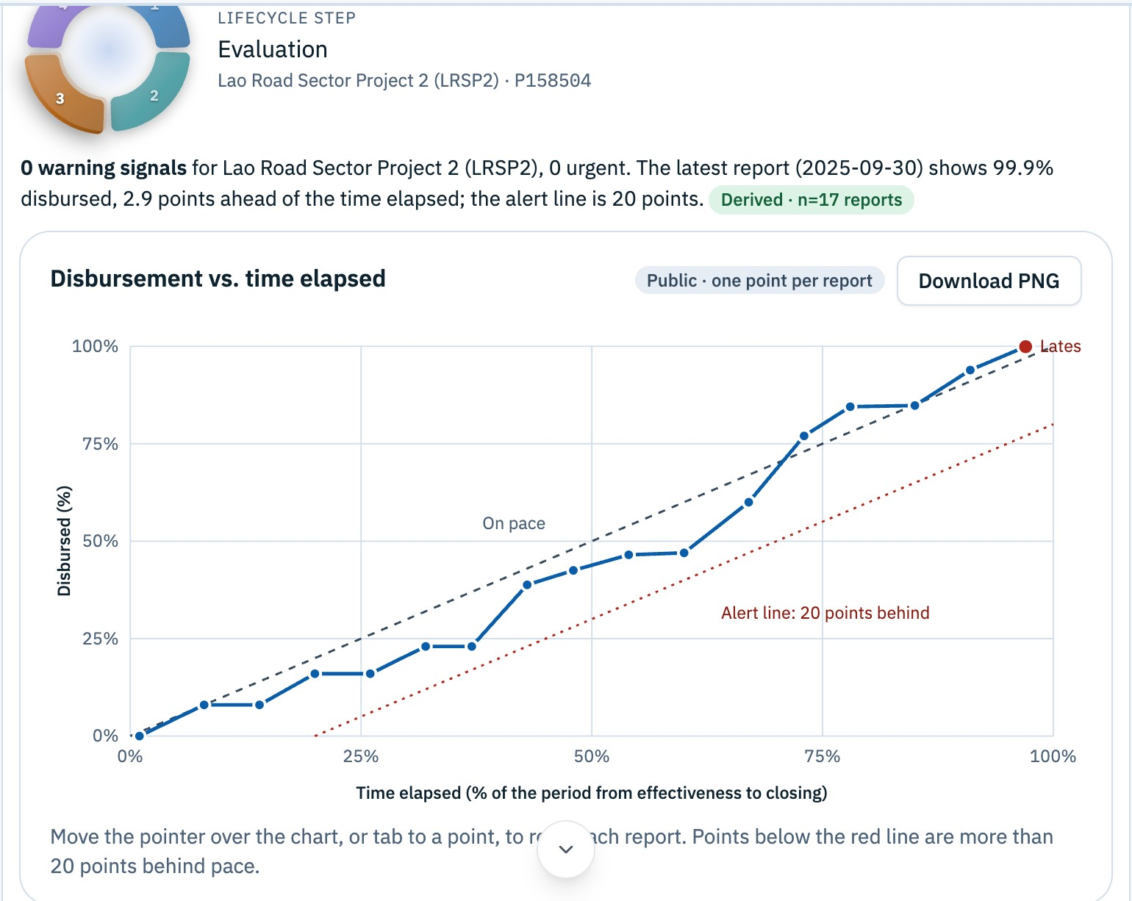
Delivery signals from supervision reports
Disbursement against time elapsed, with the alert line
Signals checked
Rating drop, risk increase, disbursement more than 20 points behind time, a contract past its entered end date, approved amendments.
This project
0 warning signals. 99.9% disbursed, 2.9 points ahead of the time elapsed (report of 2025-09-30).
Evaluation stage of a real project: 17 supervision reports
ProcureIntel Procurement intelligence on World Bank open data
Notes:
Lao Road Sector Project 2 (P158504). The dashed line is on pace; the red dotted line is the 20-point alert line from the thresholds in config. None of the nine stored real projects currently raises an alert, so this card shows a healthy project honestly.

Slide 16
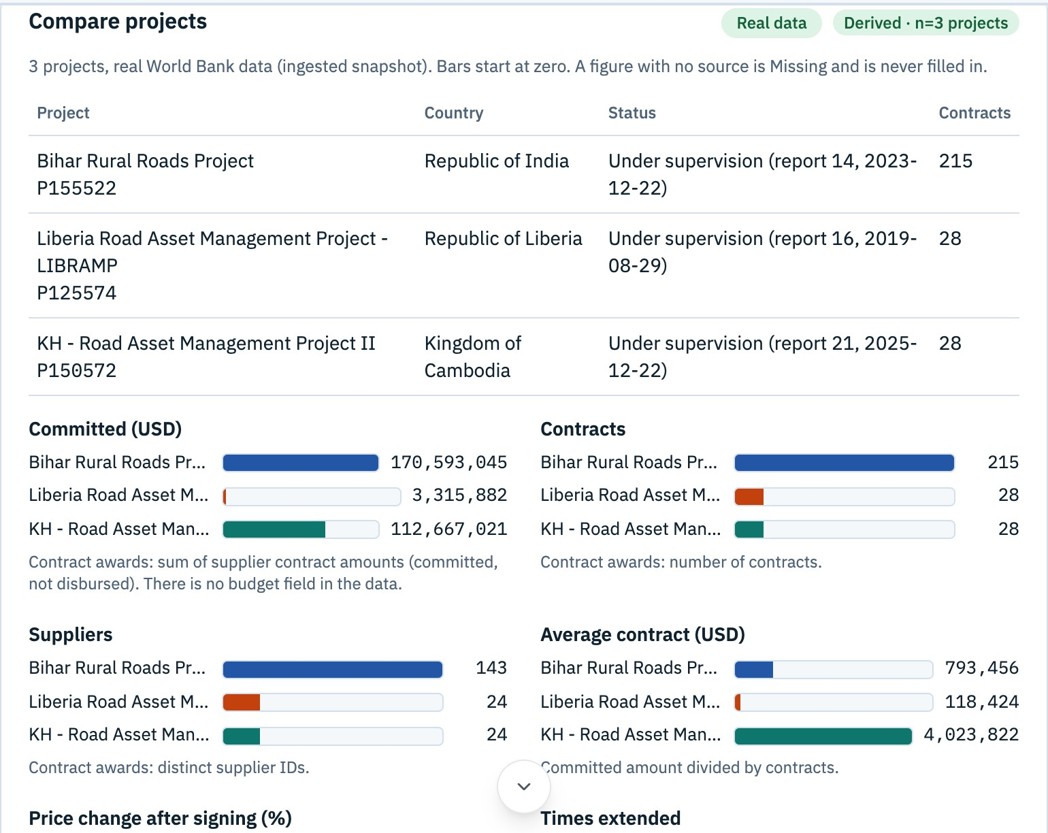
Compare projects side by side
A figure with no source is Missing, never zero
How to read it
Bars start at zero. Committed amounts are contract awards, not disbursements, and there is no budget field, so the card says so. Pick any two figures for a scatter plot.
Three real road projects: bars start at zero
ProcureIntel Procurement intelligence on World Bank open data
Notes:
Bihar, Liberia and Cambodia road projects, compared on committed amount, contracts, suppliers, average contract size, price change after signing, times extended, disbursed and time elapsed.

Slide 17
Bring in a project while you watch
One pipeline for the CLI, the local server and the hosted function
find
contracts
notices
documents
texts
parse
plans
chunk
embed
publish
No model
Uses a model
Only the user starts it
find_world_bank_project searches the Projects API; the card offers Proceed. No tool can start an ingestion, so the model cannot.
Safe by design
Contact details are never copied. A plan row is kept only if its reference, description and cost appear in the document text. Refused documents are skipped and listed.
Resumable, searchable
Hosted steps pause and continue from a cache. Chunks are embedded, so questions are answered by meaning plus keywords.
ProcureIntel Procurement intelligence on World Bank open data
Notes:
Embeddings: text-embedding-3-small at 512 numbers, stored as int8; a chunk with no keyword hit needs similarity of at least 0.30 (a starting value, not measured) or the answer is No supporting evidence found. Without an OpenAI key the embed and plan stages are skipped and say why.

Slide 18
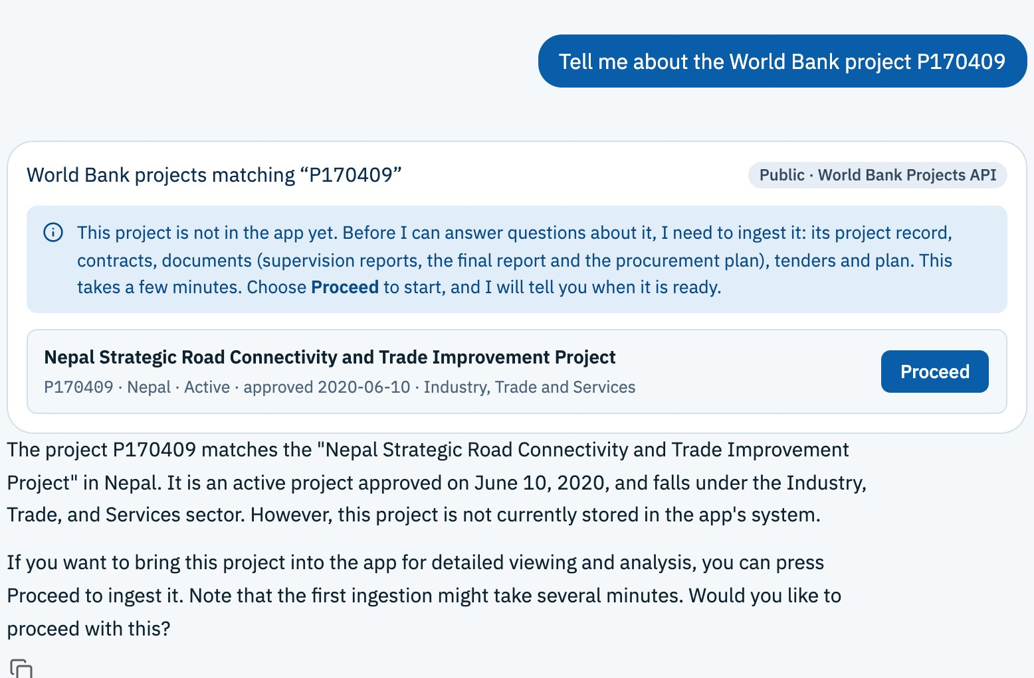
The ingest card
A project the app does not hold: found, explained, and only the user presses Proceed
What happens next
1. The model searches the Projects API; the card lists the match.
2. Proceed starts the pipeline: record, contracts, documents, tenders, plan, embeddings.
3. An alert and Show details confirm it is ready; the project becomes the one in context.
P170409 (Nepal) found through the World Bank Projects API; nothing is ingested yet
ProcureIntel Procurement intelligence on World Bank open data
Notes:
Proceed was not pressed when capturing this: a real ingestion writes to the stored data and calls OpenAI for plan reading and embeddings. The running and ready states are described but not shown.

Slide 19
Help with your own procurement
Suggest mode builds a lifecycle from similar real projects
Review
A stored project: show only what is on record, nothing made up. Past projects are view-only in the chat.
Suggest
propose_lifecycle, plan, tender clauses, suppliers, monitoring and learning options. Each figure is a median with its sample size.
My lifecycle
Add from any suggestion card. Edit and Save as final: the item turns from Derived to Entered, keeping its basis. Download each item as PNG, or all of it as Word. Kept in the browser tab only.
1
2
3
4
Planning
Tender design
Monitoring
Learning
ProcureIntel Procurement intelligence on World Bank open data
Notes:
Estimates use real projects only. Tender clauses and plans are suggested from the stored drafts, each clause labelled with its source and sample size. My lifecycle is not saved beyond the session: that would need a login or a stored collection, which is a data-model change that needs K's approval.

Slide 20
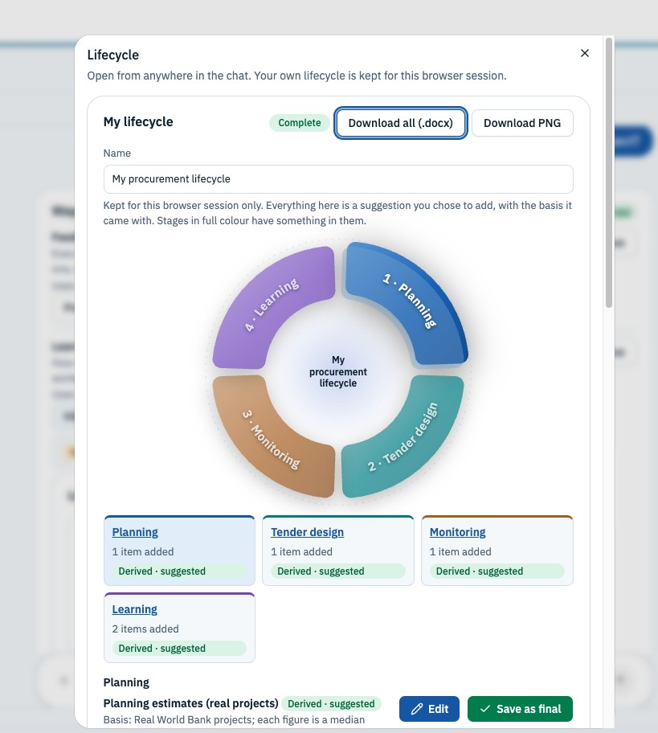
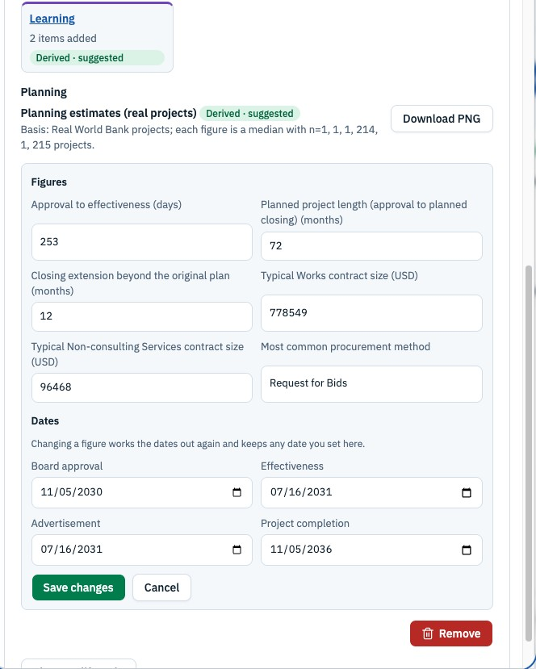
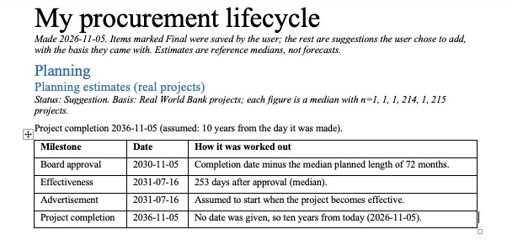
Build and export your own lifecycle
Add suggestions, edit them, then download as PNG or Word
Word export, with the basis of each item
My lifecycle: stages fill in as items are added
Edit figures; dates recalculate
ProcureIntel Procurement intelligence on World Bank open data
Notes:
Items start as Derived (suggested) and become Entered once the user edits and saves them. The lifecycle lives in the browser tab only (sessionStorage).

Slide 21
Feedback changes what the platform shows
The continuous-learning loop, end to end
1
2
3
4
Helpful / Not helpful
Feedback record
Review queue
KPIs and update log
on recommendations and on cards in the chat
written to feedback and audit_log
Reviewer accepts, edits or rejects
recomputed from the logs
Roles gate who can act
Planner, Contract manager, Reviewer, Admin. A control a role cannot use is disabled with a reason, not hidden.
Honest empty states
A project with no feedback says so and shows clearly labelled samples with nothing to press.
ProcureIntel Procurement intelligence on World Bank open data
Notes:
In the chat the filter rail is hidden, so Role stays at its saved value (normally Planner). To review feedback, use the Learning page where the rail is present. The Learning card in the chat shows only feedback about the open project.

Slide 22
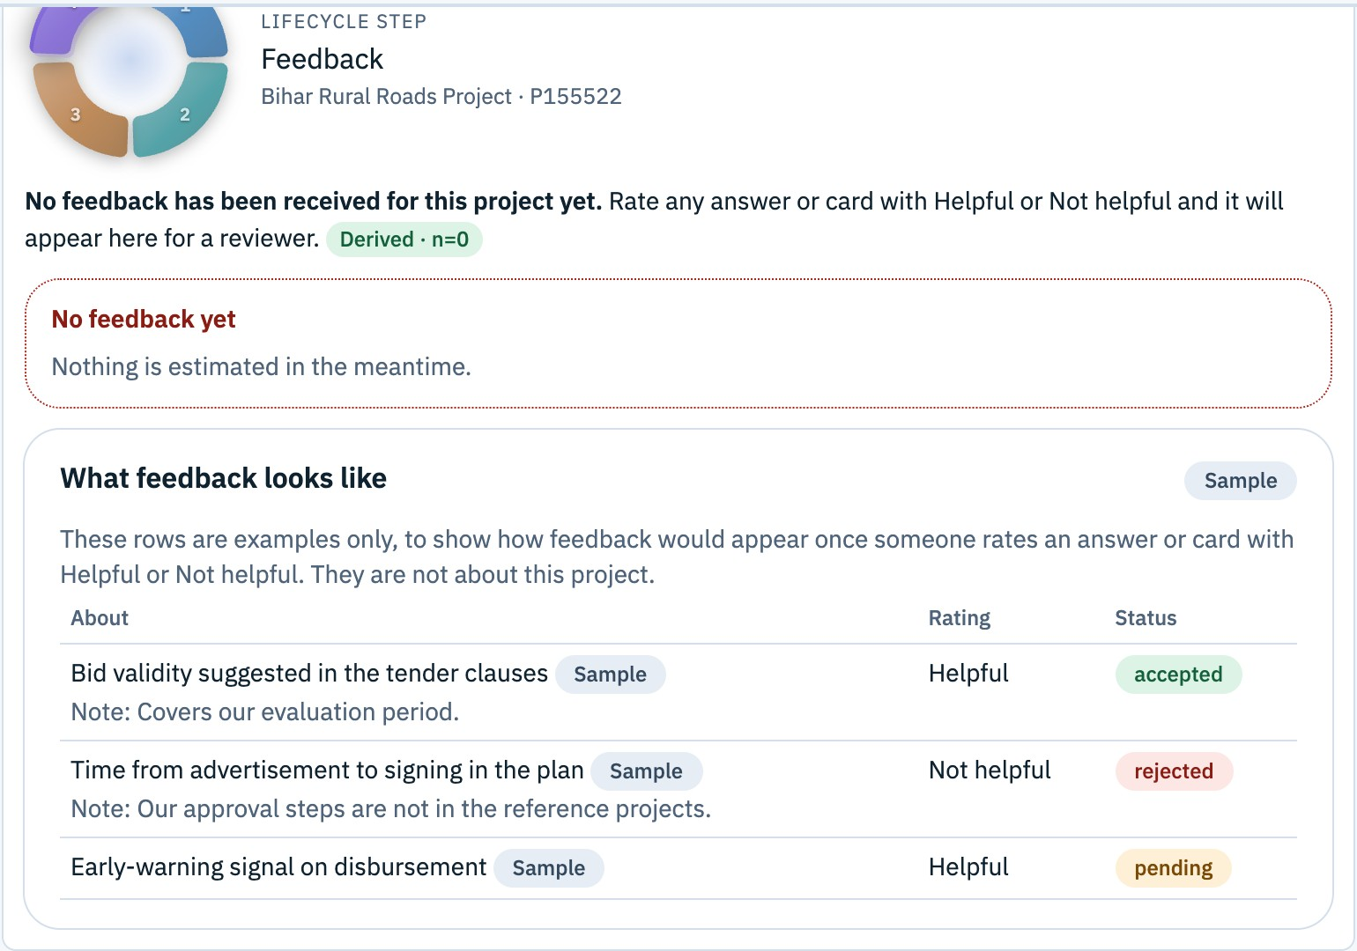
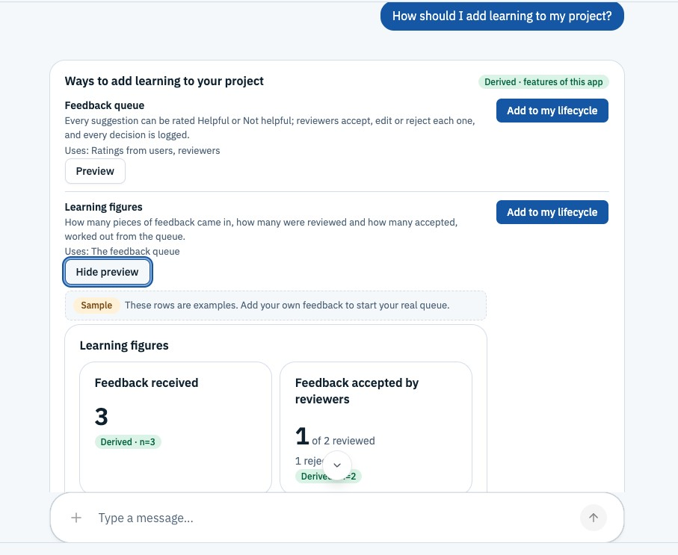
Learning in the chat
No feedback yet is said plainly; labelled samples show how it will look
Learning options, with a sample preview
Feedback stage of a real project: nothing estimated
ProcureIntel Procurement intelligence on World Bank open data
Notes:
The Learning card in the chat shows only feedback about the open project. A project with none shows the empty state and three clearly labelled sample rows. The Learning page itself shows the shared review queue, where a Reviewer accepts, edits or rejects.

Slide 23
Built to keep working during a demo
Failure isolation
RemoteBoundary tells "files could not be fetched" from "loaded then failed". CardBoundary replaces one crashing card with a note and Try again; the chat carries on.
Tests that guard drift
Over 200 Vitest tests (PROGRESS.md). Guards fail on a prompt naming a missing tool, a stale generated function, or a card style regression.
Responsive
Checked at 375, 768 and desktop widths. Wide tables stack into labelled blocks on a phone; cards use minmax(0, 1fr) so nothing is cut off.
Hosting
Vercel builds the shell and remotes into one origin. Functions are plain JS or .mjs. Without a key the chat falls back to the rule-based assistant.
ProcureIntel Procurement intelligence on World Bank open data
Notes:
Generated files (api/_lib/assistant.js and copilot.mjs) come from pnpm build:chat; run it after changing server/copilot.ts or the pure data files it imports, and commit the result. Test count is from PROGRESS.md and docs/architecture/README.md; the suite was not re-run for this deck.

Slide 24
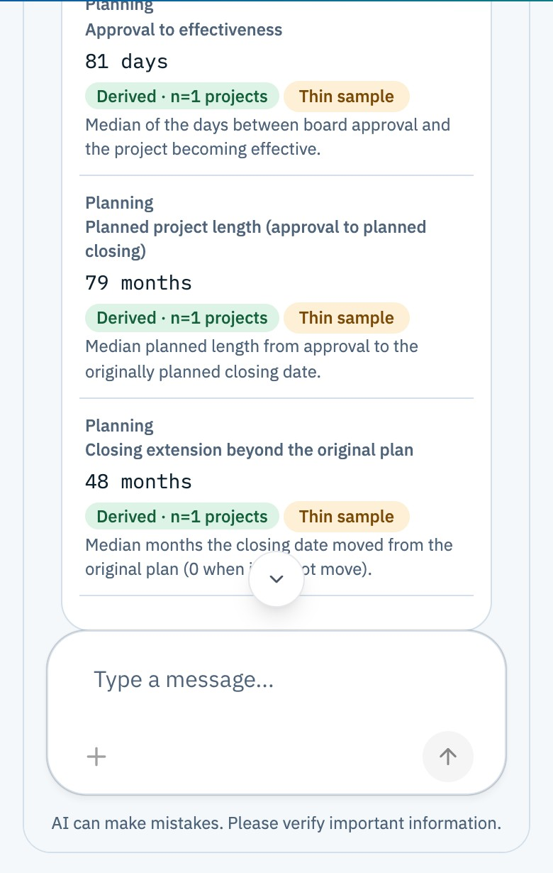
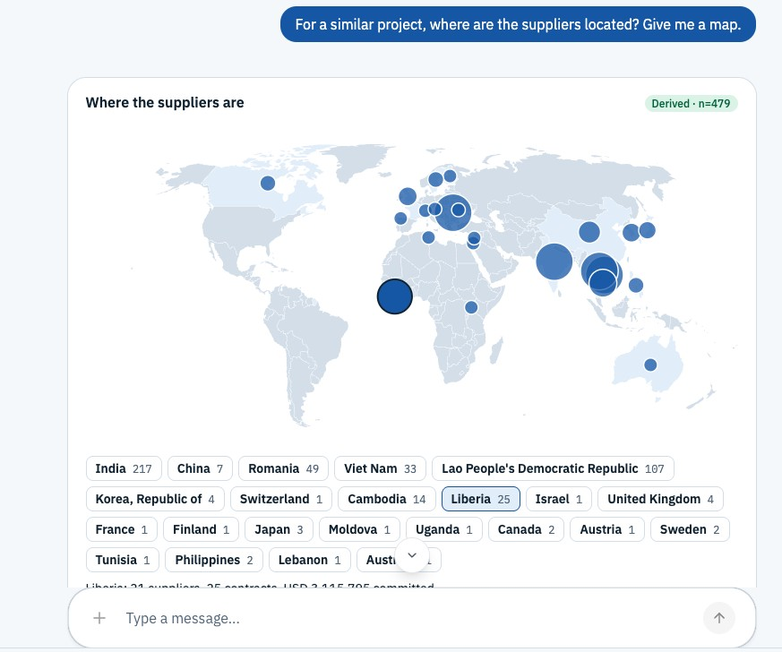
Phone-ready, with a supplier map
Cards reflow; tables stack into labelled blocks
Layout
Tables stack below 640 px. Checked at 375, 768 and desktop widths.
Chat card at 390 px wide
Where the suppliers of a similar project are
ProcureIntel Procurement intelligence on World Bank open data
Notes:
Phone view captured at 390 by 844 with desktop Chrome in headless mode, not on a real device.

Slide 25
Assessment dimensions, and where to see them
Dimension | What the UI demonstrates | Status
Ingestion and sources | Live pipeline for World Bank projects, source registry, provenance chips, GPPD context | Built
Knowledge links | Consistent IDs, records linked to document text, citations to chunks | No graph view
Risk models | Monitoring signals and rule-based analysis tools, gaps named by kind | Rules, not trained models
Grounded retrieval | Semantic and keyword search, SourceDrawer, No supporting evidence found | Built
Conflict handling | Public and entered values kept apart, review queue, rule applied and resolution | Built
Continuous learning | Feedback, review queue, derived KPIs, update log | Built
Architecture | Module Federation, shared singletons, package boundaries, ADR 0001 | Built
ProcureIntel Procurement intelligence on World Bank open data
Notes:
Status follows docs/ARCHITECTURE.md section 10, updated for the chat and ingestion work in PROGRESS.md. Be plain: the risk side is rules, and the knowledge-graph view was never built.

Slide 26
What comes next
Planned steps after this demo
1
Save My lifecycle beyond the session
needs a login or a stored collection
2
Save to Google Docs
needs Google OAuth
3
Read more plan tables
later versions and further rows of each plan
4
Knowledge-graph view
records and documents as a graph
5
Playwright smoke test
automate the demo path
ProcureIntel Procurement intelligence on World Bank open data
Notes:
Persisting a lifecycle is a data-model change, which needs K's approval per the project rules. Playwright was never built (PROGRESS.md Not done).

Slide 27
THANK YOU
Notes:
A suggested path through the current chat-first product; the original six-step script in CLAUDE.md predates it. See docs/DEMO.md for data-editing details. Reset the data and present the production build. The model chat needs OPENAI_API_KEY in .env.local.

