Slide 1
Author Identification in Online Text
Guide : Mohd. Ahsan Chishti
Co Guide : Azra naaz
Kishan Kumar Mishra
Mayank Kumar Gupta

Slide 2
Introduction
Introduction
Authorship Identification is the task of identifying who wrote a
given piece of text from a given set of candidate authors .
A single label multiclass classification problem.

Slide 3
Problem statement
Given a set of documents each labeled with its author name, learn a function which can identify the author of an unlabelled document.
author1
author2
author1
author2
author1
author2
Training data
learning
?
author1
Hypothesis function

Slide 4
Motivation
Much of the work in the field of Author Identification has been done on classification of texts written in English.
No work has been done on classification of Hindi texts.
Our aim is to classify texts written in Hindi.

Slide 5
Flowchart
start
Collect data
Feature extraction
Change
Normalize features
No
Satisfied with accuracy
Yes
Apply machine learning algorithm
stop

Slide 6
Data collection
Data collected from various online blogs
Number of authors = 18
Documents per each author = 12
300-400 words per document
Posts on topics like Internet, Banking, Motivation, Success.

Slide 7
Bag of words
Different authors use different words
Difference in word usage can be used to identify authors

Slide 8
Bag of words
Author | Content
Author1 | Teaching is an art.
Author2 | Not every one is an artist.
Author | Teaching | is | an | art | Not | every | one | artist
Author1 | 1 | 1 | 1 | 1 | 0 | 0 | 0 | 0
Author2 | 0 | 1 | 1 | 0 | 1 | 1 | 1 | 1

Slide 9
TF normalization
Normalizes the frequency across documents of different lengths.
Before normalization
Document 1 | Document 2
Frequency=10 | Frequency =20
Document length=100 | Document length=200
After normalization
Document 1 | Document 2
Frequency=10/100=0.1 | Frequency =20/200=0.1

Slide 10
IDF normalization
Some words are common to all authors
Give little weightage to these words
Higher the number of documents that a word appears in lower is its weight

Slide 11

Mean normalization
Different features have different range of values
They must have the same range for faster convergence to objective function

Slide 12
Model Training
Goals:
Train a model which can distinguish authors
See how the model performs when the number of author increases
Approach:
Train model with 5 authors
Evaluate model performance
Repeat steps 1 and 2 with increasing the number of authors
Plot a graph showing change in accuracy with increasing number of authors

Slide 13
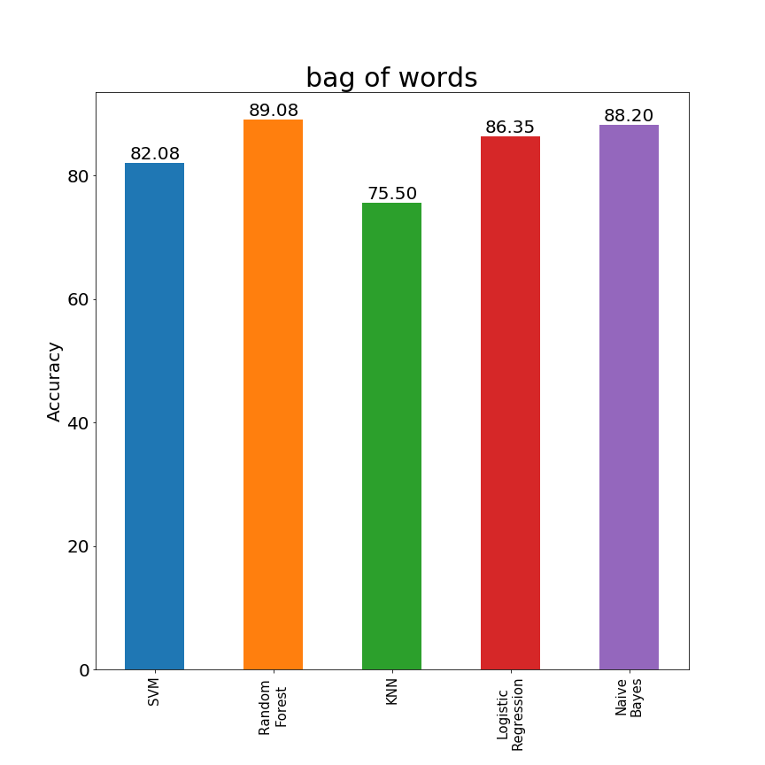
Results

Slide 14
Character trigram model
That machine can learn by itself.
Feature generated- tha

Slide 15
Character trigram model
That machine can learn by itself.
Feature generated- tha,hat

Slide 16
Character trigram model
That machine can learn by itself.
Feature generated- tha,hat, at_

Slide 17
Character trigram model
That machine can learn by itself.
Feature generated- tha,hat, at_, t_m

Slide 18
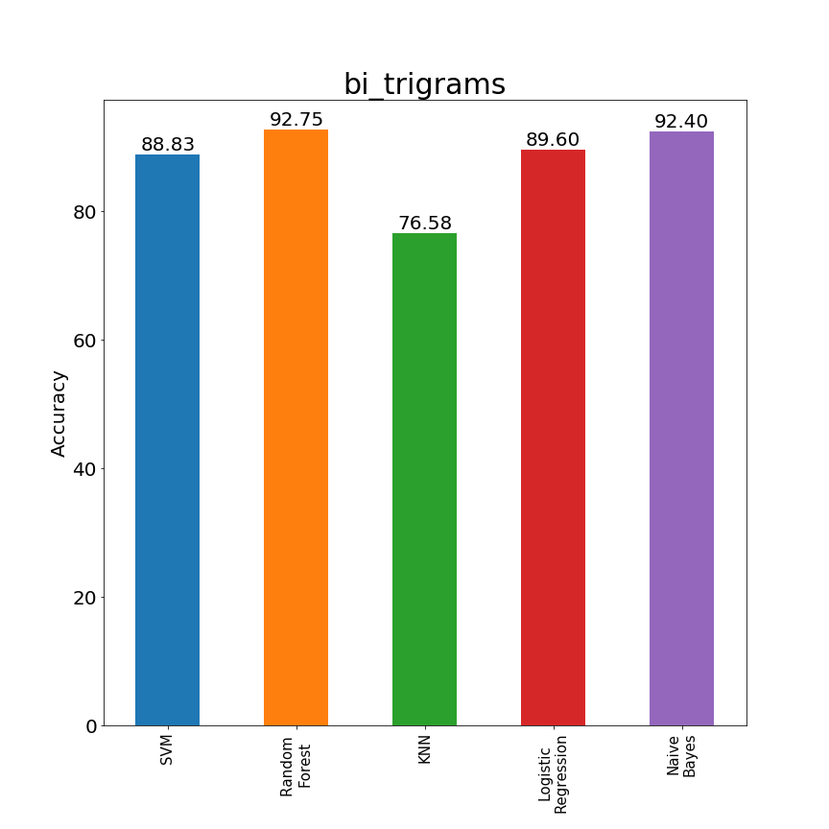
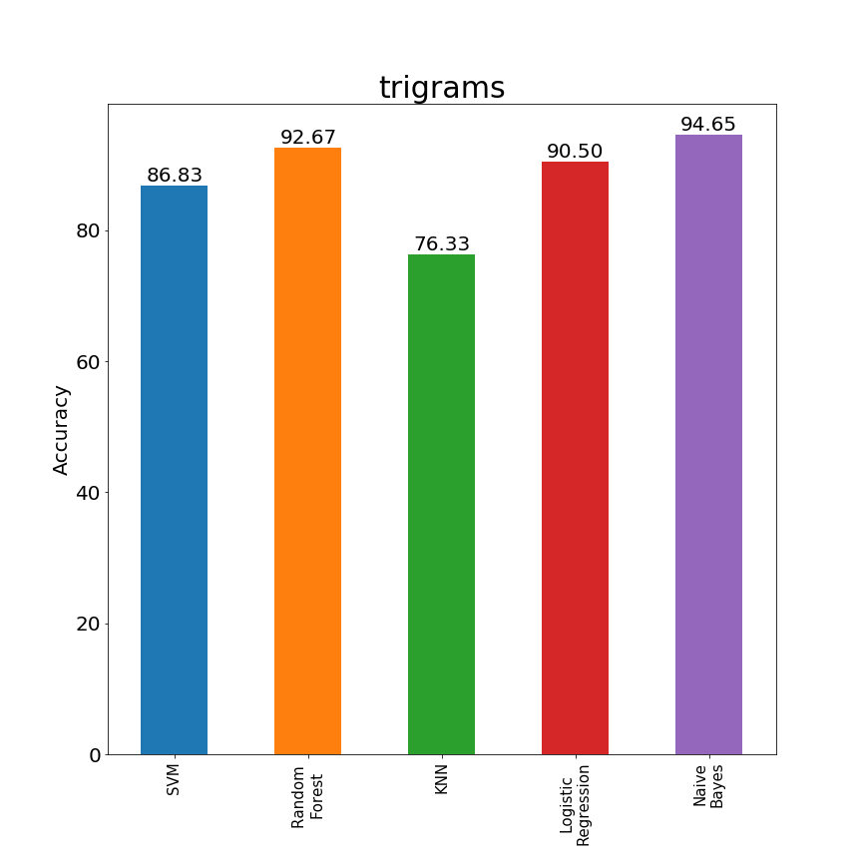
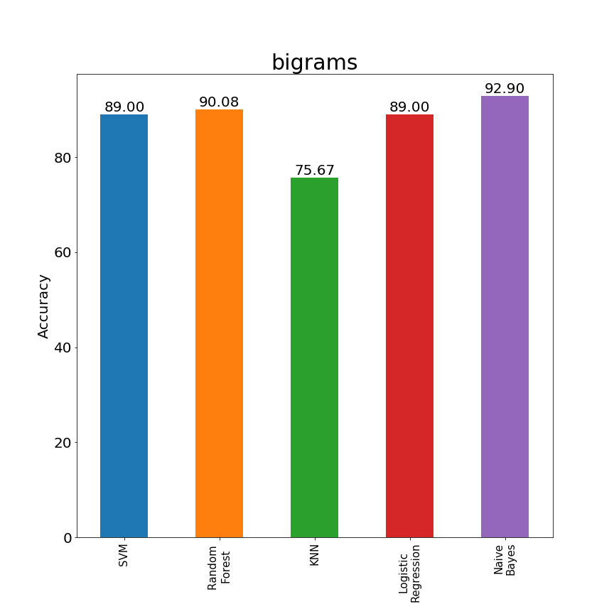
Results
Best model till now

Slide 19
Function words
Functions words express grammatical relationship between other words.
Conjunctions
Prepositions
Pronouns

Slide 20
Function words
Problem: Function words collection not available for Hindi
Solution: collect them manually
Problem: Manual collection is too much time consuming
Solution: Use a good approximation.

Slide 21
Function words
If x is a function word → x occurs frequently
If x occurs frequently → x is a function word
Fails when authors write on the same topic. The topic itself becomes a frequent word but not a function word.
Yet it holds most of the times. So frequent words can approximate function words.

Slide 22
Function words
How to get frequent words?
A word is frequent if it occurs in more than a specified percentage £ of total number of documents.
£=0.9
Total documents=100
Then the word must appear in more than 90 documents.

Slide 23
Function words
How to choose the value of £ ?
Choose a value which maximizes function words but minimizes content words
£=1
A bit too harsh even for function words
£=0.2
Would bring content words into equation

Slide 24
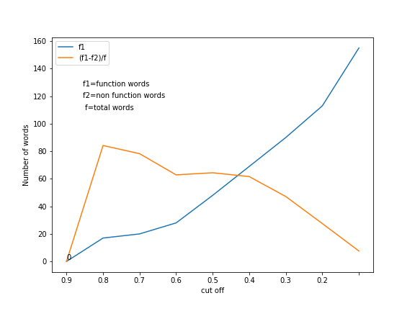
Function words
£=0.5 is a good cut off

Slide 25
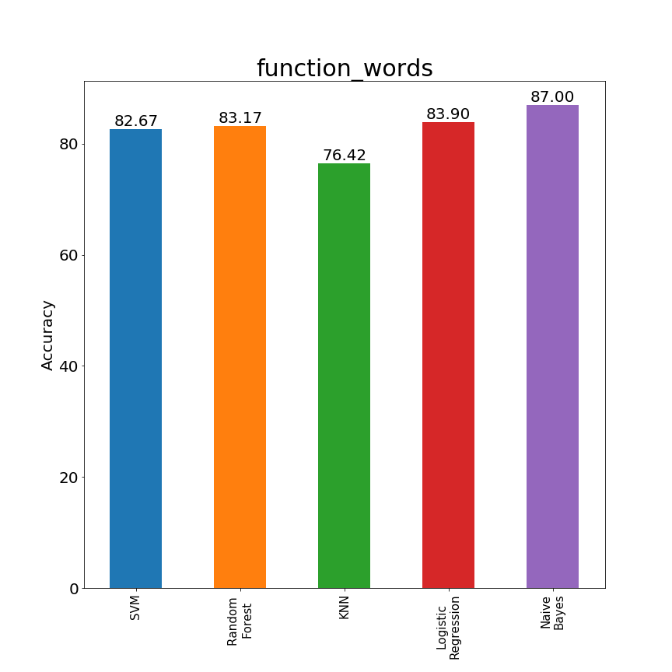
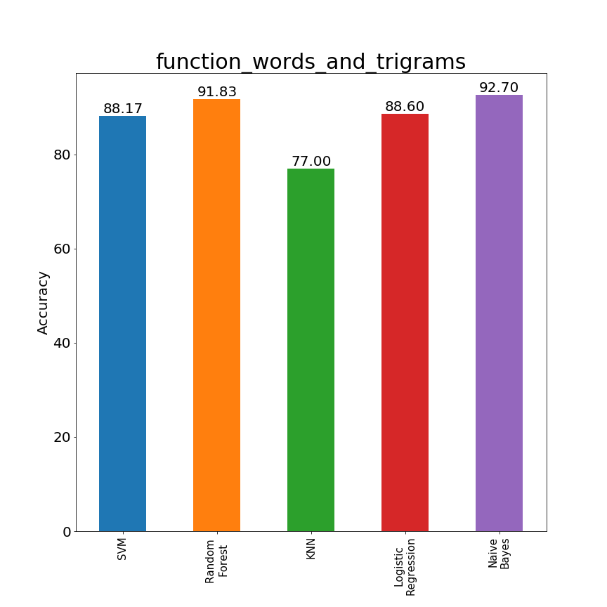
Results
Best model till now

Slide 26
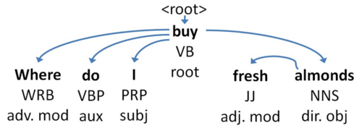
Part of speech tagging
Assigning tags to words based on whether they are noun, pronoun etc.

Slide 27
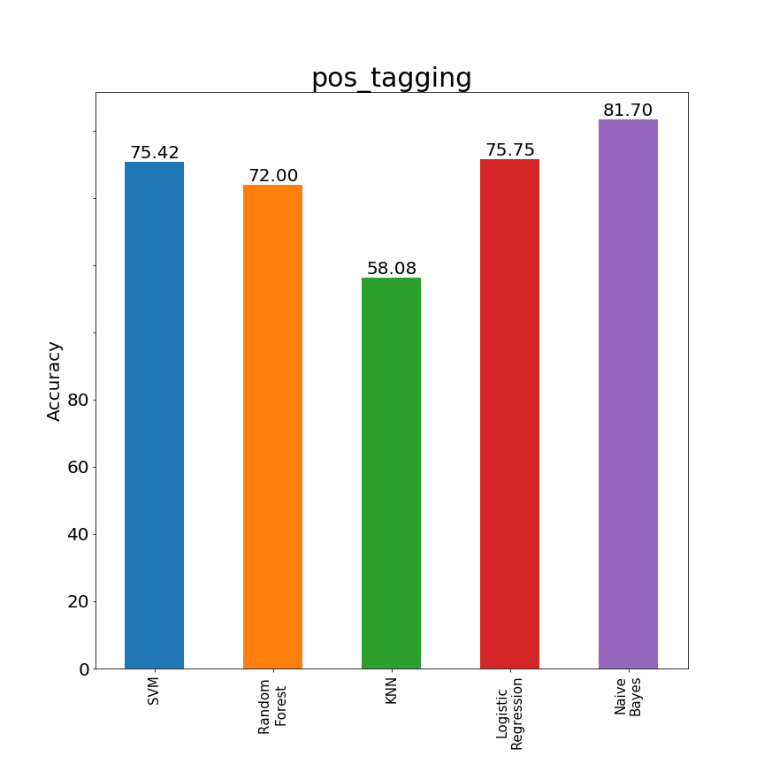
Results
Best model till now

Slide 28
Secondary features
Alone they are incapable of distinguishing authors
But in combination with other features may produce better results
Number of English words
Vocabulary richness
Average sentence length
Average word length

Slide 29
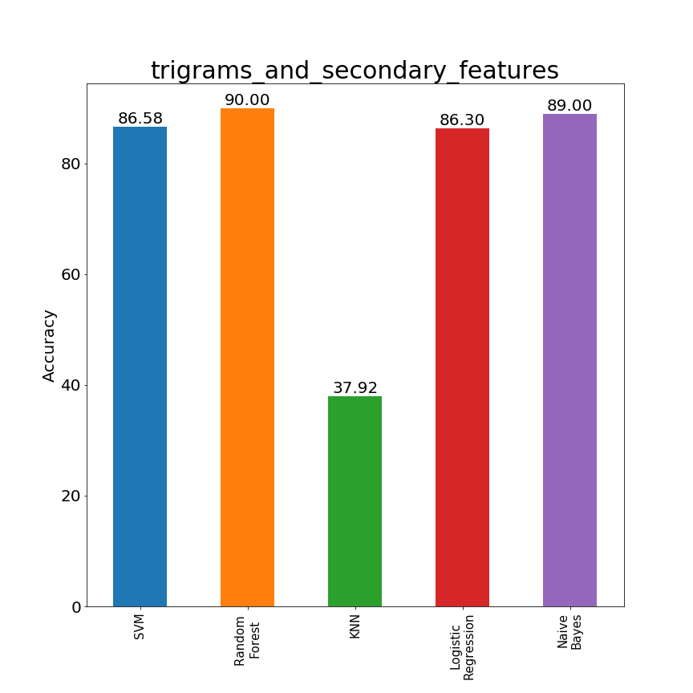
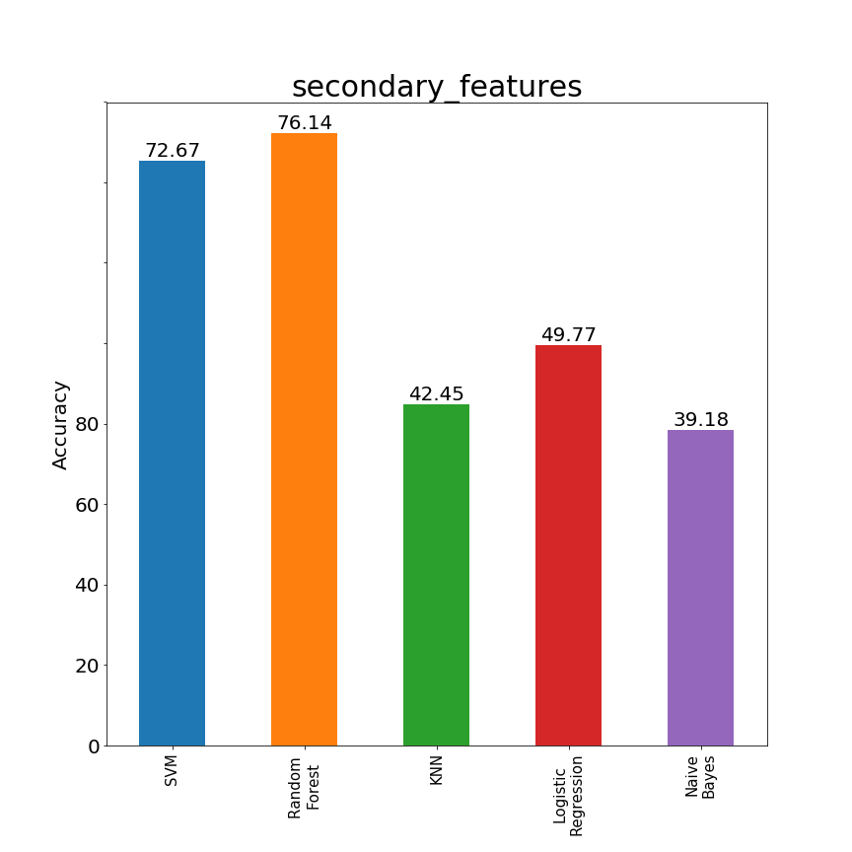
Results
Best model till now

Slide 30
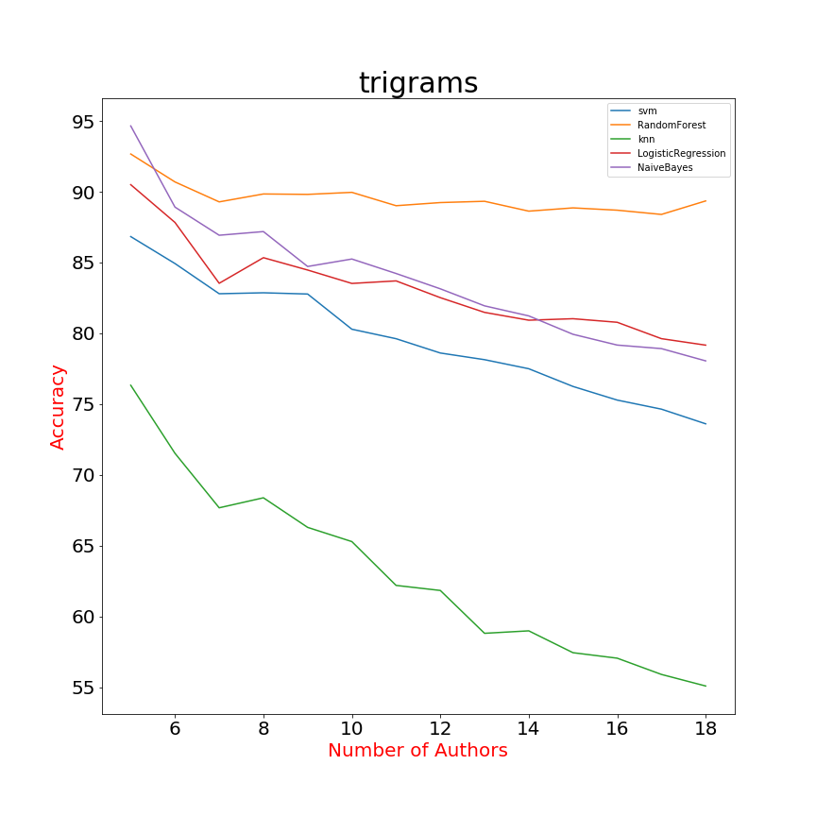
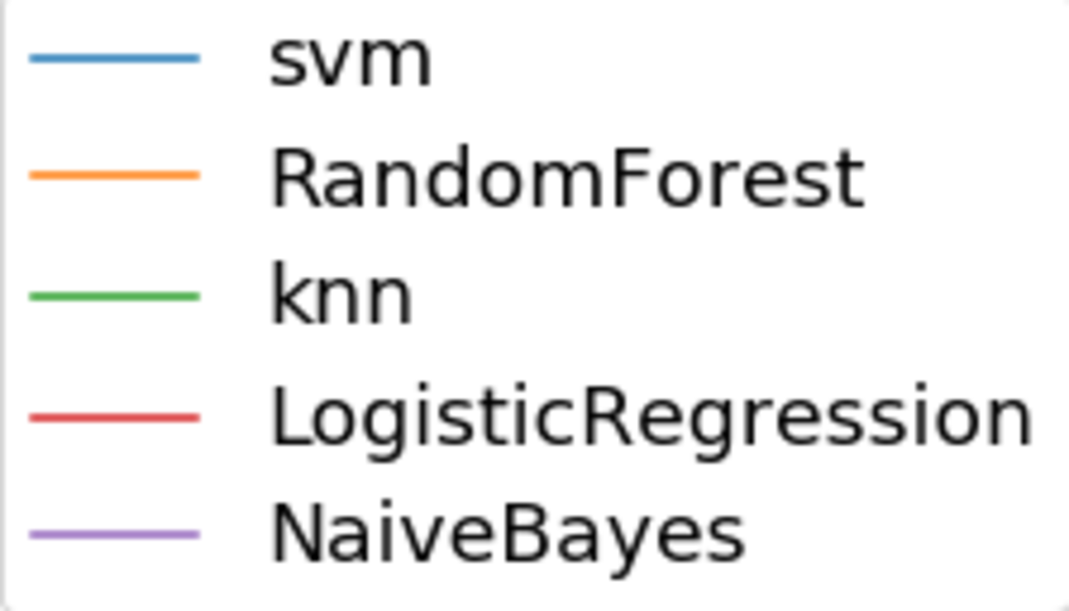
Scaling number of authors

Slide 31
Conclusions
Best feature model
Trigrams
Best learning model
Random Forest

