Slide 1
Ad Performance
Performance Analytics Report
2025-11-01 | 2025-11-14
TOTAL REVENUE
RETURN ON INVESTMENT
TOTAL IMPRESSIONS
$382,250
97.0%
10,203,000
Generated: December 03, 2025 | Powered by TrendSpotter AI

Slide 2
Key Performance Indicators
IMPRESSIONS
CLICKS
CONVERSIONS
10,203,000
306,090
15,290
Total ad views delivered
Click-through rate: 3.00%
Completed actions
REVENUE
AD SPEND
ROI
$382,250
$194,070
97.0%
Total earnings generated
Marketing investment
Return on investment
KEY INSIGHT: Tech_Gadgets leads with $98,875 revenue and 80% ROI

Slide 3
Executive Summary
AI-Generated Analysis
During the analysis period from November 1 to November 14, 2025, the campaigns generated 10,203,000 impressions, resulting in 306,090 clicks and 15,290 conversions. The total revenue reached $382,250 against a spend of $194,070, yielding an impressive ROI of 97%. The top-performing campaigns were Tech_Gadgets and Holiday_Promo, generating $98,875 and $88,075 respectively. Noteworthy anomalies (7) were identified, indicating potential areas for optimization. Continuous monitoring and adjustments can capitalize on high-performing segments while addressing discrepancies. Overall, the data reflects strong engagement and profitability, affirming robust marketing strategies during this critical promotional period.
ANOMALIES DETECTED: 7 unusual patterns identified
- Tech_Gadgets - unusual metrics on 2025-11-03
- Tech_Gadgets - unusual metrics on 2025-11-04
- Winter_Collection - unusual metrics on 2025-11-07

Slide 4
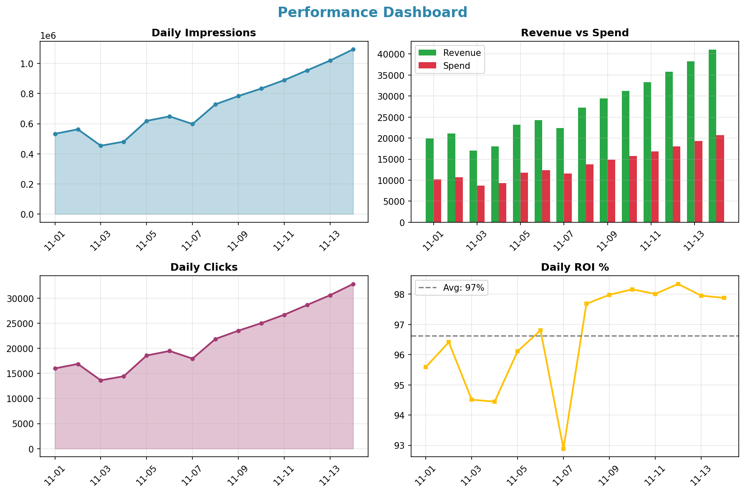
Performance Dashboard

Slide 5
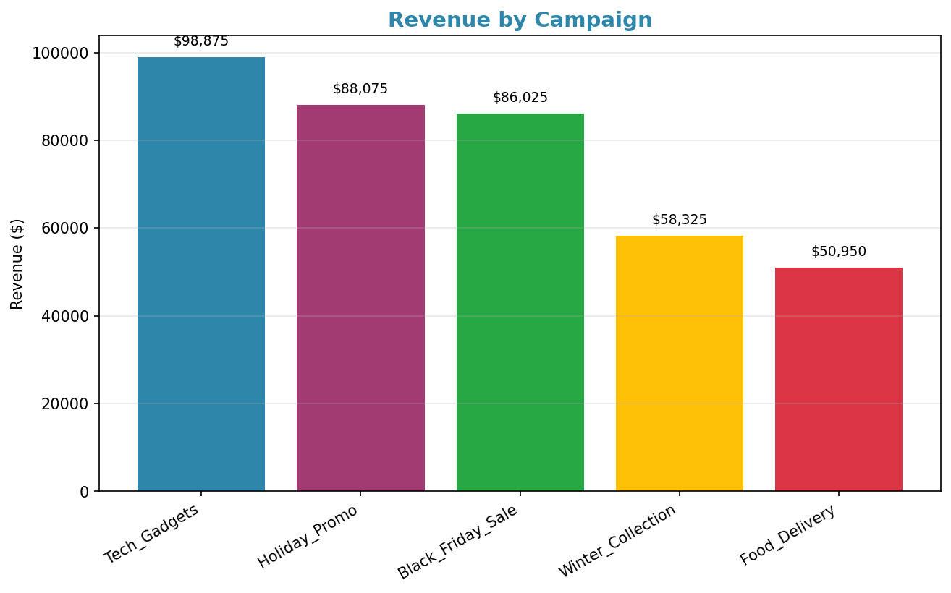
Campaign Performance

Slide 6
Strategic Recommendations
1
Optimize ad creatives for higher click-through rates.
2
Focus budget on top-performing campaigns for better ROI.
3
Investigate anomalies for potential strategy adjustments.
4
Consider increasing spend on high-converting segments.
Recommendations generated by AI based on data patterns. Review and adapt to your business context.

