Slide 1
Campaign Db
Performance Analytics Report
2024-04-01 | 2024-04-10
TOTAL REVENUE
RETURN ON INVESTMENT
TOTAL IMPRESSIONS
$34,050
266.9%
898,000
Generated: December 03, 2025 | Powered by TrendSpotter AI

Slide 2
Key Performance Indicators
IMPRESSIONS
CLICKS
CONVERSIONS
898,000
26,300
1,135
Total ad views delivered
Click-through rate: 2.93%
Completed actions
REVENUE
AD SPEND
ROI
$34,050
$9,280
266.9%
Total earnings generated
Marketing investment
Return on investment
KEY INSIGHT: Back to School leads with $10,800 revenue and 260% ROI

Slide 3
Executive Summary
AI-Generated Analysis
During the period from April 1 to April 10, 2024, our campaigns generated significant engagement, with 898,000 impressions leading to 26,300 clicks and 1,135 conversions. The overall revenue reached $34,050 against a spend of $9,280, resulting in an impressive ROI of 266.9%. The top-performing campaigns were "Back to School" ($10,800) and "Flash Friday" ($10,500), indicating strong market interest in seasonal promotions. Although there was an anomaly detected, it did not detract from the overall positive performance. Continued monitoring and optimization could further enhance results, especially for the "Loyalty Rewards" and "Summer Preview" campaigns.
ANOMALIES DETECTED: 1 unusual patterns identified
- Flash Friday - unusual metrics on 2024-04-07

Slide 4
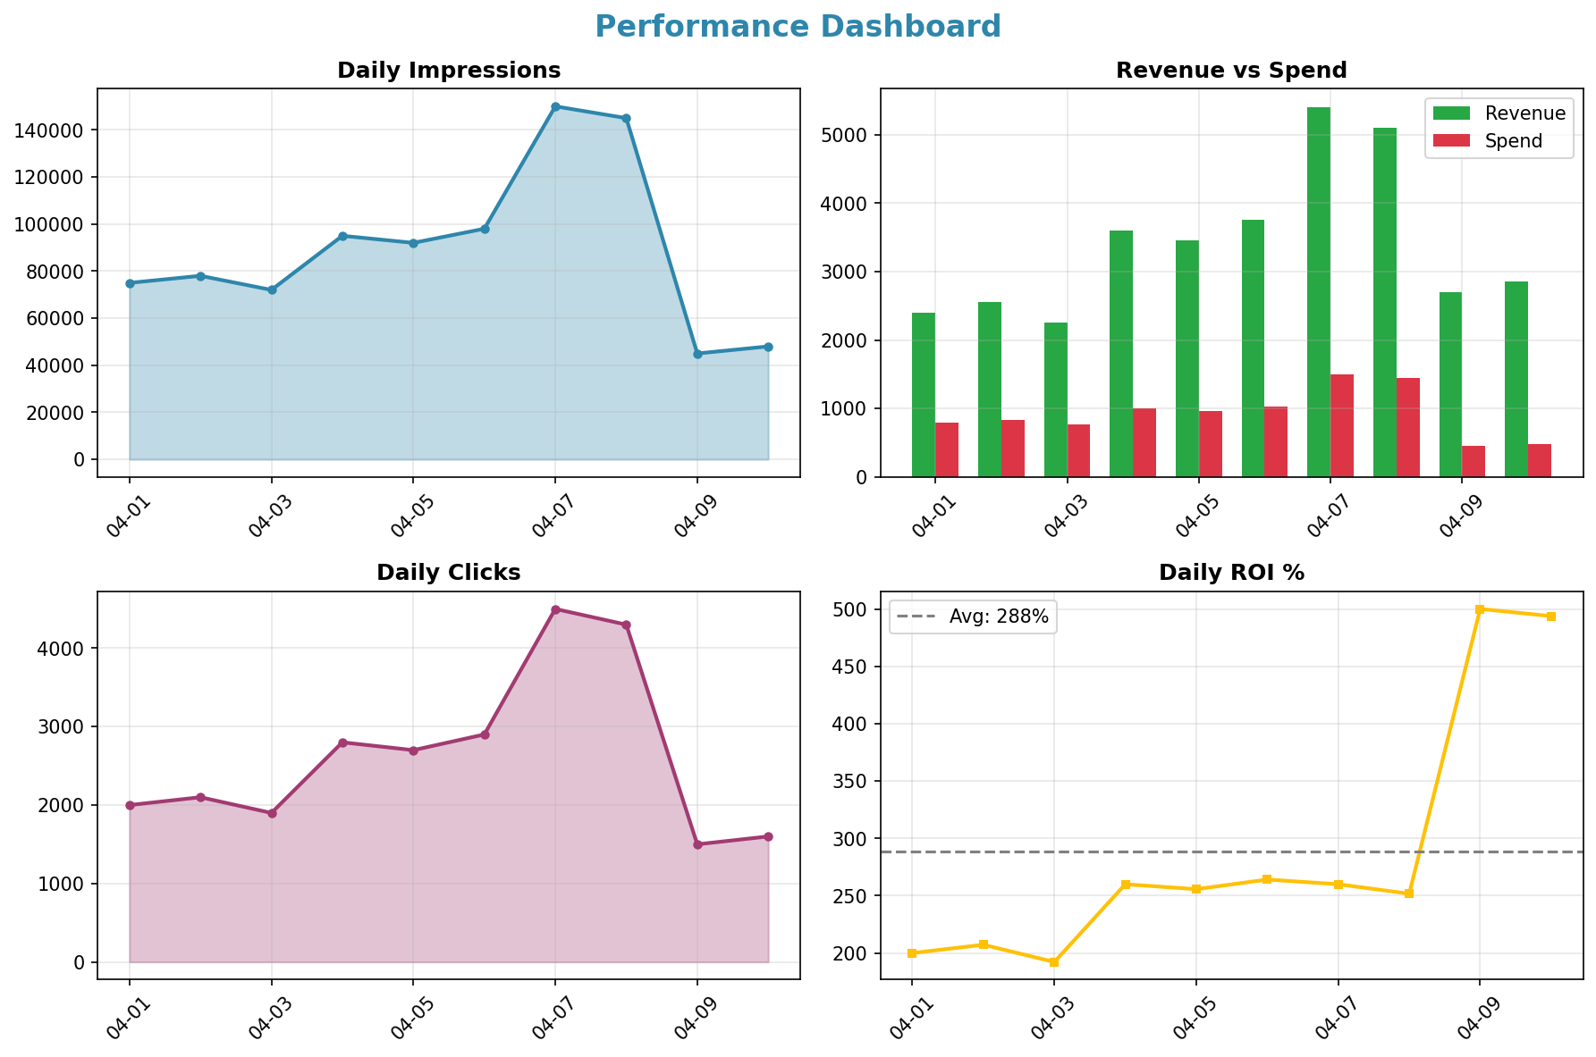
Performance Dashboard

Slide 5
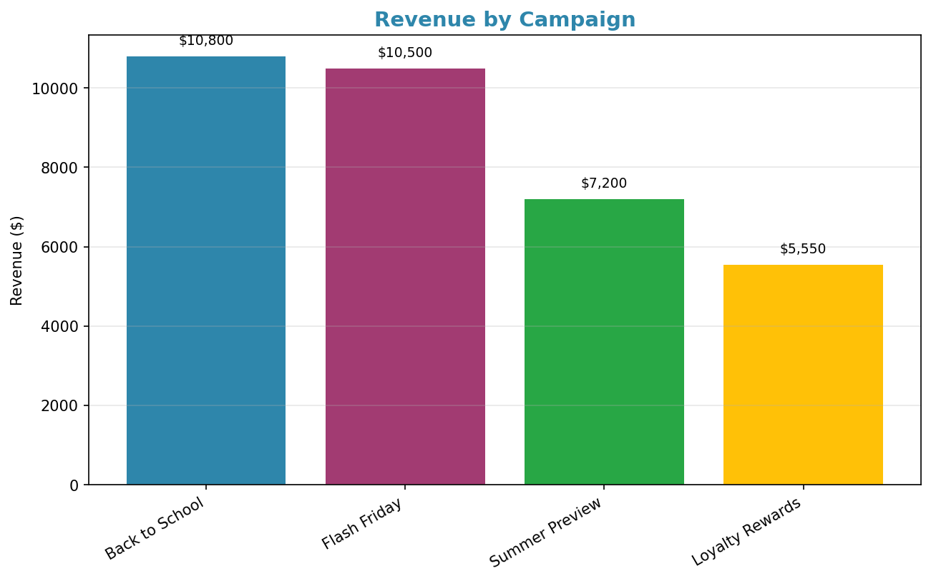
Campaign Performance

Slide 6
Strategic Recommendations
1
Optimize campaigns with high ROI, like Back to School, for better reach.
2
Reduce spending on lower-performing campaigns to increase overall efficiency.
3
Analyze the anomaly to identify potential areas for improvement.
4
Focus on boosting conversion rates through targeted ads and offers.
Recommendations generated by AI based on data patterns. Review and adapt to your business context.

