Slide 1
Ecommerce Data
Performance Analytics Report
2024-01-01 | 2024-01-12
TOTAL REVENUE
RETURN ON INVESTMENT
TOTAL IMPRESSIONS
$17,700
204.6%
558,000
Generated: December 03, 2025 | Powered by TrendSpotter AI

Slide 2
Key Performance Indicators
IMPRESSIONS
CLICKS
CONVERSIONS
558,000
15,300
590
Total ad views delivered
Click-through rate: 2.74%
Completed actions
REVENUE
AD SPEND
ROI
$17,700
$5,810
204.6%
Total earnings generated
Marketing investment
Return on investment
KEY INSIGHT: New Year Sale leads with $6,210 revenue and 199% ROI

Slide 3
Executive Summary
AI-Generated Analysis
During the initial twelve days of 2024, our advertising efforts generated 558,000 impressions, translating into 15,300 clicks and 590 conversions. This resulted in revenue of $17,700 against a spend of $5,810, yielding a robust ROI of 204.6%. Among our campaigns, the New Year Sale emerged as the top performer with a budget of $6,210, while the Flash Deal, at $1,740, contributed least to overall performance. Notably, two anomalies were detected, warranting further investigation. These insights highlight the effectiveness of our marketing strategies and open avenues for optimizing future campaigns to maximize engagement and revenue.
ANOMALIES DETECTED: 2 unusual patterns identified
- New Year Sale - unusual metrics on 2024-01-05
- Flash Deal - unusual metrics on 2024-01-07

Slide 4
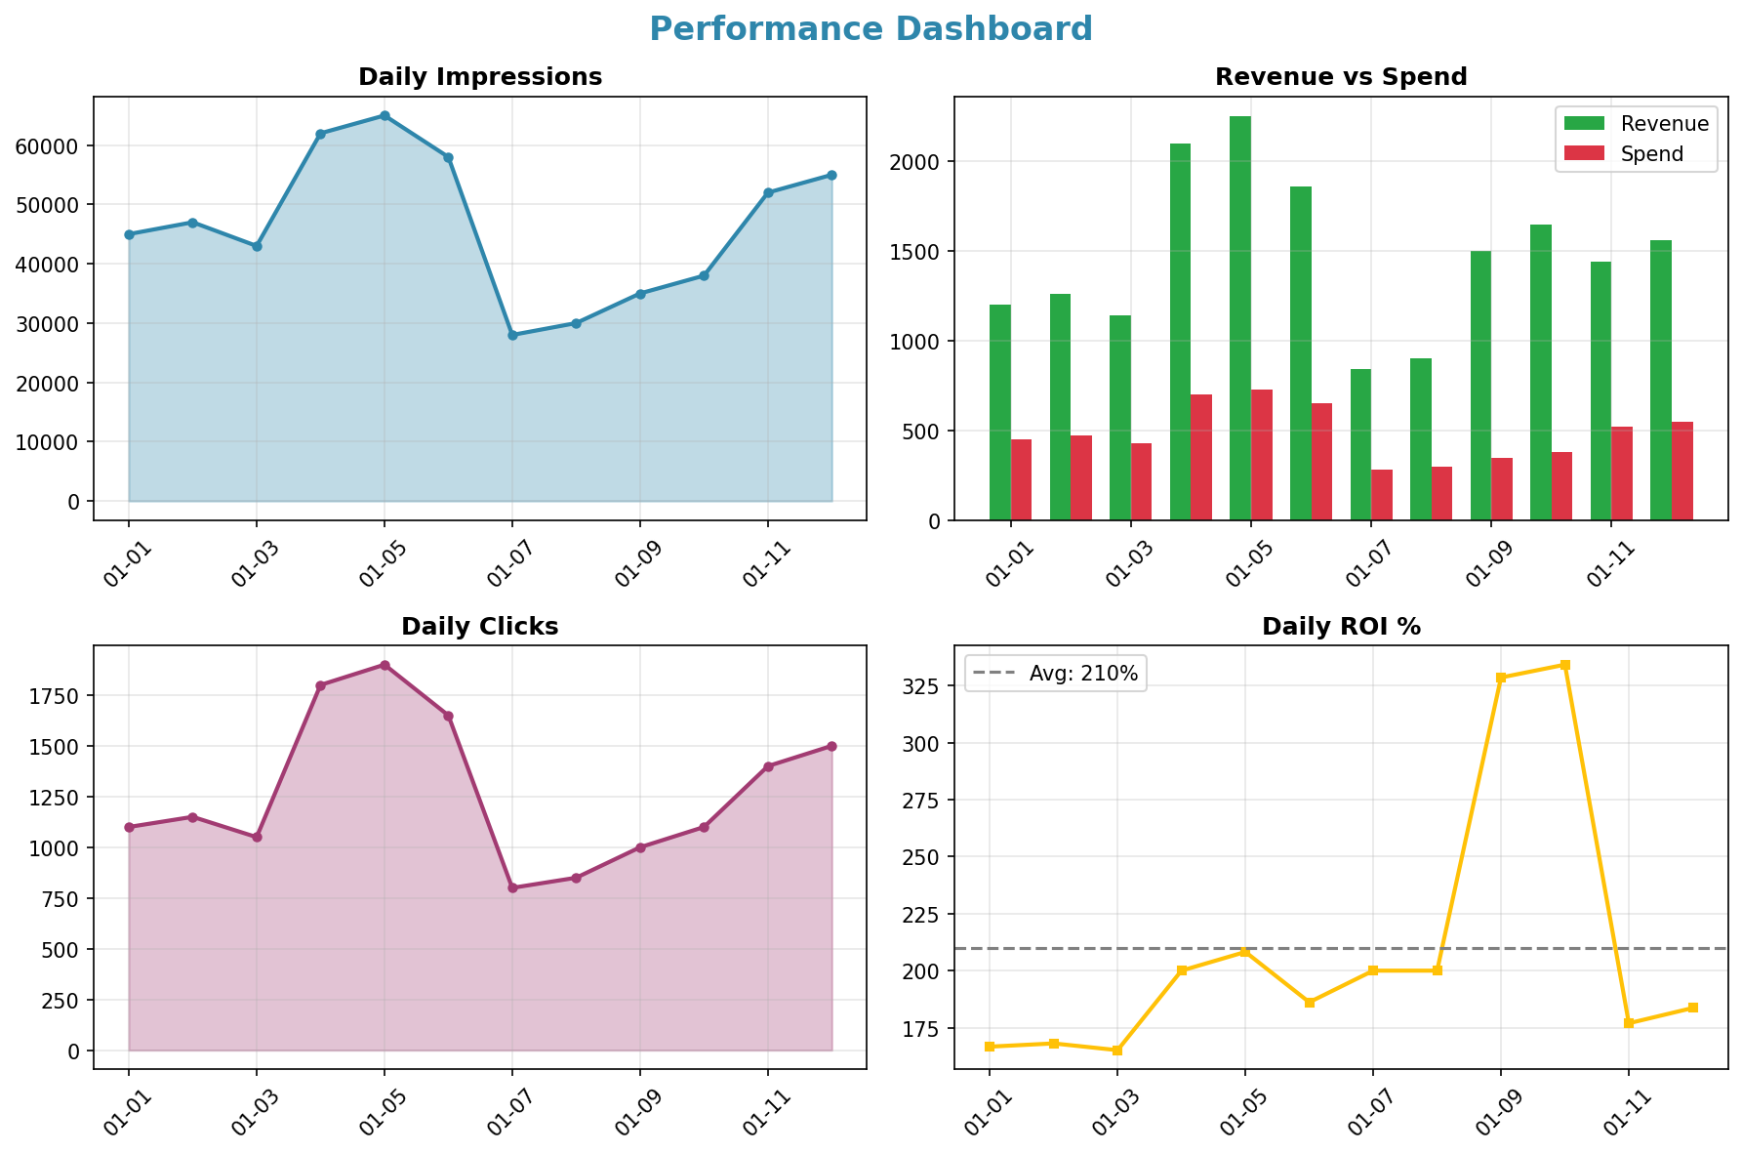
Performance Dashboard

Slide 5
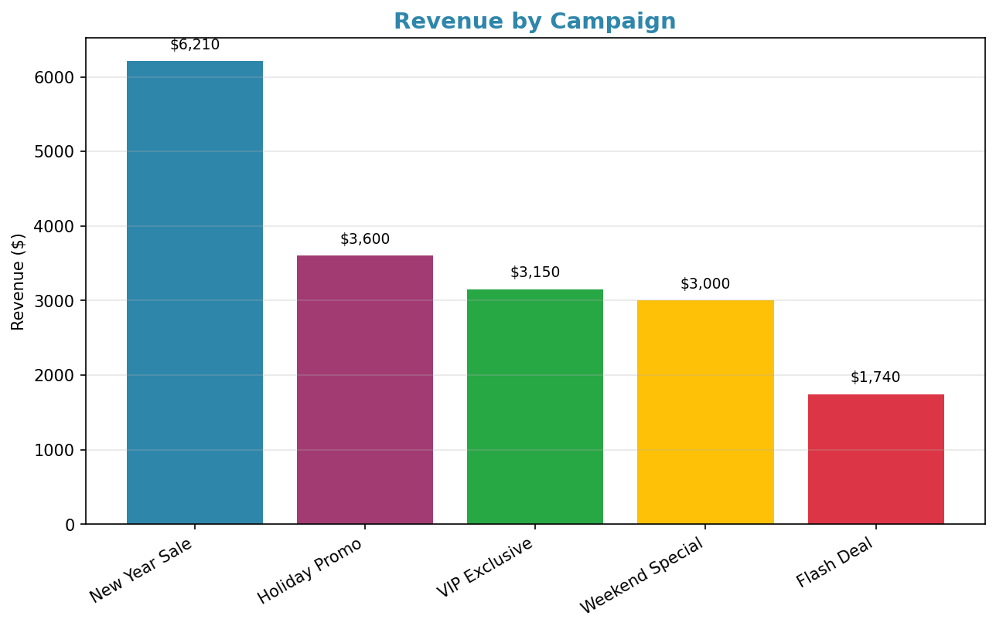
Campaign Performance

Slide 6
Strategic Recommendations
1
Increase budget for high-performing campaigns like New Year Sale.
2
Analyze anomalies to identify areas for improvement in conversion rates.
3
Test new ad creatives to boost engagement and click-through rates.
4
Consider retargeting ads for users who clicked but didn’t convert.
Recommendations generated by AI based on data patterns. Review and adapt to your business context.

