Slide 1
Unstructured Test
Performance Analytics Report
2024-01-01 | 2024-01-10
TOTAL REVENUE
RETURN ON INVESTMENT
TOTAL IMPRESSIONS
$15,500
193.6%
517,000
Generated: December 03, 2025 | Powered by TrendSpotter AI

Slide 2
Key Performance Indicators
IMPRESSIONS
CLICKS
CONVERSIONS
517,000
13,500
530
Total ad views delivered
Click-through rate: 2.61%
Completed actions
REVENUE
AD SPEND
ROI
$15,500
$5,280
193.6%
Total earnings generated
Marketing investment
Return on investment
KEY INSIGHT: Spring Launch leads with $4,700 revenue and 197% ROI

Slide 3
Executive Summary
AI-Generated Analysis
During the initial ten days of January 2024, our marketing campaigns generated 517,000 impressions and 13,500 clicks, leading to 530 conversions and a total revenue of $15,500. The overall advertising spend was $5,280, resulting in a robust ROI of 193.6%. Among the various campaigns, the Spring Launch led in expenditure at $4,700, while the Flash Deals campaign attracted the least at $1,750. Notably, there was one anomaly detected during this period, indicating potential areas for further investigation. This performance reflects strong engagement and conversion efficiency, positioning us well for future initiatives.
ANOMALIES DETECTED: 1 unusual patterns identified
- Spring Launch - unusual metrics on 2024-01-04

Slide 4
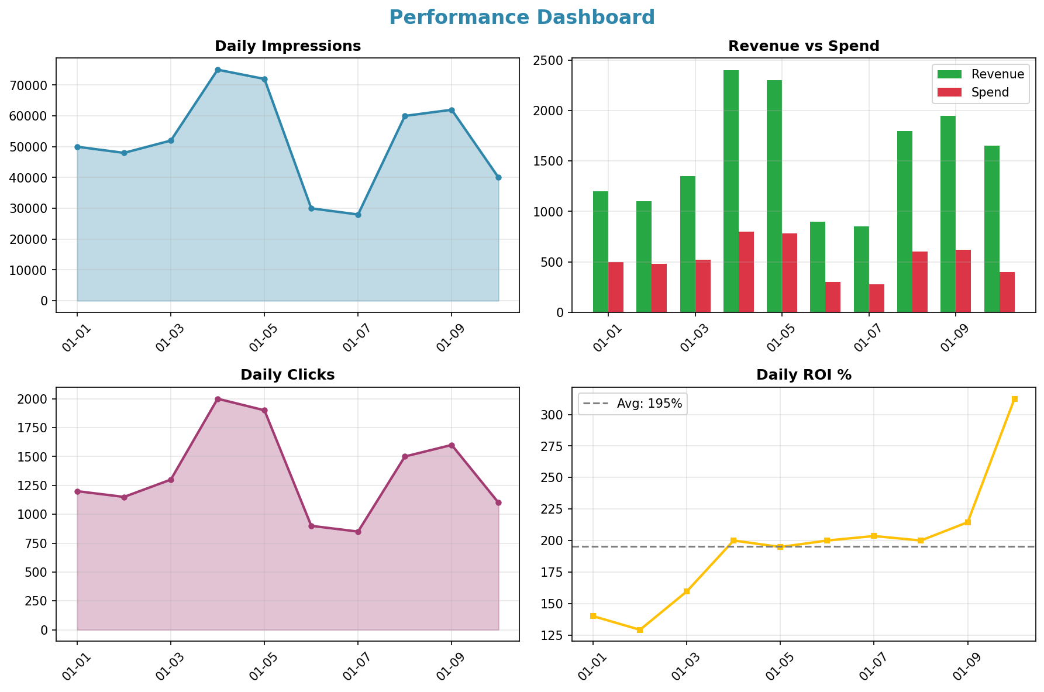
Performance Dashboard

Slide 5
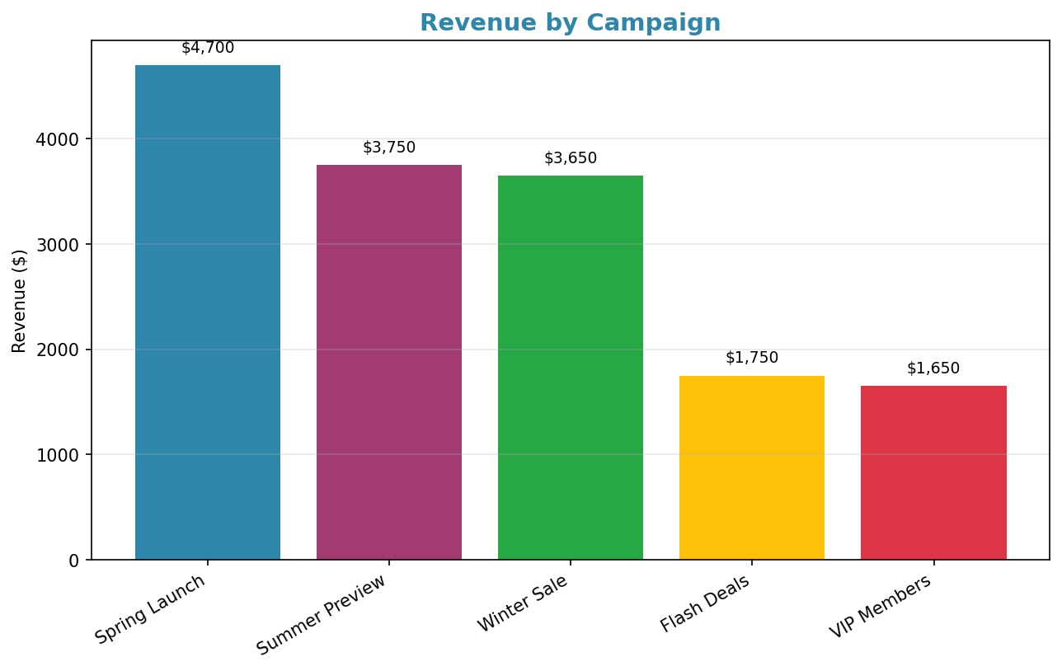
Campaign Performance

Slide 6
Strategic Recommendations
1
Optimize high-performing campaigns like Spring Launch for better ROI.
2
Investigate the single anomaly to ensure no future issues arise.
3
Allocate more budget to campaigns with higher conversion rates.
4
A/B test ad creatives for lower-performing campaigns to boost performance.
Recommendations generated by AI based on data patterns. Review and adapt to your business context.

