Slide 1
Weekly Performance Report
2025-11-01 to 2025-11-14 | Generated: December 03, 2025
IMPRESSIONS
CLICKS
CONVERSIONS
10,203,000
306,090
15,290
REVENUE
SPEND
ROI
$382,250
$194,070
97.0%

Slide 2
Executive Summary
🤖 AI-Generated
During the analysis period from November 1 to November 14, 2025, AdTech campaigns demonstrated robust performance with 10.2 million impressions, yielding 306,090 clicks and 15,290 conversions. Total revenue generated reached $382,250 against a spend of $194,070, resulting in a commendable ROI of 97.0%. The major revenue contributors were the Tech_Gadgets ($98,875) and Holiday_Promo ($88,075) campaigns, indicating strong consumer interest in technology and seasonal promotions. Notably, the dataset recorded 7 anomalies, warranting investigation for potential optimization opportunities. Overall, these insights highlight successful campaign strategies and areas to enhance ROI further by addressing the anomalies detected.
⚠️ Anomalies Detected: 7
• Tech_Gadgets - unusual metrics on 2025-11-03 (Miami)
• Tech_Gadgets - unusual metrics on 2025-11-04 (Miami)
• Winter_Collection - unusual metrics on 2025-11-07 (Chicago)

Slide 3
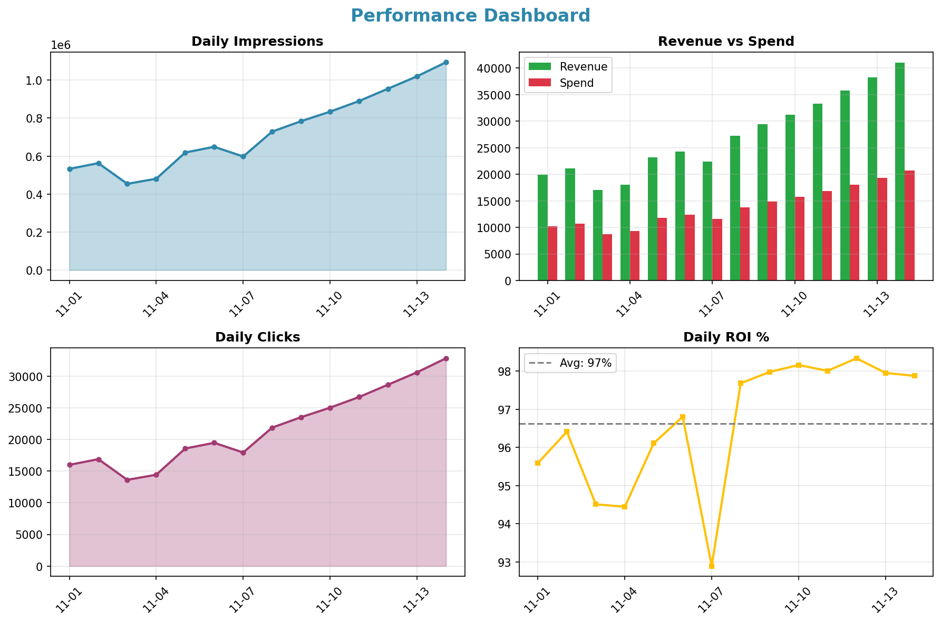
Performance Dashboard

Slide 4
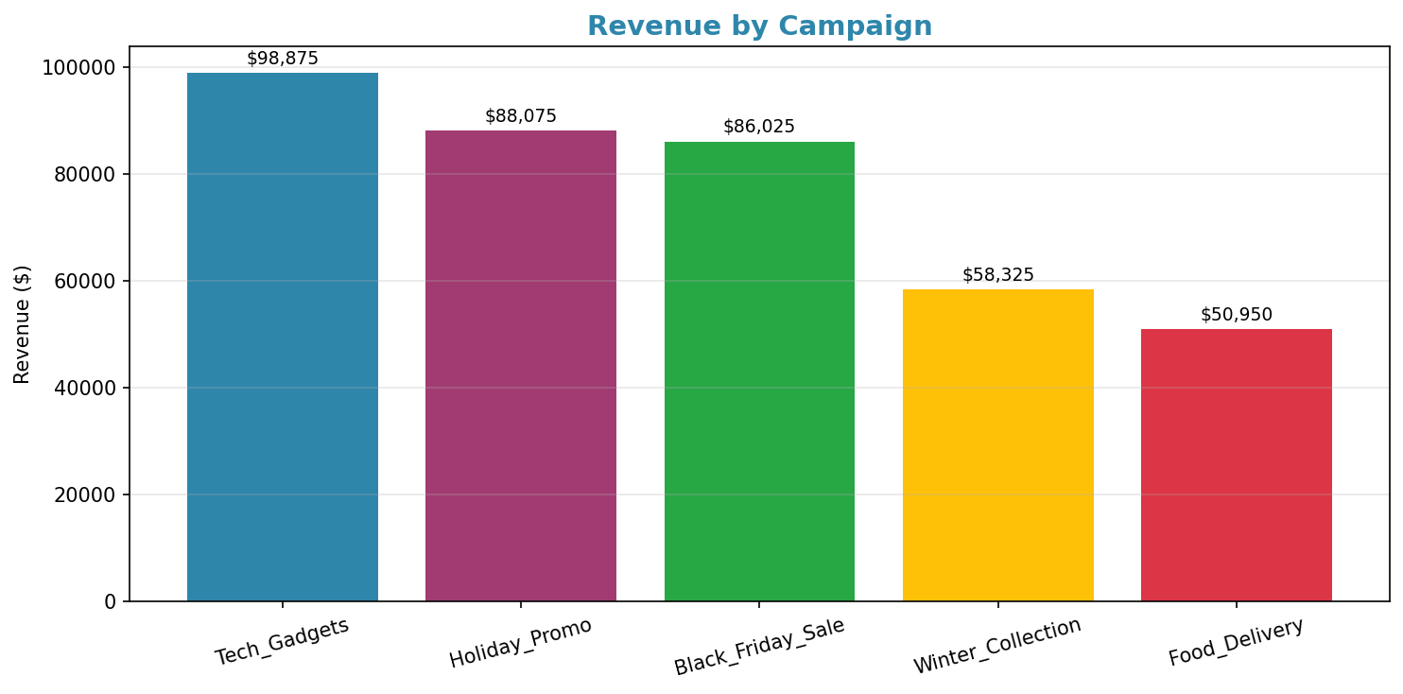
Campaign Performance

Slide 5
AI Recommendations
→ Analyze the performance of the Tech_Gadgets campaign, as it generated the highest revenue and could provide insights for future tech promotions.
→ Investigate the anomalies during the campaign period to identify any underlying issues that may have affected performance.
→ Consider reallocating budget from lower-performing campaigns like Food_Delivery to maximize ROI in more effective campaigns.
→ Leverage successful strategies from the Holiday_Promo and Black_Friday_Sale campaigns to inform upcoming seasonal marketing efforts.

