Slide 1
Image segmentation
Ravali Anthati
Rajyalakshmi Linga
Kishan Polekar

Slide 2
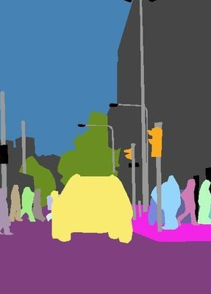
intro
In simple terms, image segmentation is the process of partitioning or separating an image into various segments so that it is easier to analyze.
Images can be segmented using various techniques like Threshold method, Clustering Based method, Region based method, and more.

Slide 3
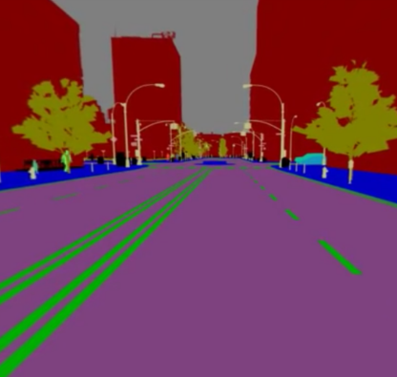
Image segmentation dataset
Taken from UCI database.
Ideal for the classification since it has a good number of rows and attributes. Also, easy to understand.
2310 observations; 19 attributes.
First column set as class attribute.
Seven classes:
Brickface Foliage Path Window
Cement Grass Sky

Slide 4
attributes
1. region-centroid-col 2. region-centroid-row 3. region-pixel-count 4. short-line-density-5 5. short-line-density-2 6. vedge-mean 7. vegde-sd 8. hedge-mean 9. hedge-sd 10. intensity-mean
11. rawred-mean 12. rawblue-mean 13. rawgreen-mean 14. exred-mean 15. exblue-mean 16. exgreen-mean 17. value-mean 18. saturation-mean 19. hue-mean

Slide 5

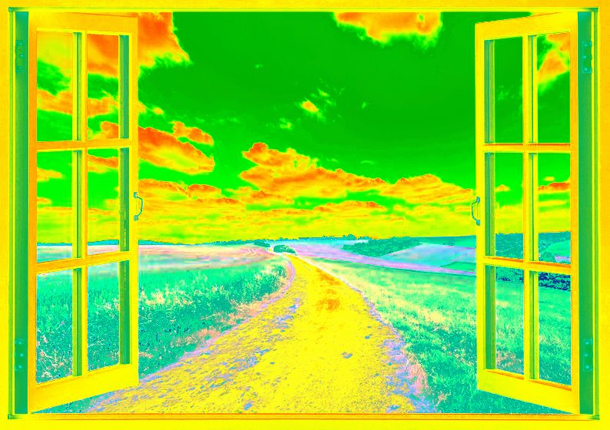
Before
After
Sample Image
for the Image
Segmentation
Dataset

Slide 6


Slide 7
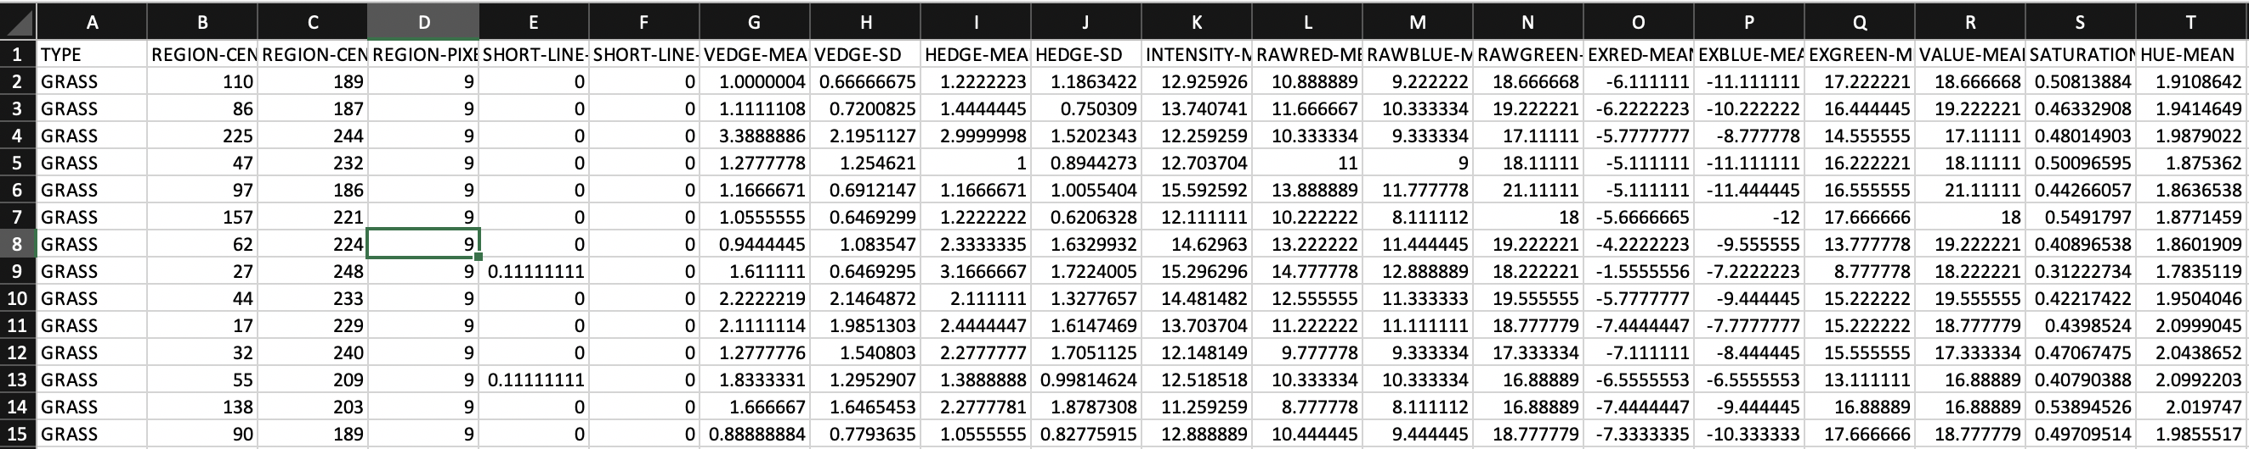
The dataset
Image Segmentation Data Set
First column as Class type, 19 attributes

Slide 8

Classifications and results

Slide 9
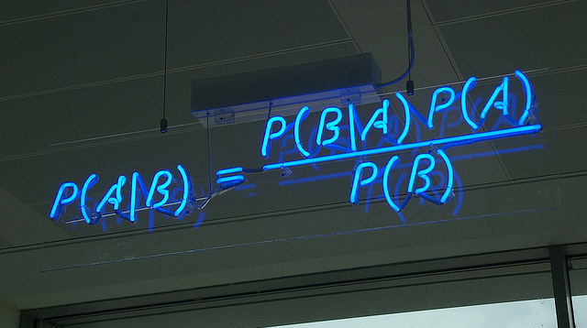
Naïve bayes classification

Slide 10
RESULTS FOR NAÏVE BAYES CLASSIFICATION
NUMBER OF ROWS IN TEST DATASET | NUMBER OF ROWS IN TRAINING DATASET | PREDICTION ERROR RATE | PREDICTION ERROR PERCENTAGE
0 | 2100 | 0.2004762 | 20.04 %
800 | 1300 | 0.2125 | 21.25 %
300 | 1800 | 0.1933333 | 19.34 %
100 | 2000 | 0.15 | 15.00 %

Slide 11
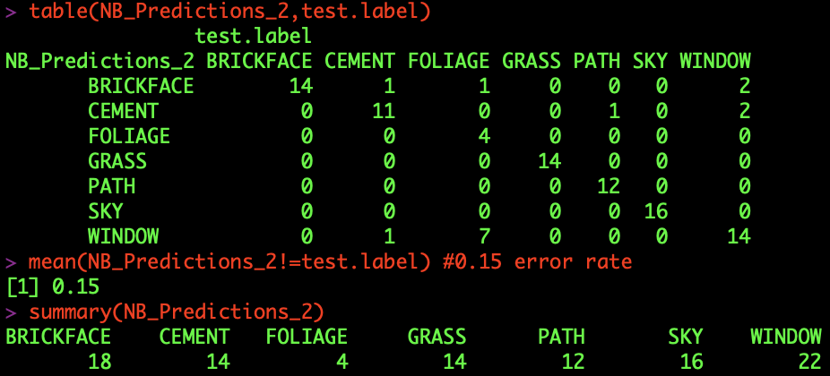
Results for naïve bayes classification
Analysis of Best Case
Best Case: Case 4
Observations in Training dataset for Best Case: 2000
Observations in Test dataset for Best Case: 100
Error rate for Best Case: 0.15 (15 wrong predictions out of 100)
Confusion Matrix and Summary:

Slide 12

Decision tree classification
Holdout Method

Slide 13
RESULTS FOR decision tree CLASSIFICATION
Holdout Method
NUMBER OF ROWS IN TEST DATASET | NUMBER OF ROWS IN TRAINING DATASET | PREDICTION ERROR RATE | PREDICTION ERROR PERCENTAGE
0 | 2100 | 0.0547619 | 5.47 %
1900 | 200 | 0.09421053 | 9.42 %

Slide 14
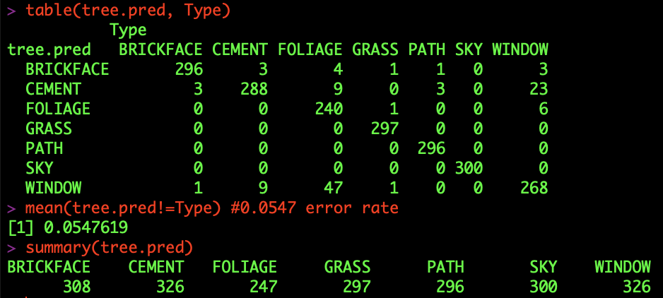
Results for decision tree classification
Analysis of Best Case for Holdout Method
Best Case: Case 1
Observations in Training dataset for Best Case: 2100
Observations in Test dataset for Best Case: 0
Error rate for Best Case: 0.0547 (115 wrong predictions out of 2100)
Confusion Matrix and Summary:

Slide 15
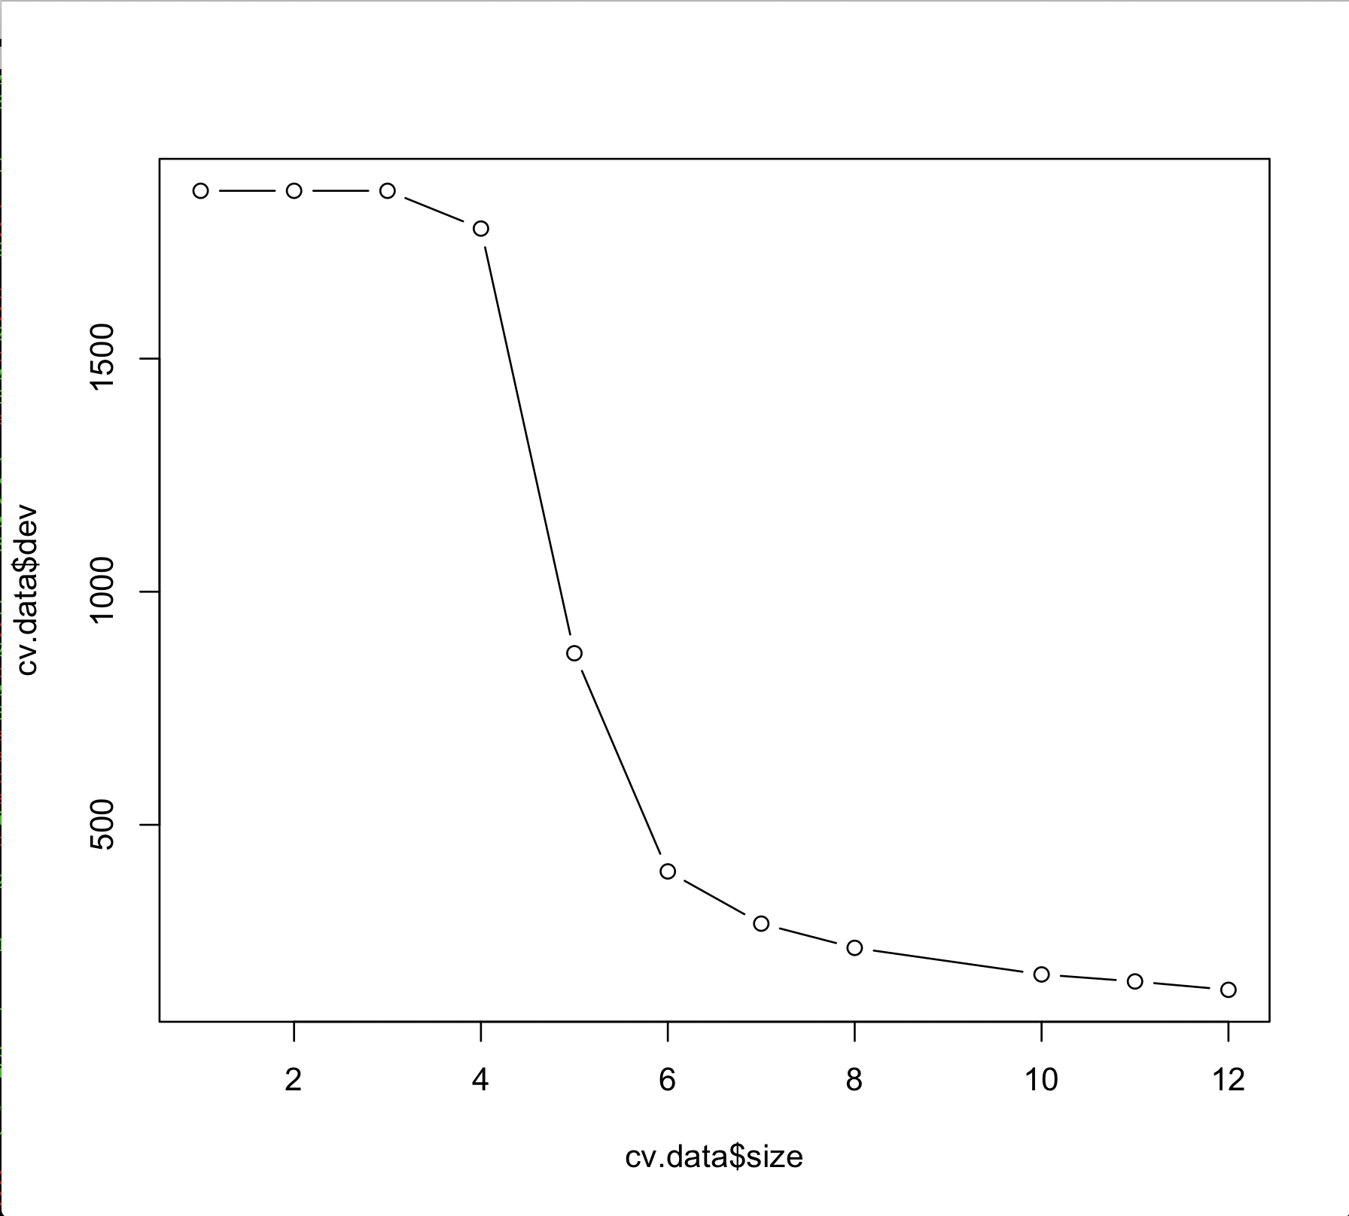
Cross validation testing
Training Data Set: 200 observations
Test Data Set: 1900 observations

Slide 16
Decision tree classification
Bagging

Slide 17
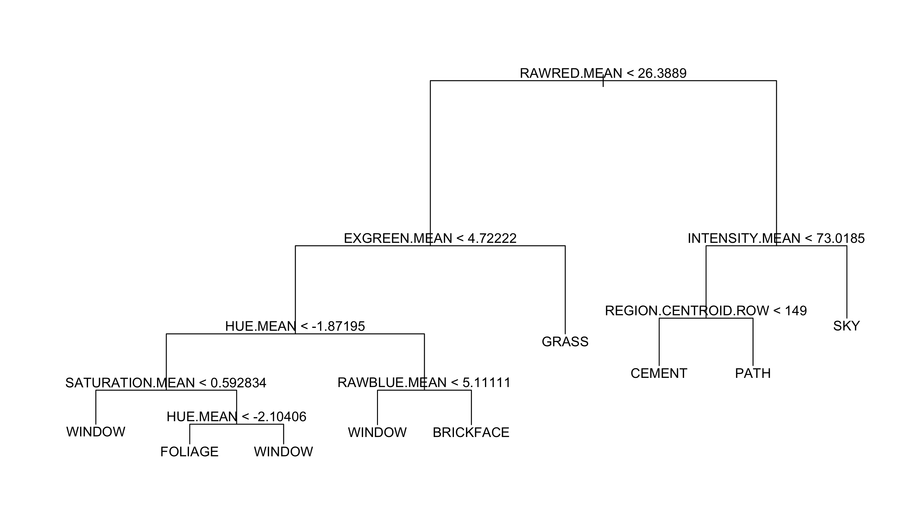
Pruning dataset with 9 nodes

Slide 18
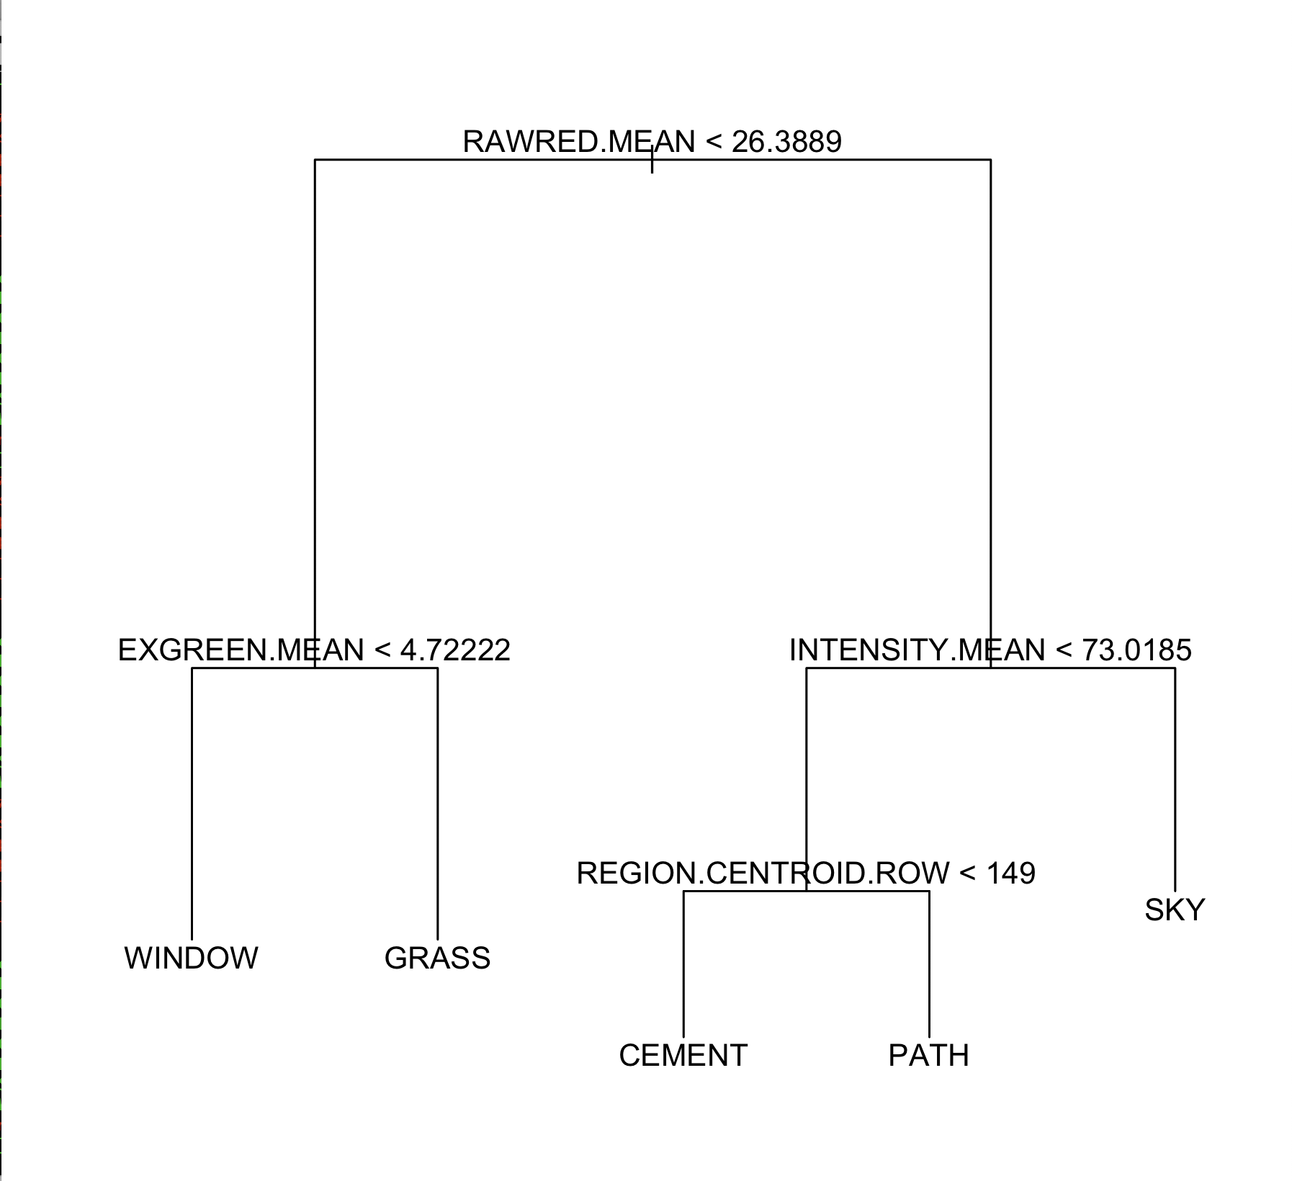
Pruning dataset with 5 nodes

Slide 19
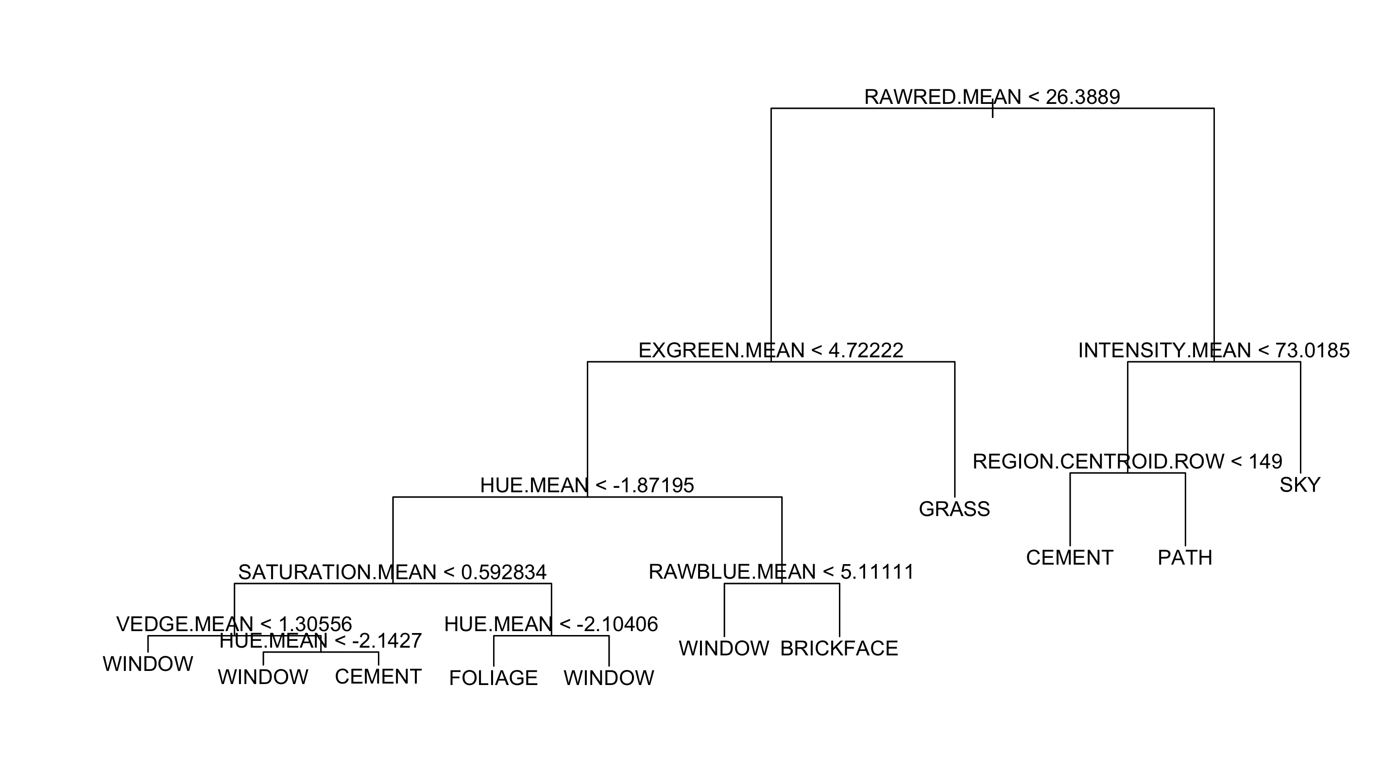
Pruning dataset with 11 nodes

Slide 20
RESULTS FOR decision tree CLASSIFICATION
Bagging
NUMBER OF NODES (BEST) | PREDICTION ERROR RATE | PREDICTION ERROR PERCENTAGE
9 | 0.09368421 | 9.37 %
5 | 0.3184211 | 31.84 %
11 | 0.09421053 | 9.42 %

Slide 21
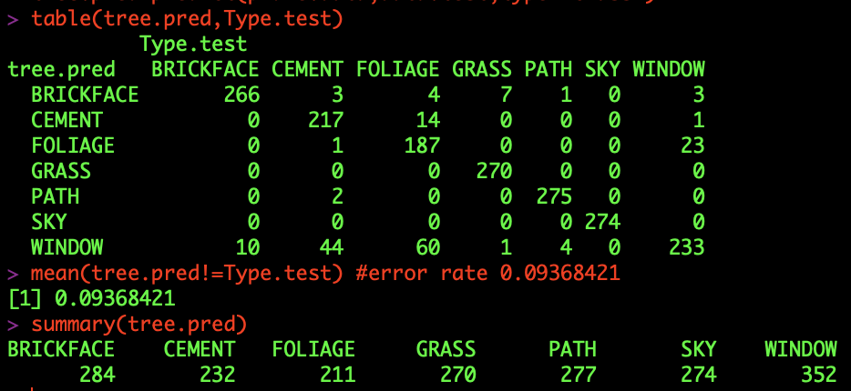
Results for decision tree classification
Analysis of Best Case using Bagging
Best Case: Case 1
Number of nodes for Best Case: 9
Error rate for Best Case: 0.0937 (178 wrong predictions out of 1900)
Confusion Matrix and Summary:

Slide 22

Random forest classification

Slide 23
RESULTS FOR random forest CLASSIFICATION
NUMBER OF TREES (NTREE) | NUMBER OF VARIABLES FOR SPLITTING AT EACH NODE (MTRY) | PREDICTION ERROR RATE | PREDICTION ERROR PERCENTAGE
500 | 10 | 0.07315789 | 7.32 %
1500 | 10 | 0.07315789 | 7.32 %
500 | 5 | 0.07631579 | 7.63 %
500 | 13 | 0.07157895 | 7.16 %

Slide 24
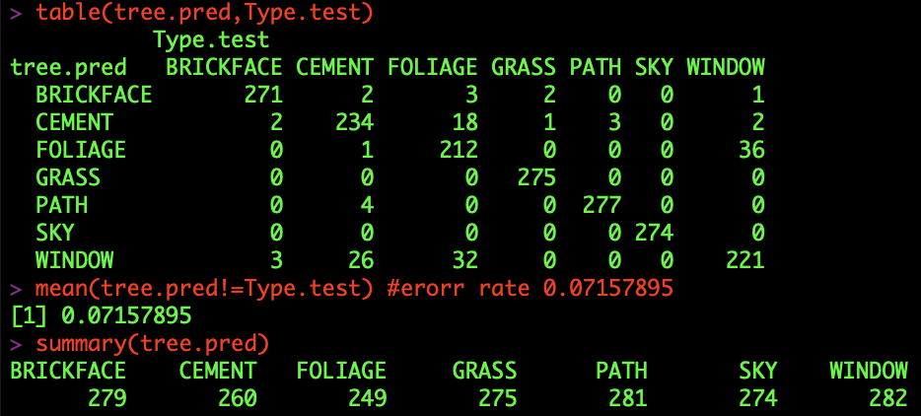
Results for random forest classification
Analysis of Best Case
Best Case: Case 4
Number of Trees in Best Case: 500
Number of Variables for Splitting at each node: 13
Error rate for Best Case: 0.0715 (136 wrong predictions out of 1900)
Confusion Matrix and Summary:

Slide 25

Support vector machine classification (svm)

Slide 26
RESULTS FOR support vector machine CLASSIFICATION
Linear
COST | PREDICTION ERROR RATE | PREDICTION ERROR PERCENTAGE
0.001 | 0.07333333 | 7.34 %
0.01 | 0.04952381 | 4.95 %
0.1 | 0.03809524 | 3.81 %
1 | 0.03761905 | 3.76 %
5 | 0.03761905 | 3.76 %
10 | 0.04095238 | 4.10 %

Slide 27
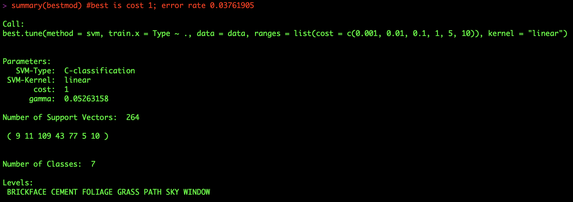
Results for support vector machine CLASSIFICATION
Linear
Analysis of Best Case
Best Case: Case 4
Cost of Best Case: 1
Error rate for Best Case: 0.0376 (79 wrong predictions out of 2100)
Summary:

Slide 28
RESULTS FOR support vector machine CLASSIFICATION
Radial
NUMBER OF OBSERVATIONS IN TRAINING DATASET | COST | GAMMA | BEST FOR THIS TRAINING DATASET | PREDICTION ERORR RATE | PREDICTION ERORR PERCENTAGE
200 | 1 | 1 | Cost: 1 Gamma: 1 | 0.8615789 | 86.16 %
 | 10 | 2
 | 100 | 3
500 | 1 | 1 | Cost: 1 Gamma: 1 | 0.860625 | 86.06 %
 | 10 | 2
 | 100 | 3
1300 | 1 | 1 | Cost: 10 Gamma: 1 | 0.845 | 84.50 %
 | 10 | 2
 | 100 | 3

Slide 29
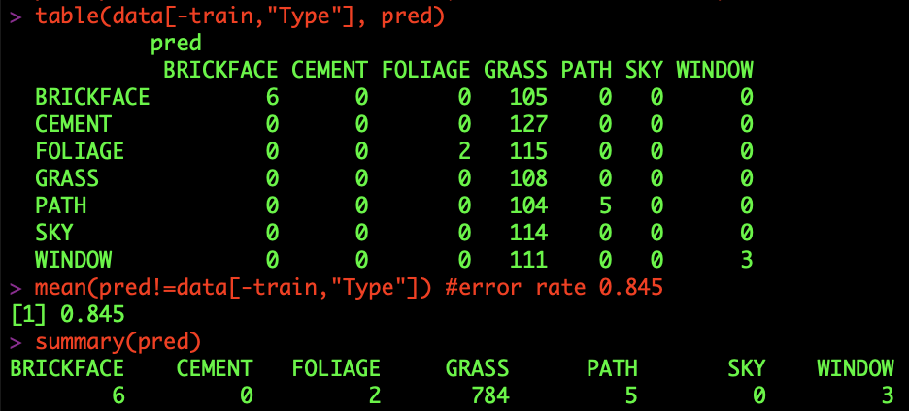
Results for support vector machine CLASSIFICATION
Radial
Analysis of Best Case
Best Case: Case 3
Number of Observations in Training Dataset for Best Case: 1300
Cost of Best Case: 10 Gamma of Best Case: 1
Error rate for Best Case: 0.845 (676 wrong predictions out of 800)
Confusion Matrix
and Summary:

Slide 30
RESULTS FOR support vector machine CLASSIFICATION
Polynomial
NUMBER OF OBSERVATIONS IN TRAINING DATASET | COST | DEGREE | BEST FOR THIS TRAINING DATASET | PREDICTION ERROR RATE | PREDICTION ERROR PERCENTAGE
200 | 1 | 1 | Cost: 10 Degree: 1 | 0.08473684 | 8.47 %
 | 10 | 2
 | 100 | 3
1600 | 1 | 1 | Cost: 100 Degree: 1 | 0.024 | 2.40 %
 | 10 | 2
 | 100 | 3
1800 | 1 | 1 | Cost: 100 Degree: 1 | 0.01666667 | 1.67 %
 | 10 | 2
 | 100 | 3

Slide 31
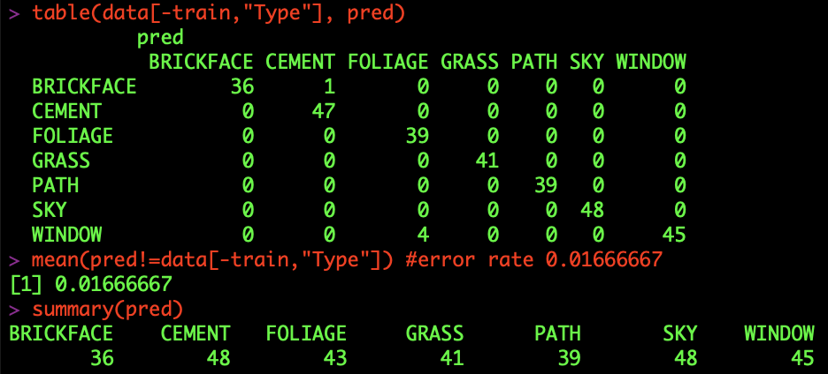
Results for support vector machine CLASSIFICATION
Polynomial
Analysis of Best Case
Best Case: Case 3
Number of Observations in Training Dataset for Best Case: 1800
Cost of Best Case: 100 Gamma of Best Case: 1
Error rate for Best Case: 0.0167 (5 wrong predictions out of 300)
Confusion Matrix
and Summary:

Slide 32

Final results

Slide 33
Overall results
PREDICTION METHOD | METHOD SUBTYPE | LEAST PREDICTION ERROR PERCENTAGE
Naïve Bayes | - | 15.00 %
Decision Tree | Holdout | 5.47 %
 | Bagging | 9.37 %
Random Forest | - | 7.16 %
Support Vector Machine | Linear | 3.76 %
 | Radial | 84.50 %
 | Polynomial | 1.67 %

Slide 34
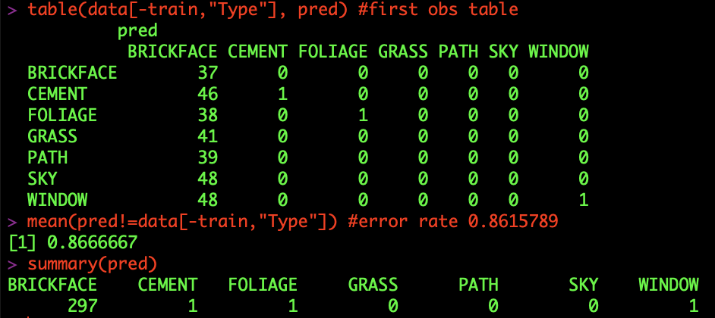
Overall results
Analysis of Overall Best Case
Best Method: Support Vector Machine (Polynomial)
Error rate for Overall Best Case: 0.0167 (1.67 %)
Summary:
Analysis of Overall Worst Case
Worst Method: Support Vector Machine (Radial)
Error rate for Overall Worst Case: 0.8615789 (86.16 %)
Summary:

Slide 35


Slide 36
Although all methods have their pros and cons, there has to be a best way to represent data. There can be several factors affecting the results like the dataset, attributes, etc. but our project which focused on Image Segmentation was best predicted using the Support Vector Machine (SVM) Polynomial Method. It had the least prediction error rate when compared to others.
S
V
M
upport
ector
achine

Slide 37

Questions?

