Slide 1

Fine Tuning a BERT Model for Text Classification
Kishan Polekar

Slide 2
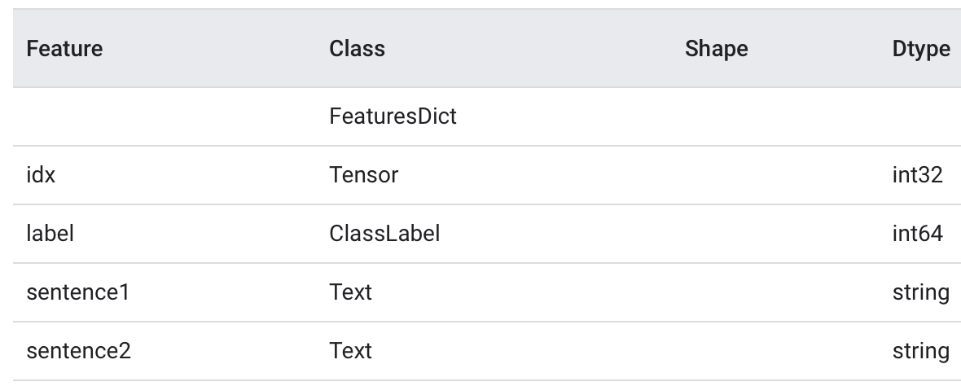
Text classification
Assess the similarity between two pairs of sentences/phrases.
Useful in several NLP tasks and various fields.
Training a BERT model using TensorFlow.
Corpus used: GLUE MRPC (Microsoft Research Paraphrase Corpus) through TensorFlow Datasets (TFDS).
Taken from various online news sources, annotated whether sentence pairs are semantically equivalent.
Two class labels: ‘equivalent’ | ‘not_equivalent’
Split | Number of Examples
train | 3,668
validation | 1,725
test | 408

Slide 3
Approach and data pre-processing
Tokenize each word in the sentence using the BERT Tokenizer.
Pack the tokenized inputs from list to BERT recognized nest of tensors.
Also tokenizes special characters using the special tokens dict containing 30k+ samples.
BertPackInputs expects the following format:
Type of problem: [CLS] in our case
Sentence 1 (tokenized) with SEP token (denoting Sentence Separation)
Sentence 2 (tokenized) with SEP token (denoting End of Sentence)
Returns dictionary containing:
input_word_ids: The tokenized sentences packed together.
input_mask: The mask indicating which locations are valid in the other outputs.
input_type_ids: Indicating which sentence each token belongs to.
Maximum Sentence Length: 128

Slide 4
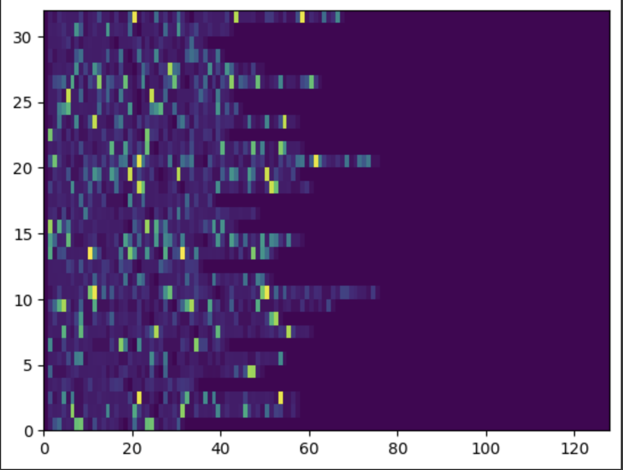
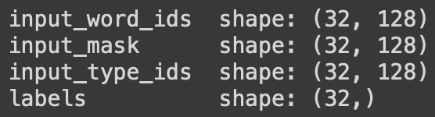
Sample data for bert model input
“hello tensorflow” : [[[7592], [23435, 12314]]]
“goodbye tensorflow”: [[[9119], [23435, 12314]]]
Packing the two sentences together, we have:
[[ 101 7592 23435 12314 102 9119 23435 12314 102 0 0 0]]
[[ [CLS] sentence_1 [SEP] sentence_2 [SEP] special_tokens_location]]
For our GLUE data, we have the following configuration on
training dataset:

Slide 5
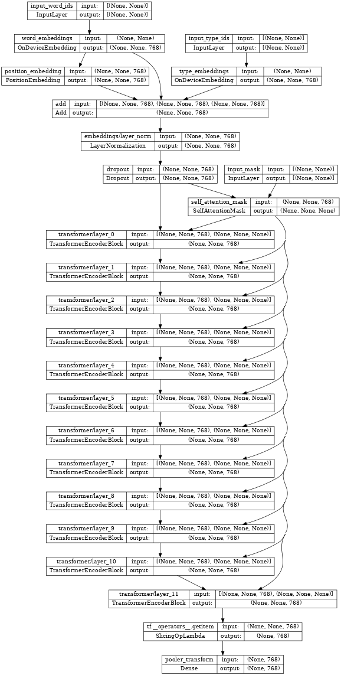
Pre-trained bert transformer encoder
Activation function (hidden layers): GELU
num_classes: 2
num_hidden_layers: 12
input_shape: (32,128)
Size of the network: 768 nodes

Slide 6
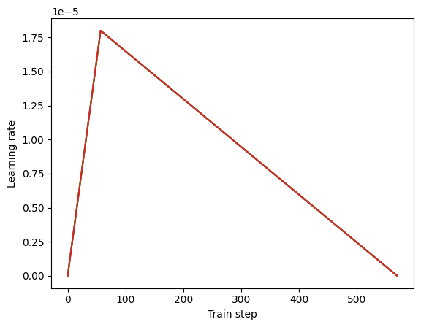
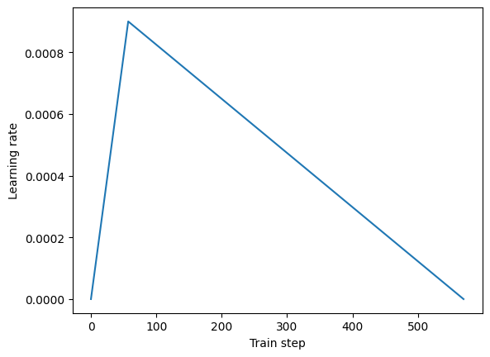
Optimizer setup
We use the Adam optimizer with weight decay.
Loss function used: SparseCategoricalCrossentropy
Learning rate starts from 0, warms up to an initial learning rate, then decays back to 0.
Epochs: 5
Batch size (training and validation): 32
Steps per epoch: 3668/32 = 114
Number of training steps: 570
Initial learning rate: 2e-5 (0.00002)

Slide 7
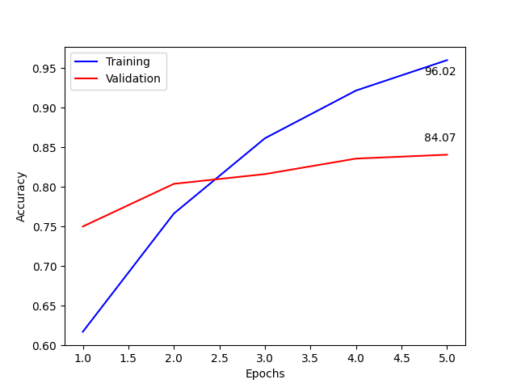
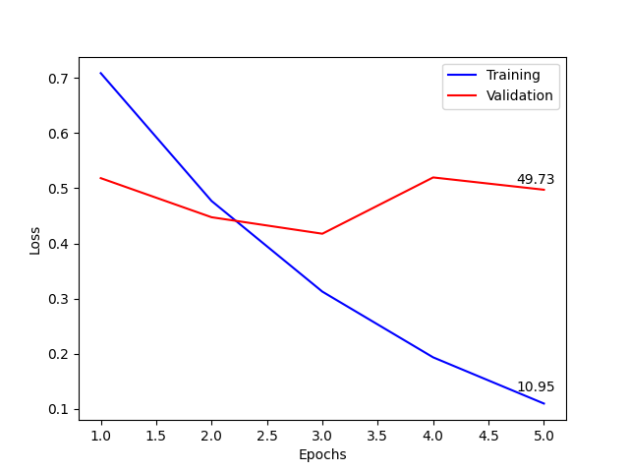
Model training
The base model performance on validation data:
Upon fitting the data over 5 epochs, we get:
loss: 0.6490 - accuracy: 0.6863
loss: 0.6217 - accuracy: 0.6835
loss: 0.6251 - accuracy: 0.6838
Learning rate: 2e-5
Learning rate: 2e-2
Learning rate: 1e-3

Slide 8
results
The fine-tuned model can predict similarities between pairs of sentences utilizing the TensorFlow Datasets library and GLUE BERT configurations.
We started out with a pre-trained BERT model and built on it using some hyperparameters like weight decay, learning rate, etc.
Validation loss was reduced from 0.649 to 0.4973 and accuracy on training set achieved a best score of 96%.
Sample sentence pairs and outputs:
Sentence Pair 1 | Sentence Pair 2
'The rain in Spain falls mainly on the plain.’ 'It mostly rains on the flat lands of Spain.' | 'Look I fine tuned BERT.’ 'Is it working? This does not match.'
‘equivalent’ | ’not_equivalent’

Slide 9
Next steps
This model classifies pairs of sentences in two groups: Equivalent and Non-equivalent.
We can further build on this for a specific domain and increase the number of classes.
One good starting point would be the ‘banking77’ model that has 77 class labels for phrases in the banking sector. We can have our model divide input sentences (not just sentence pairs) in a few of these classes related to banking.
Using a GPU instead of CPU (as used for this model) to reduce training time.

Slide 10
Thank you
Questions?

