Slide 1
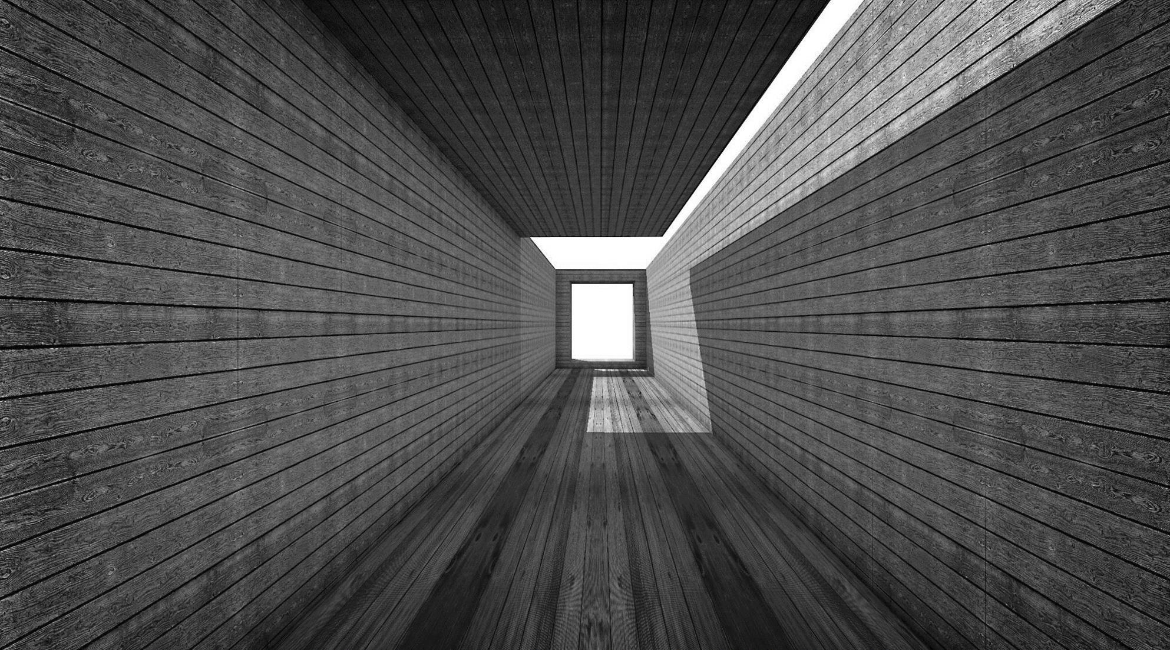
Home Security
SE 3910
The Group:
Kishan Polekar
Monis Ahmed Khan
Manthan Kale

Slide 2
Team
Kishan Polekar
Monis Ahmed Khan
Manthan Kale
Team Leader
Research Lead
Documentation Expert
Data Science minor. Good at speaking, listening, innovating. Loves programming.
Software engineering minor. Loves to explore new things in various fields. Good at preparing things to present.
Software engineering minor. Senior year. Loves to write and take notes. Good at documentation.
Home Security

Slide 3

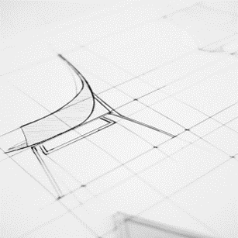

Background
A home security system is basically installed in each home to prevent against possible theft. There are many homes that have primitive systems installed and a few of the modern homes are being equipped with high end technologies. Some homes still use simple locks and keys. Security is paramount in houses today, and to achieve this, many latest technologies like facial recognition, fingerprint scanner, pin codes, etc. have been developed.
Home Security

Slide 4





The Problem
Locks can be broken
Keys stolen
Keys duplicated
Face not recognised
Incorrect Fingerprint
Traditional locks can be broken easily.
Thieves can steal your keys.
For a cheap cost, many copies can be made for your house keys.
Latest technology can fail and it can refuse to recognise your face.
Your finger might be wet which can result in your biometric not being registered.
Home Security

Slide 5




Solution
In addition to using the latest technology, we can make the house more secure by modifying the existing systems. This would mean updating or replacing some of the things in addition to installing new software and hardware for enhanced security.
Biometrics
Central Locking
Cameras
We can use advanced facial, voice, and fingerprint systems that will learn and improve by updating its system each time a registered user is identified.
A manual system can be used to further verify who gets access to what.
Normal cameras can be replaced with cameras that have night and thermal vision that detects any human presence.
Home Security

Slide 6



Solution (cont.)
Each user will be registered in one of three categories: owner, guest, servant. Owner will have complete access to the house while the other two will have permissions set by the owner. There will also be a vacation mode.
LIVE Feed
Vacation Mode
Break In
A 24-hour feed will be installed around the house that will keep track of people in the house and learn their behaviours.
When the owners are out, vacation mode is used to keep everything safe.
In case of a break in despite of all this, the security system will act accordingly. There are different settings for normal and vacation mode.
Home Security

Slide 7

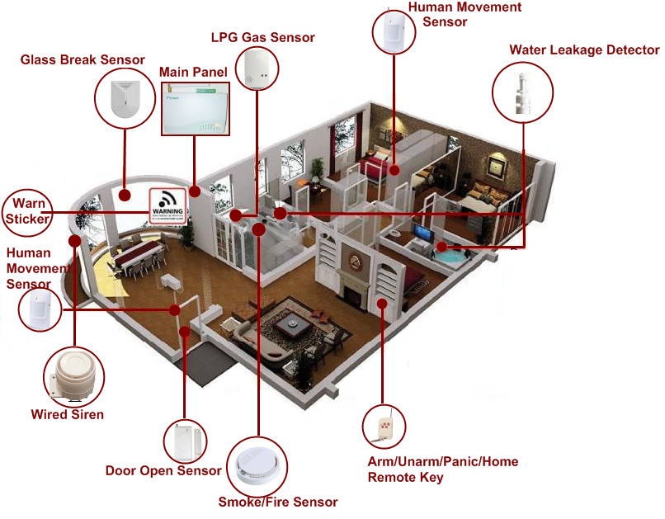
Product
The product will aim at reducing costs of installation by updating already in place systems. It will also require several hardware equipment that are connected to the central security system. A database will be provided to store live feed which can be retrieved anytime. Traditional locks will also be in place in case of emergencies. These will be controlled using a software too.
Home Security

Slide 8


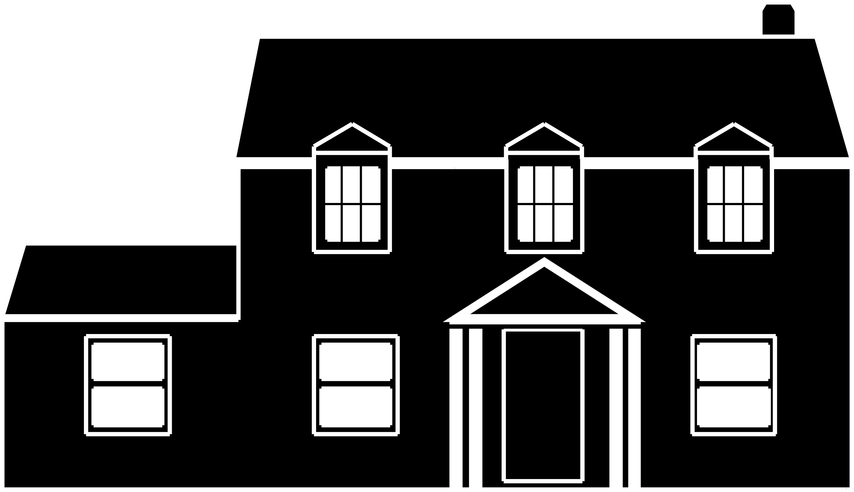

Product (cont.)
Our product will target customers that live in almost all types of environments. There will be different plans to chose from.
Home
Professional
Small homes.
Small businesses or medium homes.
Advance
Premium
Big homes and sizeable businesses.
Large businesses.
Home Security

Slide 9
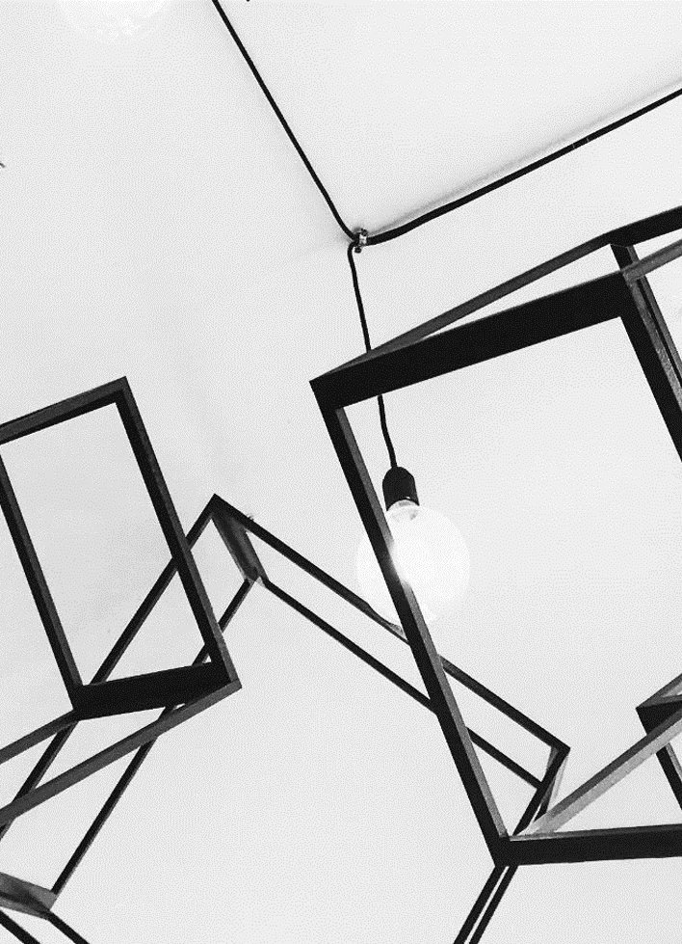



Challenges
Software
Hardware
Cost & Maintenance
At any given time, due to various reasons, software might fail. Some reasons are failing to update, no internet access, etc.
Hardware can go bad due to bad weather, tampering, lack of proper care.
A product like this requires careful planning and a lot of time. It will also need a hefty amount of money for installation as well as maintenance.
Home Security

Slide 10
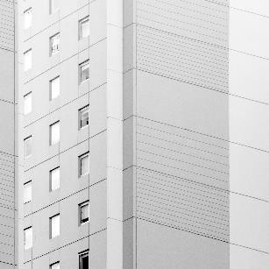

Summary
Our product, in addition to being one of its kind, is also very simple and basic. It will ensure that your house is secure at all times while learning the environment on a constant basis which will minimize the chances of theft.
https://www.researchgate.net/profile/Mohammed_Mynuddin/publication/293173717_Design_and_Implementation_of_Smart_Home_Security_System/links/56b610a608ae5ad360598bfb/Design-and-Implementation-of-Smart-Home-Security-System.pdf?origin=publication_detail
References
Home Security

Slide 11

Thank You

