Slide 1


M.Tech Program
Advanced Industry Integrated Programs
Jointly offered by University and LTIMindTree
Project Title
ClaimGuard-MCP : Multimodal Insurance Claim Consistency & Fraud Arbiter
Name: Kishan Patel
Knowledge partner | Implementation partner

Slide 2
ClaimGuard-MCP : Multimodal Insurance Claim Consistency & Fraud Arbiter
Introduction
Insurance companies process thousands of claims every month each one a bundle of claim forms, itemized bills, medical or repair invoices, and damage photos and adjusters must manually cross-check every number and date against policy rules before a claim can be settled, a process that typically takes 7 to 14 days per claim.
AI chatbots are increasingly explored to speed this up, but they have two big problems: they frequently hallucinate numbers when adding up bills or totals, and they struggle to reliably track dates across documents so a treatment billed before an accident even happened can slip through undetected.
This project, ClaimGuard-MCP, builds a smarter system that reads claim documents and damage photos together, then hands off all the math and date-checking to a deterministic engine instead of the AI turning a slow, error-prone manual review into an accurate, near-instant one.

Slide 3
ClaimGuard-MCP : Multimodal Insurance Claim Consistency & Fraud Arbiter
Objective
Build a system that extracts claim data from documents and photos with strict validation (Pydantic schemas + DuckDB storage), then verifies it through modular MCP servers — one for extraction, one for policy checks, one for cross-checking consistency.
Achieve deterministic, 100% accurate math and date-checking via SQL (not AI guesswork), catching fraud and errors with over 90% precision and recall — while giving adjusters a transparent, audit-ready report for every decision.

Slide 4
ClaimGuard-MCP : Multimodal Insurance Claim Consistency & Fraud Arbiter
Scope
Covers multimodal insurance claim dossiers forms, invoices, and damage photos evaluated on a synthetic benchmark of 50 cases (25 clean, 25 defective) spanning arithmetic, timeline, policy, and visual-evidence checks.
Delivered as a working prototype with an adjuster review dashboard, meant for research and demonstration not a certified fraud-detection tool or production-ready commercial system.

Slide 5
ClaimGuard-MCP : Multimodal Insurance Claim Consistency & Fraud Arbiter
Dataset
From Kaggle (real-world base): Structured claim data and templates e.g. datasets like "Vehicle Insurance Claim Fraud Detection" or "Auto Insurance Claims Data" for realistic claim forms, billing patterns, and fraud-labeled examples used to model authentic formats and typical claim/invoice structures.
Synthetically generated (custom-built): Damage photos paired with mismatched claims, planted timeline paradoxes (treatment/repair dated before the incident), and policy-breach scenarios cases Kaggle doesn't provide created to specifically test the system's cross-checking and fraud-detection logic.

Slide 6
ClaimGuard-MCP : Multimodal Insurance Claim Consistency & Fraud Arbiter
Additional Information…. Calibri body -36
Layer | Technology | Role
Protocol | FastMCP (Python SDK) | Implements Model Context Protocol tools over stdio/SSE
Vision / OCR | Qwen2-VL-7B + Surya OCR | Parses form data, tables, and validates damage photos against claimed line items
Storage & Math | DuckDB + Pydantic v2 | Zero-hallucination SQL storage for math, aggregations, and date checks
Reasoning Engine | Ollama (Llama 3.1 8B) | Context synthesis, routing across MCP servers, structured JSON generation
Application & Deployment | FastAPI + Streamlit + Docker Compose | REST API, adjuster dashboard UI, and containerized deployment
Dataset | Kaggle (real-world base) + Synthetic (custom anomalies) | Hybrid dataset for realistic structure + targeted fraud/error test cases

Slide 7
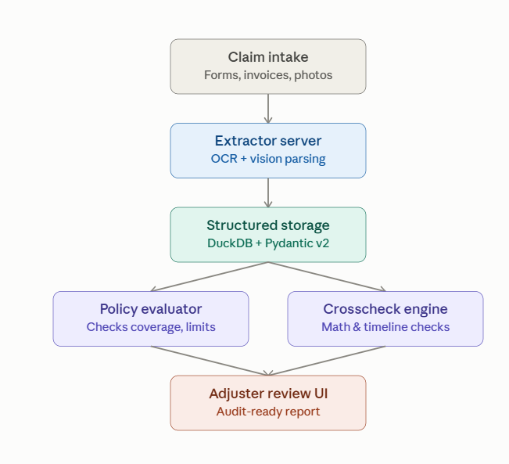
ClaimGuard-MCP : Multimodal Insurance Claim Consistency & Fraud Arbiter
Outcome and flowchat
Claim settlement time drops from 7–14 days to under 90 seconds per dossier, with 100% arithmetic and date accuracy since all calculations run through DuckDB instead of the AI.
Fraud and error detection achieves over 90% precision and recall on the benchmark, with every decision backed by a transparent, audit-ready report showing exactly which document or photo triggered the flag.

