Slide 1


M.Tech Program
Advanced Industry Integrated Programs
Jointly offered by University and LTIMindTree
Project Title
SEC EDGAR Forensic Audit System
A Dual-Pipeline Architecture for Zero-Hallucination Financial Auditing
Name: Kishan Patel
Knowledge partner | Implementation partner

Slide 2
SEC EDGAR Forensic Audit System
Introduction
Public companies like Apple, Tesla, and JPMorgan must file detailed financial reports (10-K, 10-Q) with the SEC every quarter and year — often running 100 to 300+ pages of tables, summaries, and legal fine print, which investors and analysts rely on for major decisions despite the hours it takes to read manually.
AI chatbots are increasingly used to speed this up, but they have two big problems: they often get financial numbers wrong when reading complex tables, and they tend to miss hidden risks buried in the fine print, picking up only the cheerful executive summary instead.
This project builds a smarter system that pulls numbers accurately every time and actively cross-checks what a company says against what it admits in the fine print turning a slow, error-prone manual process into something fast and trustworthy.

Slide 3
SEC EDGAR Forensic Audit System
Objective
Build a reliable AI system that reads SEC financial filings and answers questions accurately pulling exact numbers instead of letting AI guess from tables, and tracking figures across multiple filings to catch when a company quietly changes a previously reported number.
Automatically compare a company's optimistic executive summary against its footnote disclosures to flag hidden risks or contradictions, and prove the system actually works through real, verifiable testing rather than just claiming it does.

Slide 4
SEC EDGAR Forensic Audit System
Scope
Covers analysis of SEC filings (10-K and 10-Q) for a set of public companies across different industries technology, automotive, and banking to ensure the system works across varied reporting styles.
Focuses on three core capabilities: accurate numeric lookup, narrative/risk-factor search, and contradiction detection between executive summaries and footnotes.
Delivered as a working prototype with an interactive dashboard, intended for research and analyst assistance not as a certified financial advisory tool or a production-scale commercial product.

Slide 5
SEC EDGAR Forensic Audit System
DataSet
Source: U.S. SEC EDGAR (Electronic Data Gathering, Analysis, and Retrieval system) the official, free, public database where all U.S. publicly traded companies are legally required to file their financial reports..
Two types of data were collected for each company:
  XBRL Financial Facts (structured, machine-readable JSON) :exact numbers like revenue, net income, and assets, already tagged by the company itself in a standardized format.
  Raw Filing Documents (HTML) : the full text of the report, later split into sections like the executive summary, footnotes, and risk factors.

Slide 6
SEC EDGAR Forensic Audit System
Technical Stack
Layer | Technology | What It Does
Data Source | SEC EDGAR API (via edgartools) | Fetches official financial filings and structured data directly from the government database
Document Parsing | BeautifulSoup4 | Splits raw filing text into meaningful sections — executive summary, footnotes, risk factors
Numeric Database | DuckDB | Stores exact financial numbers for instant, error-free lookups — no AI guessing involved
Semantic Search | ChromaDB + sentence-transformers | Understands the meaning behind a question to find relevant passages in the report text
Keyword Search | BM25 | Catches exact accounting terms and phrases that meaning-based search might miss
Reranking | Flashrank | Picks the best, most relevant results from combined search methods
AI Reasoning | Google Gemini (gemini-flash-latest) | Compares a company's narrative claims against footnote disclosures to spot contradictions
Query Routing | Custom Python logic | Automatically decides whether a question needs a number, a text search, or a contradiction check
Web Interface | Streamlit | Interactive dashboard where users can ask questions and see cited answers
Testing | Pytest, RAGAS | Verifies the system's accuracy through real, repeatable tests

Slide 7
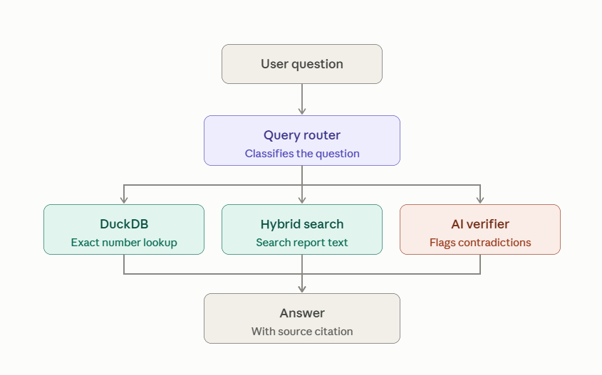
SEC EDGAR Forensic Audit System
Flowchart & Outcomes
A working system that answers questions about SEC financial filings accurately giving exact numbers every time and flagging hidden risks in the fine print, tested and proven on real filings from Apple, Tesla, and JPMorgan.
Clear proof that the approach actually works better than a standard AI method shown through a fair, side-by-side test where the standard approach failed and this system got every number right.

