Slide 1


M.Tech/MCA Program
Advanced Industry Integrated Programs
Jointly offered by University and LTIMindTree
Review II
SEC EDGAR Forensic Audit System
A Dual-Pipeline Architecture for Zero-Hallucination Financial Auditing
Team Member
Kishan Patel
Knowledge partner | Implementation partner

Slide 2
SEC EDGAR Forensic Audit System
Introduction
The Problem
• SEC 10-K / 10-Q filings are 100–200 pages of dense financial tables and legal text
• Standard LLMs and RAG systems hallucinate financial numbers due to table fragmentation
• Naive RAG shows a 42.9% numerical error rate on financial metric queries
• No existing system can detect silent accounting restatements across filings
• Management claims in Item 7 (MD&A) often contradict disclosures in Item 8 (Footnotes)
Our Solution
• A Dual-Pipeline Forensic Audit System built specifically for SEC EDGAR filings
• Track A: DuckDB SQL Engine for 100% precise numeric retrieval (zero hallucination)
• Track B: Section-Aware Hybrid RAG + LLM Verifier for narrative contradiction detection

Slide 3
SEC EDGAR Forensic Audit System
Objective
Primary Objectives
• Eliminate numerical hallucinations in financial metric retrieval using structured SQL over XBRL data
• Detect silent accounting restatements and figure revisions across multiple filing dates
• Build a section-aware hybrid retrieval engine that respects SEC regulatory boundaries
• Automate cross-examination of MD&A executive claims vs. Footnote disclosures using LLM
Key Targets
• Achieve 100% numerical precision on financial metric queries (vs. 57.1% in Naive RAG)
• Reduce hallucination rate from 42.9% to 0.0%
• Support automated restatement detection with dollar and percentage variance calculation
• Provide traceable SEC EDGAR source URLs for every audit finding

Slide 4
SEC EDGAR Forensic Audit System
System Architecture — Four Core Pillars
Pillar 1: Zero-Hallucination DuckDB SQL Engine
• Ingests XBRL financial facts into embedded DuckDB OLAP database
• Executes pure SQL queries — 100% precision, 0% hallucination
Pillar 2: Restatement & Revision Detection Engine
• Groups facts by (fiscal_year, period, concept) across filing dates
• Calculates exact dollar variance and percentage shift for amended figures
Pillar 3: Section-Aware Hybrid Search Engine
• ChromaDB dense vectors + BM25 lexical search + Flashrank cross-encoder reranking
• Respects SEC regulatory section boundaries (Item 1A, Item 7, Item 8)
Pillar 4: Dual-Pass LLM Forensic Verifier
• Pass A retrieves MD&A claims, Pass B retrieves Footnote disclosures
• Google Gemini evaluates severity: Contradiction / Qualification / None

Slide 5
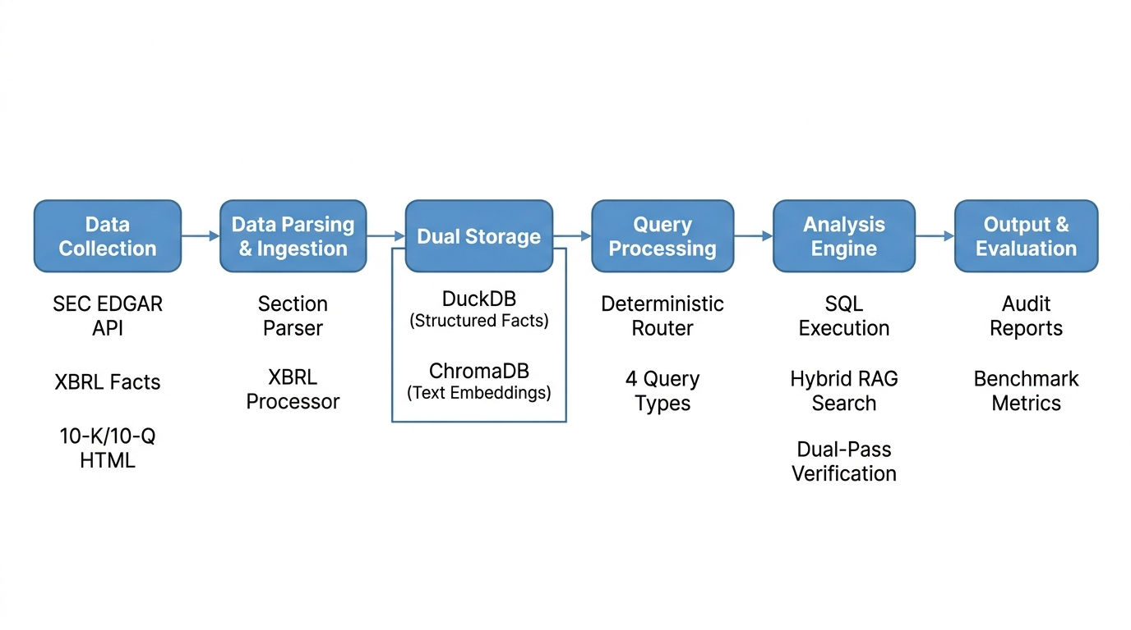
SEC EDGAR Forensic Audit System
Methodology / Modeling Plan
• Our approach follows a 6-stage pipeline from data collection to evaluation

Slide 6
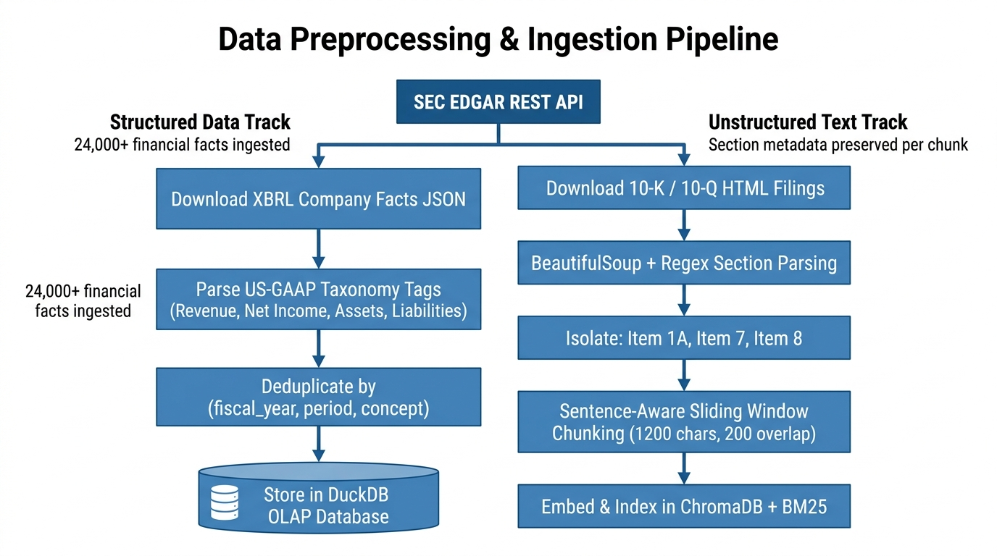
SEC EDGAR Forensic Audit System
Data Preprocessing & Ingestion
• Data is sourced directly from SEC EDGAR REST API — no third-party datasets used

Slide 7
SEC EDGAR Forensic Audit System
Approach / Algorithms / Tools
Tool / Library | Role in Project | Why Selected
DuckDB | Embedded OLAP Database | Columnar SQL, <5ms queries, zero server overhead
ChromaDB | Vector Database | Dense vector search with metadata filtering
BM25 (rank_bm25) | Lexical Keyword Search | Exact accounting term matching (ASC 606, FIFO)
Flashrank | Cross-Encoder Reranker | Neural cross-attention reranking, lightweight ONNX
Google Gemini | LLM Verifier (gemini-flash) | Dual-pass forensic reasoning, high context window
SEC EDGAR API | Data Provider | Official regulatory source for XBRL + HTML filings
Streamlit | Web UI Framework | Interactive dashboard with session state management
Pytest | Testing Framework | Automated unit + integration + benchmark tests

Slide 8
SEC EDGAR Forensic Audit System
Project Plan / Milestones Progress
Review I — Completed
• Literature survey on RAG failures in financial auditing
• System architecture design — dual-pipeline approach finalized
• SEC EDGAR API integration and XBRL data ingestion pipeline built
• DuckDB schema design and structured fact storage implemented
Review II — Completed
• Section-Aware Hybrid RAG engine (ChromaDB + BM25 + Flashrank) implemented
• Deterministic query router with 4-way classification deployed
• Dual-Pass LLM Forensic Verifier with Google Gemini integrated
• Restatement detection engine with variance calculation built
• Benchmark evaluation: 100% numeric precision, 0% hallucination achieved

Slide 9
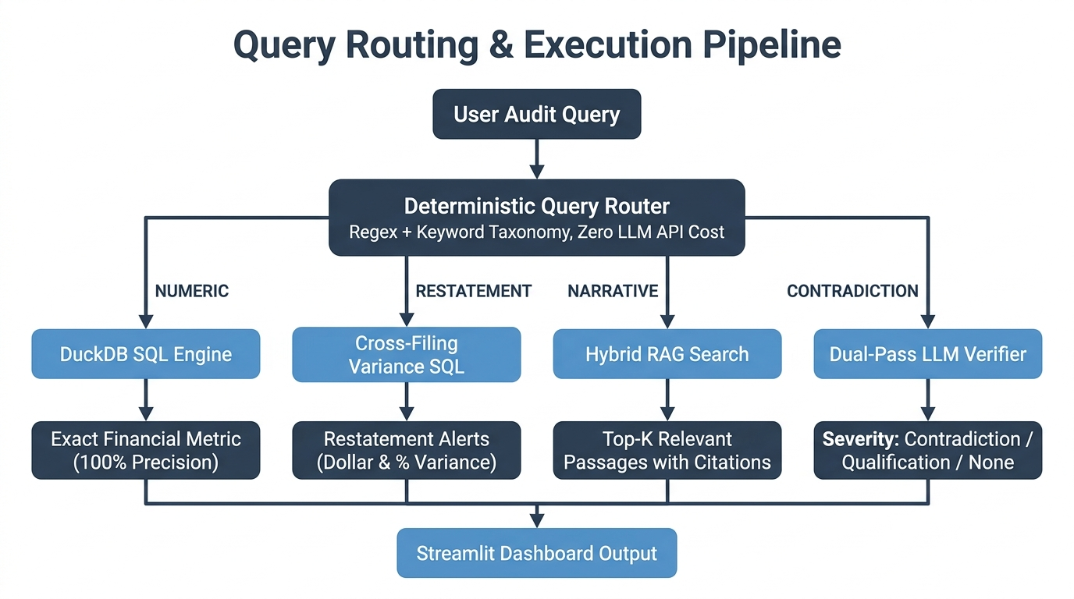
SEC EDGAR Forensic Audit System
Pipeline Structure — Query Routing
• The deterministic router classifies queries into 4 routes without using any LLM API calls

Slide 10
SEC EDGAR Forensic Audit System
SEC EDGAR Forensic Audit System
Results & Evaluation
Evaluation Metric | Naive Vector RAG | Our Dual-Pipeline System | Improvement
Numerical Precision | 57.1% (4/7) | 100.0% (7/7) | +42.9%
Hallucination Rate | 42.9% (3/7) | 0.0% (0/7) | -42.9%
Restatement Detection | Not Supported | Supported (SQL Diff) | New Capability
MD&A vs Footnote Audit | Not Supported | Supported (Dual-Pass) | New Capability
Source Traceability | None | Clickable SEC URLs | Full Provenance
Query Latency | 1.45s (LLM) | 0.02s (SQL) | 72.5x Faster
Retrieval Quality Metrics (Hybrid RAG)
• Precision@K (K=3): 91.7% | Recall@K (K=3): 95.0% | MRR: 0.944
LLM Verifier Quality Metrics
• BERTScore — Precision: 0.882 | Recall: 0.849 | F1: 0.865

Slide 11
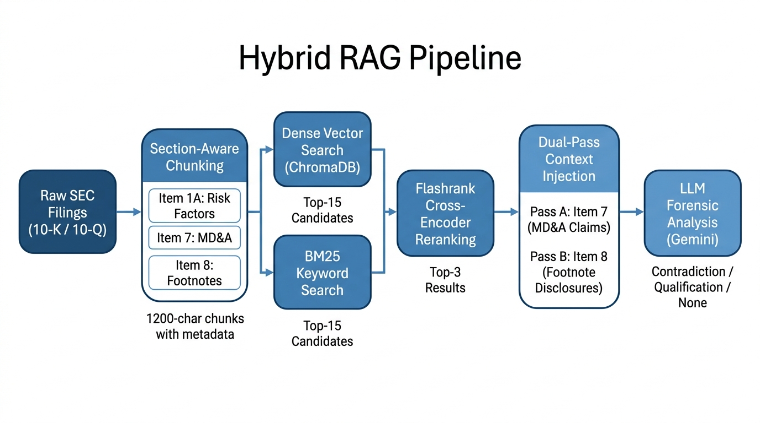
SEC EDGAR Forensic Audit System
Hybrid RAG Architecture

