Slide 1


M.Tech/MCA Program
Advanced Industry Integrated Programs
Jointly offered by University and LTIMindTree
Review II
ClaimGuard-MCP
A Multimodal Insurance Claim Consistency & Fraud Arbitration System
Team Member
Kishan Patel
Knowledge partner | Implementation partner

Slide 2
Introduction
Insurance claim verification involves multiple documents such as claim forms, policy documents, police reports, repair estimates, and bills. Since important information like vehicle details, incident dates, expenses, and reported damage is distributed across these documents, manual cross-verification is time-consuming and may miss inconsistencies.
ClaimGuard-MCP is a multimodal insurance claim validation system that uses OCR, document extraction, and rule-based consistency checks to extract and cross-verify information across claim documents. It identifies missing information and inconsistencies and generates a PASS, REVIEW, or FLAG outcome to support human claim assessment.

Slide 3
Objective
Automate document processing by extracting relevant information from claim forms, policies, police reports, bills, repair estimates, and supporting images.
Cross-verify claim information across multiple documents to identify inconsistencies in vehicle details, dates, expenses, policy information, and reported damage.
Apply structured validation rules to evaluate claim evidence and identify missing, conflicting, or inconsistent information.
Generate an explainable claim assessment using PASS, REVIEW, and FLAG outcomes to support human claim reviewers.

Slide 4
Module name - ClaimGuard-MCP
Module-1 : Document Ingestion & Classification
Accepts claim documents and identifies their document type.
Module-2 : Information Extraction
Extracts structured claim information from PDFs and images using OCR and document processing.
Module-3 : Claim Evidence Management
Stores claims, documents, policies, and extracted evidence in the system.

Slide 5
Module name - ClaimGuard-MCP
Module-4 : Consistency & Invariant Evaluation
Cross-checks vehicle details, policy information, dates, expenses, and other claim attributes.
Module-5 : Damage & Expense Validation
Evaluates reported vehicle damage and repair/expense information for consistency.
Module-6 : Claim Assessment
Combines evaluation results and generates the final PASS / REVIEW / FLAG assessment.

Slide 6
Methodology/Modeling Plan
Calibri body 28
Document Input
PDFs / Images
Ingestion & Classification
Identify document type
OCR & Information Extraction
Extract structured claim fields
Claim Assessment
PASS / REVIEW / FLAG
Consistency Evaluation
Rules + invariant checks + damage/expense validation
Evidence Cross-Verification
Compare information across documents
Multimodal Documents → Structured Evidence → Cross-Document Validation → Explainable Assessment
Why this is better

Slide 7
Data preprocessing & EDA
Document Collection: Claim forms, policy documents, police reports, repair estimates, bills, and supporting images are collected as claim evidence.
Document Processing: PDFs and images are processed through document classification and OCR to make the content machine-readable.
Field Extraction: Relevant fields such as vehicle registration, dates, policy details, expenses, and damage information are extracted into structured schemas.
Data Standardization: Extracted information is organized into consistent claim, policy, evidence, and document structures for downstream validation.

Slide 8
Data preprocessing & EDA
Analyze the availability and completeness of extracted fields across claim documents.
Compare corresponding fields across documents to identify missing, conflicting, or inconsistent values.
Examine claim evidence by categories such as vehicle details, dates, policy information, expenses, and damage.

Slide 9
Approach/Algorithms/Tools
Approach / Tool | Role in ClaimGuard-MCP
PyMuPDF | PDF text and document processing
Pytesseract (OCR) | Extract text from scanned/image documents
Pydantic | Structured data models and validation
DuckDB | Store and query structured claim/evidence data
Rule-Based Consistency Checks | Validate policy, vehicle, date, expense and damage information
FastMCP + FastAPI | Expose claim-processing services and APIs
Streamlit | Interactive claim assessment interface
Pytest | Unit, integration and realistic claim-package testing
Documents → OCR & Extraction → Structured Data → Rule-Based Validation → Claim Assessment
Documents → OCR & Extraction → Structured Data → Rule-Based Validation → Claim Assessment

Slide 10
Project plan/milestones progress
Review I — Completed
Architecture & database design
Document ingestion & OCR
Initial extraction pipeline
Review II — Completed
Claim validation modules
End-to-end evaluation pipeline
MCP integration
Unit & integration testing

Slide 11
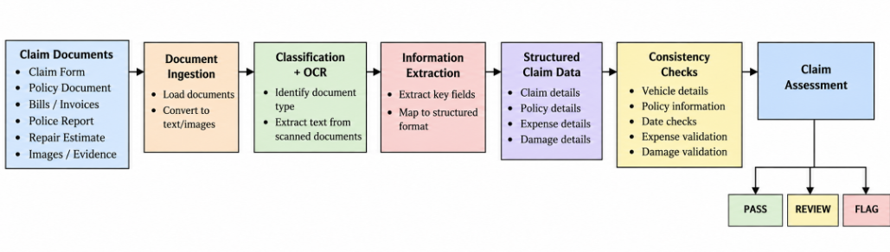
Pipeline structure

