Slide 1


Slide 2
I worked on a Capstone project where I used the Foursquare API and Zomato API to fetch location, rating and price information of various venues in Varanasi, India. In this presentation, I’ll discuss my approach of combining the data from both APIs and drawing meaningful information from the same.

Slide 3
Introduction
Whenever a person searches for a venue in a new city, they’re highly interested in the best places that the city has to offer. The person might want to know how good a given restaurant is or the price range it falls under.
This extra information would help decide which venue to choose amongst the many venues in the city.
Combining the location of the venues in the city with their price and rating information would surely help visitors in a city make better informed decisions about the places they should visit.
This project explores various venues in Varanasi and attributes the data based on user ratings and average price.

Slide 4
Data Discussion
The data has been collected from two APIs, Foursquare API and Zomato API.
Using the Foursquare’s explore API (which gives venues recommendations), I fetched venues up to a range of 6 kilometers from the center of Varanasi and collected their names, categories and locations (latitude and longitude).
After extracting over 41 locations using the Foursquare API, the latitude and longitude values were used to fetch the venue details using Zomato API.

Slide 5
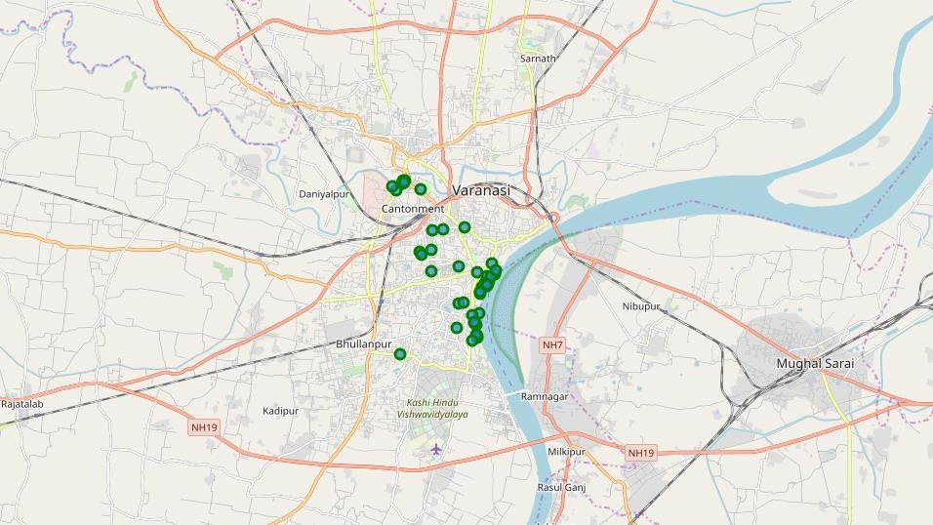
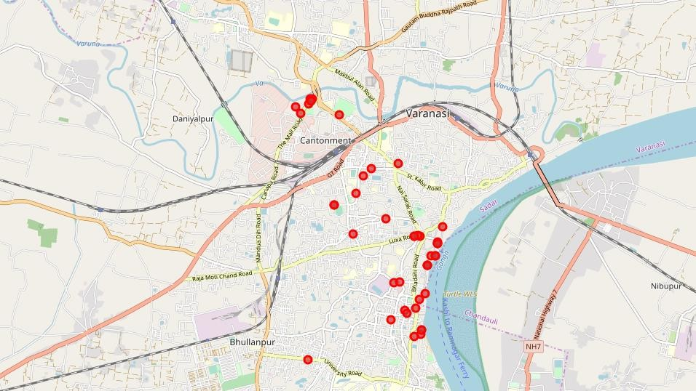
Venues retrieved from Foursquare API
Venues retrieved from Zomato API

Slide 6
Methodology
As a first step, I retrieve the venues in Varanasi from Foursquare and Zomato APIs.
I extract the location data from the Foursquare API for all venues up to a distance of 4 kilometers from the center of Varanasi.
Using this, I fetch the venue information including price and rating data from Zomato API.
Using data cleaning, the dataset from the two APIs will be combined based on the venue names, latitude, and longitude values.
The final data will include the venue name, category, address, latitude, longitude, rating, price range, and average cost per person.

Slide 7
Analysis
During the analysis phase, I explored the venue categories, the rating distribution of the venues and the price range across the map of Varanasi.

Slide 8
Categories
As we extracted categories from the Foursquare API, identifying what type of venues are most popular in the city would really be helpful. We plot a bar chart for the same.

Slide 9
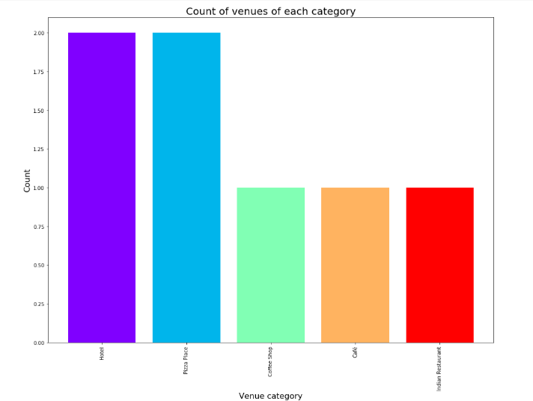
It appears that the majority venues in Varanasi are either Hotel or Pizza Places.

Slide 10
Rating
Now, we will take a look at the ratings of the venues.
As a visitor, you’d like to know the places that have good rated venues.
We can plot a bar chart of the ratings of all venues and the count of each rating to see what is the average rating across all venues.

Slide 11
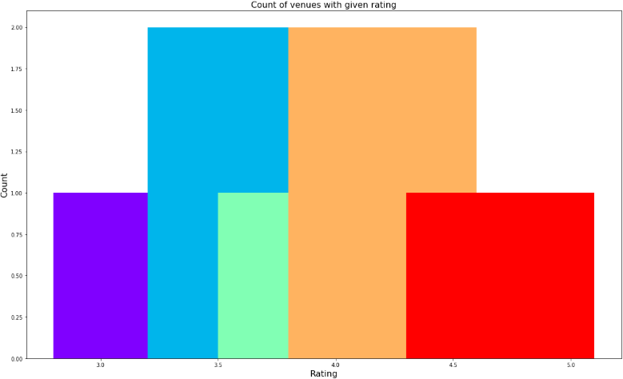
We see that the ratings range from 1.0 to 5.0.
The plot reveals that maximum venues have a rating close to 3.5 and 4.0.

Slide 12
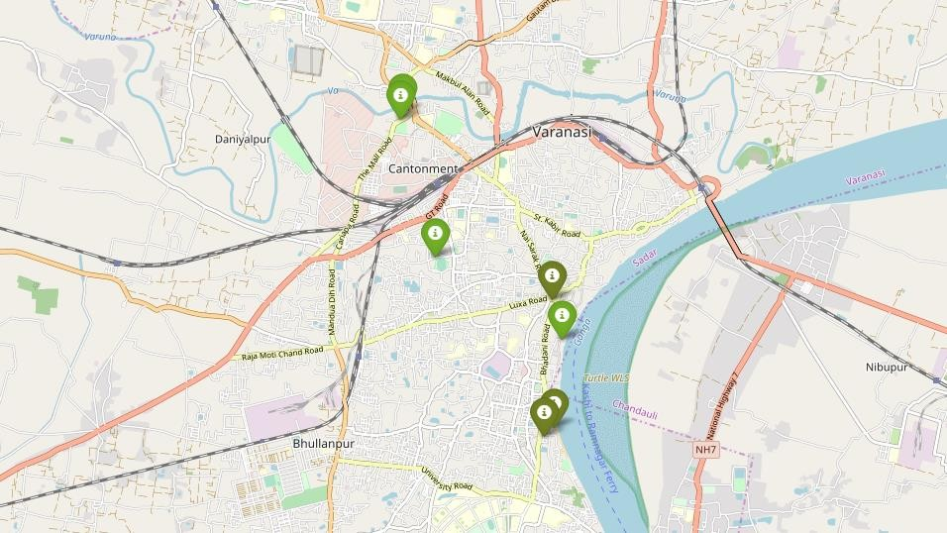
Venues Location
The visitor might also be interested in knowing where actually are the high rated venues located.

Slide 13
Price :-
We can also plot the venues based on their price range and see which areas have what priced venues.
In the below graph:
where high priced venues are marked by orange and red
while the low priced venues are marked with green and dark green .

Slide 14
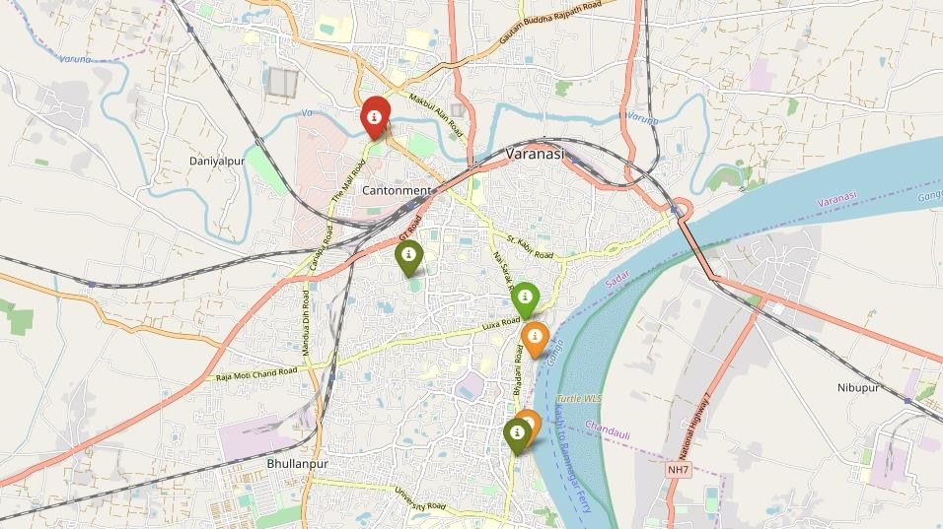
Fig : Price Indicator.

Slide 15
Clustering
We will now cluster all these venues based on their price range, location and more to identify similar venues and the relationship amongst them.
We’ll cluster the venues into two separate groups.
Indicated as Green and Red.

Slide 16
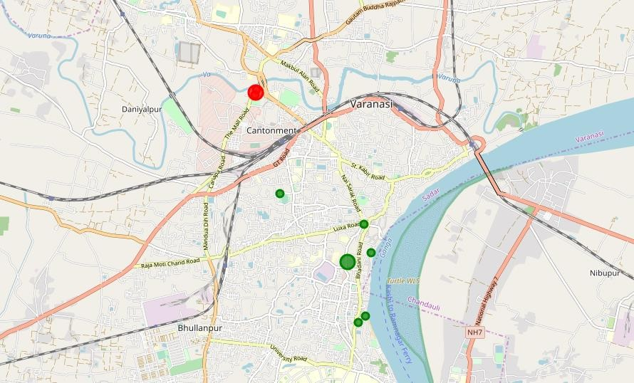
The first cluster (green) is spread across the fooding areas.
The second cluster (red) is very sparsely spread in Hotel areas.

Slide 17
Results and Discussion
After collecting data from the Foursquare and Zomato APIs, we got a list of 41 different venues.
We identified that from the total set of venues, majority of them were Hotel and Pizza Places.
While the ratings range from 1 to 5, majority venues have ratings close to 4.
Finally, through clusters we identified that there are many venues which are relatively lower priced but have an average rating of 3.57.
On the other hand, there are few venues which are high priced and have average rating of 4.0

Slide 18
Conclusion
The purpose of this project was to explore the places that a person visiting to Varanasi.
The venues have been identified using Foursquare and Zomato API and have been plotted on the map.
The map reveals that there are so many places where one can visit during his stay in Varanasi.
Based on the visitor's venue rating and price requirements, he/she can choose the places.

