Slide 1

IOT(Internet Of Things)
PRESENTED by -- KISHAN KUMAR RAI
s.r.c.e.m.

Slide 2
History
The actual term “Internet of Things” was coined by Kevin Ashton in 1999 during his work at Procter & Gamble.
Ashton who was working in supply chain optimization, wanted to attract senior management’s attention to a new exciting technology called RFID.
RFID is technology which works on radio frequency and it is used for the auto identification for the different object.

Slide 3
What is Iot ?
Internet of Things (IoT) is a system of devices connected to the Internet with the ability to collect and exchange data from users or environment with no human intervention.
In simple words, Internet of Things (IoT) is an ecosystem of connected physical objects that are accessible through the internet.
It is also referred to as Machine-to-Machine (M2M), Skynet or Internet of Everything.

Slide 4
Components of IoT
Smart Systems and Internet of Things are driven by a combination of :
1) Sensors
2) Connectivity
3) People & Processes

Slide 5
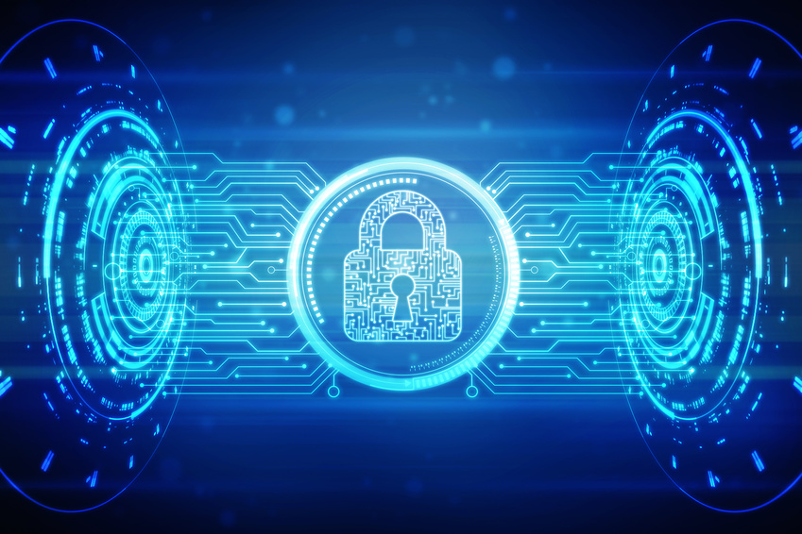
Let’s Take an Example of
Internet of Things

Slide 6
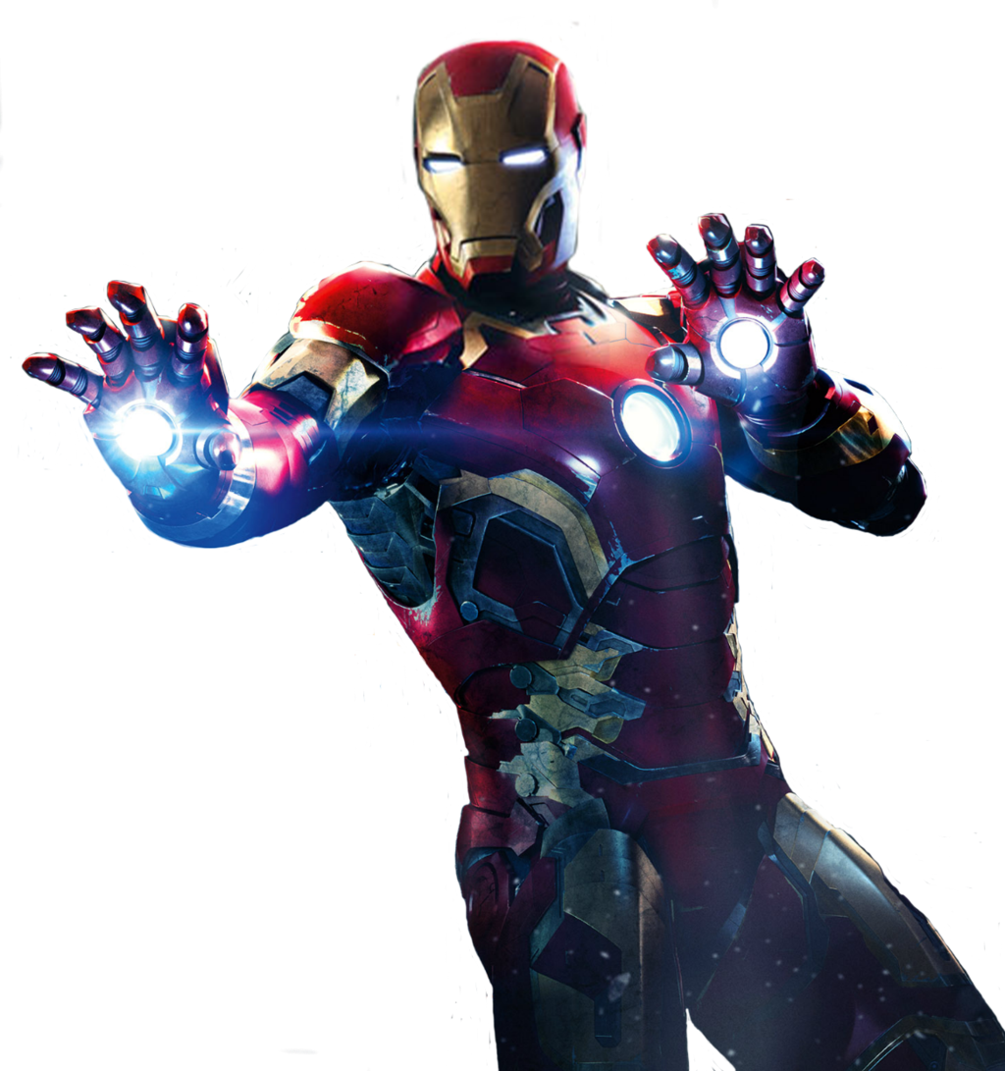
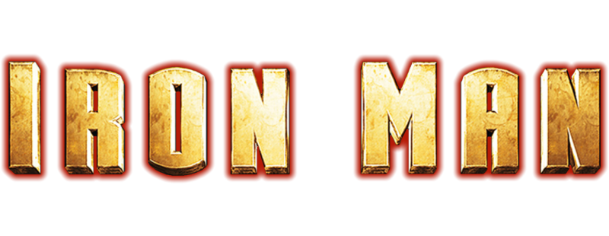
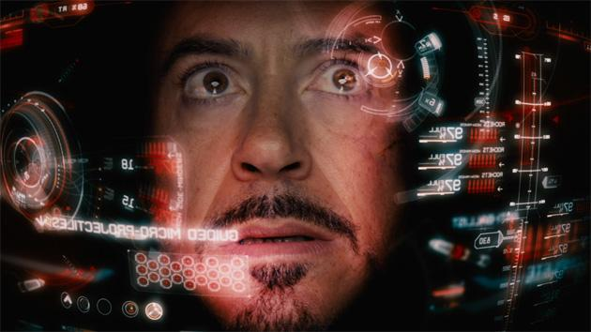
Speech Recognition.
Perfect example of AI.
Advanced GPS.
Renewal Energy Source.
Automatic wearing suit.
NextGen way to fly.

Slide 7
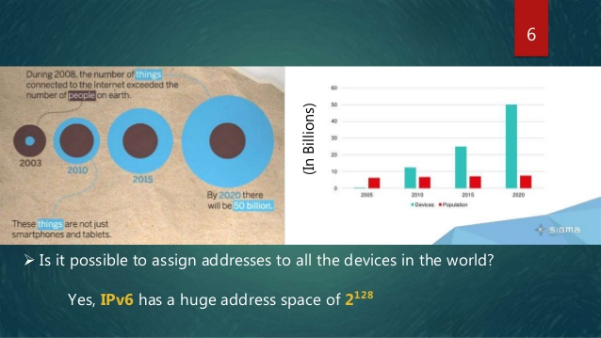

Slide 8
Why IoT ?
Dynamic control of industry and daily life.
Improves the resource utilization ratio.
Integrating human society and physical systems.
Flexible configuration.
Acts as technology integrator.
Universal inter-networking.

Slide 9
What is the scope of IoT ?
Internet of Things can connect devices embedded in various systems to the internet. When devices/objects can represent themselves digitally, they can be controlled from anywhere. The connectivity then helps us capture more data from more places, ensuring more ways of increasing efficiency.

Slide 10
How can IoT help ?
IoT platforms can help organizations reduce cost through improved process efficiency, asset utilization and productivity.
The growth and convergence of data, processes and things on the internet would make such connections more relevant and important, creating more opportunities for people, businesses and industries.

Slide 11
Challenges faced by IoT
At present IoT is faced with many challenges, like –
Scalability
Security
Technical requirements
Technological standardization
Software complexity

Slide 12
Solutions to the challenges
Several solutions are proposed to overcome the problems. Some of them are –
Overcoming compatibility issues is a significant IoT hurdle, but emerging companies are starting to enable increased interoperability through open-source development.
Governments and industry bodies need to set standards and regulations for the various industries to ensure that data is not misused.
IoT needs strong authentication methods, encrypted data and a platform that can track irregularities on a network

Slide 13
Corporate Aspect
IoT is a transformational force that can help companies improve performance through IoT analytics and IoT Security to deliver better results. Businesses in the utilities, oil & gas, insurance, manufacturing, transportation, infrastructure and retail sectors can reap the benefits of IoT by making more informed decisions, aided by the torrent of interactional and transactional data at their disposal.

Slide 14

Security in IoT
Internet of things is a sea of technology.
Software can be hackable.
Connection is exposed.
I.T vulnerable, exposed, can be tapped .
Weapons of mass disruption.

Slide 15
Conclusion
Projections for the impact of IoT on the Internet and economy are impressive, with some anticipating as many as 100 billion connected IoT devices and a global economic impact of more than $11 trillion by 2025. The potential economic impact of IoT is huge, but the journey to IoT adoption is not a seamless one. There are many challenges that face companies looking to implement IoT solutions. However, the risks and disadvantages associated with IoT can be overcome.

Slide 16
THANK YOU !

