Slide 1
UE24CS352A · MACHINE LEARNING MINI-PROJECT
Weakly Supervised Pneumonia Localization
Finding where pneumonia is on a chest X-ray, using only yes/no labels
Kishan Shenoy · Khushi Patel
Notes:
Introduce the team and the one-line idea: we only tell the model whether an X-ray has pneumonia, yet it can still draw a box around the infection.

Slide 2
Why this problem matters
1M+
15%
0
US hospitalisations per year
of deaths in children under 5
bounding boxes in most hospital records
Chest X-rays are the best tool for diagnosing pneumonia, but records store only the final diagnosis, not the pixel location of the opacity.
Supervised localisation (R-CNN) needs box labels that datasets lack, so we need a way around it.
Notes:
Source numbers are from the paper we re-implement (Huang, Cortes, Monam).

Slide 3
The idea: weak labels in, boxes out
1
2
3
Train
Ask
Draw
CNN learns pneumonia vs normal from yes/no labels only
Which pixels drove the 'pneumonia' decision?
Heat-map becomes bounding boxes
That is weakly supervised localisation: weak labels (yes/no), strong output (a box). The tool that answers step 2 is the Class Activation Map (CAM).

Slide 4
Dataset: RSNA Pneumonia (Kaggle)
14,863
6,012
8,851
images after cleaning
pneumonia (40.4%)
normal (59.6%)
DICOM X-rays, 1024×1024; boxes exist only for pneumonia cases
Dropped the ambiguous 'No Lung Opacity / Not Normal' class (as in the paper)
Stratified split 70 / 20 / 10 → 1,487 test images
Boxes used only for evaluation, never for training

Slide 5
Preprocessing and 2-channel input
Resize
Normalise
Lung mask
2 channels
1024² → 128²
faster training
per-pixel mean / std
from training set
Otsu threshold isolates
the lung region
original + masked image
stacked as input
Why two channels? The mask alone loses dense, severely infected lung (it can look like tissue); the original alone makes the model highlight ribs and equipment. Together they give the best localisation (paper's finding).

Slide 6
Model: 10 conv layers, GAP, one FC layer
Input
2×128×128
2 conv · 32
+ pool
2 conv · 64
+ pool
2 conv · 128
+ pool
4 conv · 256
Global
Avg Pool
FC → 2
classes
3×3 convolutions, zero padding, ReLU, batch-norm
GAP + a single FC layer is exactly what CAM needs
Adam, lr 1e-4, batch 64, 20 epochs; best validation epoch kept
Baselines: logistic regression, SVM, random forest on flattened pixels

Slide 7
From classifier to bounding box (CAM)
CAM
Heat-map
DFS clustering
Boxes
Weight the last feature maps by the pneumonia-class FC weights
Scale to [0, 1] and threshold at 0.45
Group hot pixels into connected regions
Min/max x,y per cluster; drop outliers (> 2 std)
Only images the classifier calls 'pneumonia' are localised. Quality is measured with IoU = overlap area ÷ union area against the doctor-drawn box.

Slide 8
Classification: CNN edges out baselines
What to say
CNN is only ~0.5 pt above SVM
Random forest over-fits: 100% train, 88% test
The CNN's edge: it also localises
Notes:
Be upfront: the accuracy gain over SVM is small. The paper reports 92.5% for its CNN; ours is 89.2%. The real value of the CNN is that CAM gives us localisation for free.

Slide 9
Where the CNN is right and wrong
Predicted normal
Predicted pneumonia
811
TN
75
FP
85.9%
Actual normal
Sensitivity: pneumonia caught (516 / 601)
85
FN
516
TP
91.5%
Actual pneumonia
Specificity: normal caught (811 / 886)
85 missed pneumonia cases (FN) matter most clinically, since a missed case gets no box at all.

Slide 10
Localisation: IoU 0.217 on detected cases
Read with care
Ours = union of predicted vs union of true boxes, on the 516 correctly detected cases
Not strictly comparable with the paper
Weak labels reach a useful location with zero box supervision
Notes:
Paper values: CNN+CAM 0.1508, R-CNN 0.1266. Our IoU 0.2167 was measured on true-positive images only and with union-of-boxes IoU, so do not claim we beat the paper.

Slide 11
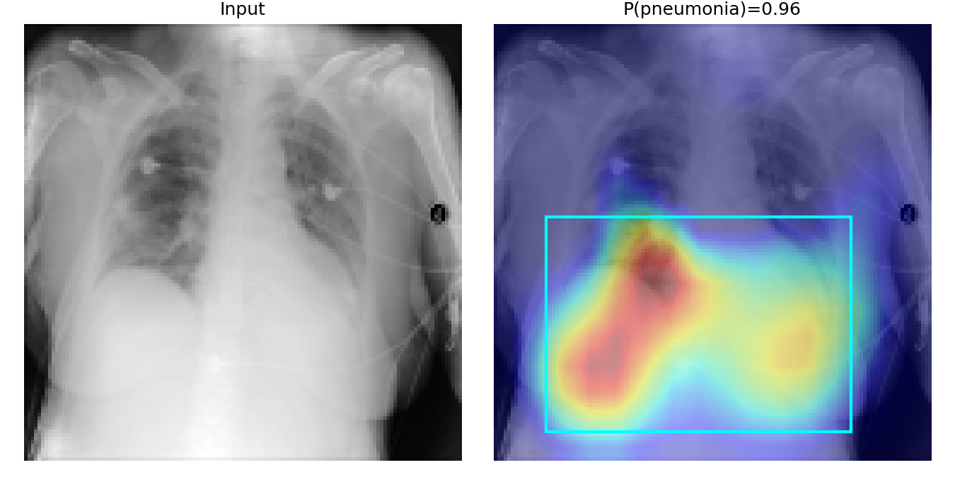
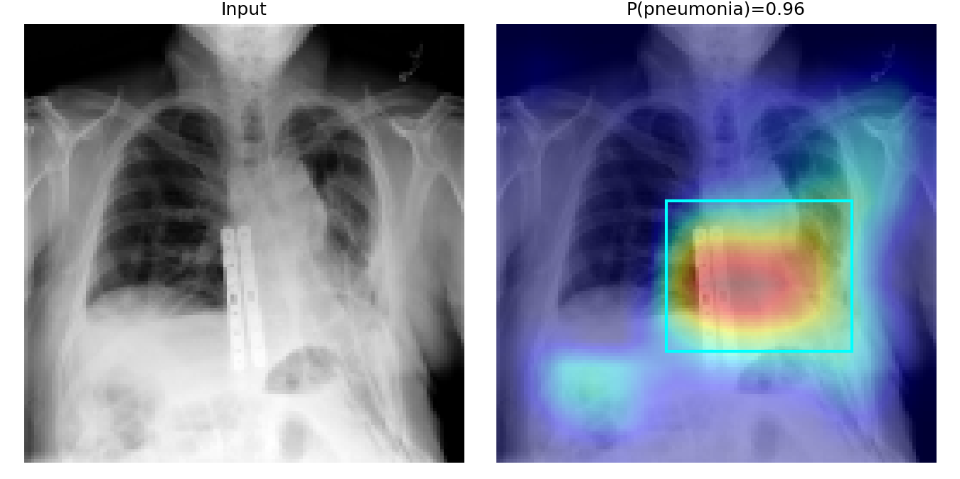
Sample CAM outputs
Each panel: input X-ray (left) and heat-map overlay with the predicted bounding box (right). Red = strongest evidence for pneumonia.
Notes:
Insert your two best demo images (P above 0.9, box on a sensible spot) with add_demo_images.py. If asked about failures, mention a missed case with P about 0.3 where no box is drawn.

Slide 12
What we learned
Input matters
Small filters
The paper found original + lung-mask channels beat either alone
The paper found big last-layer filters give imprecise boxes, so we kept 3×3
Look past accuracy
Heuristics limit us
The confusion matrix shows 85 missed cases; simple baselines are strong too
An Otsu lung mask is crude; a trained U-Net should help

Slide 13
Conclusions
89.2% test accuracy; 85.9% of pneumonia cases caught
Mean IoU 0.217 with no bounding-box labels used in training
CAM adds localisation to any GAP + FC classifier at no extra cost
Next: U-Net lung segmentation, tuned threshold, higher resolution, pre-trained backbones
Live demo next

Slide 14
Team contributions and repository
Kishan Shenoy
Khushi Patel
Code and experiments: data pipeline, CNN, CAM and localisation, baselines, evaluation, demo, GitHub repository
Project report and presentation, literature review of the paper, results write-up
Private GitHub repo: ML_MiniProject_Pneumonia_Diagnosis_Detection_and_Localization (README has set-up and run steps)
Reference: Huang, Cortes, Monam. Weakly Supervised Pneumonia Localization. Data: RSNA Pneumonia Detection Challenge (Kaggle).

