Slide 1
ECOBARTER

Slide 2
INTRODUCTION
The EcoBarter is a mobile app that makes selling your scrap the simplest process ever. It addresses the challenge of inefficient waste management by providing a convenient and rewarding solution. EcoBarter is a mobile application that facilitates online scrap sales by offering door-to-door scrap collection services. We purchase a variety of scrap materials, including paper, plastic, metal, glass, e-waste, and many more.
EcoBarter is designed for a broad spectrum of users, from individuals to businesses and organizations that generate or utilize waste products.

Slide 3

OBJECTIVES

Slide 4
OBJECTIVES
To Streamline the process of selling recyclable materials for users through a mobile platform
To Provide clear and competitive price comparisons for various recyclable materials..
To support local scrap collectors with a platform to reach a broader customer base.
To provide seamless connections between customers and local scrap collectors

Slide 5

SYSTEM ANALYSIS

Slide 6
EXISTING SYSTEM
Customers often lack bargaining power and accepts lower offers due to limited knowledge of market values
The existing systems for selling waste items are not optimized for mobile devices, which limits their reach and convenience for users.

Slide 7
PROPOSED SYSTEM
Simplified Process by listing the scrap items within the app using categories.
Schedule pickups at your preferred date and time.
Transparency in pricing and fairness.
Access all your past deals within the app for easy record-keeping and reference.

Slide 8

SYSTEM DESIGN

Slide 9

DATA FLOW DIAGRAM

Slide 10
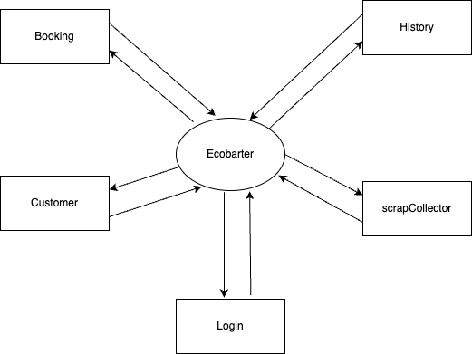
LEVEL-0

Slide 11
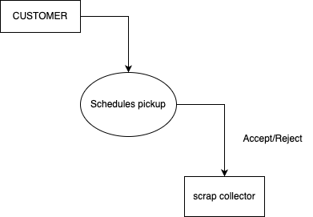
LEVEL-1

Slide 12
ENTITY RELATIONSHIP DIAGRAM

Slide 13
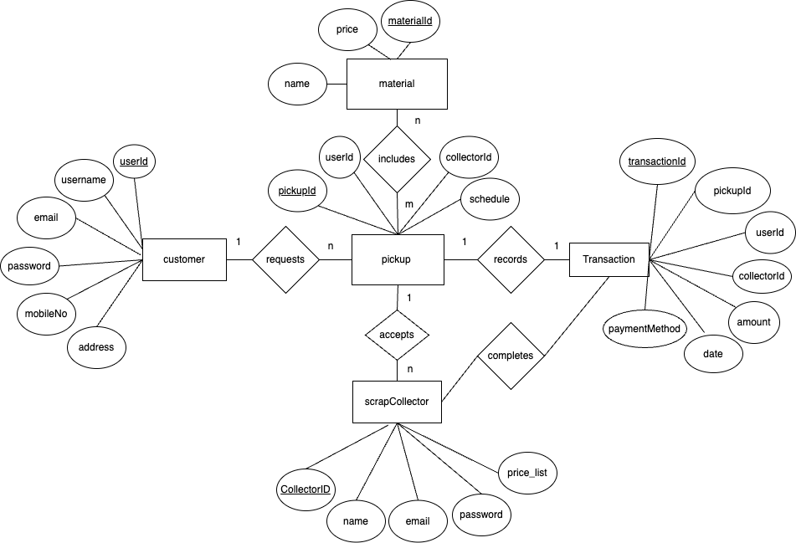
ER-DIAGRAM

Slide 14
USER INTERFACE DESIGN

Slide 15
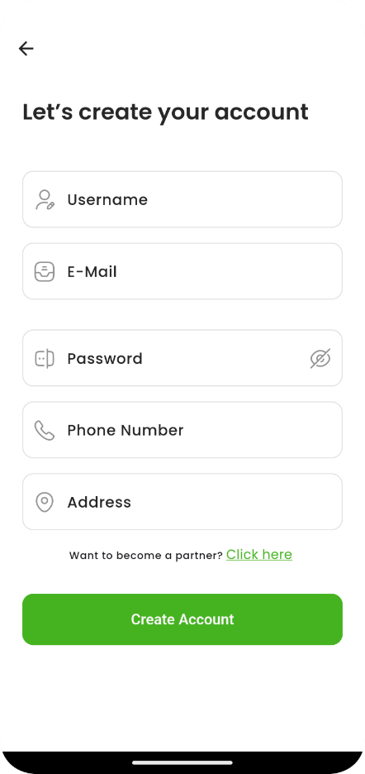
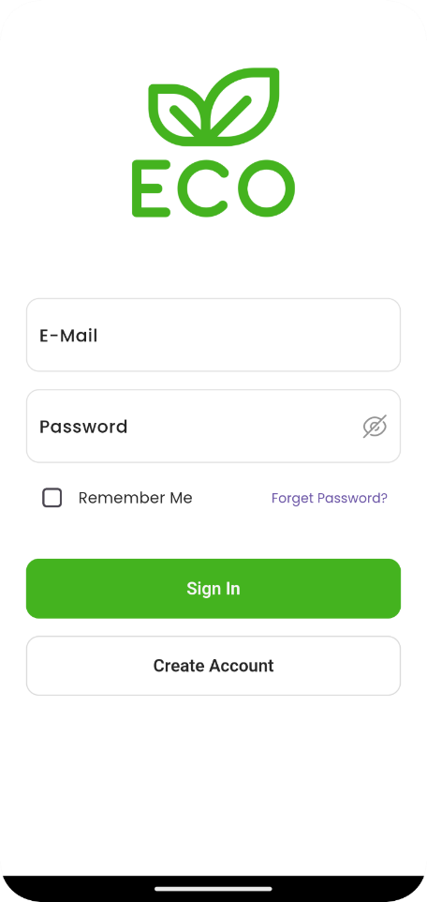
LOGIN AND REGISTER FORM
DESCRIPTION:
This is login and registration screen of the application where the user has to registered or login first before accessing the app .

Slide 16
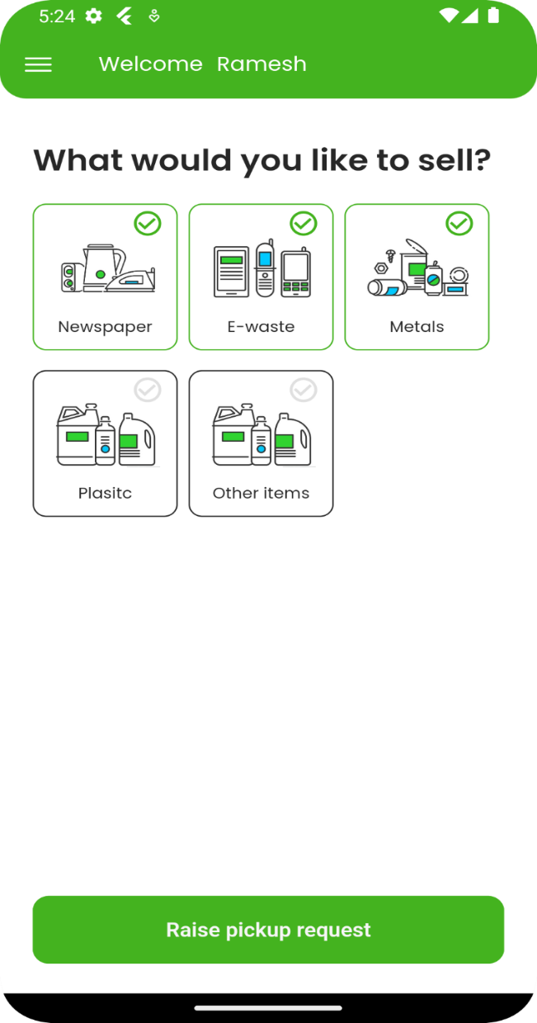
HOME PAGE
DESCRIPTION:
This is home page where the customer can manage, select categories which he would like to sell.

Slide 17
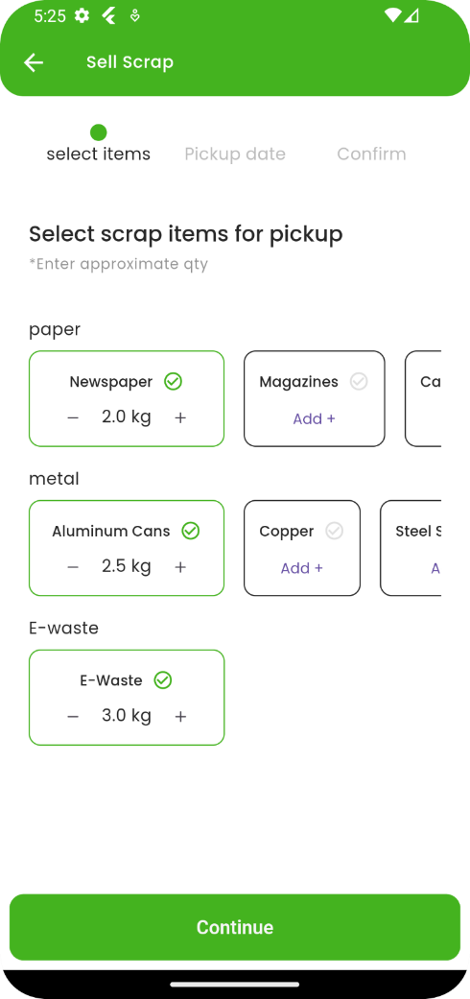
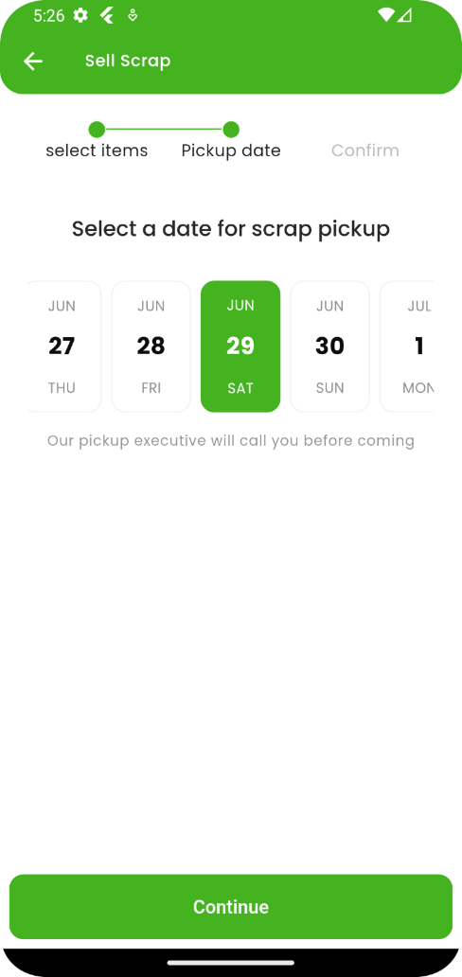
PICKUP BOOKING PAGE
DESCRIPTION:
This is subcategories selections and schedule selection screen where the user has to select items which he would like to sell and schedule time .

Slide 18
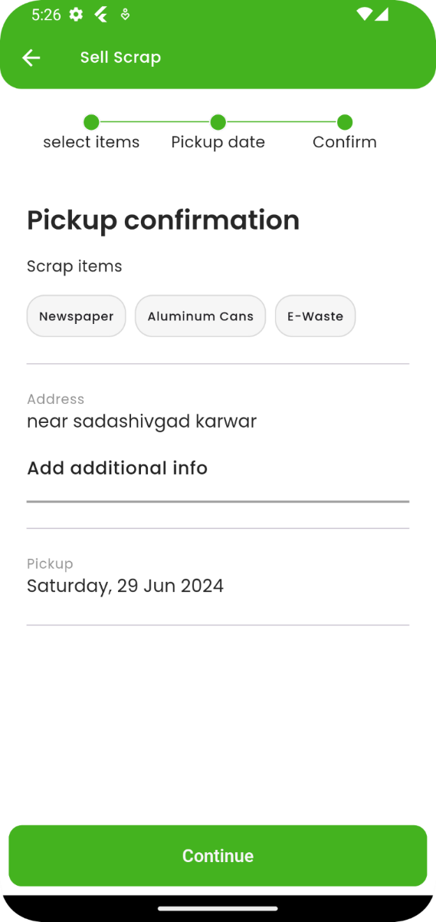
CONFIRMATION PAGE
DESCRIPTION:
This is confirmation page where the user can see all pickup details and can continue.

Slide 19
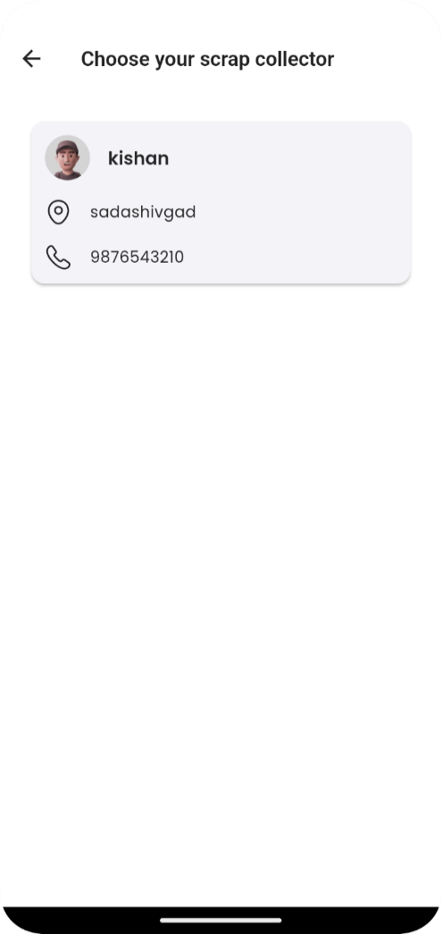
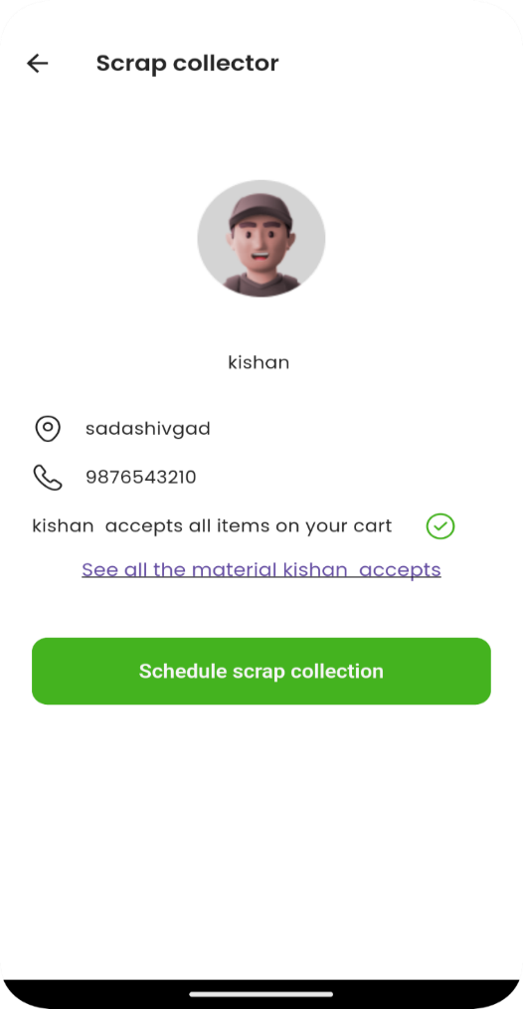
SCRAP COLLECTOR PAGE
DESCRIPTION:
This is scrap selection page where the customer can choose the scrap collector and can schedule a pickup .

Slide 20
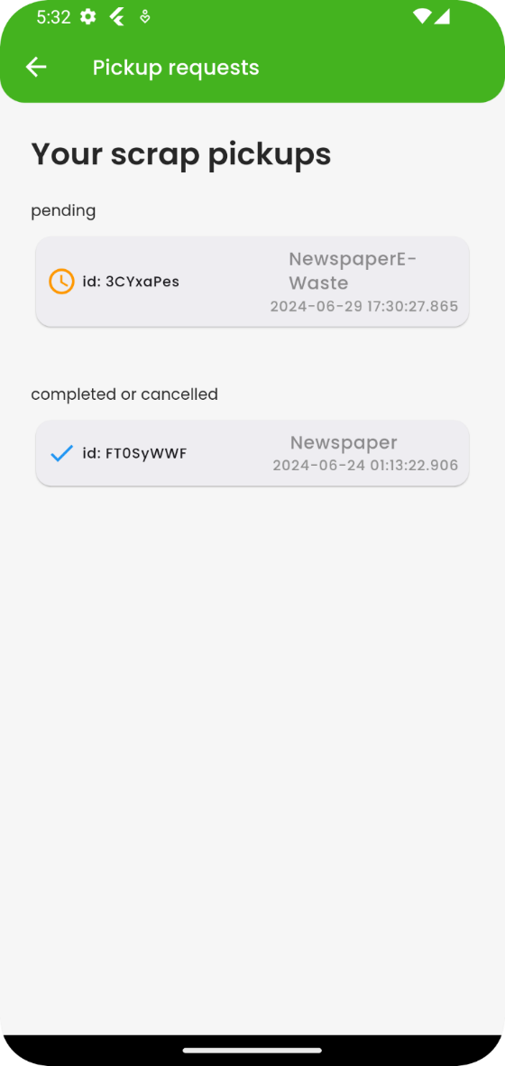
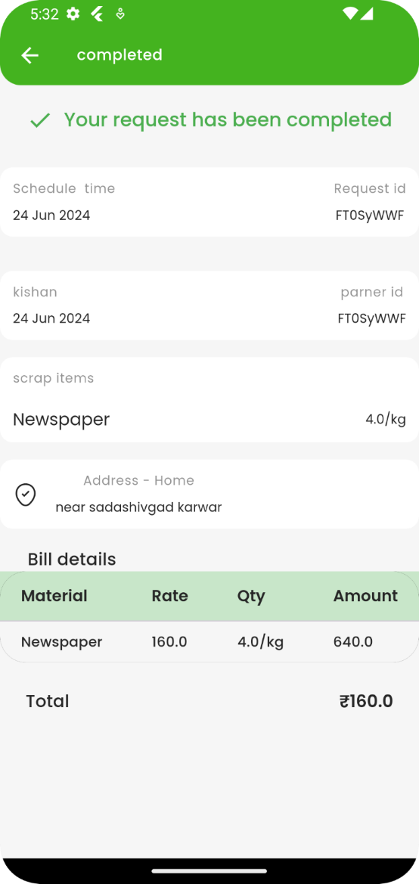
PICKUP HISTORY PAGE
DESCRIPTION:
This is history page of customer where he can access all the past deals and see the bill details as well.

Slide 21
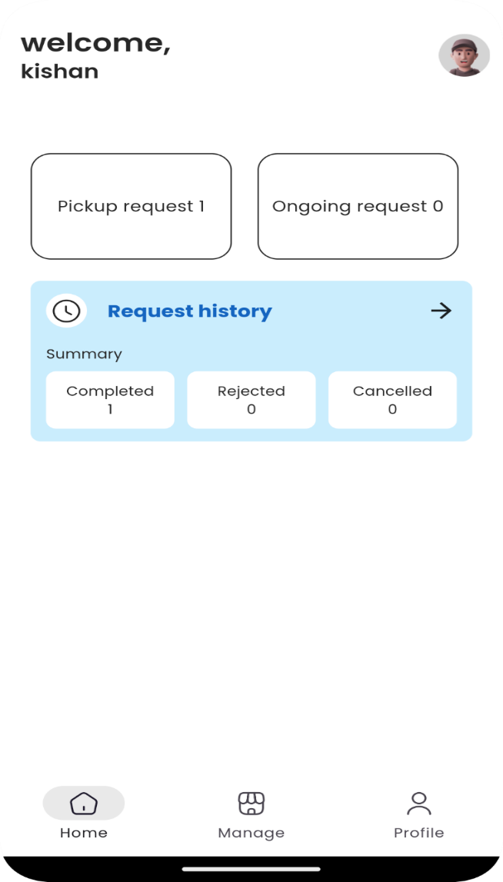
PARTNER HOME PAGE
DESCRIPTION:
This is scapcollector dashboard page where he can manage all the pickup request .

Slide 22
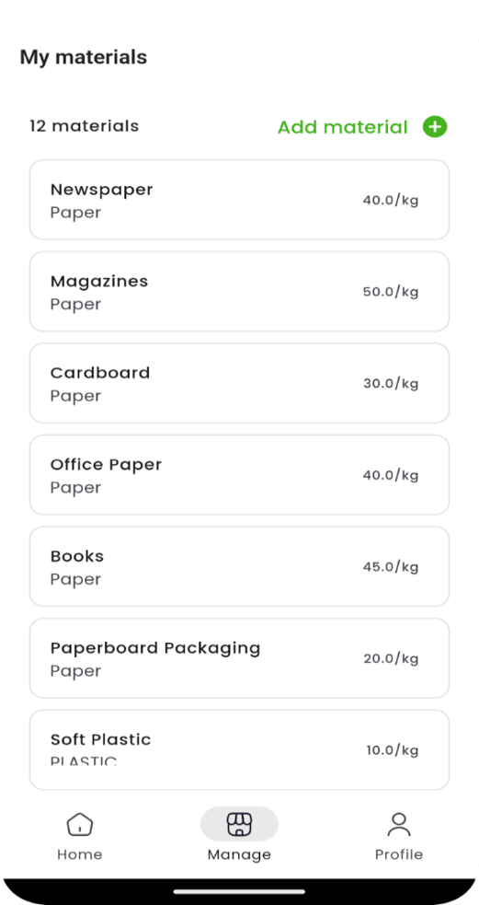
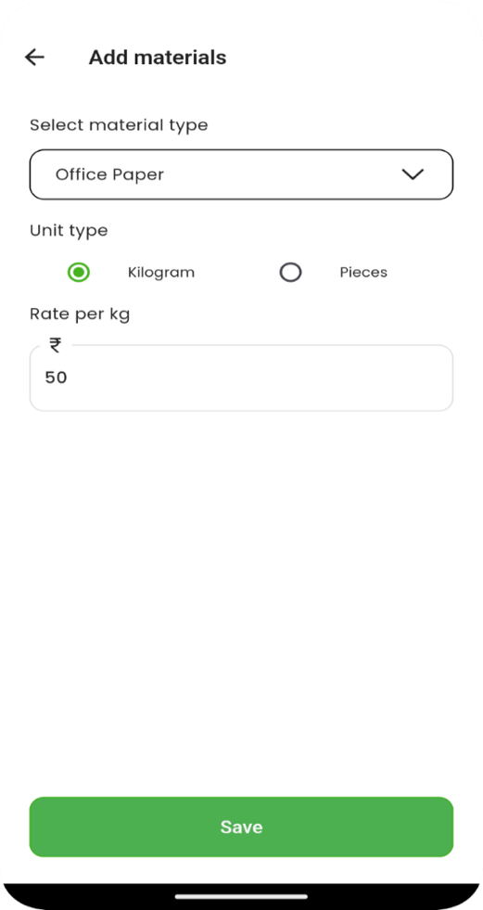
ADD MATERIAL FORM
DESCRIPTION:
This is add material form where the scrap collector can add material which he would like to buy based on price per kg.

Slide 23
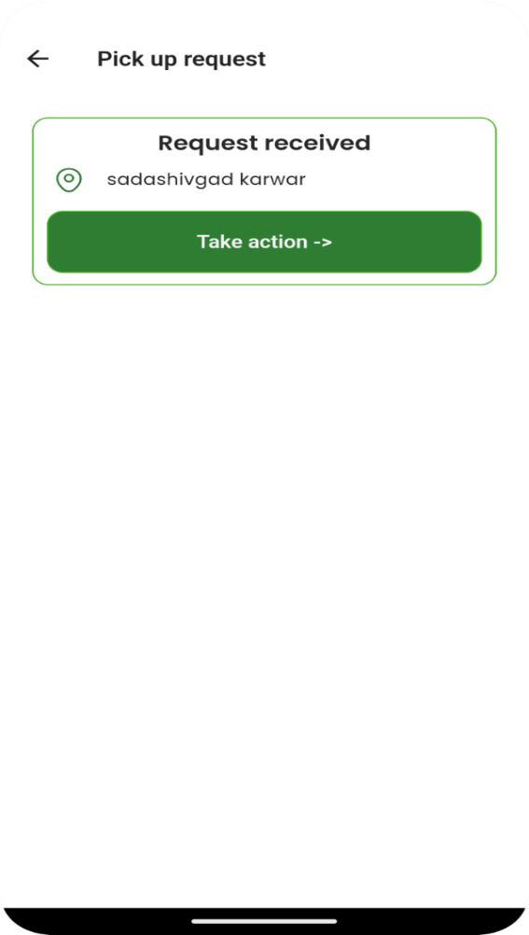
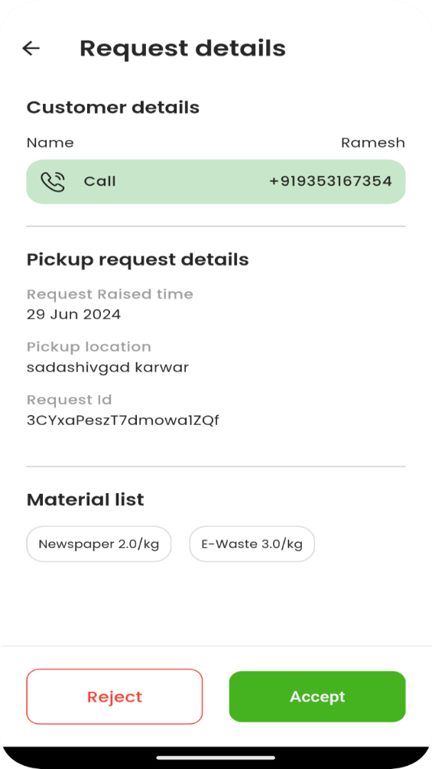
REQUEST PAGE
DESCRIPTION:
This is request page where the scrap collector can either accept or reject the pickup.

Slide 24
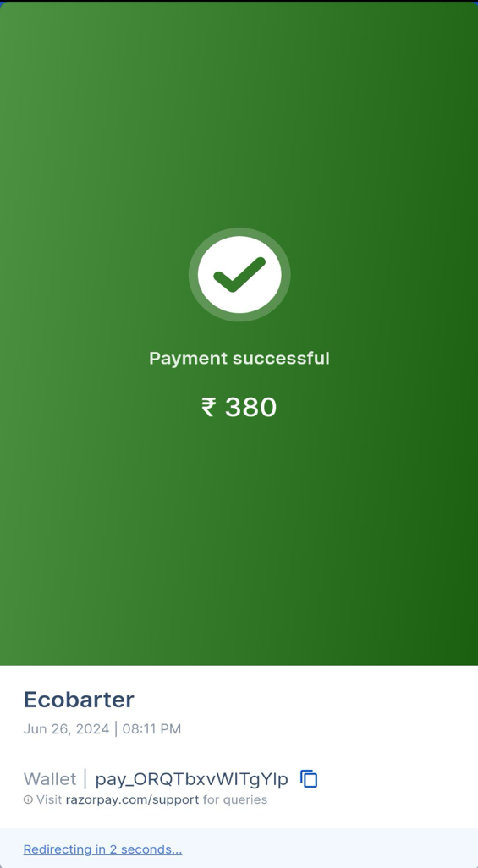
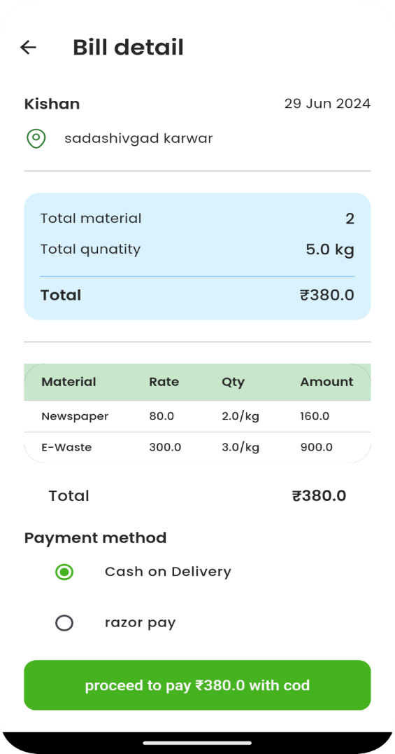
BILLING PAGE
DESCRIPTION:
This is billing page where the scrap collector can view all the items cost and can make payment.

Slide 25
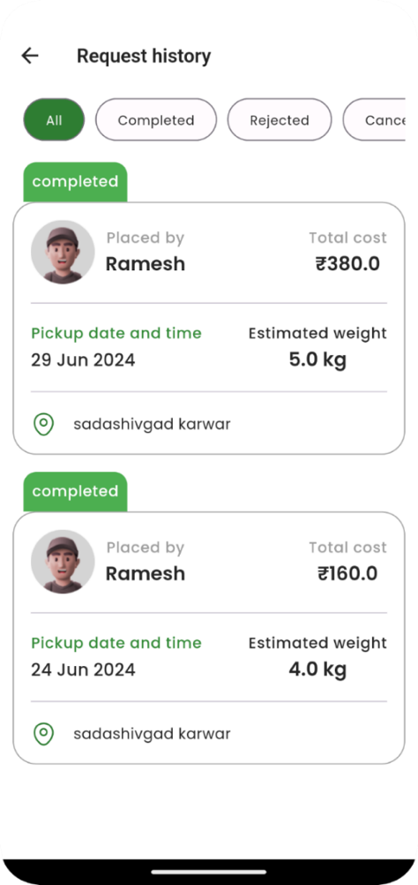
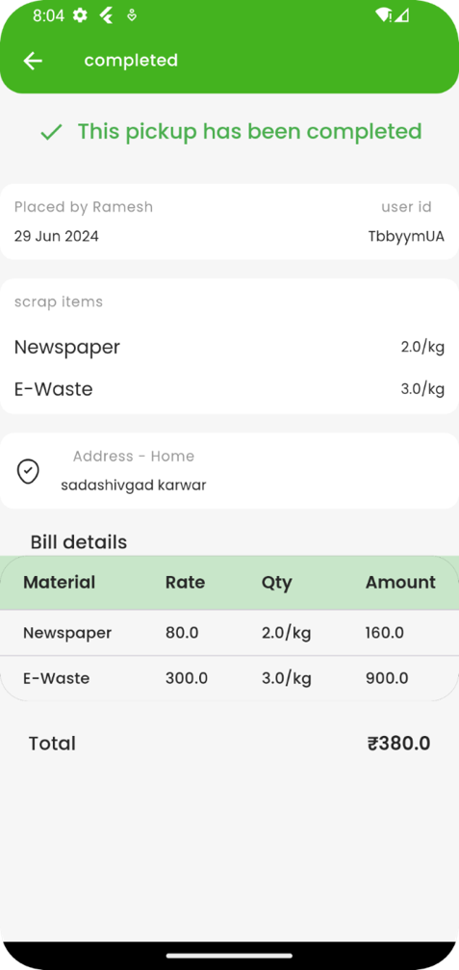
PICKUP HISTORY PAGE
DESCRIPTION:
This is pickup history page of scrap collector where he can see all the past pickups.

Slide 26
HARDWARE AND SOFTWARE REQUIREMENTS

Slide 27

HARDWARE REQUIREMENTS
Processor: 800MHZ single core processor
RAM : minimum 256MB
Storage : minimum 80MB
Device Type : Android device

Slide 28
SOFTWARE REQUIREMENT
Operating system : OS above API LEVEL 34
Core language : Dart
Frontend : Flutter
Backend :Firebase
IDE : Android Studio.

Slide 29

FUTURE SCOPE

Slide 30
Future scope
Integrating various online payment methods .
Integrating real-time tracking of location with an estimated time of arrival (ETA) for pickups, enhancing user experience.
Implementing real time te tracking for scrap pickups.
Implementing push notifications and SMS alerts to keep customer informed about the status of their requests.

Slide 31
Thank you

