Slide 1


Unit-01 ES - 6
JavaScript Frameworks (2104CS512)
Prof. Chirag K Sakhrani
Department of Computer Applications
chirag.sakhrani@darshan.ac.in
8401191184

Slide 2

Outline
Classes
Arrow Function
Variables
Array Methods
Destructuring
Modules
Spread Operator
Looping

Slide 3
Classes in JavaScripts
Classes were introduced in ECMAScript 2015 (ES6) to provide a cleaner way to follow object-oriented programming patterns.
JavaScript Classes are templates for JavaScript Objects.
Use the keyword class to create a class.
Always add a method named constructor().
A JavaScript class is not an object.
It is a template for JavaScript objects.
A JavaScript class is a blueprint for creating objects. A class encapsulates data and functions that manipulate data.
Unlike other programming languages such as Java and C#, JavaScript classes are syntactic sugar over the prototypal inheritance. In other words, ES6 classes are just special functions.

Slide 4
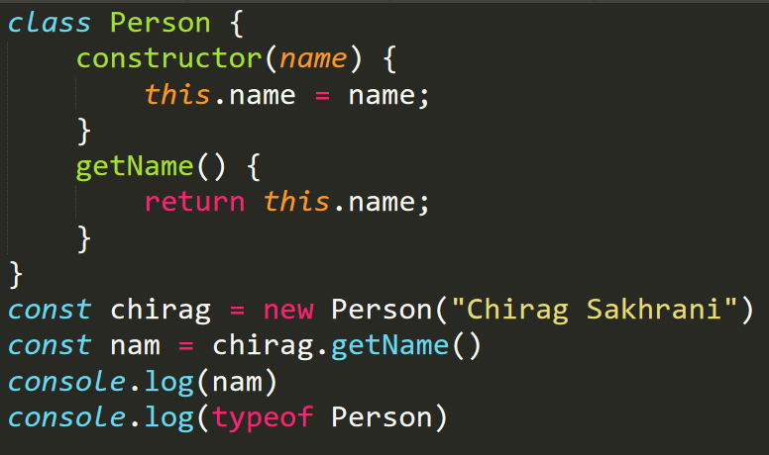
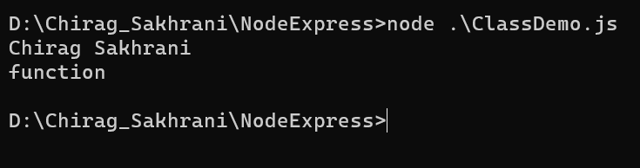
Classes in JavaScripts
Syntax:
class ClassName{
constructor() {……}
}
Output :

Slide 5
Arrow Functions
Arrow functions provides us a more accurate way to write the functions in JavaScript. Arrow functions make your code more readable and structured.
Arrow functions allow us to write shorter function syntax:
Arrow functions are anonymous functions (the functions without a name and not bound with an identifier). They declare without the function keyword.
Arrow functions cannot be used as the constructors.
The context within the arrow functions is lexically or statically defined. They are also called as Lambda Functions in different languages.
Arrow functions do not include any prototype property, and they cannot be used with the new keyword.
As you can see, (a, b) => a + b means a function that accepts two arguments named a and b. Upon the execution, it evaluates the expression a + b and returns the result.
Fat arrow notation/lambda notation: It is the notation for the arrow (=>).

Slide 6
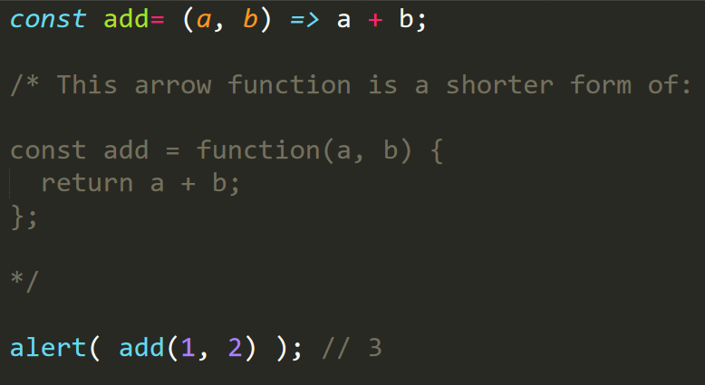
Arrow Functions
Syntax for defining the arrow function:
const functionName = (arg1, arg2, ?..) => {
//body of the function
}

Slide 7
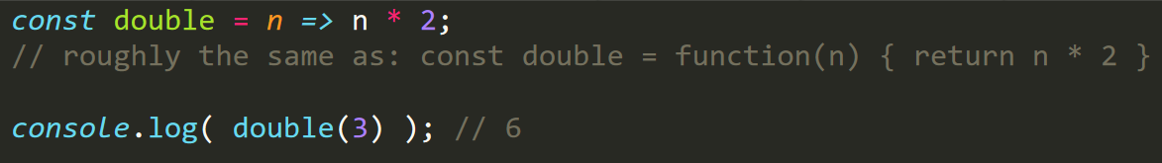
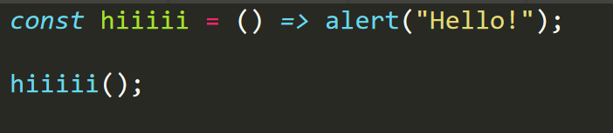
Arrow Functions
If we have only one argument, then parentheses around parameters can be omitted, making that even shorter. For example
If there are no arguments, parentheses are empty, but they must be present:

Slide 8
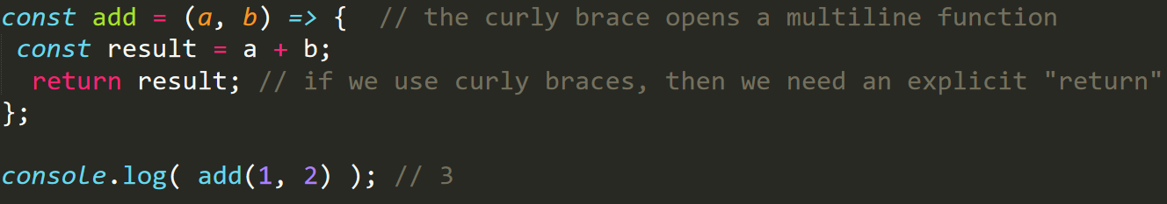
Multiline arrow functions
The arrow functions that we’ve seen so far were very simple. They took arguments from the left of =>, evaluated and returned the right-side expression with them.
Sometimes we need a more complex function, with multiple expressions and statements. In that case, we can enclose them in curly braces. The major difference is that curly braces require a return within them to return a value (just like a regular function does).
Without curly braces: (...args) => expression – the right side is an expression: the function evaluates it and returns the result. Parentheses can be omitted, if there’s only a single argument, e.g. n => n*2.
With curly braces: (...args) => { body } – brackets allow us to write multiple statements inside the function, but we need an explicit return to return something.

Slide 9
Variables
A variable, by definition, is “a named space in the memory” that stores values. In other words, it acts as a container for values in a program. Variable names are called identifiers.
Type Syntax: A variable must be declared before it is used. ES5 syntax used the var keyword to achieve the same. The ES5 syntax for declaring a variable is as follows.
//Declaration using var keyword
var variablename
ES6 introduces the following variable declaration syntax −
Using the let.
Using the const.

Slide 10
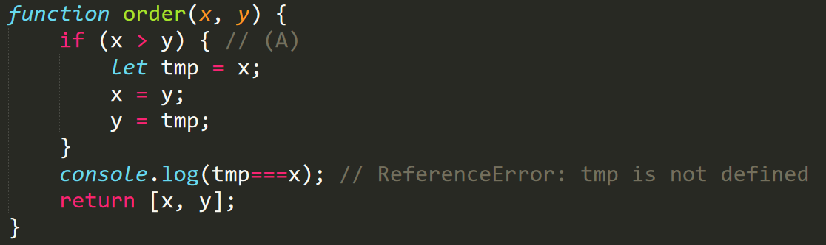
Variable using let keyword
The let keyword was introduced in ES6 (2015)
Variables declared with let have Block Scope
Variables declared with let must be Declared before use
Variables declared with let cannot be Redeclared in the same scope
Variables declared inside a { } block cannot be accessed from outside the block whereas Variables declared with varinside a { } block can be accessed from outside the block
In the following code, you can see that the let-declared variable tmp only exists inside the block that starts in line A:

Slide 11
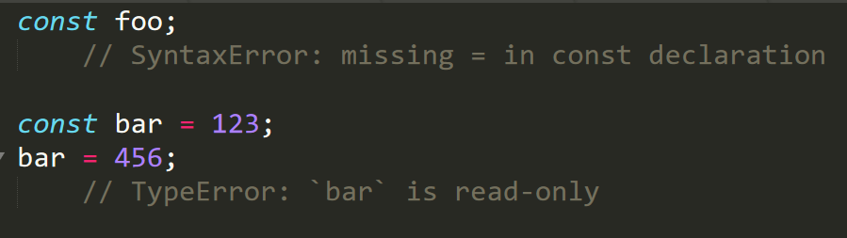
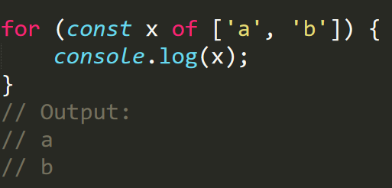
Variable using const keyword
The const keyword was introduced in ES6 (2015)
Variables defined with const cannot be Redeclared
JavaScript const variables must be assigned a value when they are declared
Variables defined with const cannot be Reassigned
Variables defined with const have Block Scope
Since for-of creates one binding (storage space for a variable) per loop iteration, it is OK to const-declare the loop variable:

Slide 12
Variable using const keyword
The keyword const is a little misleading.
It does not define a constant value. It defines a constant reference to a value.
Because of this you can NOT:
Reassign a constant value
Reassign a constant array
Reassign a constant object
But you CAN:
Change the elements of constant array
Change the properties of constant object

Slide 13
Array methods
Some important array methods,
push
sort
includes
filter
pop
reverse
find
forEach
shift
slice
some
reduce
unshift
join
every
map

Slide 14
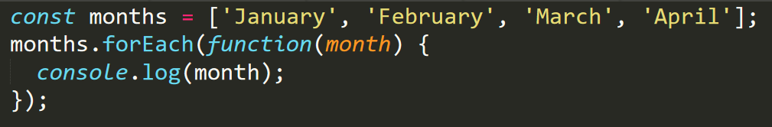
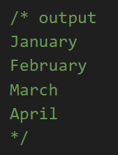
Array Methods - Array.forEach Method
The forEach method executes a provided function once for every element in the array.
The thing you need to keep in mind is that the forEach method does not return any value.
Using a forEach loop makes your code shorter and easier to understand
When using a forEach loop, we don't need to keep track of how many elements are available in the array. So it avoids the creation of an extra counter variable.
Using a forEach loop makes code easy to debug because there are no extra variables for looping through the array
The forEach loop automatically stops when all the elements of the array are finished iterating.

Slide 15
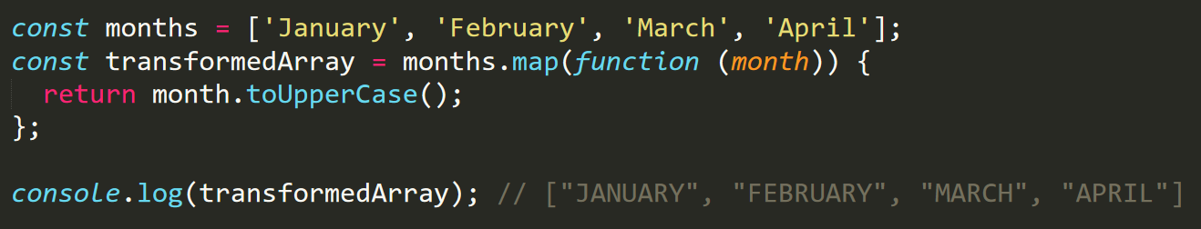
Array Methods - Array.map Method
The map method executes a provided function once for every element in the array and it returns a new transformed array.
Note that the map method returns a new array that is of the exact same length as the original array.
The difference between the forEach and map methods is that forEach is only used for looping and does not return anything back. On the other hand, the map method returns a new array that is of the exact same length as the original array.
Also, note that map does not change the original array but returns a new array.

Slide 16
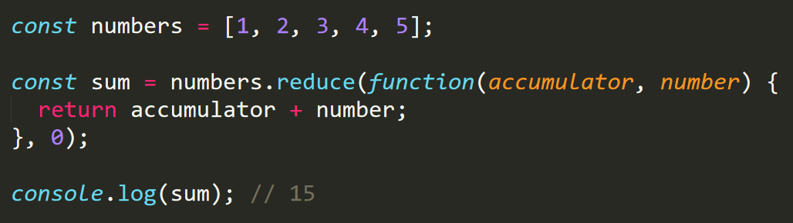
Array Methods - Array.reduce Method
The reduce method executes a reducer function (that you provide) on each element of the array, resulting in a single output value.
Note that the output of the reduce method is always a single value. It can be an object, a number, a string, an array, and so on. It depends on what you want the output of reduce method to generate but it's always a single value.
Suppose that you want to find the sum of all the numbers in the array. You can use the reduce method for that.

Slide 17
Array Methods - Array.reduce Method
The reduce method accepts a callback function that receives accumulator, number, index and array as the values. In the above code, we’re using only accumulator and number.
The accumulator will contain the initial Value to be used for the array. The initial Value decides the return type of the data returned by the reduce method.
The number is the second parameter to the callback function that will contain the array element during each iteration of the loop.
Advantages of using the reduce method : Using reduce allows us to generate any type of simple or complex data based on the array
It remembers the previously returns data from the loop so helps us avoid creating a global variable to store the previous value

Slide 18
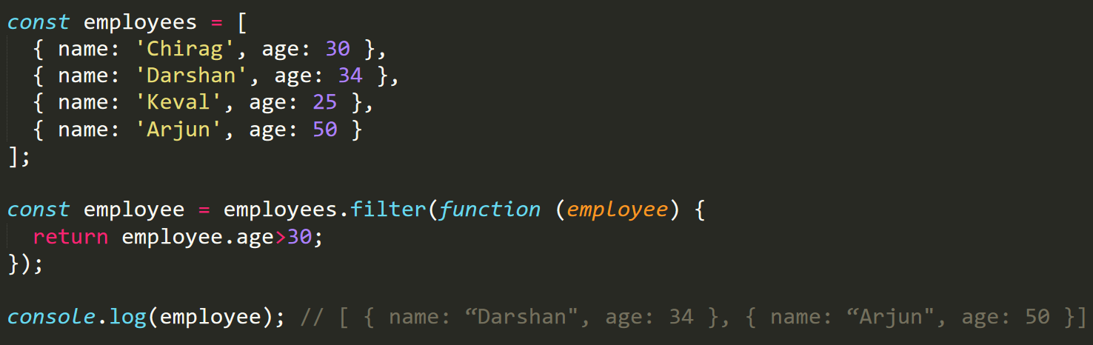
Array Methods - Array.filter Method
The filter method returns a new array with all the elements that satisfy the provided test condition.
The filter method takes a callback function as the first argument and executes the callback function for every element of the array. Each array element value is passed as the first parameter to the callback function.

Slide 19
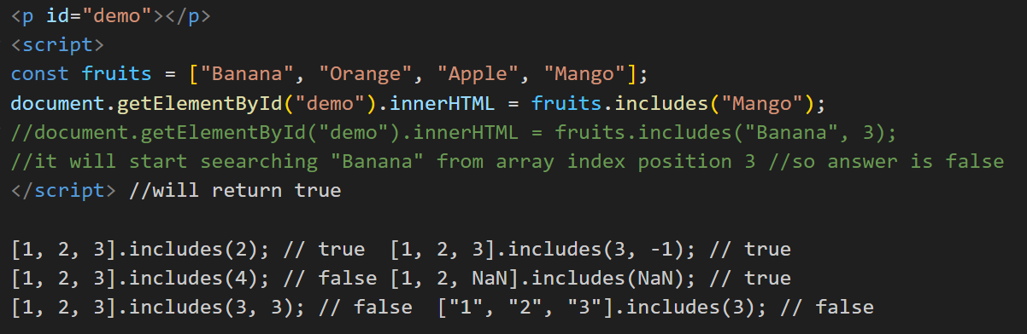
Array Methods - Array.includes Method
The includes() method returns true if an array contains a specified value.
The includes() method returns false if the value is not found.
The includes() method is case sensitive.
Syntax: array.includes(element, start)
element: required, start: optional

Slide 20
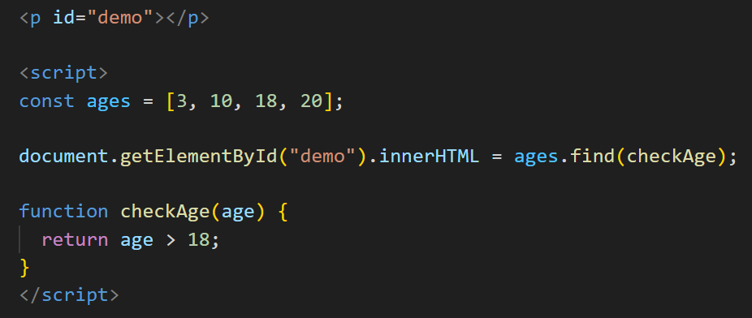
Array Methods - Array.find Method
The find() method returns the value of the first element that passes the test.
The find() method executes a function for each array element.
The find() method returns undefined if no elements are found.
The find() method does not execute the function for empty elements.
The find() method does not change the original array.

Slide 21
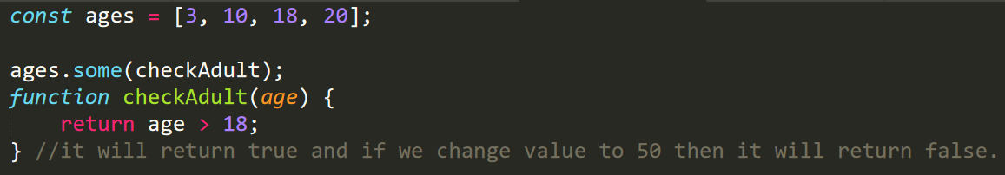
Array Methods - Array.some Method
The some() method checks if any array elements pass a test (provide as a callback function).
The some() method executes the callback function once for each array element.
The some() method returns true (and stops) if the function returns true for one of the array elements.
The some() method returns false if the function returns false for all the elements.
The some() method does not execute the function for empty array elements.
The some() method does not change the original array.

Slide 22
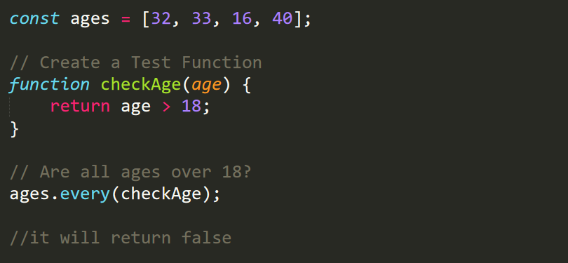
Array Methods - Array.every Method
The every() method executes a function for each array element.
The every() method returns true if the function returns true for all elements.
The every() method returns false if the function returns false for any one element.
The every() method does not execute the function for empty elements.
The every() method does not change the original array.

Slide 23
Destructuring
To illustrate destructuring, we'll make a sandwich. Do you take everything out of the refrigerator to make your sandwich? No, you only take out the items you would like to use on your sandwich.
Destructuring is exactly the same. We may have an array or object that we are working with, but we only need some of the items contained in these.
Destructuring makes it easy to extract only what is needed.
The destructuring assignment introduced in ES6 makes it easy to assign array values and object properties to distinct variables.
Let us see destructuring of
Object
Array

Slide 24
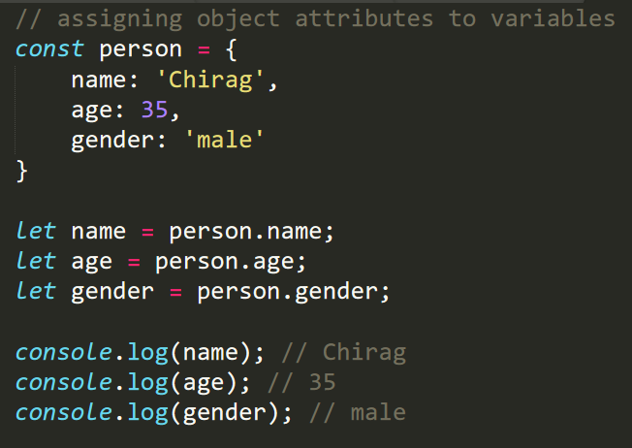
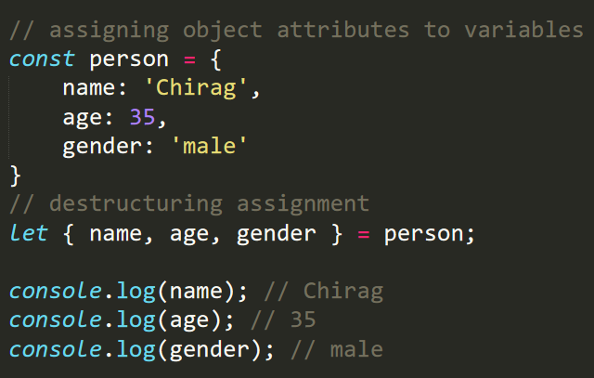
Destructsuring : Object destructuring
Before ES6
After ES6

Slide 25
Destructuring : Object destructuring
Note: The order of the name does not matter in object destructuring.
Note: When destructuring objects, you should use the same name for the variable as the corresponding object key.
If you want to assign different variable names for the object key, you can use.

Slide 26
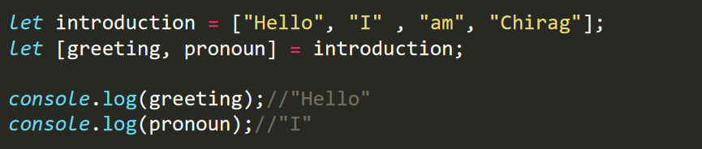
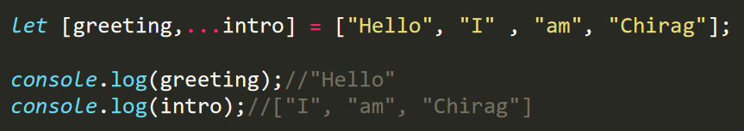
Destructuring : Array destructuring
You can also perform array destructuring in a similar way. For example,
Rest Operator

Slide 27
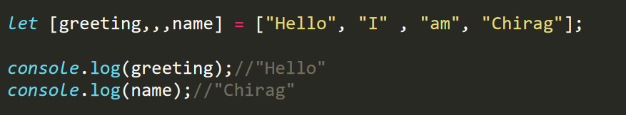
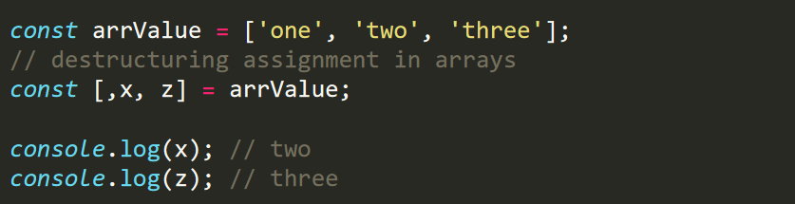
Destructuring : Array destructuring
Skipping Items in an Array
Skip the value

Slide 28
Modules
Consider a scenario where parts of JavaScript code need to be reused. ES6 comes to your rescue with the concept of Modules.
A module organizes a related set of JavaScript code.
A module can contain variables and functions.
A module is nothing more than a chunk of JavaScript code written in a file.
By default, variables and functions of a module are not available for use, Variables and functions within a module should be exported so that they can be accessed from within other files.
Modules in ES6 work only in strict mode. This means variables or functions declared in a module will not be accessible globally.
JavaScript modules allow you to break up your code into separate files.
This makes it easier to maintain the code-base.
ES Modules rely on the import and export statements.

Slide 29
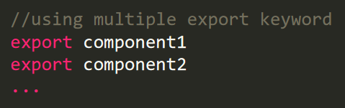
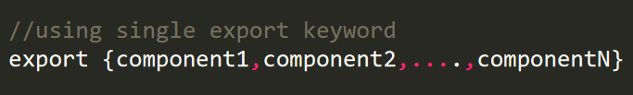
Modules: Export
You can export a function or a variable from any file.
There are two types of exports: Named and Default
Exporting a Module: The export keyword can be used to export components in a module. Exports in a module can be classified as follows −
1. Named Exports: Named exports are distinguished by their names. There can be several named exports in a module. A module can export selected components using the syntax given below −
2. Default Exports: Modules that need to export only a single value can use default exports. There can be only one default export per module.

Slide 30
Modules: Import
You can export a function or a variable from any file.
There are two types of exports: Named and Default
Importing a Module : To be able to consume a module, use the import keyword. A module can have multiple import statements.
1. Named Imports: While importing named exports, the names of the corresponding components must match.
However, while importing named exports, they can be renamed using the as keyword. Use the syntax given below −
All named exports can be imported onto an object by using the asterisk * operator.
2. Default Imports: Unlike named exports, a default export can be imported with any name.

Slide 31
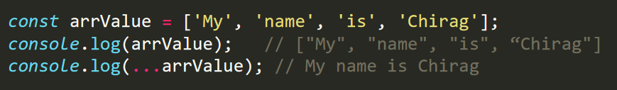
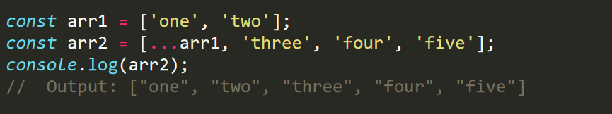
Spread Operator
The JS spread operator (…) allows us to quickly copy all or part of an existing array or object into another array or object.
The spread operator is often used in combination with destructuring.
Copy Array Using Spread Operator : You can also use the spread syntax ... to copy the items into a single array. For example,

Slide 32
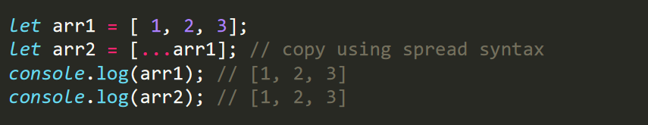
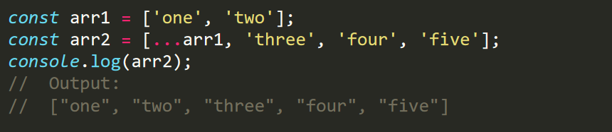
Spread Operator
Clone Array Using Spread Operator : if you want to copy arrays so that they do not refer to the same array, you can use the spread operator. This way, the change in one array is not reflected in the other. For example,
Spread Operator with Object : You can also use the spread operator with object literals. For example,

Slide 33

JavaScript Frameworks (2104CS512)
Prof. Chirag K Sakhrani
Department of Computer Applications
chirag.sakhrani@darshan.ac.in
8401191184

