Slide 1
Unit – 03 Interprocess Communication & Deadlock
Operating System Concepts (OSC)
2104CS502
Prof. Umesh Thoriya
Department of Computer Science and Engineering
umesh.thoriya@darshan.ac.in
9714233355

Slide 2

Looping
Outline
IPC, Race Conditions, Critical Section, Mutual Exclusion
Mutual exclusion with busy waiting
Disabling interrupts (Hardware approach)
Shared lock variable (Software approach)
Strict alteration (Software approach)
TSL (Test and Set Lock) instruction (Hardware approach)
Basic concepts of Deadlock
Deadlock characteristics
Deadlock ignorance
Ostrich algorithm
Deadlock detection and recovery
Deadlock avoidance
Banker’s algorithm
Deadlock prevention

Slide 3
IPC, Race Conditions, Critical Section, Mutual Exclusion
Section - 1

Slide 4

Inter-process communication (IPC)
Inter-process communication is the mechanism provided by the operating system that allows processes to communicate with each other.
This communication could involve a process letting another process know that some event has occurred or transferring of data from one process to another.
Processes in a system can be independent or cooperating.
Independent process cannot affect or be affected by the execution of another process.
Cooperating process can affect or be affected by the execution of another process.
Cooperating processes need inter process communication mechanisms.
Inter-process Communication
Process - 1
Process - 2
Exercise
Give an example of independent processes?

Slide 5
Inter-process communication (IPC)
Reasons of process cooperation
Information sharing: Several processes may need to access the same data (such as stored in a file.)
Computation speed-up: A task can often be run faster if it is broken into subtasks and distributed among different processes.
Modularity: It may be easier to organize a complex task into separate subtasks, then have different processes or threads running each subtask.
Convenience: An individual user can run several programs at the same time, to perform some task.
Issues of process cooperation
Data corruption, deadlocks, increased complexity
Requires processes to synchronize their processing

Slide 6
Models for Inter-process communication (IPC)
Message Passing
Process A send the message to Kernel and then Kernel send that message to Process B
Shared Memory
Process A put the message into Shared Memory and then Process B read that message from Shared Memory
Process - A
Process - A
M
M
Process - B
Shared Memory
Process - B
Kernel
Kernel
M

Slide 7
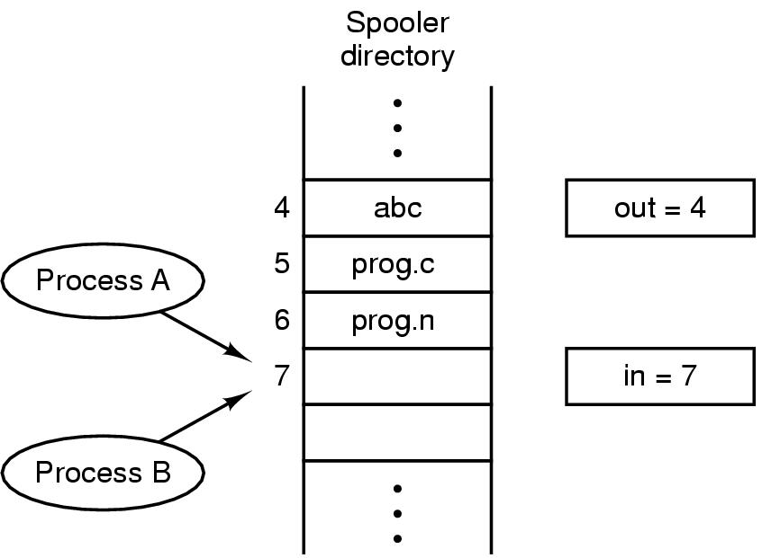
Race Condition
The situation where several processes access and manipulate shared data concurrently. The final value of the shared data depends upon which process finishes last.
A race condition is an undesirable situation that occurs when a device or system attempts to perform two or more operations at the same time.
But, because of the nature of the device or system, the operations must be done in the proper sequence to be done correctly.
To prevent race conditions, concurrent processes must be synchronized.
Print spooler directory example :
Two processes want to access shared memory at the same time.

Slide 8
Example of Race Condition
Process A
next_free_slot = in
Write file name at slot (7)
next_free_slot += 1
in = next_free_slot (8)
Context Switch
Process B
next_free_slot = in
Write file name at slot (8)
next_free_slot += 1
in = next_free_slot (9)
Process A
next_free_slot = in (7)
Context Switch
Process B
next_free_slot = in (7)
Write file name at slot (7)
next_free_slot += 1
in = next_free_slot (8)
Context Switch
Process A
Write file name at slot (7)
next_free_slot += 1
in = next_free_slot (8)
Race Condition

Slide 9


Critical Section
Critical Section: The part of program where the shared resource is accessed is called critical section or critical region.
Process
{
}
Non Critical Section
Entry Section
Critical Section
A enters in critical region
A leaves critical region
Process A
Exit Section
B attempt to enter
B enters in critical region
B leaves critical region
Process B
Non Critical Section
T1
T2
B Blocked
T3
T4

Slide 10
Critical Section
Every process can have its own critical section.
The Critical section can be accessed by only one process at a time.
In the Critical section, there are many variables and functions that are shareable among different processes.
Now, the question is: Which process will access the Critical Section first?
It depends upon the selected scheduling algorithm (FCFS, SJF, RR, Priority, etc)
A enters in critical region
A leaves critical region
Process A
B attempt to enter
B enters in critical region
B leaves critical region
Process B
T1
T2
B Blocked
T3
T4

Slide 11


Mutual Exclusion
Mutual Exclusion: Way of making sure that if one process is using a shared variable or file; the other process will be excluded (stopped) from doing the same thing.
If a process is executing in its critical section, then no other process can execute in its critical section

Slide 12



Solving Critical-Section Problem
Any good solution to the problem must satisfy following four conditions:
Mutual Exclusion
No two processes may be simultaneously inside the same critical section.
Only one process can hold the critical section at any given time.
If another process needs the critical section, they must wait until it is free.
Example: Suppose a process P1 is executing in its critical section, then if the P2, P3 or some else process try to enter into the critical section of the P1, then all these processes need to wait until the P1 leaves the Critical Section
Bounded Waiting
No process should have to wait forever to enter a critical section.
It means that each process must have a limited waiting time.

Slide 13

Solving Critical-Section Problem
Progress
No process running outside its critical region may block other processes.
If a process is not executing its own critical section, then it should not stop any other process to access the Critical Section.
Example: If a process P1 is not executing its own critical section, then P2 or some other process arrives to enter into the Critical Section of the P1, then P1 it should not stop any other process to access the Critical Section.
Arbitrary Speed
No assumption can be made about the relative speed of different processes (though all processes have a non-zero speed).

Slide 14
Mutual exclusion with busy waiting
Section - 2

Slide 15
Mutual exclusion with busy waiting
Mechanisms for achieving mutual exclusion with busy waiting
Disabling interrupts (Hardware approach)
Shared lock variable (Software approach)
Strict alteration (Software approach)
TSL (Test and Set Lock) instruction (Hardware approach)

Slide 16





Real life example to explain mechanisms for achieving mutual exclusion with busy waiting

Slide 17
Disabling interrupts (Hardware approach)
Section – 2.1

Slide 18


Disabling interrupts (Hardware approach)
It is hardware based synchronization Mechanism.
Each process disables all interrupts just after entering in its critical section and re-enable all interrupts just before leaving critical section.
With interrupts turned off the CPU could not be switched to other process. Hence, no other process will enter its critical and mutual exclusion achieved.
while (true)
{
< disable interrupts >;
< critical section >;
< enable interrupts >;
< remainder section >;
}
< critical section >
< remainder section >
< disable interrupts >
< enable interrupts >
Process A
Process B
T1
T3
T4

Slide 19
Disabling interrupts (Hardware approach)
while (true)
{
< disable interrupts >;
< critical section >;
< enable interrupts >;
< remainder section >;
}
< critical section >
< remainder section >
< disable interrupts >
< enable interrupts >
Process A
Process B
T1
T3
T4

Slide 20
Problems in Disabling interrupts (Hardware approach)
Unattractive or unwise to give user processes the power to turn off interrupts.
What if one of the process did it (disable interrupt) and never turned them on (enable interrupt) again? That could be the end of the system.
If the system is a multiprocessor, with two or more CPUs, disabling interrupts affects only the CPU that executed the disable instruction. The other ones will continue running and can access the shared memory.
Here, Mutual exclusion and Progress is achieved but there is no guarantee of bounded waiting.

Slide 21
Shared lock variable (Software approach)
Section – 2.2

Slide 22
Shared lock variable (Software approach)
A shared variable lock having value 0 or 1.
Lock value = 0 means the critical section is currently vacant and no process is present inside it.
Lock value = 1 means the critical section is currently occupied and a process is present inside it.
Before entering into critical region a process checks a shared variable lock’s value.
If the value of lock is 0 then set it to 1 before entering the critical section and enters into critical section and set it to 0 immediately after leaving the critical section.
If the value of lock is 1 then wait until it becomes 0 by some other process which is in critical section.

Slide 23


Shared lock variable (Software approach)
Problem:
If process-A sees the value of lock variable 0 and before it can set it to 1 context switch occurs.
Now process-B runs and finds value of lock variable 0, so it sets value to 1, enters critical region.
At some point of time process-A resumes, sets the value of lock variable to 1, enters critical region.
Now two processes are in their critical regions accessing the same shared memory, which violates the mutual exclusion condition.
while (true)
{ < set shared variable to 1 >;
< critical section >;
< set shared variable to 0 >;
< remainder section >;
}
< critical section >
< remainder section >
< set lock to 1 >
< set lock to 0 >
Process A
Process B
T1
T3
T4

Slide 24
Shared lock variable (Software approach)
The Lock variable mechanism is a synchronization mechanism that is implemented in a user mode.
It is a software procedure.
Lock variable is a solution for busy waiting that can be easily applied by more than two processes
Entry Section
While (lock! = 0);
Lock = 1;
//Critical Section
Exit Section
Lock =0;
< critical section >
< remainder section >
< set lock to 1 >
< set lock to 0 >
Process A
Process B
T1
T3
T4

Slide 25
Strict alteration (Software approach)
Section – 2.3

Slide 26
Strict alteration (Software approach)
This approach can only be used for only two processes.
They share a variable called turn variable.
Integer variable 'turn' keeps track of whose turn is to enter the critical section.
Turn variable is implemented on user mode, and it is a software mechanism.
Initially turn=0. Process 0 inspects turn, finds it to be 0, and enters in its critical section.
Process 1 also finds it to be 0 and therefore sits in a loop continually testing 'turn' to see when it becomes 1.
Continuously testing a variable waiting for some event to appear is called the busy waiting.
When process 0 exits from critical region it sets turn to 1 and now process 1 can find it to be 1 and enters in to critical region.
In this way, both the processes get alternate turn to enter in critical region.

Slide 27
Strict alteration (Software approach)
This approach can only be used for only two processes.
In general, let the two processes be P0 and P1. They share a variable called turn variable.
Process 0
while (TRUE)
{
while (turn != 0) /* loop */ ;
critical_region();
turn = 1;
noncritical_region();
}
Process 1
while (TRUE)
{
while (turn != 1) /* loop */ ;
critical_region();
turn = 0;
noncritical_region();
}
Initially, turn value is set to 0.
Turn value = 0 means it is the turn of process P0 to enter the critical section.
Turn value = 1 means it is the turn of process P1 to enter the critical section
0
0
0
1
0
0
0 enters in critical region
0 leaves critical region
Process 0
1 attempt to enter
1 enters in critical region
1 leaves critical region
1 attempt to enter
Process 1
T1
T2
1 Busy Wait
T3
T4
T5
1 Busy Wait

Slide 28
Disadvantages of Strict alteration (Software approach)
Taking turns is not a good idea when one of the processes is much slower than the other.
Consider the following situation for two processes P0 and P1.
P0 leaves its critical region, set turn to 1, enters non critical region.
P1 enters and finishes its critical region, set turn to 0.
Now both P0 and P1 in non-critical region.
P0 finishes non critical region, enters critical region again, and leaves this region, set turn to 1.
P0 and P1 are now in non-critical region.
0
0
0
1
0
0
1
0 enters in critical region
0 leaves critical region
Process 0
1 attempt to enter
1 enters in critical region
1 leaves critical region
Process 1
T1
T2
1 Busy Wait
T3
T4
T5
T6
T7

Slide 29
Disadvantages of Strict alteration (Software approach)
Taking turns is not a good idea when one of the processes is much slower than the other.
Consider the following situation for two processes P0 and P1.
P0 finishes non critical region but cannot enter its critical region because turn = 1 and it is turn of P1 to enter the critical section.
Hence, P0 will be blocked by a process P1 which is not in critical region. This violates one of the conditions of mutual exclusion.
It wastes CPU time, so we should avoid busy waiting as much as we can.
0
0
0
1
0
0
1
0 attempt to enter
0 enters in critical region
0 leaves critical region
Process 0
1 attempt to enter
1 enters in critical region
1 leaves critical region
1 Busy Wait
Process 1
T1
T2
1 Busy Wait
T3
T4
T5
T6
T7

Slide 30
Disadvantages of Strict alteration (Software approach)
It does not guarantee progress since it follows strict alteration approach.
Processes have to compulsorily enter the critical section alternately whether they want it or not.
This is because if one process does not enter the critical section, then other process will never get a chance to execute again.
The process has to release the key once it comes out of the critical section. After entering once into the critical section the process has to release the key. Therefore bounded waiting is guaranteed.

Slide 31
TSL (Test and Set Lock) instruction (Hardware approach)
Section – 2.4

Slide 32
TSL (Test and Set Lock) instruction (Hardware approach)
Test and Set Lock (TSL) is a synchronization mechanism.
It uses a test and set instruction to provide the synchronization among the processes executing concurrently.
The operating system provides a special instruction called Test Set Lock (TSL) instruction which simply loads the value of lock variable into the local register and sets it to 1 simultaneously
The process which executes the TSL first will enter into the critical section and no other process after that can enter until the first process comes out.
No process can execute the critical section even in the case of pre-emption of the first process.
Register
0
Process 0
Process 1
T1
T2
T3

Slide 33
TSL (Test and Set Lock) instruction (Hardware approach)
Algorithm
enter_region: (Before entering its critical region, process calls enter_region)
TSL REGISTER, LOCK |copy lock variable to register set lock to 1
CMP REGISTER, #0 |was register variable 0?
JNE enter_region |if it was nonzero, lock was set, so loop
RET |return to caller: critical region entered
leave_region: (When process wants to leave critical region, process calls leave_region)
MOVE LOCK, #0 |store 0 in lock variable
RET |return to caller
Register
0
Process 0
Process 1
T1
T2
T3

Slide 34
TSL (Test and Set Lock) instruction (Hardware approach)
Test and Set Lock Instruction
TSL REGISTER, LOCK
It reads the contents of the memory word lock into register RX and then stores a nonzero value at the memory address lock.
The operations of reading the word and storing into it are guaranteed to be indivisible—no other processor can access the memory word until the instruction is finished.
The CPU executing the TSL instruction locks the memory bus to prohibit other CPUs from accessing memory until it is done.
Register
0
Process 0
Process 1
T1
T2
T3

Slide 35
TSL (Test and Set Lock) instruction (Hardware approach)
Mutual exclusion is guaranteed as preemption can not occur before setting the lock variable to 1.
A process that doesn't want to enter the critical section will not execute TSL instruction. Hence this guarantees progress.
Bounded waiting is not guaranteed.

Slide 36
Questions
Define : Inter-process communication (IPC), Independent process and Cooperating process
Explain Reasons of process cooperation.
Explain the following terms in details: Mutual Exclusion, Critical Section, Race Condition
What is critical section? What requirement should be satisfied for a solution to the critical section problem?
Explain the following algorithms to achieve mutual exclusion.
Disabling interrupts
Shared lock variable
Strict alteration
TSL (Test and Set Lock) instruction

Slide 37
Thank You

