Slide 1
Unit – 03 Interprocess Communication & Deadlock
Operating System Concepts (OSC)
2104CS502
Prof. Umesh Thoriya
Department of Computer Science and Engineering
umesh.thoriya@darshan.ac.in
9714233355

Slide 2

Looping
Outline
Basic concepts of Deadlock
Deadlock characteristics
Deadlock ignorance
Ostrich algorithm
Deadlock detection and recovery
Deadlock avoidance
Banker’s algorithm
Deadlock prevention

Slide 3
Basic concepts of Deadlock
Section - 1

Slide 4
What is Deadlock?
A process requests resources for its execution.
If the resources are not available at that time, the process enters a waiting state.
Sometimes, the resources it has requested are held by other waiting processes, hence the current process never changes its (waiting) state.
This situation is called a Deadlock.
Process
Process
P1
Hold
Request
R1
DEADLOCK
R2
Request
Hold
P2
Request
Hold
Resource
Resource

Slide 5
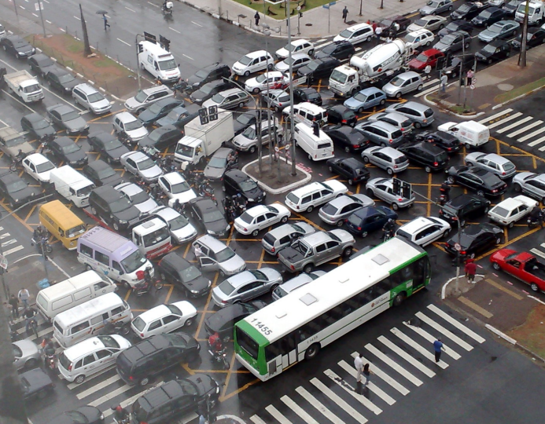
What is Deadlock?

Slide 6
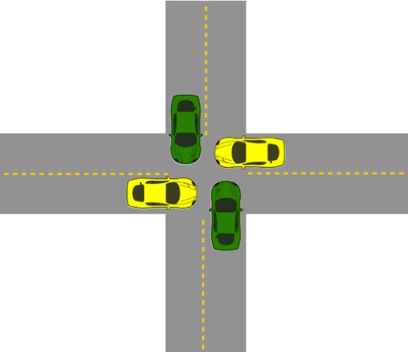
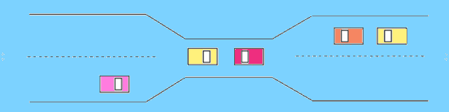
What is Deadlock?
A set of processes is deadlocked if each process in the set is waiting for an event that only another process in the set can cause.
Deadlocks are a set of blocked processes each holding a resource and waiting to acquire a resource held by another process.
Process
Process
P1
Hold
Request
R1
DEADLOCK
R2
Request
Hold
P2
Request
Hold
Resource
Resource
Exercise
Give an real life example of deadlock?

Slide 7
Preemptable and non-preemptable resource
Preemptable:- Preemptive resources are those which can be taken away from a process without causing any ill effects to the process.
Example:- Memory.
Non-preemptable:- Non-pre-emptive resources are those which cannot be taken away from the process without causing any ill effects to the process.
Example:- CD-ROM (CD recorder), Printer.

Slide 8


Deadlock v/s Starvation
Deadlock | Starvation

Slide 9
Deadlock v/s Starvation
Deadlock | Starvation
All processes keep waiting for each other to complete and none get executed. | High priority process keep executing and low priority process are blocked.
Resources are blocked by the process. | Resources are continuously utilized by the higher priority process.
Necessary conditions are mutual exclusion, hold and wait, no preemption, circular wait. | Priorities are assigned to the process.
Also known as circular wait. | Also known as lived lock.
It can be prevented by avoiding the necessary conditions for deadlock. | It can be prevented by Aging.

Slide 10
Deadlock characteristics
Section – 2

Slide 11
Conditions that lead to deadlock (Deadlock characteristics)
Mutual exclusion
Each resource is either currently assigned to exactly one process or is available.
Only one process at a time can use a resource.
If another process requests that resource, the requesting process must be delayed until the resource has been released
Examples:
If two people want to print a paper simultaneously, this process can not be done. One has to wait until the system releases the print (resource). Thus, we can assign a resource to only one process at a time.
Full-screen process in our computers can not be used by 2 apps simultaneously.
Hold and wait
A process must be holding at least one resource and waiting to acquire additional resources that are currently being held by other processes

Slide 12
Conditions that lead to deadlock (Deadlock characteristics)
No preemption
Previously granted resources cannot be forcibly taken away from process.
A resource cannot be taken from a process unless the process releases the resource.
If preemption was allowed deadlock would never occur because then no process would have been able to hold a resource for long amount of time.
Example: If your speaker is running an audio and after some time you click on some other audio it starts playing but in case if no preemption was allowed we would had to wait for the first audio to end and if in case it was on loop we will end up in a deadlock.

Slide 13
Conditions that lead to deadlock (Deadlock characteristics)
Circular wait
There must be a circular chain of 2 or more processes. Each process is waiting for resource that is held by next member of the chain.
A process is waiting for the resource held by the second process, which is waiting for the resource held by the third process and so on, till the last process is waiting for a resource held by the first process.
All four of these conditions must be present for a deadlock to occur.
P1
Hold
Request
R1
R2
P2
Request
Hold

Slide 14
Strategies for dealing with deadlock
Just ignore the problem
In this method, it is assumed that there will never be a deadlock. It i
Detection and recovery.
Let deadlocks occur, detect them and take action.
Dynamic avoidance by careful resource allocation.
Prevention, by structurally negating (killing) one of the four required conditions.
There can never be a deadlock in a system if one of the four conditions can be violated at any time.

Slide 15
Deadlock ignorance (Ostrich Algorithm)
Section - 3

Slide 16

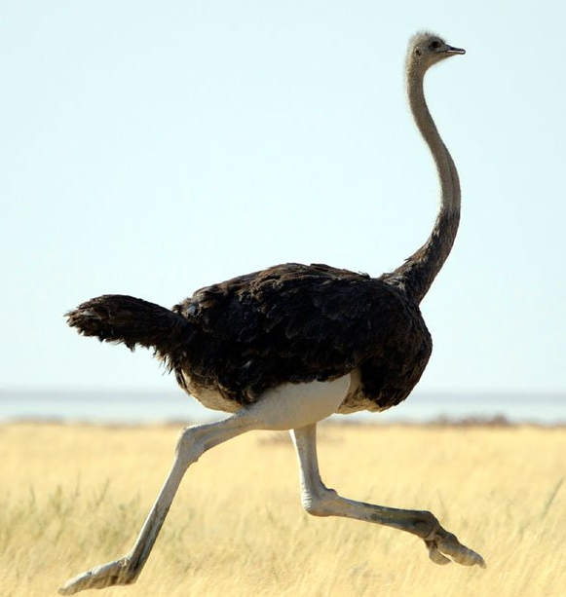
Deadlock ignorance (Ostrich Algorithm)
Deadlock ignorance occurs when system designers and programmers don’t consider the possibility of a deadlock in their design or coding.
This algorithm is a well-used method to ignore problems.
When storm approaches, an ostrich puts his head in the sand (ground) and pretend (imagine) that there is no problem at all.
Ignore the deadlock and pretend that deadlock never occur.
Reasonable if
deadlocks occur very rarely
difficult to detect
cost of prevention is high
If there is a condition of deadlock, the OS will reboot the system. This method is very popular where OS is for the end-users.
UNIX and Windows takes this approach

Slide 17
Deadlock detection and recovery
Section - 4

Slide 18
Deadlock detection for single resource (RAG - Resource Allocation Graph)
We are starting from node D.
Empty list L = ()
Add current node so Empty list = (D).
From this node there is one outgoing arc to T so add T to list.
So list become L = (D, T).
Continue this step….so we get list as below
L = (D, T, E)………… L = (D, T, E, V, G, U, D)
In the above step in list the node D appears twice, so deadlock.
R
A
B
C
S
D
T
E
F
U
DEADLOCK
V
W
G
Process | Holds | Wants
A | R | S
B |  | T
C |  | S
D | U | S,T
E | T | V
F | W | S
G | V | U

Slide 19
Deadlock detection for single resource (RAG - Resource Allocation Graph)
Algorithm for detecting deadlock for single resource
For each node, N in the graph, perform the following five steps with N as the starting node.
Initialize L to the empty list, designate all arcs as unmarked.
Add current node to end of L, check to see if node now appears in L two times. If it does, graph contains a cycle (listed in L), algorithm terminates.
From given node, see if any unmarked outgoing arcs. If so, go to step 4; if not, go to step 5.
Pick an unmarked outgoing arc at random and mark it. Then follow it to the new current node and go to step 2.
If this is initial node, graph does not contain any cycles, algorithm terminates. Otherwise, dead end. Remove it, go back to previous node, make that one current node, go to step 2.

Slide 20
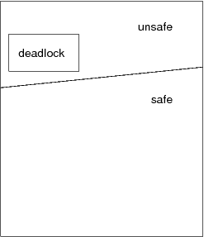
Possibility of Deadlock
If a resource allocation graph contains no cycles, then no process is deadlocked.
If a resource allocation graph contains a cycle, then a deadlock may exist.
Therefore, a cycle means deadlock is possible, but not necessarily present.
A cycle is not sufficient proof of the presence of deadlock. A cycle is a necessary condition for deadlock, but not a sufficient condition for deadlock.

Slide 21
Deadlock detection for multiple resources
Tape Drives | Plotters | Scanners | CD Roms
4 | 2 | 3 | 1
Tape Drives | Plotters | Scanners | CD Roms
2 | 1 | 0 | 0
T =
A =
total no of each resource
no of resources that are available (free)
Process | Tape Drives | Plotters | Scanners | CD Roms
P1 | 0 | 0 | 1 | 0
P2 | 2 | 0 | 0 | 1
P3 | 0 | 1 | 2 | 0
Process | Tape Drives | Plotters | Scanners | CD Roms
P1 | 2 | 0 | 0 | 1
P2 | 1 | 0 | 1 | 1
P3 | 2 | 1 | 0 | 0
C =
R =
no of resources held by each process
no of resources still needed by each process to proceed

Slide 22
Deadlock detection for multiple resources
Tape Drives | Plotters | Scanners | CD Roms
4 | 2 | 3 | 1
Tape Drives | Plotters | Scanners | CD Roms
2 | 1 | 0 | 0
T =
A =
total no of each resource
no of resources that are available (free)
Process | Tape Drives | Plotters | Scanners | CD Roms
P1 | 0 | 0 | 1 | 0
P2 | 2 | 0 | 0 | 1
P3 | 0 | 1 | 2 | 0
Process | Tape Drives | Plotters | Scanners | CD Roms
P1 | 2 | 0 | 0 | 1
P2 | 1 | 0 | 1 | 1
P3 | 2 | 1 | 0 | 0
C =
R =
no of resources held by each process
no of resources still needed by each process to proceed

Slide 23
Deadlock detection for multiple resources
Tape Drives | Plotters | Scanners | CD Roms
4 | 2 | 3 | 1
Tape Drives | Plotters | Scanners | CD Roms
0 | 0 | 0 | 0
T =
A =
total no of each resource
no of resources that are available (free)
Process | Tape Drives | Plotters | Scanners | CD Roms
P1 | 0 | 0 | 1 | 0
P2 | 2 | 0 | 0 | 1
P3 | 2 | 2 | 2 | 0
Process | Tape Drives | Plotters | Scanners | CD Roms
P1 | 2 | 0 | 0 | 1
P2 | 1 | 0 | 1 | 1
P3 | 2 | 1 | 0 | 0
C =
R =
no of resources held by each process
no of resources still needed by each process to proceed

Slide 24
Deadlock detection for multiple resources
Tape Drives | Plotters | Scanners | CD Roms
4 | 2 | 3 | 1
Tape Drives | Plotters | Scanners | CD Roms
0 | 0 | 0 | 0
T =
A =
total no of each resource
no of resources that are available (free)
Process | Tape Drives | Plotters | Scanners | CD Roms
P1 | 0 | 0 | 1 | 0
P2 | 2 | 0 | 0 | 1
P3 | 2 | 2 | 2 | 0
Process | Tape Drives | Plotters | Scanners | CD Roms
P1 | 2 | 0 | 0 | 1
P2 | 1 | 0 | 1 | 1
P3 | 2 | 1 | 0 | 0
C =
R =
no of resources held by each process
no of resources still needed by each process to proceed

Slide 25

Deadlock detection for multiple resources
Tape Drives | Plotters | Scanners | CD Roms
4 | 2 | 3 | 1
Tape Drives | Plotters | Scanners | CD Roms
2 | 2 | 2 | 0
T =
A =
total no of each resource
no of resources that are available (free)
Process | Tape Drives | Plotters | Scanners | CD Roms
P1 | 0 | 0 | 1 | 0
P2 | 2 | 0 | 0 | 1
P3 | 0 | 0 | 0 | 0
Process | Tape Drives | Plotters | Scanners | CD Roms
P1 | 2 | 0 | 0 | 1
P2 | 1 | 0 | 1 | 1
P3 | 2 | 1 | 0 | 0
C =
R =
DEADLOCK
no of resources held by each process
no of resources still needed by each process to proceed

Slide 26
Deadlock detection for multiple resources
Tape Drives | Plotters | Scanners | CD Roms
4 | 2 | 3 | 1
Tape Drives | Plotters | Scanners | CD Roms
2 | 2 | 2 | 0
T =
A =
total no of each resource
no of resources that are available (free)
Process | Tape Drives | Plotters | Scanners | CD Roms
P1 | 0 | 0 | 1 | 0
P2 | 2 | 0 | 0 | 1
P3 | 0 | 0 | 0 | 0
Process | Tape Drives | Plotters | Scanners | CD Roms
P1 | 2 | 0 | 0 | 1
P2 | 1 | 0 | 1 | 1
P3 | 2 | 1 | 0 | 0
C =
R =
DEADLOCK
no of resources held by each process
no of resources still needed by each process to proceed

Slide 27
Deadlock recovery
Recovery through pre-emption
In this method resources are temporarily taken away from its current owner and give it to another process.
The ability to take a resource away from a process, have another process use it, and then give it back without the process noticing it is highly dependent on the nature of the resource.
Recovering this way is frequently difficult or impossible.
P1
Hold
Request
R1
R2
P2
Hold

Slide 28
Deadlock recovery
Recovery through rollback
As the operating system keeps a record of the process state and it can easily make a process roll back to its previous state due to which deadlock situation can be easily eliminate.
PCB (Process Control Block) and resource state are periodically saved at “checkpoint”.
When deadlock is detected, rollback the preempted process up to the previous safe state before it acquired that resource.
Discard the resource manipulation that occurred after that checkpoint.
Start the process after it is determined it can run again.
A
A
A
A
F1
F2
R
R
B
First
Checkpoints
Second
Checkpoints

Slide 29
Deadlock recovery
Recovery through killing processes
The simplest way to break a deadlock is to kill one or more processes.
Kill all the process involved in deadlock
Kill process one by one.
After killing each process check for deadlock
If deadlock recovered then stop killing more process
Otherwise kill another process
Hold
P1
Request
Hold
R1
R2
Request
Hold
P3
P2
Hold
R3
Request
Hold

Slide 30
Deadlock avoidance (Banker’s algorithm)
Section - 5

Slide 31
Safe and unsafe states
A state is said to be safe if it is not deadlocked and there is some scheduling order in which every process can run to completion even if all of them suddenly request their maximum number of resources immediately.
Total resources are 10
7 resources already allocated
So there are 3 still free
A need 6 resources more to complete it.
B need 2 resources more to complete it.
C need 5 resources more to complete it.
Process | Has / Hold | Max required
A | 3 | 9
B | 2 | 4
C | 2 | 7
Free : 3

Slide 32
Safe state
Process | Has / Hold | Max required
A | 3 | 9
B | 2 | 4
C | 2 | 7
Free : 3
Process | Has / Hold | Max required
A | 3 | 9
B | 4 | 4
C | 2 | 7
Free : 1
Process | Has / Hold | Max required
A | 3 | 9
B | 0 | -
C | 2 | 7
Free : 5
2
4
Process | Has / Hold | Max required
A | 3 | 9
B | 0 | -
C | 7 | 7
Free : 0
5
Process | Has / Hold | Max required
A | 3 | 9
B | 0 | -
C | 0 | -
Free : 7
Process | Has / Hold | Max required
A | 9 | 9
B | 0 | -
C | 0 | -
Free : 1
6
7

Slide 33
Unsafe state
Process | Has / Hold | Max required
A | 3 | 9
B | 2 | 4
C | 2 | 7
Free : 3
Process | Has / Hold | Max required
A | 4 | 9
B | 2 | 4
C | 2 | 7
Free : 2
Process | Has / Hold | Max required
A | 4 | 9
B | 4 | 4
C | 2 | 7
Free : 0
1
2
Process | Has / Hold | Max required
A | 4 | 9
B | 0 | -
C | 2 | 7
Free : 4
4

Slide 34
Resource Allocation Graph (RAG)
We use the resource allocation graph for the pictographic representation of the state of a system.
The resource allocation graph contains all the information related to the processes that are holding some resources and also waiting for some more resources.
The process is represented by a circle in the Resource Allocation Graph, whereas the resource is represented using a rectangle.
There are two components of the resource allocation graph:
Vertices
Edges

Slide 35
Resource Allocation Graph (RAG)
Graph
Vertices
Edges
Process Vertices
Resources Vertices
Assign Edge
Request Edge
P
R
P
R
Single Instance
Multiple Instance

Slide 36
Example of Single Instances RAG
Hold
P1
Request
R1
R2
Request
Hold
P3
P2
Hold
R3
Request
In the above single instances RAG example, it can be seen that P1 is holding the R1 and waiting for R2. P2 is waiting for R3 and holding R2 and, P3 is holding the R3 and waiting for R1.
So, it can be concluded that none of the processes will get executed.
If there is a cycle in a single instance RAG then the processes will be in a deadlock.

Slide 37
Example of Multiple Instances RAG
We use numerous dots inside the box in the multiple instance resource type. Multiple dots indicate that the resource is used multiple times.
In the case of Multiple Instances RAG, it becomes difficult to analyze from the RAG whether the system is in a safe state or not.
Unlike Single Instances RAG, a cycle in Multiple Instances RAG does not guarantee that the processes are in deadlock.
P1
R1
R2
P4
P2
P3
Hold
Request
R3

Slide 38
Deadlock avoidance
Deadlock can be avoided by allocating resources carefully.
Carefully analyze each resource request to see if it can be safely granted.
Need an algorithm that can always avoid deadlock by making right choice all the time (Banker’s algorithm).
Banker’s algorithm for single resource
Banker’s algorithm for multiple resource

Slide 39
Deadlock avoidance
Deadlock can be avoided by allocating resources carefully.
Carefully analyze each resource request to see if it can be safely granted.
Need an algorithm that can always avoid deadlock by making right choice all the time (Banker’s algorithm).
Banker’s algorithm for single resource
Banker’s algorithm for multiple resource

Slide 40
Banker’s algorithm
Banker's Algorithm consists of two algorithms
Safety Algorithm – The safety algorithm checks for the safe state of the system. If the system is in the safe state with any of the resource allocation permutations then deadlock can be avoided.
Resource request algorithm – The resource request algorithm checks if the request can be safely granted or not to the process requesting for resources.
These two algorithms together control the processes and avoid deadlock in a system.

Slide 41
Banker’s algorithm for single resource
What the algorithm does is check to see if granting the request leads to an unsafe state. If it does, the request is denied.
If granting the request leads to a safe state, it is carried out.
If we have situation as per figure
then it is safe state
because with 10 free units
one by one all customers can be served.
Process | Has / Hold | Max required
A | 0 | 6
B | 0 | 5
C | 0 | 4
D | 0 | 7
Free : 10

Slide 42
Banker’s algorithm for single resource (safe state)
Process | Has / Hold | Max required
A | 1 | 6
B | 1 | 5
C | 2 | 4
D | 4 | 7
Free : 2
Process | Has / Hold | Max required
A | 1 | 6
B | 1 | 5
C | 4 | 4
D | 4 | 7
Free : 0
Process | Has / Hold | Max required
A | 1 | 6
B | 1 | 5
C | 0 | -
D | 4 | 7
Free : 4
2
3
Process | Has / Hold | Max required
A | 1 | 6
B | 1 | 5
C | 0 | -
D | 7 | 7
Free : 1
Process | Has / Hold | Max required
A | 1 | 6
B | 1 | 5
C | 0 | -
D | 0 | -
Free : 8
Process | Has / Hold | Max required
A | 1 | 6
B | 5 | 5
C | 0 | -
D | 0 | -
Free : 4
4

Slide 43

Banker’s algorithm for single resource (safe state)
Process | Has / Hold | Max required
A | 1 | 6
B | 0 | -
C | 0 | -
D | 0 | -
Free : 9
Process | Has / Hold | Max required
A | 6 | 6
B | 0 | -
C | 0 | -
D | 0 | -
Free : 4
Process | Has / Hold | Max required
A | 0 | -
B | 0 | -
C | 0 | -
D | 0 | -
Free : 10
5
The order of execution is C, D, B, A. So if we can find proper order of execution then there is no deadlock.

Slide 44
Banker’s algorithm for single resource (unsafe state)
Process | Has / Hold | Max required
A | 1 | 6
B | 1 | 5
C | 2 | 4
D | 4 | 7
Free : 2
Process | Has / Hold | Max required
A | 1 | 6
B | 2 | 5
C | 2 | 4
D | 4 | 7
Free : 1
Process | Has / Hold | Max required
A | 1 | 6
B | 2 | 5
C | 2 | 4
D | 4 | 7
Free : 1
1

Slide 45
Banker’s Algorithm
Banker’s Algorithm is used to determine whether a process’s request for allocation of resources be safely granted immediately.
The grant of request be deferred to a later stage.
For the banker’s algorithm to operate, each process has to a priori specify its maximum requirement of resources.
A process is admitted for execution only if its maximum requirement of resources is within the system capacity of resources.
The Banker’s algorithm is an example of resource allocation policy that avoids deadlock.
Process | Has / Hold | Max required
A | 0 | 6
B | 0 | 5
C | 0 | 4
D | 0 | 7
Free : 10

Slide 46
Banker’s Algorithm
Let n = number of processes, and m = number of resources types.
Available: no. of available resources of each type with the system.
Vector of length m. If available [j] = k, there are k instances of resource type R_{j} available.
Max: maximum need of any process for any resource
n x m matrix. If Max [i,j] = k, then process P_{i} may request at most k instances of resource type R_{j}.
Allocation: number of resources allocated to each process
n x m matrix. If Allocation[i,j] = k then P_{i} is currently allocated k instances of R_{j}.
Need: is calculated based on the formula (Max – Allocation)
n x m matrix. If Need[i,j] = k, then P_{i} may need k more instances of R_{j} to complete its task.
Need [i,j] = Max[i,j] – Allocation [i,j].

Slide 47
Banker’s Algorithm Example
Process | Allocated
 | R1 | R2 | R3 | R4
P1 | 0 | 0 | 1 | 2
P2 | 2 | 0 | 0 | 0
P3 | 0 | 0 | 3 | 4
P4 | 2 | 3 | 5 | 4
P5 | 0 | 3 | 3 | 2
Process | Max
 | R1 | R2 | R3 | R4
P1 | 0 | 0 | 1 | 2
P2 | 2 | 7 | 5 | 0
P3 | 6 | 6 | 5 | 6
P4 | 4 | 3 | 5 | 4
P5 | 0 | 6 | 5 | 2
Available
R1 | R2 | R3 | R4
2 | 1 | 0 | 0
Find the content of Need Matrix.
Is the system in safe state? Justify.

Slide 48
Banker’s Algorithm Example
Process | Allocated |  |  |  | Max |  |  |  | Available
 | R1 | R2 | R3 | R4 | R1 | R2 | R3 | R4 | R1 | R2 | R3 | R4
P1 | 0 | 0 | 1 | 2 | 0 | 0 | 1 | 2 | 2 | 1 | 0 | 0
P2 | 2 | 0 | 0 | 0 | 2 | 7 | 5 | 0
P3 | 0 | 0 | 3 | 4 | 6 | 6 | 5 | 6
P4 | 2 | 3 | 5 | 4 | 4 | 3 | 5 | 4
P5 | 0 | 3 | 3 | 2 | 0 | 6 | 5 | 2
NEED MATRIX | R1 | R2 | R3 | R4
P1 | 0 | 0 | 0 | 0
P2 | 0 | 7 | 5 | 0
P3 | 6 | 6 | 2 | 2
P4 | 2 | 0 | 0 | 0
P5 | 0 | 3 | 2 | 0
Compute NEED Matrix = ?
Need [i] = Max[i] - Allocated[i],
Therefore,

Slide 49
Banker’s Algorithm Example
Process | Allocated
 | R1 | R2 | R3 | R4
P1 | 0 | 0 | 1 | 2
P2 | 2 | 0 | 0 | 0
P3 | 0 | 0 | 3 | 4
P4 | 2 | 3 | 5 | 4
P5 | 0 | 3 | 3 | 2
By applying the Banker’s Algorithm:
Let Avail = Available; i.e . Avail = {2,1,0,0}
Check all processes from P1 to P5.
For P1:
if (P1 Need < Avail ) => TRUE
then calculate
Avail= Avail + Allocated [P1]
= {2,1,0,0} + {0,0,1,2}
Avail = {2,1,1,2}
NEED MATRIX | R1 | R2 | R3 | R4
P1 | 0 | 0 | 0 | 0
P2 | 0 | 7 | 5 | 0
P3 | 6 | 6 | 2 | 2
P4 | 2 | 0 | 0 | 0
P5 | 0 | 3 | 2 | 0

Slide 50
Banker’s Algorithm Example
For P2:
if (P2 Need < Avail ) => FALSE
//then Check for next process.
For P3:
if (P3 Need < Avail ) => FALSE
//then Check for next process.
For P4:
if (P4 Need < Avail ) => TRUE
then calculate
Avail= Avail + Allocated [P4]
= {2,1,1,2} + {2,3,5,4}
Avail = {4,4,6,6}
NEED MATRIX | R1 | R2 | R3 | R4
P1 | 0 | 0 | 0 | 0
P2 | 0 | 7 | 5 | 0
P3 | 6 | 6 | 2 | 2
P4 | 2 | 0 | 0 | 0
P5 | 0 | 3 | 2 | 0
Avail = {2,1,1,2}

Slide 51
Banker’s Algorithm Example
For P5:
if (P5 Need < Avail ) => TRUE
then calculate
Avail= Avail + Allocated [P5]
= {4,4,6,6} + {0,3,3,2}
Avail = {4,7,9,8}
NEED MATRIX | R1 | R2 | R3 | R4
P1 | 0 | 0 | 0 | 0
P2 | 0 | 7 | 5 | 0
P3 | 6 | 6 | 2 | 2
P4 | 0 | 0 | 0 | 0
P5 | 0 | 3 | 2 | 0
Avail = {4,4,6,6}

Slide 52
Banker’s Algorithm Example
Check only process P2 to P3.
For P2:
if (P2 Need < Avail ) => TRUE
then calculate
Avail= Avail + Allocated [P2]
= {4,7,9,8} + {2,0,0,0}
Avail = {6,7,9,8}
Avail = {4,7,9,8}
NEED MATRIX | R1 | R2 | R3 | R4
P1 | 0 | 0 | 0 | 0
P2 | 0 | 7 | 5 | 0
P3 | 6 | 6 | 2 | 2
P4 | 0 | 0 | 0 | 0
P5 | 0 | 0 | 0 | 0

Slide 53
Banker’s Algorithm Example
Avail = {6,7,9,8}
For P3:
if (P3 Need < Avail ) => TRUE
then calculate
Avail= Avail + Allocated [P3]
= {6,7,9,8} + {0,0,3,4}
Avail = {6,7,12,12}
NEED MATRIX | R1 | R2 | R3 | R4
P1 | 0 | 0 | 0 | 0
P2 | 0 | 0 | 0 | 0
P3 | 6 | 6 | 2 | 2
P4 | 0 | 0 | 0 | 0
P5 | 0 | 0 | 0 | 0
NEED MATRIX | R1 | R2 | R3 | R4
P1 | 0 | 0 | 0 | 0
P2 | 0 | 0 | 0 | 0
P3 | 0 | 0 | 0 | 0
P4 | 0 | 0 | 0 | 0
P5 | 0 | 0 | 0 | 0
Therefore, Safe Sequence = P1, P4, P5, P2 , P3 Therefore, the System is in the Safe State.

Slide 54
Deadlock prevention
Section - 6

Slide 55
Deadlock prevention
Deadlock can be prevented by attacking the one of the four conditions that leads to deadlock.
Attacking the Mutual Exclusion Condition
No deadlock if each resource can be assigned to more than one process.
We can not assign some resources to more than one process at a time such as CD-Recorder, Printer etc…
So this solution is not feasible.
Hence, the OS can’t avoid mutual exclusion.
For example, a printer cannot be simultaneously shared by several processes.
A good example of a sharable resource is Read-only files because if several processes attempt to open a read-only file at the same time, then they can be granted simultaneous access to the file.
Let’s take a practical example to understand this issue. Jack and Jones share a bowl of soup. Both of them want to drink the soup from the same bowl and use a single spoon simultaneously, which is not feasible

Slide 56
Deadlock prevention
Deadlock can be prevented by attacking the one of the four conditions that leads to deadlock.
Attacking the Hold and Wait Condition
Require processes to request all their resources before starting execution.
A process is allowed to run if all resources it needed is available. Otherwise nothing will be allocated and it will just wait.
Problem with this strategy is that a process may not know required resources at start of run.
Before starting the execution, the process does not know how many resources would be required to complete it. In addition to that
Resource will not be used optimally.
Example: Preparation of documents with MS Office in the computer and printing of the documents.

Slide 57
Deadlock prevention
Deadlock can be prevented by attacking the one of the four conditions that leads to deadlock.
Attacking the No Preemption Condition
When a process P0 request some resource R which is held by another process P1 then resource R is forcibly taken away from the process P1 and allocated to P0.
It means the CPU can’t take acquired resources from any process forcefully even though that process is in a waiting state.
If we can remove the no preemption and forcefully take resources from a waiting process, we can avoid the deadlock. This is an implementable logic to avoid deadlock.
Consider a process holds the printer, halfway through its job; taking the printer away from this process without having any ill effect is not possible.

Slide 58
Deadlock prevention
Deadlock can be prevented by attacking the one of the four conditions that leads to deadlock.
Attacking the Circular Wait Condition
Provide a global numbering of all the resources.
Printer
Scanner
Plotter
Tape Drive
CD Rom
Now the rule is that: processes can request resources whenever they want to, but all requests must be made in numerical order.
A process need not acquire them all at once.
Circular wait is prevented if process holding resource n cannot wait for resource m, if m > n
A process may request 1st a CD ROM, then tape drive. But it may not request 1st a tape drive, then CD ROM.
Resource graph can never have cycle.

Slide 59
Questions
What is resource allocation graph (RAG) ? Explain briefly.
What is deadlock? How deadlock can be prevented?
Differentiate: deadlock and starvation?
Which are the necessary conditions for deadlock? Explain in brief.
Define: safe state and unsafe state.
What are the methods for handling deadlock?
Explain about deadlock avoidance.
Explain deadlock recovery techniques in details.
i. Recovery through pre-emption, ii. Recovery through rollback, iii. Recovery through killing processes
Explain deadlock detection (Banker’s algorithm) with example.
Define the following terms in banker’s algorithm: available, max, allocation, and need
Explain the methods for deadlock prevention.

Slide 60
Questions - Deadlock
Consider the snapshot of the system with Five Processes and Four types of resources A,B,C,D.
Currently available set of resources is (1,5,2,0).
Answer the following Questions using bankers algorithm.
Find the content of Need Matrix.
Is the System in Safe State? If yes, then find a safe sequence.
Allocation |  |  |  |  |  | Max
Process | A | B | C | D |  | A | B | C | D
P0 | 0 | 0 | 1 | 2 |  | 0 | 0 | 1 | 2
P1 | 1 | 0 | 0 | 0 |  | 1 | 7 | 5 | 0
P2 | 1 | 3 | 5 | 4 |  | 2 | 3 | 5 | 6
P3 | 0 | 6 | 3 | 2 |  | 0 | 6 | 5 | 2
P4 | 0 | 0 | 1 | 4 |  | 0 | 6 | 5 | 6

Slide 61
Thank You

