Slide 1
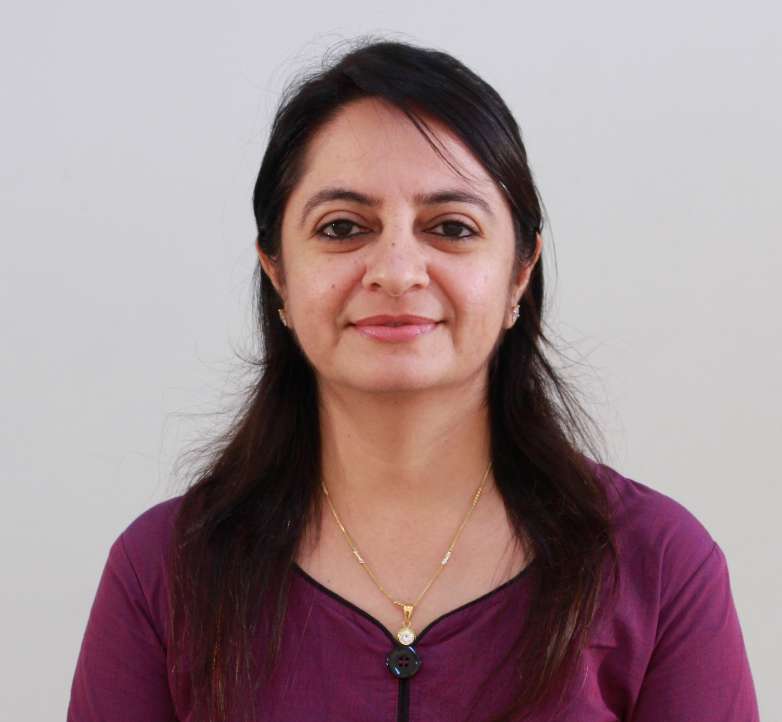
Unit-1 Fundamentals of Testing
Software Testing (ST)
# 21O4CS503
Prof. Devangi L. Kotak
Darshan Institute of Computer Application
Devangi.kotak@darshan.ac.in

Slide 2
Topics to be covered
What is Testing?
What is a Defect?
What is an Error?
Testing Objectives
Test Process
The Psychology of Testing
Testing Approaches
Software Testing Life Cycle - STLC
Principles of Software Testing
Verification & Validation
Bug Life Cycle

Looping

Slide 3
What is Testing?
Section 1

Slide 4
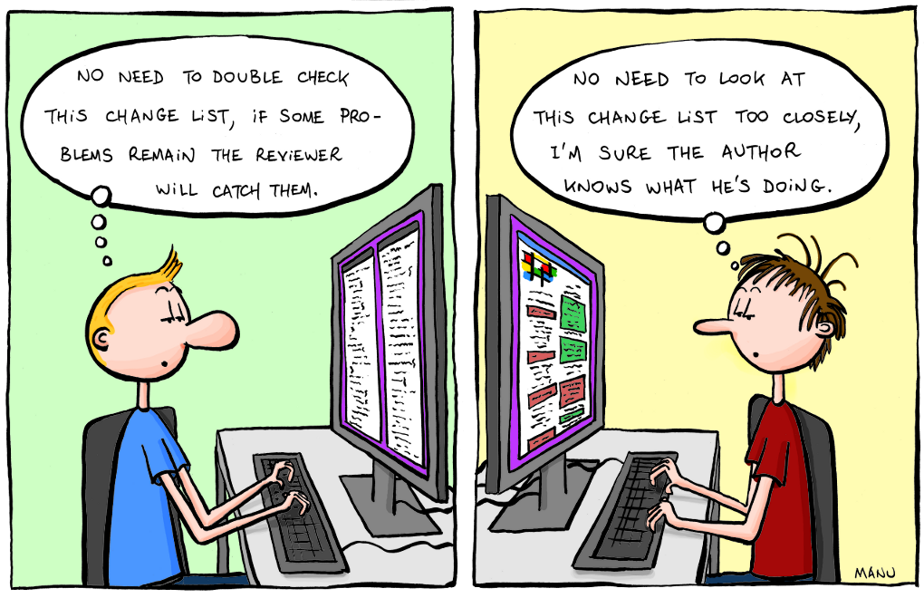


Software Testing
Testing is the process of exercising a program with the specific intent of finding errors prior to delivery to the end user.
Don’t view testing as a “safety net” that will catch all errors that occurred because of weak software engineering practice.

Slide 5
Software Testing
Software testing is a method of measuring a software product with expected requirements to check whether it is matching or not and to ensures that the software product is defect free.
The purpose of software testing is to identify errors, gaps or missing requirements.
Testing is the process of finding errors before delivering the product to the end user.
In the testing process, evaluation of bugs or errors, security, reliability and performance etc. is to be done.

Slide 6
What is a Defect?
Section 2

Slide 7
What is a Defect?
Defect is a deviation/variation of the software from the users or business requirements.
A software defect arises when the expected result don't match with the actual results.
It is an issue in application coding that can affect the whole program.
If a developer finds an issue and corrects it by himself in the development phase then it’s called a defect.
A defect can form when a programmer or developer makes some minor or major mistake during the development phase.
Following are the common types of defects that occur during development:
Arithmetic Defects
Logical Defects
Syntax Defects
Multithreading Defects
Interface Defects
Performance Defects

Slide 8
Types of Defect
Arithmetic Defects
Defects in the arithmetic expression or finding solutions to some arithmetic expression in the program.
These mistakes are caused mainly by the developers working on the software due to less knowledge or excess work.
For example: A financial software application calculate interest rate incorrectly.
Logical Defects
Logical defects come into the picture during the implementation of the code.
When the programmer doesn’t understand the problem clearly or thinks in a wrong way then such types of defects happen.
For example: In calculator, in division function when zero is detected at that time instead of showing error message, application crashes or freezes.

Slide 9
Types of Defect
Syntax Defects
Syntax defects are the common types of mistakes made while writing code.
It also focuses on the small mistake made by the developer while writing the code.
Often the developers do the syntax defects as there might be some small symbols escaped.
For example: While writing a code in C++ there is possibility that a semicolon(;) is escaped.
Multithreading Defects
Multithreading defects happen when executing or running multiple tasks (threads) at the same time.
This can lead to the possibility of complex debugging.
For example: In ecommerce site, when multiple threads attempt to update the same order status simultaneously, a race condition occurs and as a result, the order status is updated incorrectly leading to incorrect order processing.

Slide 10
Types of Defect
Interface Defects
Interface defects are the defects that occur during the interaction of users and software.
It includes complicated interfaces, platform-based interfaces, or unclear interfaces.
These defects prevent users from utilizing the software effortlessly.
For example: In email application, attach file button is not clear or missing from app.
Performance Defects
Performance defects are the defects when the system or the software application is unable to meet the desired and expected results and doesn’t fulfill the users’ requirements.
It includes the response of the application during use with varying loads.
For example: E-commerce website is expected to handle a high volume of user traffic efficiently, but during peak traffic hours, users report that the website is slow to load product pages, process search queries, and update cart contents.

Slide 11
What is an Error?
Section 3

Slide 12
What is an Error?
An Error is a mistake made in the code due to which compilation or execution fails.
We can’t compile or run a program due to coding mistakes in a program. If a developer unable to successfully compile or run a program then they call it is an error.
Error raised by the developer and automation test engineers.
Different type of Error is
Syntactic Error
User Interface Error
Flow Control Error
Calculation Error
Hardware Error

Slide 13
Testing Objectives
Section 4

Slide 14
Testing Objectives
Testing is the backbone of software development!
Application cannot enter the public domain until it ticks all the software testing objectives.
It’s like releasing a half-baked cake — not a good idea!
Let’s look at some standard software testing objectives and why it’s such an important element of the development process.
It’s more than simply detecting bugs!

Slide 15
Testing Objectives conti..
1. Prevent defect
2. Evaluate work product
3. Build confidence
4. Reduce risk
5. Verify requirement
6. Validate test objects
7. Share information to stack holders
8. Find failures and defect

Slide 16
Testing Objectives conti..
1. Prevent Defects
Avoid mistakes in the early stage of development.
The cost and labor associated with error detection are considerably reduced when faults are detected early. It also saves time.
If you prevent defects, it will result in reducing the overall defect count in the product, which gives high quality product.
2. Evaluate work products
Work products such as Requirement documents, Design, and User Stories should be verified before the developer picks them up for development.
Identifying any confusing or contradictory requirements at this stage saves a significant amount of development and testing time.

Slide 17
Testing Objectives conti..
3. Build Confidence
One of the most important goals of software testing is to improve software quality.
High-quality software has lower number of defects which develops confidence in developers.
4. Reduce Risk
The probability of loss is sometimes referred to as risk.
The goal of software testing is to lower the likelihood of the risk occurring.
If we do not control these uncertainties, it will impose possible risk not only during the development phases but also during the product’s whole life cycle.
As a result, the major goal of software testing is to include the risk management process as early as possible in the development phase in order to identify any risks.

Slide 18
Testing Objectives conti..
5. Verify Requirements
Most important aspect of testing should be to meet the needs of the client.
Testers examine the product and ensure that all of the agreed standards are met.
Developing all test cases, ensures functionality confirmation for every executed test case.
6. Validate test objects
Testing ensures that requirements are implemented as well as that they function as expected by users. This type of testing is known as validation.
It is the process of testing a product after it has been developed.
Validation can be done manually or automatically.

Slide 19
Testing Objectives conti..
7. Share information to stakeholders
The goal of testing is to offer complete information to stakeholders regarding technological constraints, risk factors, confusing requirements, and so on.
It can take the shape of test coverage, testing reports that cover specifics such as what is missing and what went wrong.
The goal is, to be honest and ensure that stakeholders fully grasp the challenges that affect quality.
8. Find failures and defects
Uncover all defects in a product.
The basic goal of testing is to uncover as many defects as possible in a software product while confirming whether or not the application meets the user’s needs.
Defects should be found as early in the testing cycle as feasible.

Slide 20
Test Process
Section 5

Slide 21
Test Process
Test Process is a set of activities from the start of the testing to the end of the testing.
Test process provides the facility to plan, control and monitor the testing throughout the project cycle.
Planning and control
Test Closure Activities
Analysis and Design
Fundamental Test Process
Evaluating Test Exit Criteria and Reporting
Implementation and Execution

Slide 22
Test Process conti..
Planning and Control
Determine the scope and risks and identify the objectives of testing.
Determine the required test resources like people, test environments etc.
To schedule test analysis and design tasks, test implementation, execution and evaluation.
Analysis and Design
To identify test conditions.
To design the tests.
To design the test environment set-up and identify the required infrastructure and tools.

Slide 23
Test Process conti..
Implementation and Execution
To develop and prioritize test cases by using techniques and create test data for those tests.
To create test suites from the test cases for efficient test execution.
To re-execute the tests that previously failed in order to confirm a fix.
To log the outcome of the test execution. A test log is the status of the test case (pass/fail).
To compare actual results with expected results.
Evaluating Exit criteria and Reporting
To assess if more test are needed or if the exit criteria specified should be changed.
To write a test summary report for stakeholders.

Slide 24
Test Process conti..
Test Closure Activities
To check which planned deliverables are actually delivered.
To finalize and archive testware such as scripts, test environments, etc. for later reuse.
To handover the testware to the maintenance organization. They will give support to the software.
To evaluate how the testing went and learn lessons for future releases and projects.

Slide 25
The Psychology of Testing
Section 6

Slide 26


The Psychology of Testing
Testing is a process to prove that the software works correctly.
So he will give only those inputs which generate correct results or press those keys by which the software does not crash.
Psychology of Developer
Testing is the process to prove that the software does not work.
So they give most of the incorrect inputs.
This type of psychology towards testing would bring out most of the defects.
Psychology of QA Team

Slide 27
The Psychology of Testing
How long you will go on testing after which you can confidently say, “Yes, the software works”?
Lots of software available in the market have a bug.
But still they released into the market and millions of copies have been sold.
You can never say that the testing is complete and the software is defect free.
So realistic definition of testing is: Testing is a process to detect the defect and minimize the risk associated with the leftover defects.
Testing એ ખામીને શોધવા અને બાકી રહેલી ખામીઓ સાથે સંકળાયેલા જોખમને ઘટાડવા માટેની પ્રક્રિયા છે.
The psychology of the people also plays a role in testing the software.
Who is capable to test software? Developer or Tester?

Slide 28
The Psychology of Testing
Advantages of software testing done by Developer
Developer is very familiar with the requirements specification document and design.
Developer knows the complexity of the code written by him.
In case there are defects, debugging has to be done by the developer.
Advantages of software testing done by software testing team
Testing is done objectively. It is likely that many defects are detected.
Test engineers are specialized in testing and testing tools required for their job; So they can do the job productively.

Slide 29
The Psychology of Testing
When a separate test team is formed, it is very important that at last some test engineer be involved in the project from the beginning.
So that the test engineer can check whether each and every specification is testable or not.
The test engineers and developers need to interact regularly.
The test engineers need to periodically communicate the test result to the developer.
This communication has to be very friendly.
Only a person with good communication skills and interpersonal skills can survive as test engineers.

Slide 30
Test Approaches
Section 7

Slide 31
Test Approaches
Test approaches and strategies refer to the overall approach or plan that a testing team adopts.
Test approach has two techniques: Proactive and Reactive
Proactive - tests are designed as early as possible in order to find and fix the defects.
Reactive - test design comes after software or system has been produced

Slide 32
List of Test Approaches
Test Approach
Black-box
White-box
Gray-box
Functional
Non-functional
Automated
Manual

Slide 33
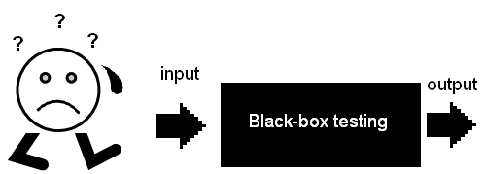
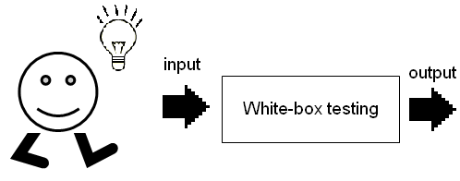
List of Test Approaches conti..
Black-box testing
Black-box testing is a test approach where the tester
has no knowledge of the internal workings of the software.
The tester only interacts with the software's input and output.
White-box testing
White-box testing is a test approach where the tester has
detailed knowledge of the internal workings of the software.
The tester uses this knowledge to design and execute tests
that examine the internal structure of the software.

Slide 34
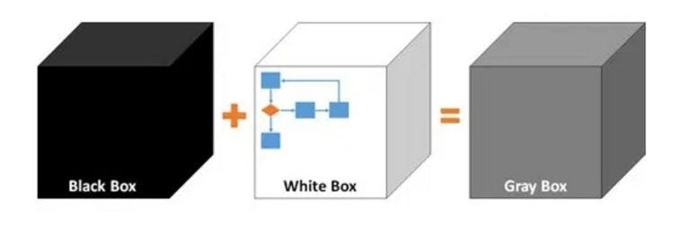
List of Test Approaches conti..
Gray-box testing
Gray-box testing is a test approach that combines elements of both black-box and white-box testing.
The tester has some knowledge of the internal workings of the software being tested, but not full knowledge.

Slide 35
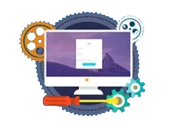

List of Test Approaches conti..
Functional testing
Functional testing is a test approach that focuses on verifying that
the software functions as intended.
This involves testing individual functions or features of the software
to ensure that they meet the required specifications.
Non-functional testing
Non-functional testing is a test approach that focuses on verifying
the performance, reliability, security and other non-functional aspects of
the software.
This includes testing factors such as load capacity, response times
and security weaknesses.

Slide 36

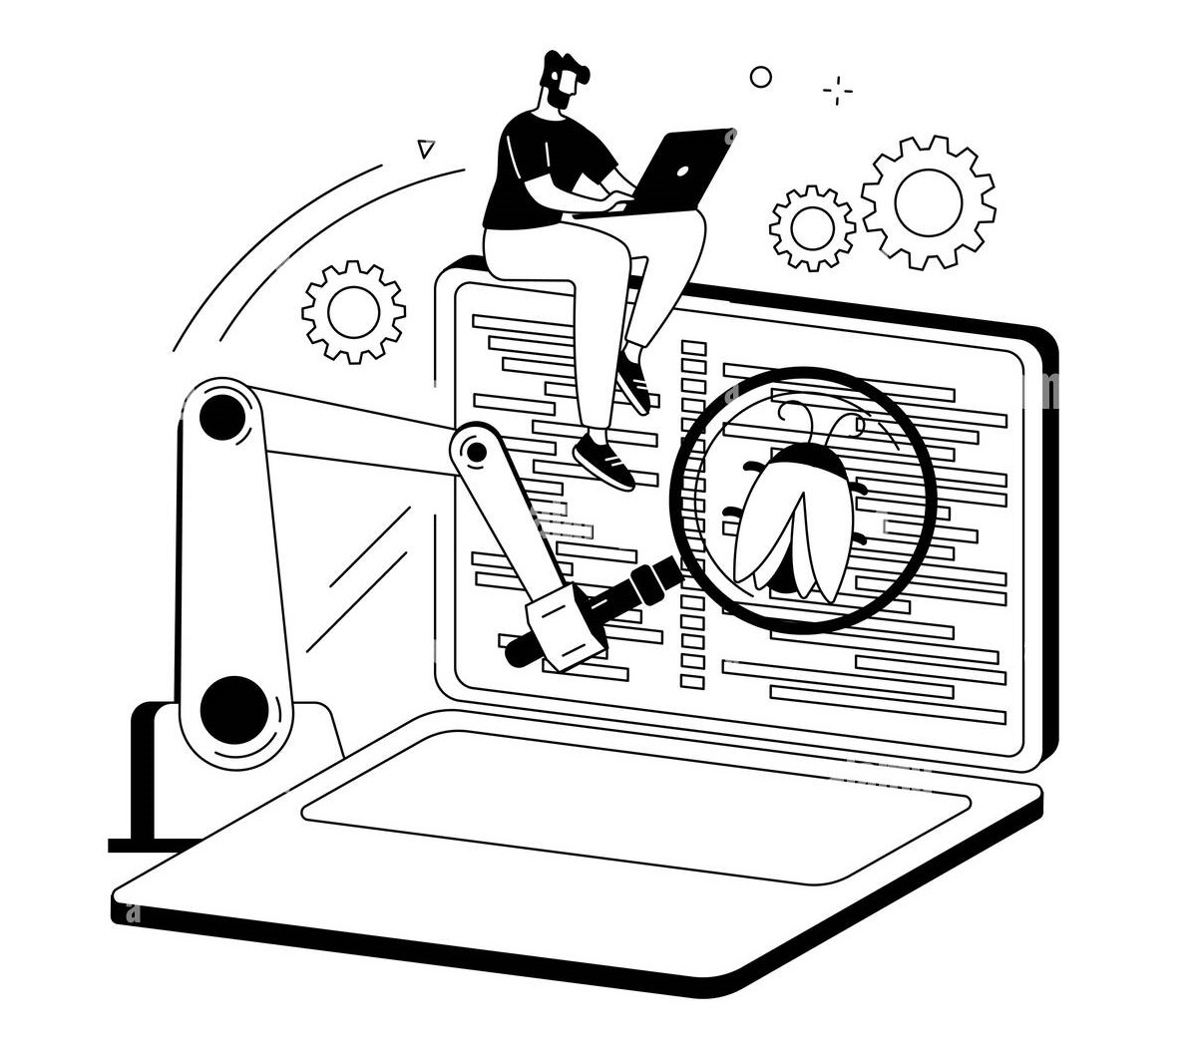
List of Test Approaches conti..
Manual testing
Manual testing is a test approach where the tester manually executes
tests on the software being tested.
This involves using a range of techniques, such as exploratory testing,
to identify and report issues with the software.
Automated testing is a test approach that involves using tools and
scripts to execute tests automatically.
This can help to reduce the time and effort required for testing and
improve the consistency of test results.
Automated testing

Slide 37
Software Testing Life Cycle - STLC
Section 8

Slide 38
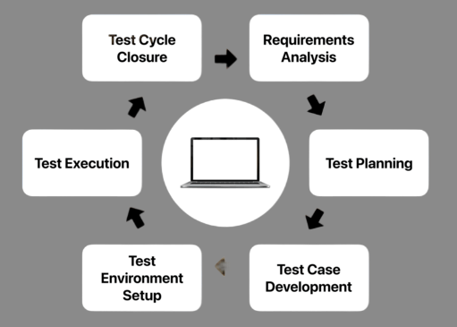
SDLC vs STLC
Requirement Analysis
System design
Implementation
Testing
Testing
Deployement
Maintenance

Slide 39
Software Testing Life Cycle - STLC
STLC is a sequence of specific activities conducted during the testing process to ensure software quality goals are met.
STLC involves both verification and validation activities.
Testing is a process rather than a single activity.
It consists of a series of activities carried out methodologically to help certify your software product.
Requirement Analysis
Test Planning
Test Case Development
Test Environment Setup
Test Execution
Test Cycle Closure

Slide 40
STLC – Requirement Analysis
Requirement Analysis is the first step of the Software Testing Life Cycle (STLC).
QA team has been given SRS (software requirement specification) document.
In this phase quality assurance team understands the requirements like what is to be tested.
If anything is missing or not understandable then the quality assurance team meets with the stakeholders to better understand the detailed knowledge of requirements.
Activities in Requirement Analysis
Identify types of tests to be performed.
Gather details about testing priorities and focus.
Prepare Requirement Traceability Matrix (RTM).
Identify test environment details where testing is supposed to be carried out.

Slide 41
STLC – Test Planning
In this phase a Senior QA manager decides the test plan strategy, estimates the time and cost required for testing.
Moreover the resources, test environment, test limitations and testing schedule are also determined.
Activities in Test Planning
Preparation of test plan/strategy document for various types of testing
Identifying the testing environment and resources needed.
Estimating the time and cost required for testing.
Identifying the test deliverables and milestones.
Resource planning and determining roles and responsibilities.
Reviewing and approving the test plan.

Slide 42
STLC – Test Case Development
In this phase testing team notes down the detailed test cases.
The testing team also prepares the required test data for the testing.
When the test cases are prepared then they are reviewed by the QA team.
Activities in Test Case Development
Identifying the test cases that will be developed.
Writing test cases that are clear, brief, and easy to understand.
Creating test data and test scenarios that will be used in the test cases.
Identifying the expected results for each test case.
Reviewing and validating the test cases.
Updating the requirement traceability matrix (RTM) to map requirements to test cases.

Slide 43
STLC – Test Environment Setup
Decides the software and hardware conditions under which a work product is tested.
Test team may not be involved in this activity if the development team provides the test environment.
Setup test Environment and test data.
Activities in Test Environment Setup
Understand the required architecture, environment set-up and prepare hardware and software requirement list for the Test Environment.
Perform a smoke test on the build

Slide 44
STLC – Test Execution Phase
Carried out by the testers in which testing of the software build is done based on test plans and test cases prepared.
The process consists of test script execution, test script maintenance and bug reporting.
If bugs are reported then it is reverted back to development team for correction and retesting will be performed.
Activities in Test Execution Phase
Execute tests as per plan.
Document test results, and log defects for failed cases.
Map defects to test cases in RTM.
Retest the Defect fixes.
Track the defects to closure.

Slide 45
STLC – Test Cycle Closure
Test closure is the final stage of the STLC where all testing-related activities are completed and documented.
The main objective of the test closure stage is to ensure that all testing-related activities have been completed and that the software is ready for release.
Activities in Test Cycle Closure
Ensure that the planned deliverable has been delivered.
Ensure Incident reports are resolved or marked deferred.
Finalize and archive test ware, test environment and infrastructure for reuse.
Hand over test ware to the maintenance team.
Evaluate lessons learned to determine changes needed for future releases and projects

Slide 46
Principles of Software Testing
Section 9

Slide 47
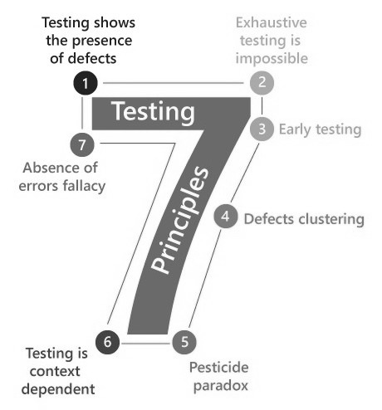
Testing Principles
In software testing, it is necessary to follow some principles to make product defects free.
Every Software tester and QA professional should know seven software testing principles
7 Principles of Software Testing
Testing shows the presence of defects
Exhaustive Testing is not possible
Early Testing
Defect Clustering
Pesticide Paradox
Testing is context-dependent
Absence of errors fallacy

Slide 48
Testing Principles conti..
1. Testing shows the presence of defects
Software testing talks about the presence of defects and doesn’t talks about the absence of defects.
Only identify that the application or software has any errors.
Tester will test the application to make sure that the application is defects free.
Even multiple testing can never ensure that the software is bug free.
2. Exhaustive testing is not possible
Exhaustive testing is impossible means the software can not be 100% tested.
It can test only some test cases and assume that software is correct and it will produce the correct output in every test cases
We are executing certain test cases and assuming that this test cases working fine, then other all cases is working fine.

Slide 49
Testing Principles conti..
3. Early Testing
Testing should start as early as possible in the SDLC Phase.
Any defects in the requirements or design phase are captured in the early stages.
It is much cheaper to fix a defect in the early stages of testing.
4. Defect Clustering
In software, a small number of modules contain most of the defects.
This is the application of the Pareto Principle to software testing
Pareto Principle: approximately 80% of the fault are found in 20% of the modules.

Slide 50
Testing Principles conti..
5. Pesticide Paradox
Repetitive use of the same pesticide mix to destroy insects during farming will over time lead to the insects developing resistance to the pesticide. Thereby ineffective of pesticides on insects. The same applies to software testing.
Executing the same set of test cases again and again over a particular time, then these kinds of tests will not be able to find the new bugs.
So it is necessary to review the test cases and add or update test cases to find new bugs.
6. Testing is context dependent
We have multiple fields such as e-commerce websites, commercial websites, and so on available in the market.
Different types of software need to perform different types of testing.
You might use a different approach, methodologies, techniques and types of testing.
For Example, testing of a commercial website is different from testing of mobile application.

Slide 51
Testing Principles conti..
7. Absence of error fallasy
Once the application is completely tested and there are no bugs identified, So that the application is 99 percent bug-free.
But if it does not follow the user requirement then it is unusable.
It is not only necessary that software is 99% bug-free but it is also mandatory to fulfill all the customer requirements.

Slide 52
Verification & Validation
Section 10

Slide 53
Verification & Validation
Verification
Lets see one example:
Are we building the product right?
Verification
The objective of Verification is to make sure that the product being develop is as per the requirements and design specifications.
When we make new recipe at that time while making dish we verify so many times that do we have all the required ingredients in our kitchen? Are we making dish properly or not? Are we following all the steps or not? This is called verification.
Validation
Are we building the right product?
Validation
The objective of Validation is to make sure that the developed product actually meet up the user’s requirements, and check whether the specifications were correct in the first place.
When that new dish is ready at that time we test it to check whether this dish is tests perfect or not, is it as per our family member’s test or not. This is called validation.

Slide 54
Verification & Validation
Verification
Validation
Process of evaluating products at a development phase to check whether software achieves its goal without any bugs.
Process of evaluating software at the end of the development to determine whether software meets the customer expectations and requirements.
Activities involved: Reviews, Meetings and Inspections
Activities involved: Testing like black box testing, white box testing, gray box testing
Carried out by QA team
Carried out by testing team
Execution of code is not comes under Verification
Execution of code is comes under Validation
Explains whether the outputs are according to inputs or not
Describes whether the software is accepted by the user or not
Cost of errors caught is less
Cost of errors caught is high

Slide 55
Bug Life Cycle
Section 11

Slide 56

What is a Bug?
If the tester finds any mistake in the application in the testing phase then they call it a bug.
The test engineers generate the bug report.
The most common type of bug is a crash.
For example, a word processing application could crash while the user is writing an essay or report. This may cause them to lose work if they haven’t hit “save” for some time, which results in a negative impact on productivity (and bad perceptions of the product).
Why do bugs arise?
Unclear/incorrect Requirements
Complex Design
Poor skilled developer
Complicated logic
Insufficient time.
“I am Human and I make mistakes”

Slide 57
Bug Life Cycle
Bug Life Cycle in software testing is the specific set of states that a bug goes through in its entire life.
The purpose of the bug life cycle is to easily coordinate and communicate the current status of the bug.
Bug Status in the bug life cycle is the present state from which the bug is currently undergoing.
New
Assigned
Duplicate
Rejected
Open
Deferred
Fixed
Not a bug
Pending retest
Reopen
Retest
Verified
Closed

Slide 58
Bug/Defect Life Cycle
New: When a new defect is logged and posted for the first time. It is assigned a status as NEW.
Assigned: Tester approves the bug and assigns the bug to the developer team
Open: The developer starts analyzing and works on the defect to fix
Fixed: When a developer makes a necessary code change and verifies the change then he or she can make the bug status “Fixed.”
Pending Retest: Once the defect is fixed the developer gives a particular code for retesting the code to the tester.
Since the software testing remains pending from the tester’s end, the status assigned is “pending retest.”
Retest: Tester does the retesting of the code at this stage to check whether the defect is fixed by the developer or not and changes the status to “Re-test.”

Slide 59
Bug Life Cycle
Verified: If there is no bug detected in the retesting, then the bug is fixed and the status assigned is “verified.”
Reopen: If the bug continues even after the developer has fixed the bug, the tester changes the status to “reopened”. Once again the bug goes through the life cycle.
Closed: If the bug no longer exists then the tester assigns the status “Closed.”
Duplicate: If the defect is repeated twice or the defect corresponds to the same concept of the bug, the status is changed to “duplicate.”
Rejected: If the developer feels the defect is not a genuine defect then it changes the defect to “rejected.”
Deferred: If the present bug is not of a high priority and if it is expected to get fixed in the next release, then status “Deferred” is assigned to such bugs
Not a bug: If it does not affect the functionality of the application then the status assigned to a bug is “Not a bug”.

Slide 60
Software Testing (ST)
# 21O4CS503
Prof. Devangi L. Kotak
Devangi.kotak@darshan.ac.in

