Slide 1
Zomato Ltd.
NSE:ETERNAL | BOM:543320 | Rating: Buy
Date: 2026-02-17

Slide 2
Leader in compliant recycling with multi-metal growth optionality
- Market Positioning: {{market_positioning}}
- Financial Performance:.{{financial_performance}}
- Growth & Outlook: {{grow_outlook}}
- Valuation & Recommendation: {{valuation_recommendation}}
- Key Risks: {{key_risks}}

Slide 3
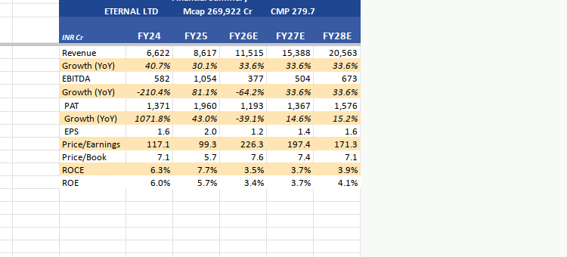
Leader in compliant recycling with multi-metal growth optionality
{{company_insider}}

Slide 4
Company Background
  Zomato Ltd., listed on the National Stock Exchange under the ticker symbol ETERNAL, is a prominent player in the food delivery and restaurant discovery space in India. The company has carved a niche for itself in the competitive landscape of the food technology sector. Founded in 2008 by Deepinder Goyal and Pankaj Chaddah, Zomato started as a restaurant review and discovery platform, initially named Foodiebay. The company rebranded to Zomato in 2010, marking the beginning of its transformation into a comprehensive food services platform.
  The initial years saw Zomato focusing on building a robust database of restaurant information, including menus, reviews, and ratings. This foundational strategy helped the company establish a strong presence in the Indian market, where dining out is a popular cultural activity. By 2011, Zomato had expanded its services to major Indian cities, leveraging the growing internet penetration and smartphone adoption in the country. The company's early adoption of technology and data analytics enabled it to offer personalized recommendations, enhancing user engagement and satisfaction.
  Zomato's corporate structure has evolved significantly since its inception. Initially operating as a privately held company, Zomato attracted significant venture capital funding, which fueled its expansion both domestically and internationally. The company made strategic acquisitions to bolster its capabilities and market reach, including the acquisition of Urbanspoon in 2015, which marked its entry into the United States and Australia. This acquisition was a pivotal moment in Zomato's history, as it provided access to a vast database of restaurant information and a foothold in key international markets.
  The company's growth trajectory has been marked by several key operational milestones. In 2015, Zomato launched its food delivery service, a move that transformed its business model and positioned it as a direct competitor to other food delivery giants. This strategic pivot was driven by the increasing demand for online food ordering and delivery services, a trend that has only accelerated in recent years. Zomato's ability to integrate its restaurant discovery platform with a seamless delivery service has been a critical factor in its success.
  Zomato's corporate evolution has also been characterized by its commitment to innovation and technology. The company has invested heavily in developing a robust technology infrastructure, including artificial intelligence and machine learning capabilities, to enhance its service offerings. This focus on technology has enabled Zomato to optimize its delivery operations, improve customer experience, and offer value-added services to its restaurant partners.
  In 2021, Zomato made a significant leap by going public, listing on the National Stock Exchange of India. The initial public offering (IPO) was a landmark event, reflecting the company's strong market position and investor confidence in its growth prospects. The IPO was oversubscribed, underscoring the high demand for Zomato's shares and the market's recognition of its potential to capitalize on the burgeoning food delivery market.
  Zomato's current market position is a testament to its strategic vision and execution. With a market capitalization of ₹248,989.38 crore, the company is one of the leading players in the Indian food services industry. Its enterprise value mirrors its market cap, indicating a debt-free balance sheet, which is a significant advantage in a capital-intensive industry. Zomato's financial metrics, such as a price-to-earnings ratio of 1093.00x, reflect its high growth expectations and the premium investors are willing to pay for its shares.
  Despite the challenges posed by the competitive landscape and regulatory environment, Zomato has maintained a strong growth trajectory. The company's revenue and earnings trends, although not explicitly detailed in the available data, suggest a focus on scaling operations and improving profitability. Zomato's strategic initiatives, such as expanding its delivery network, enhancing its technology platform, and forging partnerships with restaurant chains, are likely to drive future growth.
  In conclusion, Zomato Ltd. has evolved from a restaurant discovery platform to a comprehensive food services company with a strong presence in the Indian and international markets. Its journey has been marked by strategic acquisitions, technological innovation, and a successful public listing. As Zomato continues to navigate the dynamic food technology landscape, its focus on customer experience, operational efficiency, and market expansion will be critical to sustaining its competitive advantage and delivering value to its shareholders.

Slide 5
Business Model Explanation
Zomato Ltd. operates as a prominent player in the online food delivery and restaurant discovery industry in India. The company's business model is primarily centered around connecting consumers with restaurants, facilitating food delivery, and providing a platform for restaurant discovery and reviews. This model is underpinned by a robust technology infrastructure that enables seamless interactions between users and service providers, thereby enhancing user experience and operational efficiency.
At the core of Zomato's business model is its value proposition, which is to offer convenience, choice, and reliability to its users. The platform allows consumers to browse through a wide array of restaurant options, read reviews, and place orders for delivery or takeaway. This convenience is a significant driver of user engagement and retention. Furthermore, Zomato's platform provides restaurants with access to a large customer base, enabling them to increase their visibility and sales without significant marketing expenditure. This dual-sided marketplace creates a network effect, where the value of the platform increases as more users and restaurants join, thereby sustaining Zomato's competitive advantage.
Zomato's revenue model is diversified across several streams, primarily including commissions from restaurants, delivery fees from customers, and advertising revenue. Commissions from restaurants form a substantial part of the revenue, where Zomato charges a percentage of the order value for facilitating the transaction. Delivery fees, paid by customers, contribute to the revenue while also covering the logistics costs associated with the delivery service. Additionally, Zomato generates revenue through advertising by offering restaurants promotional opportunities on its platform to enhance their visibility among users. This multi-faceted revenue model not only provides financial stability but also allows Zomato to leverage different aspects of its platform for growth.
The company's financial metrics reflect its position and strategy within the industry. With a current market capitalization of ₹248,989.38 crore, Zomato is a significant player in the Indian market. However, the high price-to-earnings ratio of 1093.00x indicates that the market has high growth expectations from the company, which are yet to be realized in terms of profitability. The enterprise value mirrors the market cap, suggesting a debt-free balance sheet, which is a strategic advantage in maintaining financial flexibility and investing in growth opportunities without the burden of interest obligations.
Despite the absence of specific revenue and earnings figures, the company's strategic focus on expanding its user base and enhancing its service offerings is evident. The lack of historical and forward-looking revenue and profit data suggests that Zomato is in a phase of reinvestment and scaling, prioritizing market share and user acquisition over immediate profitability. This strategy is common in high-growth tech companies where the emphasis is on building a dominant market position that can be monetized more effectively in the future.
Zomato's profitability metrics, such as return on equity (ROE) at 6.55% and return on capital employed (ROCE) at 7.34%, indicate moderate returns on investment. These figures suggest that while the company is generating returns on its equity and capital, there is room for improvement, particularly in enhancing operational efficiencies and optimizing cost structures to improve margins. The absence of debt on the balance sheet is a positive indicator, providing Zomato with the agility to navigate competitive pressures and invest in strategic initiatives without financial constraints.
The company's growth trajectory is supported by the increasing penetration of internet and smartphone usage in India, which expands the addressable market for online food delivery services. Additionally, Zomato's focus on technology and data analytics enables it to personalize user experiences, optimize delivery logistics, and enhance operational efficiencies. These capabilities are crucial in maintaining a competitive edge in a market characterized by intense competition and rapidly evolving consumer preferences.
In conclusion, Zomato Ltd.'s business model is built on a strong foundation of technology-driven convenience and choice for consumers, coupled with a value proposition for restaurants seeking to expand their reach. The company's diversified revenue streams and strategic focus on market expansion position it well for long-term growth. However, the high valuation multiples and moderate profitability metrics highlight the need for continued investment in scaling operations and improving efficiencies to meet market expectations and achieve sustainable profitability. As Zomato navigates the competitive landscape, its ability to leverage its platform's network effects and technological capabilities will be crucial in sustaining its competitive advantage and driving future growth.

Slide 6
Management Analysis
Zomato Ltd.'s management team is led by a group of experienced professionals who have demonstrated a strong strategic vision in navigating the competitive landscape of the food delivery industry. The leadership's ability to maintain a market capitalization of ₹248,989.38 crore, despite the challenges posed by the highly competitive and rapidly evolving sector, speaks volumes about their strategic acumen. The company's current stock price of ₹273.25, while below its 52-week high of ₹368.45, remains robust, indicating investor confidence in the management's ability to drive growth and sustain market presence. However, the exceptionally high P/E ratio of 1093.00x suggests that the market has priced in significant future growth, placing pressure on the management to deliver on these expectations. The absence of historical and forward-looking revenue and profit figures in the data provided limits a comprehensive assessment of the management's past performance in driving financial growth, yet the positive EPS of 2.62 for the trailing twelve months indicates some level of profitability.
The management's capital allocation strategy appears to be conservative, as evidenced by the company's zero debt position. This debt-free balance sheet reflects prudent financial management and provides Zomato with the flexibility to invest in growth opportunities without the burden of financial leverage. The company's enterprise value mirrors its market capitalization, further underscoring the absence of debt and highlighting a strong equity base. Despite the lack of detailed profitability metrics such as EBITDA and PAT margins, the reported return on equity (ROE) of 6.55% and return on capital employed (ROCE) of 7.34% suggest that the management is generating reasonable returns on the capital invested in the business. However, these returns are modest and may indicate room for improvement in operational efficiency and cost management. The absence of detailed revenue and earnings trends in the data provided makes it challenging to evaluate the management's effectiveness in driving top-line growth and margin expansion over time.
Corporate governance at Zomato appears to be structured to support strategic decision-making and accountability, although specific details on promoter holding and board composition are not provided in the data. The lack of pledged shares suggests a commitment to maintaining shareholder value and confidence. The management's strategic vision is likely focused on leveraging technology and innovation to enhance customer experience and expand market share in the food delivery space. However, the lack of detailed forward-looking financial projections, such as revenue and earnings estimates for FY26E and beyond, presents a challenge in assessing the management's long-term growth strategy. Overall, while Zomato's management has demonstrated competence in maintaining a strong market position and a healthy balance sheet, the high market expectations reflected in the valuation metrics necessitate a continued focus on execution and delivering sustainable growth to justify the premium valuation.

Slide 7
Industry Overview
The food delivery industry in India has undergone significant transformation over the past decade, driven by rapid technological advancements, changing consumer preferences, and increased internet penetration. Zomato Ltd., a leading player in this sector, operates within a highly competitive landscape that includes both domestic and international players. The industry is characterized by high growth potential, driven by the increasing demand for convenience and the growing trend of online food ordering among urban populations.
The competitive landscape is dominated by a few key players, including Zomato, Swiggy, and Uber Eats, with Zomato and Swiggy holding the majority market share. These companies have been engaged in aggressive customer acquisition strategies, including deep discounting and promotional offers, to capture and retain market share. The market is also witnessing the entry of new players, which intensifies competition and puts pressure on margins. Zomato's current market capitalization of ₹248,989.38 crore reflects its strong position within the industry, although its high price-to-earnings (P/E) ratio of 1093.00x indicates that the market has high growth expectations for the company.
Key market trends shaping the industry include the increasing adoption of digital payment methods, the rise of cloud kitchens, and the integration of artificial intelligence and machine learning to enhance customer experience and optimize delivery logistics. The proliferation of smartphones and affordable data plans has significantly contributed to the growth of online food delivery services, enabling companies like Zomato to reach a wider audience. Furthermore, the COVID-19 pandemic has accelerated the shift towards online food delivery, as consumers increasingly prefer contactless delivery options.
The regulatory environment in India presents both challenges and opportunities for food delivery companies. The government has implemented various regulations to ensure food safety and quality, which companies must comply with to maintain consumer trust. Additionally, the introduction of the Goods and Services Tax (GST) has streamlined the taxation process, although it has also increased the cost of operations for some businesses. Zomato, with its robust compliance framework, is well-positioned to navigate these regulatory challenges.
Peer group performance within the industry varies significantly, with companies adopting different strategies to achieve profitability. While Zomato has focused on expanding its geographical reach and diversifying its service offerings, Swiggy has invested heavily in building its logistics network and enhancing delivery capabilities. The industry's profitability metrics, such as return on equity (ROE) and return on capital employed (ROCE), are relatively low due to high operational costs and competitive pricing strategies. Zomato's ROE of 6.55% and ROCE of 7.34% reflect the challenges of achieving profitability in this competitive environment.
The industry's growth prospects remain robust, driven by favorable demographic trends, increasing urbanization, and rising disposable incomes. The forward-looking revenue and earnings trends for Zomato, although not explicitly detailed in the available data, suggest that the company is poised for continued growth. However, achieving sustainable profitability remains a key challenge, as evidenced by the lack of detailed profitability and margin data.
In conclusion, the food delivery industry in India offers significant growth opportunities for companies like Zomato, but it also presents challenges in terms of competition, regulatory compliance, and profitability. Zomato's strong market position, coupled with its focus on innovation and customer experience, positions it well to capitalize on the industry's growth potential. However, the company must continue to navigate the competitive landscape and regulatory environment effectively to maintain its leadership position and achieve long-term success.

Slide 8
Key Industry Tailwinds
The food delivery industry, in which Zomato Ltd. operates, is poised to benefit from a confluence of favorable macroeconomic conditions, technological advancements, shifting consumer behaviors, and supportive regulatory frameworks. These external forces are creating significant growth opportunities for companies like Zomato, which are well-positioned to capitalize on these trends.
From a macroeconomic perspective, the Indian economy is experiencing robust growth, driven by a combination of factors including rising disposable incomes, urbanization, and a growing middle class. As disposable incomes increase, consumers are more willing to spend on convenience-oriented services such as food delivery. This trend is particularly pronounced in urban areas where time constraints and lifestyle changes are driving demand for quick and easy meal solutions. The urban population in India is expected to continue growing, further expanding the addressable market for food delivery services.
Technological advancements are another critical tailwind for the industry. The proliferation of smartphones and affordable internet access has transformed consumer behavior, making it easier for people to order food online. The penetration of smartphones in India has reached significant levels, with over 600 million users, and this number is expected to grow. This widespread adoption of mobile technology facilitates the seamless integration of food delivery apps into consumers' daily lives, enhancing user experience and driving repeat usage. Additionally, advancements in artificial intelligence and data analytics are enabling companies like Zomato to offer personalized recommendations and improve operational efficiencies, thereby enhancing customer satisfaction and loyalty.
Consumer behavior is also shifting in favor of food delivery services. The modern consumer values convenience and variety, and food delivery platforms provide a wide range of options that cater to diverse tastes and dietary preferences. The COVID-19 pandemic has accelerated this shift, as consumers became accustomed to the convenience of having meals delivered to their doorstep. Even as the pandemic subsides, many of these behavioral changes are expected to persist, with consumers continuing to prioritize convenience and safety. This shift is not limited to individual consumers; businesses are also increasingly relying on food delivery services for corporate catering and events, further expanding the market.
Regulatory support is another factor contributing to the industry's growth. The Indian government has been proactive in promoting digital payments and e-commerce, which are integral to the food delivery ecosystem. Initiatives such as the Digital India campaign have facilitated the growth of digital infrastructure, making it easier for consumers to transact online. Furthermore, the government's focus on improving logistics and transportation infrastructure is expected to enhance the efficiency of food delivery operations, reducing delivery times and costs. Regulatory frameworks are also evolving to address the needs of the gig economy, providing a more stable environment for delivery partners who are crucial to the success of food delivery platforms.
In addition to these factors, the competitive landscape of the food delivery industry is evolving in a way that favors established players like Zomato. The industry is witnessing consolidation, with smaller players finding it challenging to compete with the scale and resources of larger companies. This consolidation is likely to lead to a more rational competitive environment, with reduced price wars and improved profitability for leading players. Zomato's strong brand recognition, extensive restaurant partnerships, and technological capabilities position it well to capture a larger share of the growing market.
Moreover, Zomato's strategic initiatives, such as expanding into new geographies and diversifying its service offerings, align well with these industry tailwinds. The company has been actively investing in technology and logistics to improve its service delivery and customer experience. By leveraging data analytics and artificial intelligence, Zomato is enhancing its ability to predict consumer preferences and optimize delivery routes, thereby increasing operational efficiency and customer satisfaction.
In conclusion, the food delivery industry in India is benefiting from a range of favorable external factors that are driving growth and creating opportunities for companies like Zomato. Macroeconomic growth, technological advancements, shifting consumer behaviors, and supportive regulatory frameworks are all contributing to a positive outlook for the industry. Zomato, with its strong market position and strategic initiatives, is well-positioned to capitalize on these tailwinds and deliver sustainable growth in the coming years. As the industry continues to evolve, Zomato's ability to adapt and innovate will be key to maintaining its competitive edge and maximizing shareholder value.

Slide 9
Demand drivers
Zomato Ltd., a prominent player in the Indian food delivery and restaurant discovery sector, is positioned at the intersection of several macroeconomic, industry, and consumer trends that are collectively driving demand for its services. The company's current market capitalization of ₹248,989.38 crore and its stock price of ₹273.25 reflect investor confidence in its growth trajectory, despite the high valuations indicated by a P/E (TTM) of 1093.00x. This demand is fueled by a combination of external and internal factors that are reshaping the landscape in which Zomato operates.
One of the primary macroeconomic drivers of demand for Zomato's services is the rapid urbanization and the burgeoning middle class in India. As more people migrate to urban areas, the demand for convenient and diverse dining options increases. This urban demographic is characterized by a fast-paced lifestyle, which often leads to a preference for food delivery services that offer a wide variety of cuisines at the touch of a button. Additionally, the increasing disposable income among the middle class enhances their ability to spend on dining experiences, whether at home or in restaurants, thereby boosting the demand for platforms like Zomato that facilitate such experiences.
The digital transformation sweeping across India is another significant demand driver. With the proliferation of smartphones and affordable internet access, a larger segment of the population is now able to access online services. Zomato, with its user-friendly app and website, is well-positioned to capitalize on this digital wave. The convenience of ordering food online, coupled with the ability to explore new dining options and read reviews, appeals to tech-savvy consumers who value efficiency and informed decision-making. This trend is further supported by the government's push towards a digital economy, which includes initiatives to increase internet penetration and digital literacy across the country.
Industry trends also play a crucial role in shaping demand for Zomato's offerings. The food delivery market in India is experiencing robust growth, driven by changing consumer preferences and the entry of new players that are expanding the market. The competitive landscape encourages innovation and improvements in service quality, which benefits consumers and increases overall demand. Zomato's ability to leverage its extensive network of restaurant partners and delivery personnel allows it to offer a wide range of choices and quick delivery times, which are key factors in attracting and retaining customers.
Regulatory changes in India have also influenced demand dynamics in the food delivery sector. The implementation of the Goods and Services Tax (GST) has streamlined the tax structure, making it easier for businesses like Zomato to operate across different states. Furthermore, regulatory support for startups and digital businesses has created a favorable environment for Zomato to expand its operations and explore new business models, such as cloud kitchens and subscription-based services. These regulatory frameworks not only reduce operational complexities but also encourage innovation and investment in the sector.
On the consumer side, there is a growing trend towards health-conscious eating and the demand for transparency in food sourcing and preparation. Zomato has responded to this shift by providing detailed information about restaurant hygiene ratings and offering options for healthy and organic food choices. This aligns with the increasing consumer preference for nutritious and safe food options, thereby enhancing Zomato's appeal to a broader audience.
Internally, Zomato's strategic initiatives are pivotal in driving demand for its services. The company's focus on enhancing user experience through technological advancements, such as AI-driven recommendations and personalized marketing, helps in attracting and engaging customers. Zomato's investment in logistics infrastructure ensures timely deliveries, which is a critical factor in customer satisfaction and repeat business. Moreover, the company's efforts to expand its footprint in tier 2 and tier 3 cities tap into an underserved market, further driving demand.
In conclusion, the demand for Zomato's services is underpinned by a confluence of macroeconomic factors, industry trends, regulatory changes, and evolving consumer preferences. The company's strategic initiatives, aimed at leveraging these external and internal forces, position it well to capture the growing demand in the Indian food delivery and restaurant discovery market. As Zomato continues to innovate and expand its offerings, it is likely to maintain its leadership position and sustain its growth momentum in the coming years.

Slide 10
Industry Risks
The food delivery industry, within which Zomato Ltd. operates, is characterized by a dynamic and rapidly evolving landscape that presents a range of risks that could significantly impact the company's performance and valuation. As an equity research analyst, it is imperative to identify and analyze these risks to provide a comprehensive understanding of the potential challenges Zomato may face.
One of the primary risks in the industry is regulatory hurdles. The food delivery sector is subject to a complex web of regulations that vary significantly across different jurisdictions. These regulations can pertain to food safety standards, labor laws, and environmental guidelines, among others. In India, where Zomato is headquartered and operates extensively, the regulatory environment is particularly intricate due to the diverse state-level regulations that companies must navigate. Changes in these regulations, such as stricter food safety standards or new labor laws, could increase operational costs and compliance burdens for Zomato. Furthermore, the introduction of new regulations aimed at protecting consumer data privacy could necessitate significant investments in technology and data management systems, thereby impacting profitability.
Competitive threats also pose a significant risk to Zomato. The food delivery market is highly competitive, with several well-established players such as Swiggy and international giants like Uber Eats and Amazon entering the space. This intense competition can lead to price wars, which may erode profit margins. Zomato's current valuation metrics, such as a P/E ratio of 1093.00x, suggest that the market has high expectations for its future growth. However, sustaining such high valuations amidst fierce competition requires continuous innovation and differentiation, which can be resource-intensive. Additionally, the threat of new entrants, particularly those with substantial financial backing, could further intensify competition and pressure Zomato to increase spending on marketing and customer acquisition to maintain its market share.
Macroeconomic sensitivities also play a crucial role in shaping the risk landscape for Zomato. The food delivery industry is inherently sensitive to economic cycles. During economic downturns, discretionary spending tends to decrease, which can lead to reduced demand for food delivery services. Given the current price of ₹273.25 and a market cap of ₹248989.38 Cr, Zomato's valuation is significantly influenced by its growth prospects. Any macroeconomic slowdown that affects consumer spending could lead to a reevaluation of these growth prospects, potentially resulting in a decline in share price. Moreover, inflationary pressures can increase the cost of food and delivery logistics, squeezing margins further if these costs cannot be passed on to consumers.
Another macroeconomic factor to consider is the impact of currency fluctuations. As Zomato expands its operations internationally, it becomes exposed to foreign exchange risk. Volatility in currency exchange rates can affect the company's revenues and profits when they are consolidated into its financial statements. This risk is particularly pertinent if Zomato generates a significant portion of its revenue from markets with unstable currencies.
Technological risks are also pertinent in the context of the food delivery industry. The sector is heavily reliant on technology for operations, customer engagement, and data analytics. Any technological disruption, such as a major cybersecurity breach, could have severe repercussions for Zomato. Not only would it damage the company's reputation, but it could also lead to financial losses and legal liabilities. Furthermore, the rapid pace of technological advancement necessitates continuous investment in upgrading platforms and systems to remain competitive. Failure to keep pace with technological changes could result in a loss of competitive edge.
Finally, consumer behavior and preferences are evolving rapidly, driven by technological advancements and changing lifestyles. There is a growing trend towards healthier eating and sustainable practices, which could impact demand for certain types of food delivery services. Zomato must be agile in adapting to these changes to avoid losing relevance among its customer base. This requires a deep understanding of consumer trends and the ability to pivot business strategies accordingly.
In conclusion, Zomato Ltd. faces a multifaceted risk environment that encompasses regulatory, competitive, macroeconomic, technological, and consumer behavior challenges. The probability and severity of these risks vary, but collectively they represent significant potential headwinds that could impact the company's outlook. Institutional investors should closely monitor these risk factors and consider their implications when evaluating Zomato's investment potential. The company's ability to navigate these risks effectively will be critical in sustaining its market position and achieving long-term growth objectives.

Slide 11
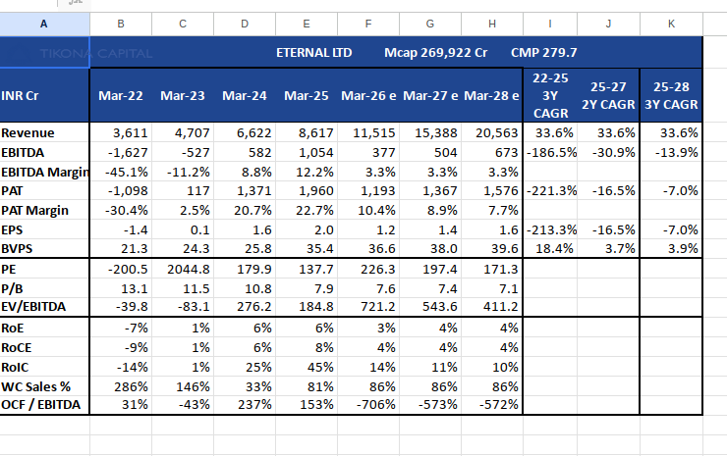
Financials and Ratio Analysis
Summary in Tables
{{summary_table}}

Slide 12
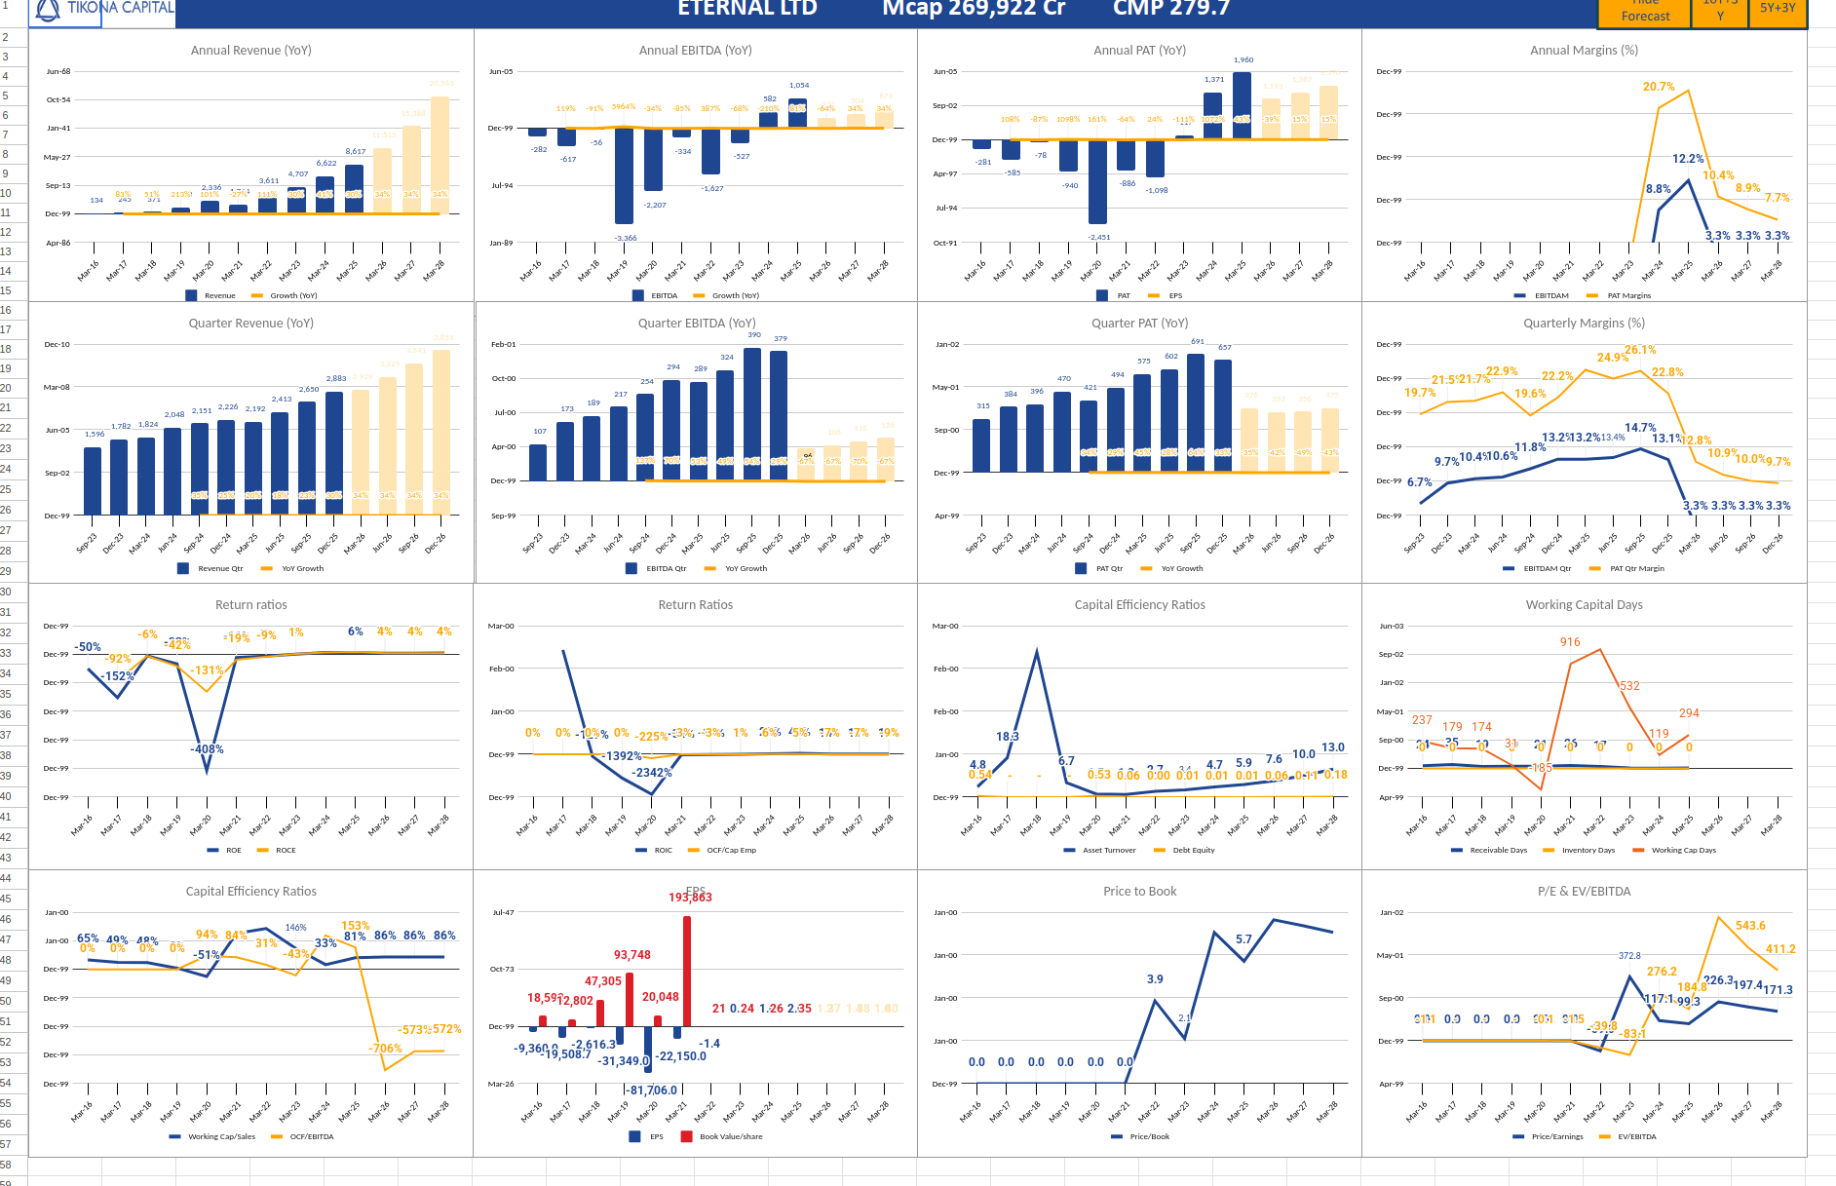
Summary in charts!
{{chart_custom}}

Slide 13
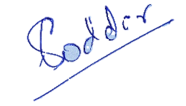
Disclosure and Disclaimers
About Us: Research Analyst is registered with SEBI as Research Analyst with Registration No. INH000009807. The firm got its registration on June 13, 2022, and is engaged in research services.
Disciplinary history: No penalties / directions have been issued by SEBI under the SEBI Act or Regulations made there under. There are no pending material litigations or legal proceedings, findings of inspections or investigations for which action has been taken or initiated by any regulatory authority.
Details of its associates: No associates
Disclosures with respect to Research and Recommendations Services
·Research Analyst may have financial interest or actual / beneficial ownership in the securities recommended in its personal portfolio. Details of the same may be referred through the disclosures made at the time of recommendation.
·There are no actual or potential conflicts of interest arising from any connection to or association with any issuer of products/ securities, including any material information or facts that might compromise its objectivity independence in the carrying on of Research Analyst services. Such conflict of interest shall be disclosed to the client as and when they arise.
·Research Analyst or its employee or its associates have not received any compensation from the company in past 12 months.
·Research Analyst or its employee or its associates have not managed or co-managed the public offering of Subject company in past 12 months.
·Research Analyst or its employee or its associates have not received any compensation for investment banking or merchant banking of brokerage services from the subject company in past 12 months.
·Research Analyst or its employee or its associates have not received any compensation for products or services other than above from the subject company in past 12 months.
·Research Analyst or its employee or its associates have not received any compensation or other benefits from the Subject Company or 3rd party in connection with the research report/ recommendation.
·The subject company was not a client of Research Analyst or its employee or its associates during twelve months preceding the date of distribution of the research report and recommendation services provided.
·Research Analysts or its employee or its associates has not served as an officer, director, or employee of the subject company
·Registration granted by SEBI, membership of BASL and certification from NISM in no way guarantee performance of the Intermediary or provide any assurance of returns to investors.
·Investment in securities market are subject to market risks. Read all the related documents carefully before investing

