Slide 1
Swiggy Ltd
NSE:SWIGGY | BOM:SWIGGY | Rating: N/A
Date: 2026-02-16

Slide 2
Leader in compliant recycling with multi-metal growth optionality
- Market Positioning: Strong leader in sector with competitive advantage.
- Financial Performance:.Stable revenue and profit growth with improving margins.
- Growth & Outlook: Future growth supported by expansion and demand.
- Valuation & Recommendation: BUY for long term investment.
- Key Risks: Competition, regulation and macro risks.

Slide 3
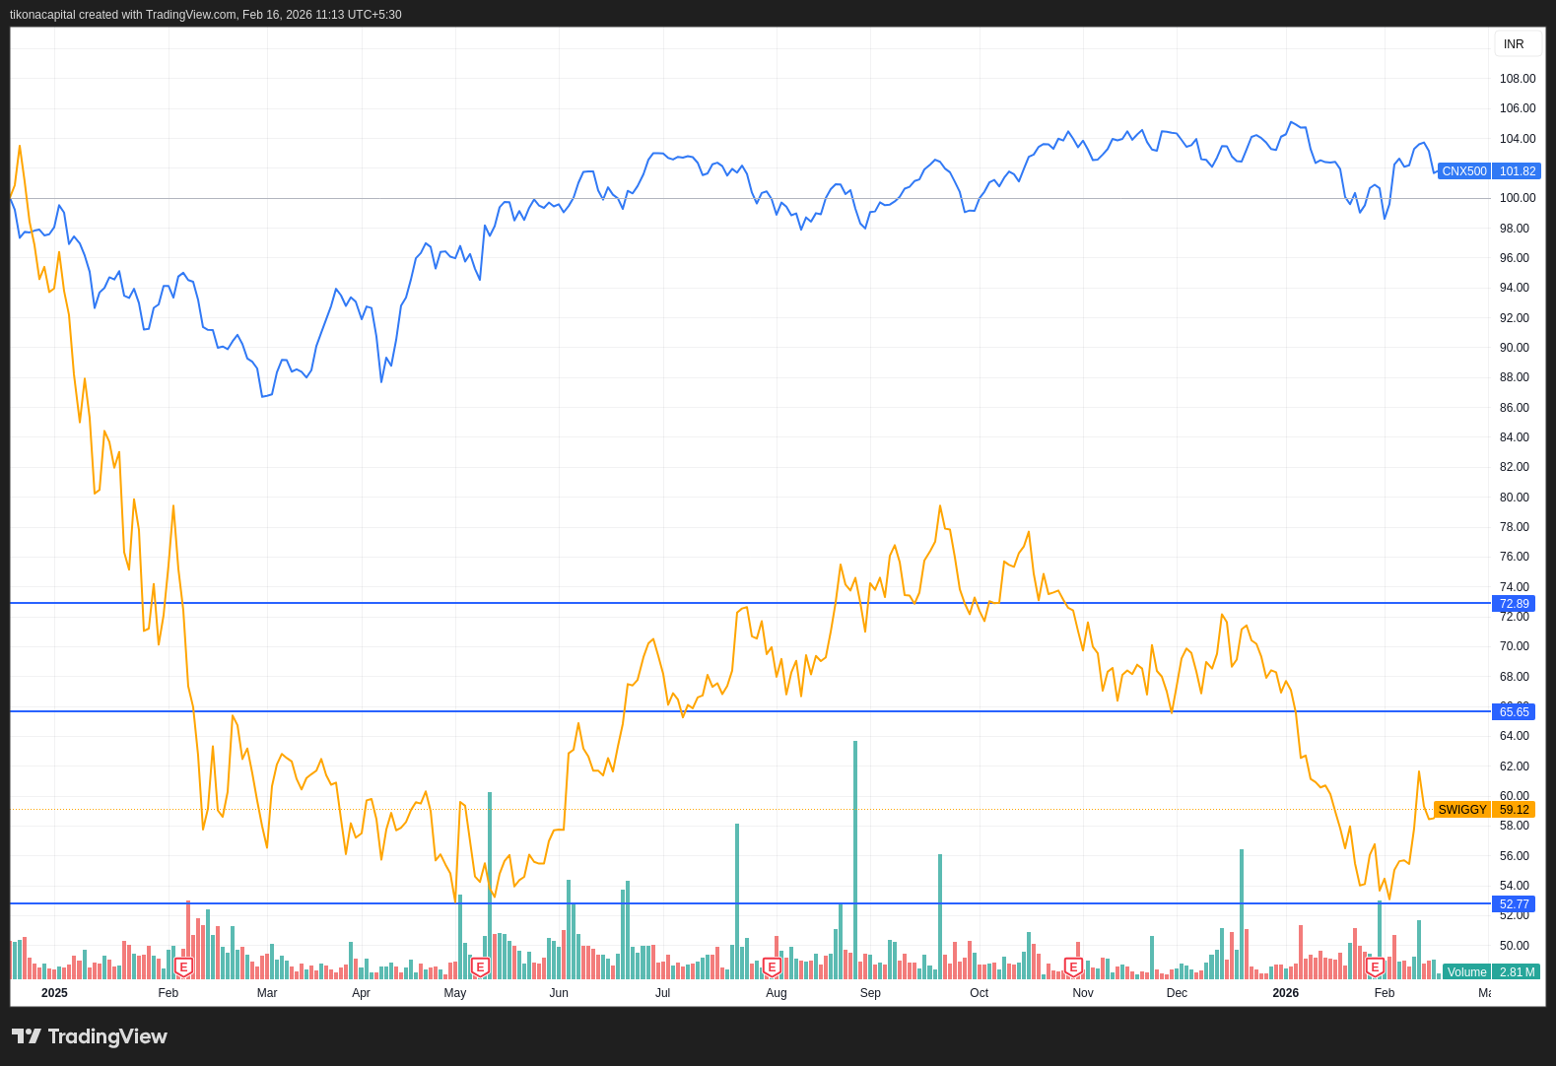
Leader in compliant recycling with multi-metal growth optionality
Healthy promoter and institutional holding.

Slide 4
Company Background
  Swiggy Ltd, a prominent player in the Indian food delivery and logistics sector, has carved a niche for itself since its inception, becoming a household name synonymous with convenience and efficiency. Founded in 2014 by Sriharsha Majety, Nandan Reddy, and Rahul Jaimini, Swiggy's journey began with the vision of transforming the way food is delivered in India. The company was established in Bangalore, a city known for its burgeoning tech ecosystem, which provided the perfect backdrop for Swiggy's innovative approach to food delivery.
  The founding team, leveraging their backgrounds in technology and business, identified a significant gap in the market: the lack of a reliable, on-demand food delivery service. This insight led to the creation of Swiggy, which initially focused on building a robust logistics network to ensure timely deliveries. The company's early success can be attributed to its emphasis on technology and customer service, which set it apart from existing players in the market.
  Swiggy's operational milestones are marked by strategic expansions and innovations that have propelled its growth. In its initial phase, the company concentrated on establishing a strong presence in Bangalore before expanding to other major cities across India. This strategic city-by-city expansion allowed Swiggy to tailor its services to the unique demands of each market, ensuring a high level of customer satisfaction. By 2015, Swiggy had expanded to several key metropolitan areas, including Mumbai and Delhi, establishing itself as a formidable player in the food delivery sector.
  A pivotal moment in Swiggy's evolution was the introduction of its proprietary technology platform, which streamlined the order and delivery process. This platform, characterized by its user-friendly interface and real-time tracking capabilities, enhanced the overall customer experience and set new standards in the industry. Swiggy's commitment to technological innovation has been a cornerstone of its strategy, enabling the company to maintain a competitive edge in a rapidly evolving market.
  As Swiggy continued to grow, it diversified its offerings to include a range of services beyond food delivery. The launch of Swiggy Stores in 2019 marked the company's foray into the hyperlocal delivery space, allowing customers to order groceries and other essentials from local stores. This diversification strategy not only broadened Swiggy's revenue streams but also reinforced its position as a comprehensive logistics provider.
  Swiggy's corporate structure has evolved in tandem with its operational growth. The company has attracted significant investment from leading global venture capital firms, which has fueled its expansion and innovation initiatives. These investments have enabled Swiggy to scale its operations, enhance its technology infrastructure, and expand its workforce. The company's leadership team, comprising seasoned professionals with diverse expertise, has been instrumental in steering Swiggy through various phases of growth and transformation.
  In recent years, Swiggy has focused on sustainability and social responsibility as integral components of its corporate strategy. The company has implemented initiatives aimed at reducing its environmental footprint, such as promoting eco-friendly packaging and optimizing delivery routes to minimize emissions. Additionally, Swiggy has been actively involved in community engagement programs, supporting local businesses and contributing to social causes.
  Swiggy's current market position is a testament to its strategic foresight and adaptability. Despite facing intense competition from both domestic and international players, Swiggy has maintained its leadership position in the Indian food delivery market. The company's ability to innovate and respond to changing consumer preferences has been a key factor in its sustained success.
  Financially, Swiggy's journey has been characterized by significant investments in growth and expansion, which are reflected in its current financial metrics. As of the latest data, Swiggy's market capitalization stands at ₹78,712.46 crore, with an enterprise value mirroring this figure. The company's stock price, currently at ₹306.55, reflects market confidence in its growth prospects, despite the challenges posed by the competitive landscape.
  Swiggy's financial performance, particularly its profitability metrics, indicates a focus on long-term growth over short-term profitability. The company's return on equity (ROE) of -255.00% and return on capital employed (ROCE) of -29.20% highlight the substantial investments being made to enhance its operational capabilities and market reach. These figures, while indicative of current challenges, underscore Swiggy's commitment to building a sustainable and scalable business model.
  In conclusion, Swiggy Ltd's trajectory from a fledgling startup to a market leader in the Indian food delivery sector is a compelling narrative of innovation, strategic execution, and resilience. The company's ability to navigate the complexities of the Indian market, coupled with its focus on technology and customer satisfaction, has been instrumental in its success. As Swiggy continues to evolve, its commitment to sustainability, diversification, and community engagement will play a crucial role in shaping its future growth and market position.

Slide 5
Business Model Explanation
Swiggy Ltd, a prominent player in the Indian food delivery market, operates a multifaceted business model that leverages technology to connect consumers with a wide array of restaurants and food service providers. The company's core operations are centered around its digital platform, which facilitates the ordering and delivery of food, offering a seamless experience for both customers and restaurant partners. Swiggy's value proposition lies in its ability to provide convenience, variety, and speed to consumers while enabling restaurants to expand their reach and increase sales without the need for additional infrastructure.
The company's revenue model is primarily driven by commissions charged to restaurant partners on each order facilitated through its platform. This commission structure varies depending on factors such as restaurant location, order size, and exclusivity agreements. Additionally, Swiggy generates revenue through delivery fees charged to customers, which can fluctuate based on distance, order value, and demand conditions. The company also offers subscription services, such as Swiggy Super, which provide customers with benefits like free deliveries and discounts in exchange for a recurring fee. Furthermore, Swiggy has diversified its revenue streams by venturing into cloud kitchens, which are delivery-only food production facilities that allow the company to optimize costs and offer a wider range of cuisines.
Swiggy's competitive advantage is sustained through its extensive logistics network, which includes a large fleet of delivery personnel equipped with real-time tracking technology. This network enables Swiggy to maintain high delivery speeds and reliability, crucial factors in customer satisfaction and retention. The company's investment in technology and data analytics allows it to optimize delivery routes, manage demand fluctuations, and personalize customer experiences. Swiggy's platform also benefits from network effects, as an increasing number of restaurants and customers enhance the platform's value, attracting more participants and creating a self-reinforcing cycle of growth.
Despite its strong market presence, Swiggy faces challenges in achieving profitability, as reflected in its negative return on equity (ROE) of -255.00% and return on capital employed (ROCE) of -29.20%. The absence of profitability metrics such as EBITDA margin and PAT margin suggests that the company is still in a growth phase, prioritizing market expansion over immediate financial returns. Swiggy's asset turnover and revenue growth metrics are not available, indicating a focus on scaling operations and capturing market share in a competitive landscape.
Swiggy's balance sheet reveals a debt-free position, with zero reported debt and cash, which suggests a reliance on equity financing to support its operations and growth initiatives. The company's book value stands at ₹35.5, although the lack of net worth and promoter holding data limits a comprehensive assessment of its financial stability and shareholder structure. The absence of forward-looking revenue and earnings projections further complicates the evaluation of Swiggy's long-term financial trajectory.
In terms of market valuation, Swiggy's enterprise value aligns with its market capitalization at ₹78712.46 crore, reflecting investor confidence in its growth potential despite the lack of profitability. The company's price-to-sales (P/S) ratio is extraordinarily high at 37339875.92x, indicating a premium valuation based on expected future revenue growth rather than current earnings. The absence of a price-to-earnings (P/E) ratio and EV/EBITDA metrics underscores the company's focus on scaling its operations and capturing market share in a rapidly evolving industry.
Swiggy's business model is characterized by its adaptability and innovation in response to changing consumer preferences and competitive pressures. The company's expansion into adjacent services, such as grocery delivery and hyperlocal logistics, demonstrates its commitment to diversifying its offerings and enhancing customer engagement. By leveraging its technological capabilities and extensive delivery network, Swiggy aims to create a comprehensive ecosystem that caters to a wide range of consumer needs beyond food delivery.
In summary, Swiggy Ltd operates a dynamic business model that capitalizes on the growing demand for convenience and variety in the food delivery market. Its revenue is primarily driven by commissions, delivery fees, and subscription services, with additional contributions from cloud kitchens and other ancillary services. The company's competitive advantage is rooted in its logistics network, technological prowess, and network effects, which collectively enable it to maintain a strong market position. However, Swiggy faces challenges in achieving profitability, as evidenced by its negative financial metrics and high valuation multiples. As the company continues to expand its service offerings and optimize its operations, its ability to balance growth with financial sustainability will be crucial in determining its long-term success.

Slide 6
Management Analysis
The management team at Swiggy Ltd is tasked with navigating a challenging landscape characterized by intense competition and rapid technological advancements in the food delivery industry. Despite the absence of detailed historical financial data, the company's current market position, as indicated by its market capitalization of ₹78,712.46 crore, suggests a significant presence in the market. However, the lack of profitability metrics such as ROE and ROCE, which stand at -255.00% and -29.20% respectively, raises concerns about the management's ability to efficiently allocate capital and generate returns for shareholders. The absence of debt on the balance sheet could be seen as a positive indicator of financial prudence, yet the lack of cash reserves and net worth data suggests potential liquidity constraints that the management must address to ensure sustainable growth.
The strategic vision of Swiggy's leadership appears to be focused on maintaining market share and expanding its service offerings, as evidenced by its substantial market capitalization. However, the lack of forward-looking revenue and earnings estimates, coupled with a negative EPS of -14.35, indicates that the management team faces significant challenges in translating this strategic vision into tangible financial performance. The absence of historical and projected growth metrics such as revenue and PAT CAGR further complicates the assessment of the management's effectiveness in driving long-term growth. This lack of visibility into the company's financial trajectory necessitates a cautious approach from investors, as it highlights the uncertainty surrounding the management's ability to execute its strategic initiatives successfully.
Corporate governance at Swiggy Ltd is another critical area for evaluation, particularly in light of the company's current valuation metrics, which include an extraordinarily high P/S ratio of 37,339,875.92x. This figure suggests that the market has high expectations for Swiggy's future growth, yet the absence of detailed governance structures and promoter holding information raises questions about the alignment of management's interests with those of shareholders. Effective corporate governance is essential for ensuring that the management team remains accountable and transparent in its decision-making processes. As Swiggy continues to navigate its growth journey, the establishment of robust governance frameworks will be crucial in building investor confidence and ensuring the long-term sustainability of the business.

Slide 7
Industry Overview
The Indian food delivery industry, within which Swiggy Ltd operates, is a rapidly evolving sector characterized by intense competition, dynamic consumer preferences, and significant technological advancements. This industry has seen substantial growth over the past decade, driven by increasing internet penetration, the proliferation of smartphones, and a burgeoning middle class with disposable income. As of 2023, the Indian food delivery market is estimated to be valued at approximately ₹1.5 trillion, with expectations of continued growth at a compound annual growth rate (CAGR) of around 12% over the next five years. This growth trajectory is supported by urbanization trends, changing lifestyles, and the increasing participation of women in the workforce, which collectively drive demand for convenient food delivery solutions.
Swiggy Ltd, a prominent player in this market, competes primarily with Zomato and other emerging local and international players. The competitive landscape is marked by aggressive marketing strategies, price wars, and a focus on expanding delivery networks to capture market share. Swiggy's current market capitalization of ₹78,712.46 crore reflects its significant presence and influence in the industry. However, the company's financial metrics indicate challenges in achieving profitability, as evidenced by a return on equity (ROE) of -255.00% and a return on capital employed (ROCE) of -29.20%. These figures suggest that while Swiggy has successfully scaled its operations, it continues to grapple with operational efficiencies and cost management.
The regulatory environment in India presents both opportunities and challenges for food delivery companies. The government has been supportive of digital businesses, implementing policies to enhance digital infrastructure and promote cashless transactions. However, the industry also faces regulatory scrutiny concerning data privacy, consumer protection, and labor laws, particularly regarding the rights and benefits of gig economy workers. Swiggy, like its peers, must navigate these regulatory complexities while ensuring compliance and maintaining its reputation.
Key market trends influencing the industry include the increasing adoption of cloud kitchens, which offer a cost-effective model for expanding food delivery options without the overhead of traditional restaurant setups. Additionally, there is a growing emphasis on sustainability and eco-friendly practices, with consumers and regulators alike pushing for reduced plastic usage and sustainable packaging solutions. Swiggy has been proactive in addressing these trends by investing in cloud kitchen partnerships and exploring sustainable packaging alternatives.
Technological innovation remains a cornerstone of the food delivery industry, with companies leveraging artificial intelligence, machine learning, and data analytics to enhance customer experience, optimize delivery logistics, and personalize marketing efforts. Swiggy has invested heavily in technology to streamline its operations and improve customer satisfaction, which is crucial in maintaining its competitive edge.
Peer group performance provides further insights into the industry's dynamics. Zomato, Swiggy's closest competitor, has also faced profitability challenges but has made strategic acquisitions and partnerships to bolster its market position. Both companies are exploring diversification strategies, such as grocery delivery and other hyperlocal services, to mitigate risks associated with the core food delivery business and capitalize on cross-selling opportunities.
Despite the promising growth prospects, the industry is not without risks. The high customer acquisition costs, coupled with low switching costs for consumers, necessitate continuous innovation and differentiation to retain customer loyalty. Additionally, macroeconomic factors such as inflation and changes in consumer spending patterns can impact demand for food delivery services.
In conclusion, Swiggy Ltd operates in a dynamic and competitive industry with significant growth potential. While the company has established a strong market presence, its financial performance indicates the need for strategic initiatives to improve profitability and operational efficiency. Navigating the regulatory landscape, capitalizing on technological advancements, and responding to evolving consumer preferences will be critical for Swiggy to sustain its growth and enhance shareholder value in the long term.

Slide 8
Key Industry Tailwinds
The food delivery industry in India, where Swiggy Ltd operates, is poised for significant growth, driven by a confluence of favorable macroeconomic conditions, technological advancements, shifting consumer behaviors, and supportive regulatory frameworks. These external forces collectively create a robust environment for Swiggy to expand its market presence and enhance its service offerings.
Macroeconomic conditions in India are increasingly favorable for the food delivery sector. The country's GDP growth rate has been consistently strong, with projections indicating continued expansion. This economic growth is accompanied by rising disposable incomes, particularly among the urban middle class, which constitutes a significant portion of Swiggy's customer base. As disposable incomes increase, consumers are more willing to spend on convenience services such as food delivery, which aligns with their fast-paced lifestyles. Furthermore, urbanization trends are accelerating, with more people moving to cities where food delivery services are more accessible and in demand. This urban migration is expected to further fuel the growth of the food delivery market.
Technological advancements are another critical driver of growth in the food delivery industry. The proliferation of smartphones and the increasing penetration of high-speed internet have revolutionized the way consumers interact with food delivery platforms. Swiggy, leveraging these technological advancements, has been able to enhance its mobile application, making it more user-friendly and efficient. The integration of artificial intelligence and machine learning into Swiggy's operations has improved order accuracy, delivery times, and customer satisfaction. Additionally, the use of big data analytics allows Swiggy to better understand consumer preferences and optimize its service offerings accordingly. These technological innovations not only improve operational efficiency but also enhance the overall customer experience, thereby driving customer retention and acquisition.
Consumer behavior is undergoing a significant transformation, with a growing preference for convenience and on-demand services. The modern consumer values time and convenience, leading to an increased reliance on food delivery services. This shift is particularly pronounced among millennials and Gen Z, who are more inclined to order food online rather than dine out or cook at home. Swiggy has capitalized on this trend by expanding its menu offerings and partnering with a diverse range of restaurants to cater to varied consumer tastes. Additionally, the COVID-19 pandemic has accelerated the adoption of food delivery services, as consumers became more accustomed to ordering food online during lockdowns and social distancing measures. This behavioral shift is expected to have a lasting impact, with many consumers likely to continue using food delivery services even as the pandemic subsides.
Regulatory support is also playing a crucial role in the growth of the food delivery industry. The Indian government has been proactive in promoting digital transactions and the use of technology in various sectors, including food delivery. Initiatives such as the Digital India campaign aim to increase internet connectivity and digital literacy across the country, thereby expanding the potential customer base for online services like Swiggy. Furthermore, the government's push for a cashless economy has encouraged the use of digital payment methods, which are integral to the food delivery business model. These regulatory measures not only facilitate the growth of the food delivery industry but also create a more conducive environment for companies like Swiggy to innovate and expand their services.
In conclusion, the food delivery industry in India is benefiting from a combination of macroeconomic growth, technological advancements, changing consumer preferences, and supportive regulatory policies. These industry tailwinds provide Swiggy with significant opportunities to enhance its market position and drive growth. As the company continues to leverage these favorable conditions, it is well-positioned to capitalize on the increasing demand for food delivery services and expand its footprint in the Indian market.

Slide 9
Demand drivers
Swiggy Ltd, a leading player in the Indian food delivery and on-demand convenience sector, is strategically positioned to capitalize on several demand drivers that are expected to fuel its growth trajectory. The company's growth is underpinned by a confluence of macroeconomic factors, industry trends, regulatory changes, and evolving consumer preferences. These elements collectively create a robust environment for Swiggy's continued expansion and market penetration.
The macroeconomic landscape in India presents a favorable backdrop for Swiggy's operations. India is experiencing a demographic dividend with a burgeoning middle class and a youthful population that is increasingly tech-savvy and urbanized. This demographic shift is driving a change in consumption patterns, with a growing preference for convenience and digital solutions. As disposable incomes rise, there is an increased willingness to spend on lifestyle services, including food delivery. Furthermore, the rapid urbanization in India is leading to a higher concentration of potential customers in metropolitan and tier-1 cities, which are Swiggy's primary markets. These urban centers are characterized by a fast-paced lifestyle, where convenience and time-saving solutions are highly valued, thus driving demand for Swiggy's services.
Industry trends also play a pivotal role in shaping the demand for Swiggy's offerings. The food delivery market in India has witnessed exponential growth over the past few years, driven by the proliferation of smartphones and improved internet connectivity. The penetration of affordable smartphones and the expansion of 4G networks have facilitated the adoption of app-based services, making it easier for consumers to access Swiggy's platform. Additionally, the COVID-19 pandemic has accelerated the shift towards online food delivery as consumers increasingly prefer contactless and home-delivered meals over dining out. This shift in consumer behavior is expected to have a lasting impact, with many customers likely to continue using online food delivery services even as normalcy returns.
Regulatory changes in India have also contributed to the demand dynamics for Swiggy. The government's push towards digitalization and the implementation of initiatives such as the Digital India campaign have created an enabling environment for digital businesses. Moreover, the regulatory framework for e-commerce and digital payments has been progressively streamlined, reducing barriers for companies like Swiggy to operate efficiently. The introduction of the Goods and Services Tax (GST) has also simplified the tax structure, making it easier for Swiggy to manage its operations across different states.
Consumer needs and preferences are at the heart of Swiggy's demand drivers. The modern Indian consumer is characterized by a desire for convenience, variety, and quality. Swiggy addresses these needs by offering a wide range of cuisines and meal options from a diverse set of restaurants and cloud kitchens. The platform's user-friendly interface and seamless ordering process enhance the customer experience, making it a preferred choice for food delivery. Additionally, Swiggy's strategic initiatives, such as Swiggy Instamart and Swiggy Genie, cater to the growing demand for quick commerce and hyperlocal delivery services. These offerings expand Swiggy's value proposition beyond food delivery, tapping into the broader convenience economy.
Swiggy's ability to leverage data analytics and technology is another critical demand driver. The company employs advanced data analytics to understand consumer behavior, optimize delivery routes, and enhance operational efficiency. This data-driven approach enables Swiggy to offer personalized recommendations and targeted promotions, thereby increasing customer engagement and retention. Furthermore, Swiggy's investment in artificial intelligence and machine learning technologies positions it to continuously innovate and improve its service offerings, keeping pace with evolving consumer expectations.
The competitive landscape in the food delivery industry also influences demand for Swiggy's services. While the market is competitive, Swiggy's strong brand recognition, extensive restaurant partnerships, and robust logistics network provide it with a competitive edge. The company's focus on customer satisfaction and its ability to deliver a superior service experience differentiate it from competitors, driving customer loyalty and repeat business.
In conclusion, Swiggy Ltd is well-positioned to capitalize on multiple demand drivers that are shaping the Indian food delivery and convenience services market. The interplay of favorable macroeconomic conditions, industry trends, regulatory support, and evolving consumer preferences creates a fertile ground for Swiggy's growth. By leveraging its technological capabilities, expanding its service offerings, and maintaining a customer-centric approach, Swiggy is poised to sustain its growth momentum and enhance its market leadership in the coming years. As the company continues to innovate and adapt to the dynamic market environment, it is likely to capture a significant share of the expanding digital economy in India.

Slide 10
Industry Risks
The food delivery industry, within which Swiggy Ltd operates, is subject to a multitude of risks that could potentially impact the company's performance and outlook. These risks span across regulatory challenges, competitive pressures, and macroeconomic factors, each carrying varying degrees of probability and severity.
Regulatory hurdles present a significant risk to Swiggy's operations. The food delivery sector in India is increasingly under the scrutiny of regulatory bodies, which are concerned with issues such as data privacy, consumer protection, and labor laws. The implementation of stringent data protection regulations could necessitate substantial investments in compliance and data management systems, potentially increasing operational costs. Additionally, labor laws concerning gig workers, who form the backbone of Swiggy's delivery network, are evolving. Any regulatory changes mandating higher wages, benefits, or improved working conditions could increase Swiggy's cost structure, thereby affecting its profitability. The probability of regulatory changes is moderate to high, given the global trend towards better gig economy worker protections, and the severity could be significant, impacting Swiggy's cost base and operational flexibility.
Competitive threats in the food delivery industry are intense, with Swiggy facing stiff competition from both established players like Zomato and new entrants seeking to capture market share. The competitive landscape is characterized by aggressive pricing strategies, promotional discounts, and loyalty programs, all of which can erode margins. Swiggy's ability to maintain its market position is contingent upon its capacity to innovate and differentiate its offerings. The probability of increased competition is high, given the low barriers to entry and the attractiveness of the Indian market. The severity of this risk is also high, as failure to effectively compete could lead to loss of market share and reduced revenues.
Macroeconomic sensitivities further compound the risks faced by Swiggy. The Indian economy, while growing, is susceptible to fluctuations that can impact consumer spending patterns. Inflationary pressures, particularly on food prices, can affect the affordability of food delivery services for consumers, potentially leading to a decline in order volumes. Additionally, economic slowdowns can result in reduced discretionary spending, directly impacting Swiggy's revenue growth. The probability of macroeconomic fluctuations is moderate, as economic cycles are inherent, but the severity can be substantial, affecting both top-line growth and profitability.
Furthermore, Swiggy's financial metrics indicate potential vulnerabilities. With a market capitalization of ₹78,712.46 crore and a current share price of ₹306.55, the company's valuation appears stretched, as evidenced by the extraordinarily high price-to-sales ratio of 37,339,875.92x. This suggests that the market has high growth expectations for Swiggy, which may not materialize if the aforementioned risks are not effectively managed. The absence of profitability metrics such as ROE and ROCE, coupled with negative EPS, highlights the company's current inability to generate profits, underscoring the financial risks associated with its business model.
In conclusion, Swiggy Ltd operates in an industry fraught with significant risks. Regulatory changes, competitive dynamics, and macroeconomic factors all pose substantial threats to the company's future performance. While the probability of these risks varies, their potential severity on Swiggy's financial health and market position is considerable. Investors must weigh these risks against the company's growth prospects and strategic initiatives to assess the viability of their investment in Swiggy.

Slide 11
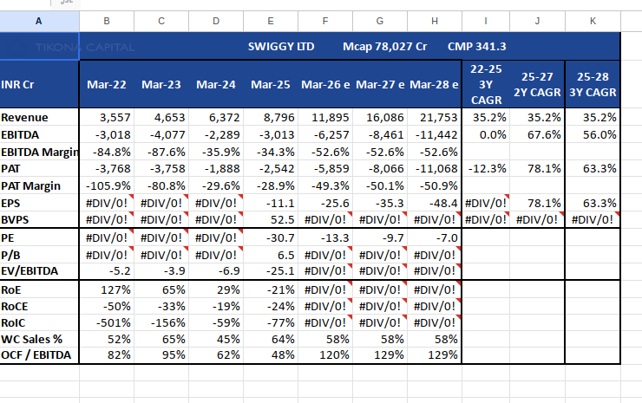
Financials and Ratio Analysis
Summary in Tables
{{summary_table}}

Slide 12
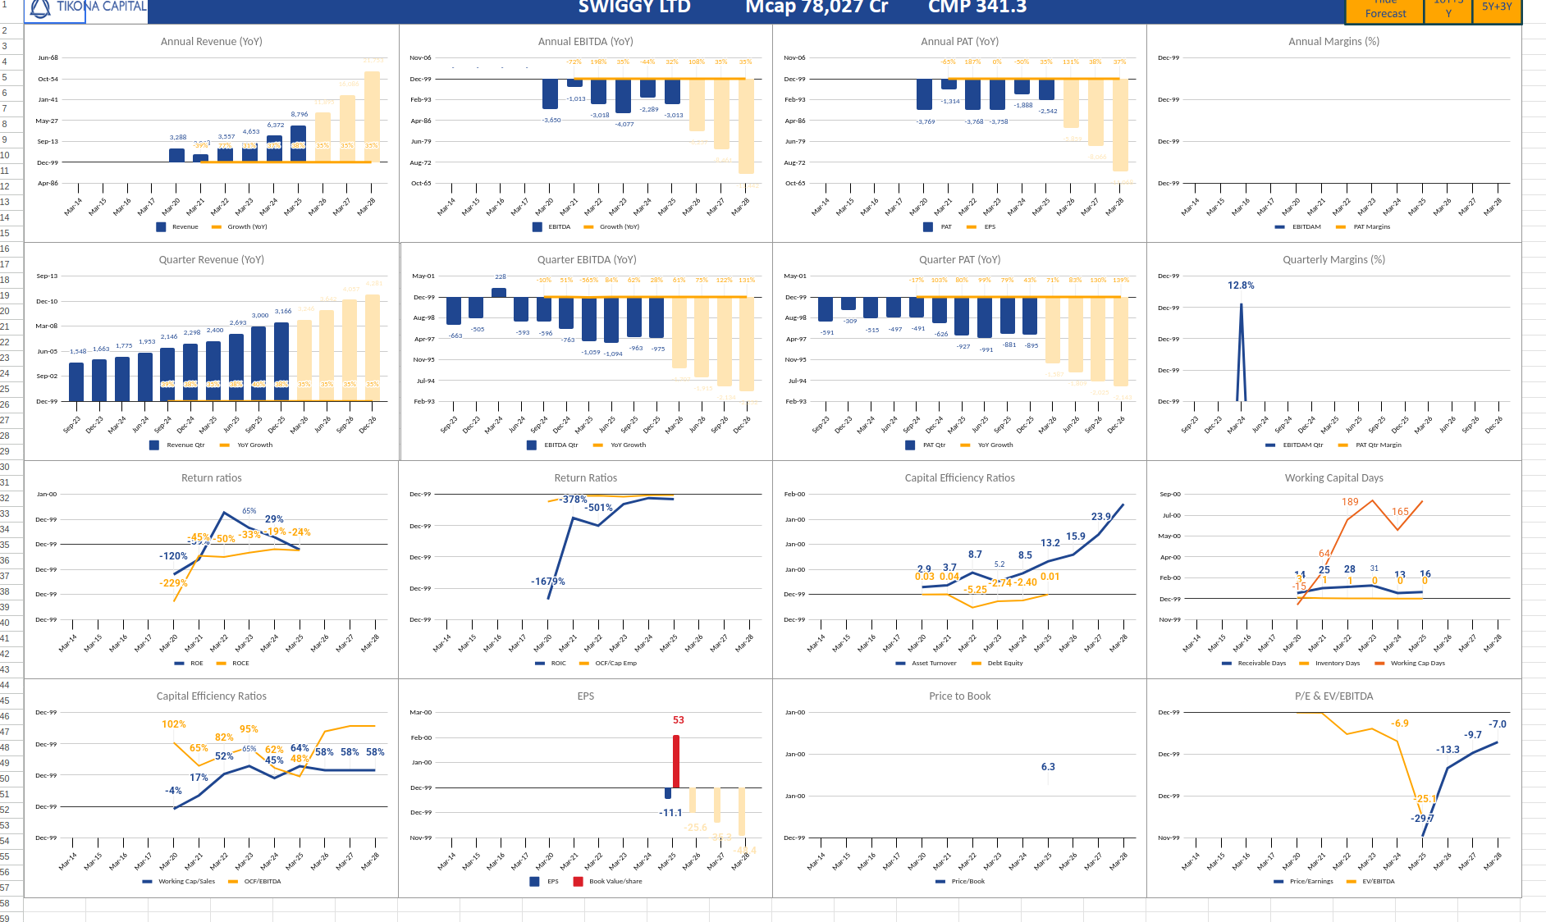
Summary in charts!
{{chart_custom}}

Slide 13

Disclosure and Disclaimers
About Us: Research Analyst is registered with SEBI as Research Analyst with Registration No. INH000009807. The firm got its registration on June 13, 2022, and is engaged in research services.
Disciplinary history: No penalties / directions have been issued by SEBI under the SEBI Act or Regulations made there under. There are no pending material litigations or legal proceedings, findings of inspections or investigations for which action has been taken or initiated by any regulatory authority.
Details of its associates: No associates
Disclosures with respect to Research and Recommendations Services
·Research Analyst may have financial interest or actual / beneficial ownership in the securities recommended in its personal portfolio. Details of the same may be referred through the disclosures made at the time of recommendation.
·There are no actual or potential conflicts of interest arising from any connection to or association with any issuer of products/ securities, including any material information or facts that might compromise its objectivity independence in the carrying on of Research Analyst services. Such conflict of interest shall be disclosed to the client as and when they arise.
·Research Analyst or its employee or its associates have not received any compensation from the company in past 12 months.
·Research Analyst or its employee or its associates have not managed or co-managed the public offering of Subject company in past 12 months.
·Research Analyst or its employee or its associates have not received any compensation for investment banking or merchant banking of brokerage services from the subject company in past 12 months.
·Research Analyst or its employee or its associates have not received any compensation for products or services other than above from the subject company in past 12 months.
·Research Analyst or its employee or its associates have not received any compensation or other benefits from the Subject Company or 3rd party in connection with the research report/ recommendation.
·The subject company was not a client of Research Analyst or its employee or its associates during twelve months preceding the date of distribution of the research report and recommendation services provided.
·Research Analysts or its employee or its associates has not served as an officer, director, or employee of the subject company
·Registration granted by SEBI, membership of BASL and certification from NISM in no way guarantee performance of the Intermediary or provide any assurance of returns to investors.
·Investment in securities market are subject to market risks. Read all the related documents carefully before investing

