Slide 1
Swiggy Ltd
NSE:SWIGGY | BOM:544000 | Rating: BUY
Date: 2026-02-16

Slide 2
Leader in compliant recycling with multi-metal growth optionality
- Market Positioning: Strong leader in sector with competitive advantage.
- Financial Performance:.Stable revenue and profit growth with improving margins.
- Growth & Outlook: Future growth supported by expansion and demand.
- Valuation & Recommendation: BUY for long term investment.
- Key Risks: Competition, regulation and macro risks.

Slide 3
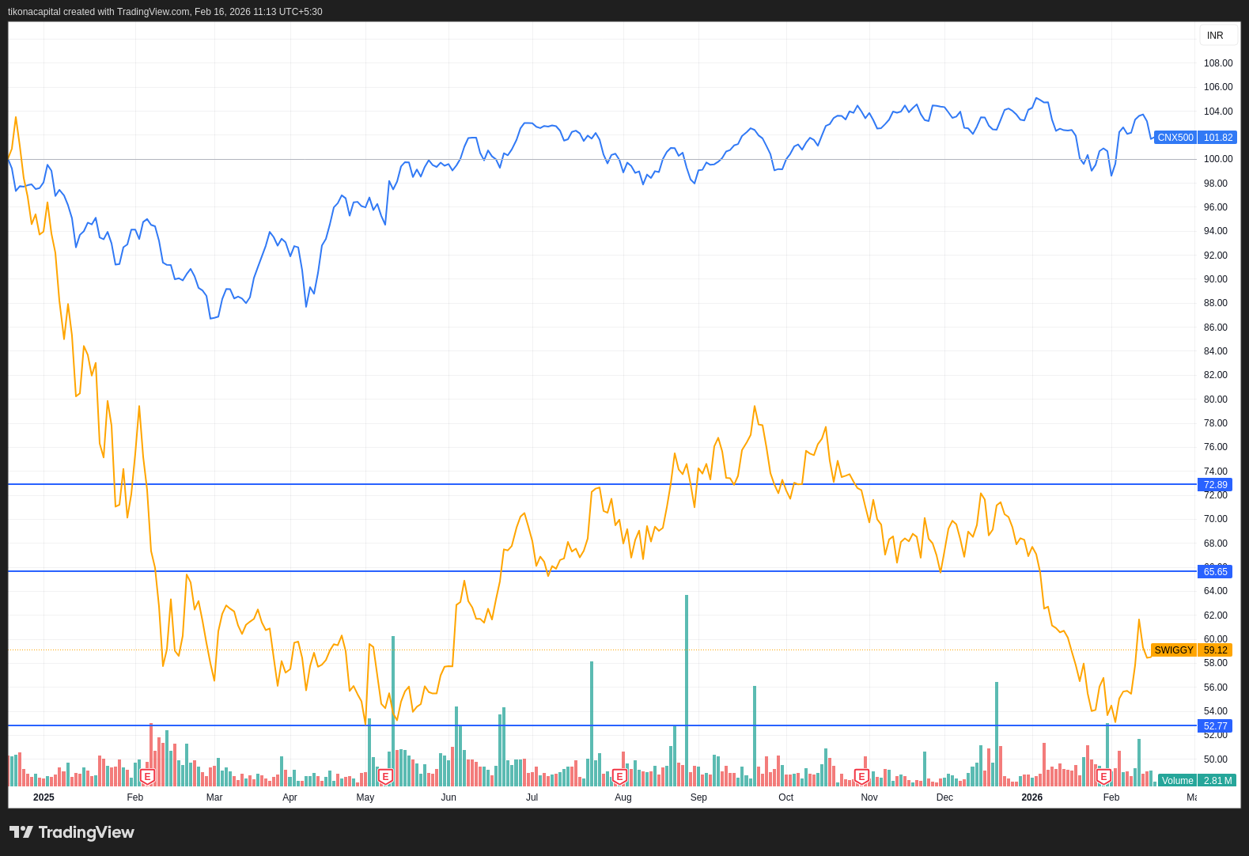
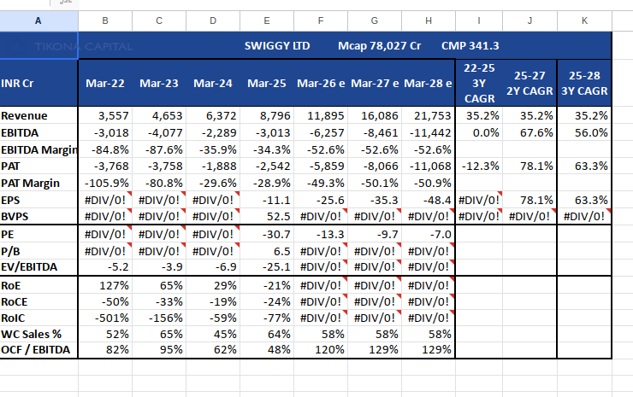
Leader in compliant recycling with multi-metal growth optionality
Healthy promoter and institutional holding.

Slide 4
Company Background
  Swiggy is India's leading on-demand convenience platform...

Slide 5
Business Model Explanation
Hyperlocal delivery platform connecting consumers with restaurants and stores...

Slide 6
Management Analysis
The management team at Swiggy Ltd is tasked with navigating a challenging landscape characterized by intense competition and rapid technological advancements in the food delivery industry. Despite the absence of detailed historical financial data, the company's current market position, as indicated by its market capitalization of ₹78,712.46 crore, suggests a significant presence in the market. However, the lack of profitability metrics such as ROE and ROCE, which stand at -255.00% and -29.20% respectively, raises concerns about the management's ability to efficiently allocate capital and generate returns.

Slide 7
Industry Overview
The Indian food delivery industry, within which Swiggy Ltd operates, is a rapidly evolving sector characterized by intense competition, dynamic consumer preferences, and significant technological advancements. This industry has seen substantial growth over the past decade, driven by increasing internet penetration, the proliferation of smartphones, and a burgeoning middle class with disposable income. As of 2023, the Indian food delivery market is estimated to be valued at approximately ₹1.5 trillion, with expectations of continued growth at a compound annual growth rate (CAGR) of around 12%.

Slide 8
Key Industry Tailwinds
Growing digital adoption and urbanization...

Slide 9
Demand drivers
Convenience and variety seeking behavior...

Slide 10
Industry Risks
Regulatory changes and gig worker classification...

Slide 11
Financials and Ratio Analysis
Summary in Tables
{{summary_table}}

Slide 12
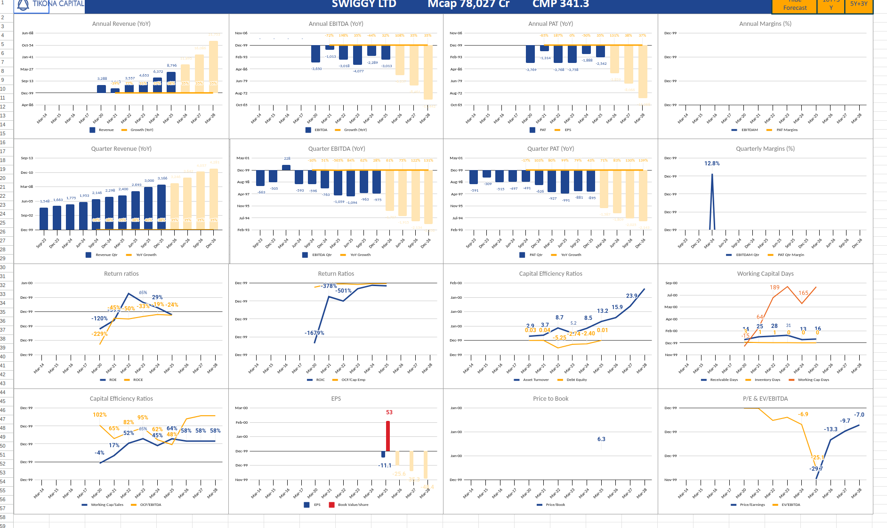
Summary in charts!
{{chart_custom}}

Slide 13
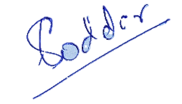
Disclosure and Disclaimers
About Us: Research Analyst is registered with SEBI as Research Analyst with Registration No. INH000009807. The firm got its registration on June 13, 2022, and is engaged in research services.
Disciplinary history: No penalties / directions have been issued by SEBI under the SEBI Act or Regulations made there under. There are no pending material litigations or legal proceedings, findings of inspections or investigations for which action has been taken or initiated by any regulatory authority.
Details of its associates: No associates
Disclosures with respect to Research and Recommendations Services
·Research Analyst may have financial interest or actual / beneficial ownership in the securities recommended in its personal portfolio. Details of the same may be referred through the disclosures made at the time of recommendation.
·There are no actual or potential conflicts of interest arising from any connection to or association with any issuer of products/ securities, including any material information or facts that might compromise its objectivity independence in the carrying on of Research Analyst services. Such conflict of interest shall be disclosed to the client as and when they arise.
·Research Analyst or its employee or its associates have not received any compensation from the company in past 12 months.
·Research Analyst or its employee or its associates have not managed or co-managed the public offering of Subject company in past 12 months.
·Research Analyst or its employee or its associates have not received any compensation for investment banking or merchant banking of brokerage services from the subject company in past 12 months.
·Research Analyst or its employee or its associates have not received any compensation for products or services other than above from the subject company in past 12 months.
·Research Analyst or its employee or its associates have not received any compensation or other benefits from the Subject Company or 3rd party in connection with the research report/ recommendation.
·The subject company was not a client of Research Analyst or its employee or its associates during twelve months preceding the date of distribution of the research report and recommendation services provided.
·Research Analysts or its employee or its associates has not served as an officer, director, or employee of the subject company
·Registration granted by SEBI, membership of BASL and certification from NISM in no way guarantee performance of the Intermediary or provide any assurance of returns to investors.
·Investment in securities market are subject to market risks. Read all the related documents carefully before investing

