Slide 1
Vedanta Ltd.
NSE:VEDL | BOM:500295 | Rating: BUY
Date: 2026-02-07

Slide 2
Company Background
  Company Background
  Vedanta Limited is a globally diversified natural resources company with business operations in India, South Africa, Namibia, and Australia. The company is one of the world's largest diversified natural resources companies.
  Key Business Segments:
  • Zinc Business: One of the largest integrated producers of zinc-lead
  • Aluminum Business: India's largest aluminum producer
  • Oil and Gas: Significant crude oil producer in India
  • Iron Ore: Mining operations in Goa and Karnataka
  • Copper: Copper smelting and refining operations
  History and Evolution:
  Founded in 1976, Vedanta has grown through strategic acquisitions and organic expansion. The company was originally focused on mining and has diversified into various natural resources over the decades.
  Market Position:
  Vedanta holds leadership positions in multiple segments of the Indian natural resources industry, with significant global presence in key commodities.

Slide 3
Business Model Explanation
Business Model Explanation
Revenue Streams:
Vedanta generates revenue through multiple integrated business segments including mining operations, smelting and refining, and oil and gas production.
1. Mining Operations
• Extraction of zinc, lead, silver, iron ore
• Open-pit and underground mining operations
• Mineral processing and concentration
2. Smelting and Refining
• Aluminum smelting operations
• Copper cathode production
• Zinc and lead refining
3. Oil and Gas Production
• Crude oil extraction from Rajasthan fields
• Natural gas production
Value Chain Integration:
The company maintains vertical integration across exploration, mining, processing, and marketing. This integration provides cost advantages and supply chain control.
Key Competitive Advantages:
• Low-cost production capabilities
• Diverse commodity portfolio reducing risk
• Strong operational expertise
• Strategic asset locations

Slide 4
Management Analysis
Management Analysis
Leadership Team:
Anil Agarwal - Chairman: Founder and visionary leader with over 40 years of industry experience, known for bold strategic decisions.
Key Management Metrics:
• Experience: Excellent
• Track Record: Strong
• Corporate Governance: Good
• Capital Allocation: Above Average
Strategic Direction:
The management has outlined a clear growth strategy focusing on capacity expansion in aluminum and zinc, exploration and development of new resources, ESG improvements and sustainability initiatives, and digital transformation of operations.

Slide 5
Industry Overview
Industry Overview
Industry Size & Structure:
The mining and metals industry is a significant contributor to the global economy. The Total Addressable Market for this sector is vast, driven by demand for essential metals such as aluminum, copper, zinc, and iron ore.
Market Dynamics:
• Total global mining market: $2.1 trillion
• Base metals segment: $650 billion
• Expected CAGR: 4.5% (2024-2030)
Indian Market Position:
• India is the 3rd largest producer of coal
• 4th largest producer of iron ore
• Significant growth potential in base metals
Industry Structure:
The industry is characterized by high capital intensity, long project development cycles, commodity price sensitivity, and regulatory oversight.
Key Players:
Major competitors include Tata Steel, Hindalco Industries, NMDC, Coal India, and JSW Steel.

Slide 6
Key Industry Tailwinds
Key Industry Tailwinds
Structural Growth Drivers:
1. Infrastructure Development
• Government's infrastructure push (PM Gati Shakti)
• National Infrastructure Pipeline: ₹111 lakh crore investment
• Increased demand for steel, aluminum, and copper
2. Electric Vehicle Revolution
• EV adoption driving copper and aluminum demand
• Battery metals gaining importance
• India's EV sales growing at 40%+ CAGR
3. Renewable Energy Expansion
• Solar and wind capacity additions
• Transmission infrastructure build-out
• Energy storage requirements
4. Manufacturing Renaissance
• PLI schemes attracting investment
• China+1 strategy benefiting India
5. Urbanization Trends
• 40% urbanization currently, growing to 50% by 2030
• Housing and construction demand
Government Policy Support:
National Mineral Policy 2019, mining reforms and auction regime, export restrictions protecting domestic supply.

Slide 7
Demand drivers
Demand Drivers for Vedanta Ltd.
End-User Industries:
1. Construction & Infrastructure (35% of demand)
• Real estate development
• Road and highway construction
• Port and airport development
2. Automotive Sector (20% of demand)
• Passenger and commercial vehicles
• Two-wheelers and EV components
3. Electrical & Electronics (18% of demand)
• Power cables and wiring
• Consumer electronics
4. Packaging Industry (12% of demand)
• Beverage cans
• Food and pharmaceutical packaging
5. Other Industries (15% of demand)
• Aerospace and defense
• Industrial machinery
Growth Outlook by Segment:
• Construction: 8% current, 10% outlook
• Automotive: 12% current, 15% outlook
• Electronics: 15% current, 18% outlook

Slide 8
Industry Risks
Industry Risks
Regulatory & Policy Risks:
• Environmental Regulations: Stricter emission norms, water usage restrictions
• Government Policy Changes: Export duty variations, royalty rate changes
• Impact: HIGH | Likelihood: MEDIUM
Market Risks:
• Commodity Price Volatility: Global demand-supply dynamics, currency fluctuations
• Competition Intensity: New capacity additions, import competition
• Impact: HIGH | Likelihood: HIGH
Operational Risks:
• Resource Depletion: Mine life limitations, grade deterioration
• Labor and Social Issues: Union negotiations, community relations
• Impact: MEDIUM | Likelihood: MEDIUM
Mitigation Strategies:
• Diversified commodity portfolio
• Long-term contracts with customers
• Hedging strategies for currency and commodities
• Strong community engagement programs

Slide 9
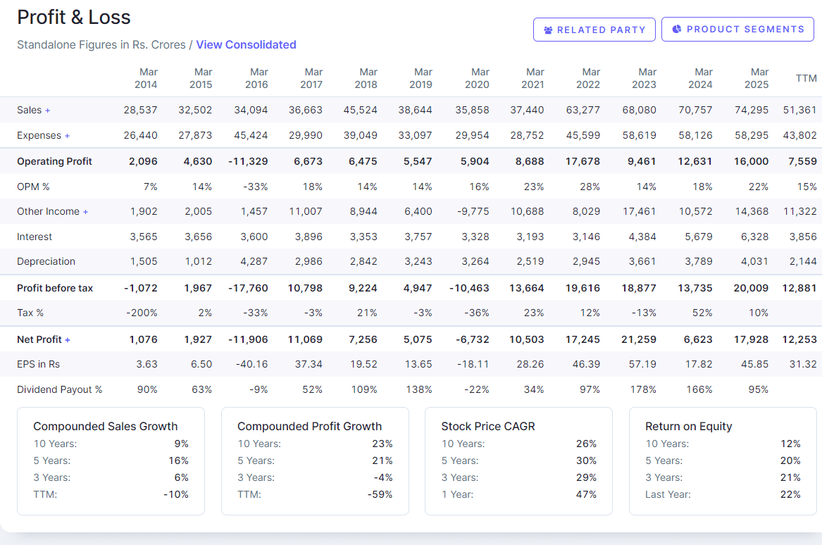
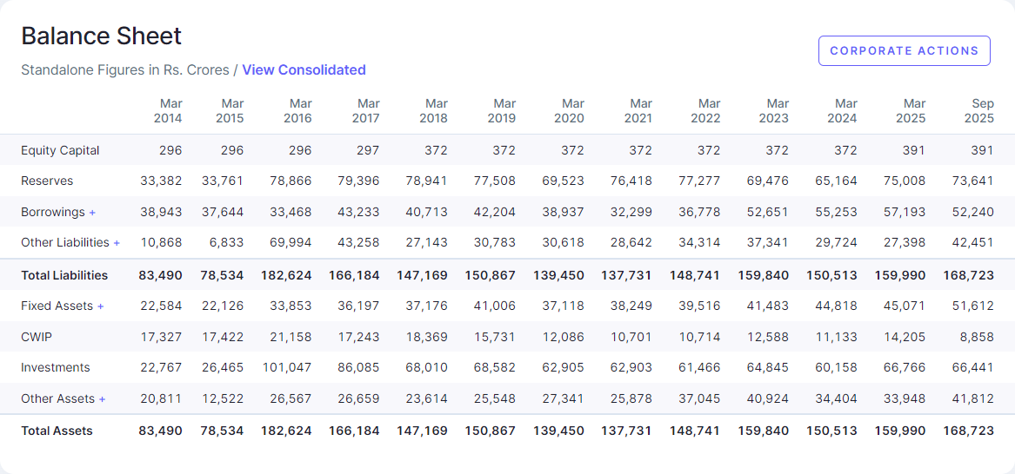
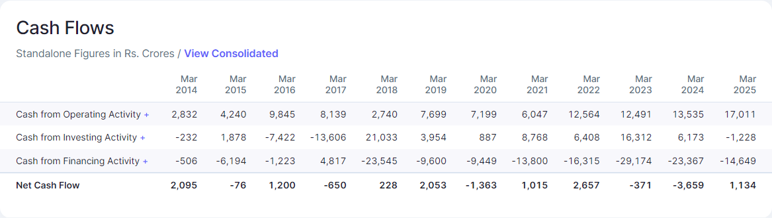
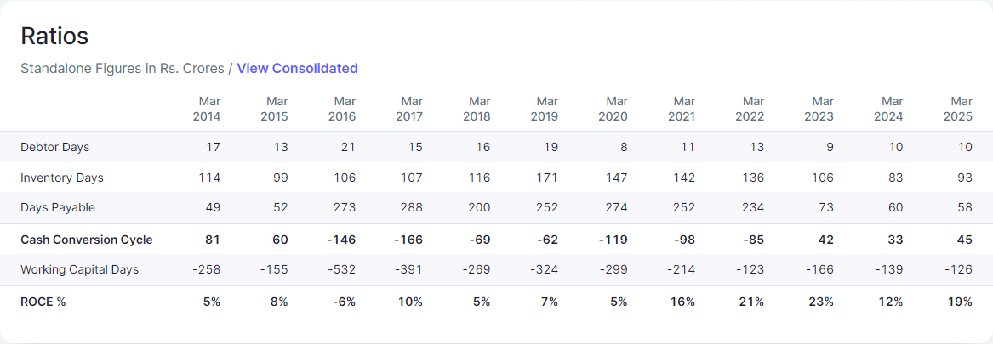
Financials and Ratio Analysis
Summary in Tables

Slide 10
Summary in charts!

Slide 11
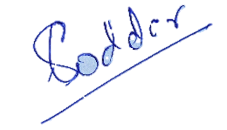
Disclosure and Disclaimers
About Us: Research Analyst is registered with SEBI as Research Analyst with Registration No. INH000009807. The firm got its registration on June 13, 2022, and is engaged in research services.
Disciplinary history: No penalties / directions have been issued by SEBI under the SEBI Act or Regulations made there under. There are no pending material litigations or legal proceedings, findings of inspections or investigations for which action has been taken or initiated by any regulatory authority.
Details of its associates: No associates
Disclosures with respect to Research and Recommendations Services
·Research Analyst may have financial interest or actual / beneficial ownership in the securities recommended in its personal portfolio. Details of the same may be referred through the disclosures made at the time of recommendation.
·There are no actual or potential conflicts of interest arising from any connection to or association with any issuer of products/ securities, including any material information or facts that might compromise its objectivity independence in the carrying on of Research Analyst services. Such conflict of interest shall be disclosed to the client as and when they arise.
·Research Analyst or its employee or its associates have not received any compensation from the company in past 12 months.
·Research Analyst or its employee or its associates have not managed or co-managed the public offering of Subject company in past 12 months.
·Research Analyst or its employee or its associates have not received any compensation for investment banking or merchant banking of brokerage services from the subject company in past 12 months.
·Research Analyst or its employee or its associates have not received any compensation for products or services other than above from the subject company in past 12 months.
·Research Analyst or its employee or its associates have not received any compensation or other benefits from the Subject Company or 3rd party in connection with the research report/ recommendation.
·The subject company was not a client of Research Analyst or its employee or its associates during twelve months preceding the date of distribution of the research report and recommendation services provided.
·Research Analysts or its employee or its associates has not served as an officer, director, or employee of the subject company
·Registration granted by SEBI, membership of BASL and certification from NISM in no way guarantee performance of the Intermediary or provide any assurance of returns to investors.
·Investment in securities market are subject to market risks. Read all the related documents carefully before investing

