Slide 1
Dynamic Fire Evacuation Router with
Real-Time Hazard Mapping
Idea Presentation
Problem Statement ID – 2
Problem Statement Title – Dynamic Fire Evacuation Router with Real-Time Hazard Mapping
Theme – IoT and Real-Time Embedded Systems for Life Safety
PS Category – Software
Student Name – Kishaunjith S
Student ID – 23BCE1857
Dynamic Fire Evacuation Router
1

Slide 2
Proposed solution
Idea title: Dynamic Fire Evacuation Router with Real-Time Hazard Mapping
Decentralized, MQTT-based system senses, fuses, and reroutes live
Non-linear sensor fusion feeds one centralized Dijkstra routing pass
Broadcasts safest exit direction to every zone within 300 ms
Replaces static exit signage with live-recalculated LED guidance
Falls back to shelter-in-place when no safe path exists
Validated under real load testing, not just a single demo
Dynamic Fire Evacuation Router
2

Slide 3

Technical approach
Python: Flask, NetworkX, paho-mqtt for core routing logic
Mosquitto MQTT broker; Node-RED for monitoring dashboard
HTML, CSS, JavaScript control panel; Web Audio API alarm
Fusion formula validated on real ESP32 firmware (Wokwi simulation)
Figure 1. Sensor-to-dashboard system pipeline
Dynamic Fire Evacuation Router
3

Slide 4
Feasibility and viability
Fully working software prototype validated end-to-end across 36 zones.
Issue | Root cause | Resolution
Redundant recomputation | Each of 36 nodes independently re-ran Dijkstra per update | One centralized coordinator computes and broadcasts routes
MQTT publish volume growth | Every node republished LED state on every broadcast | Publish only on real state change, plus keepalive
Result: typical recompute latency of 20–130 ms, within the 300 ms budget.
Dynamic Fire Evacuation Router
4

Slide 5
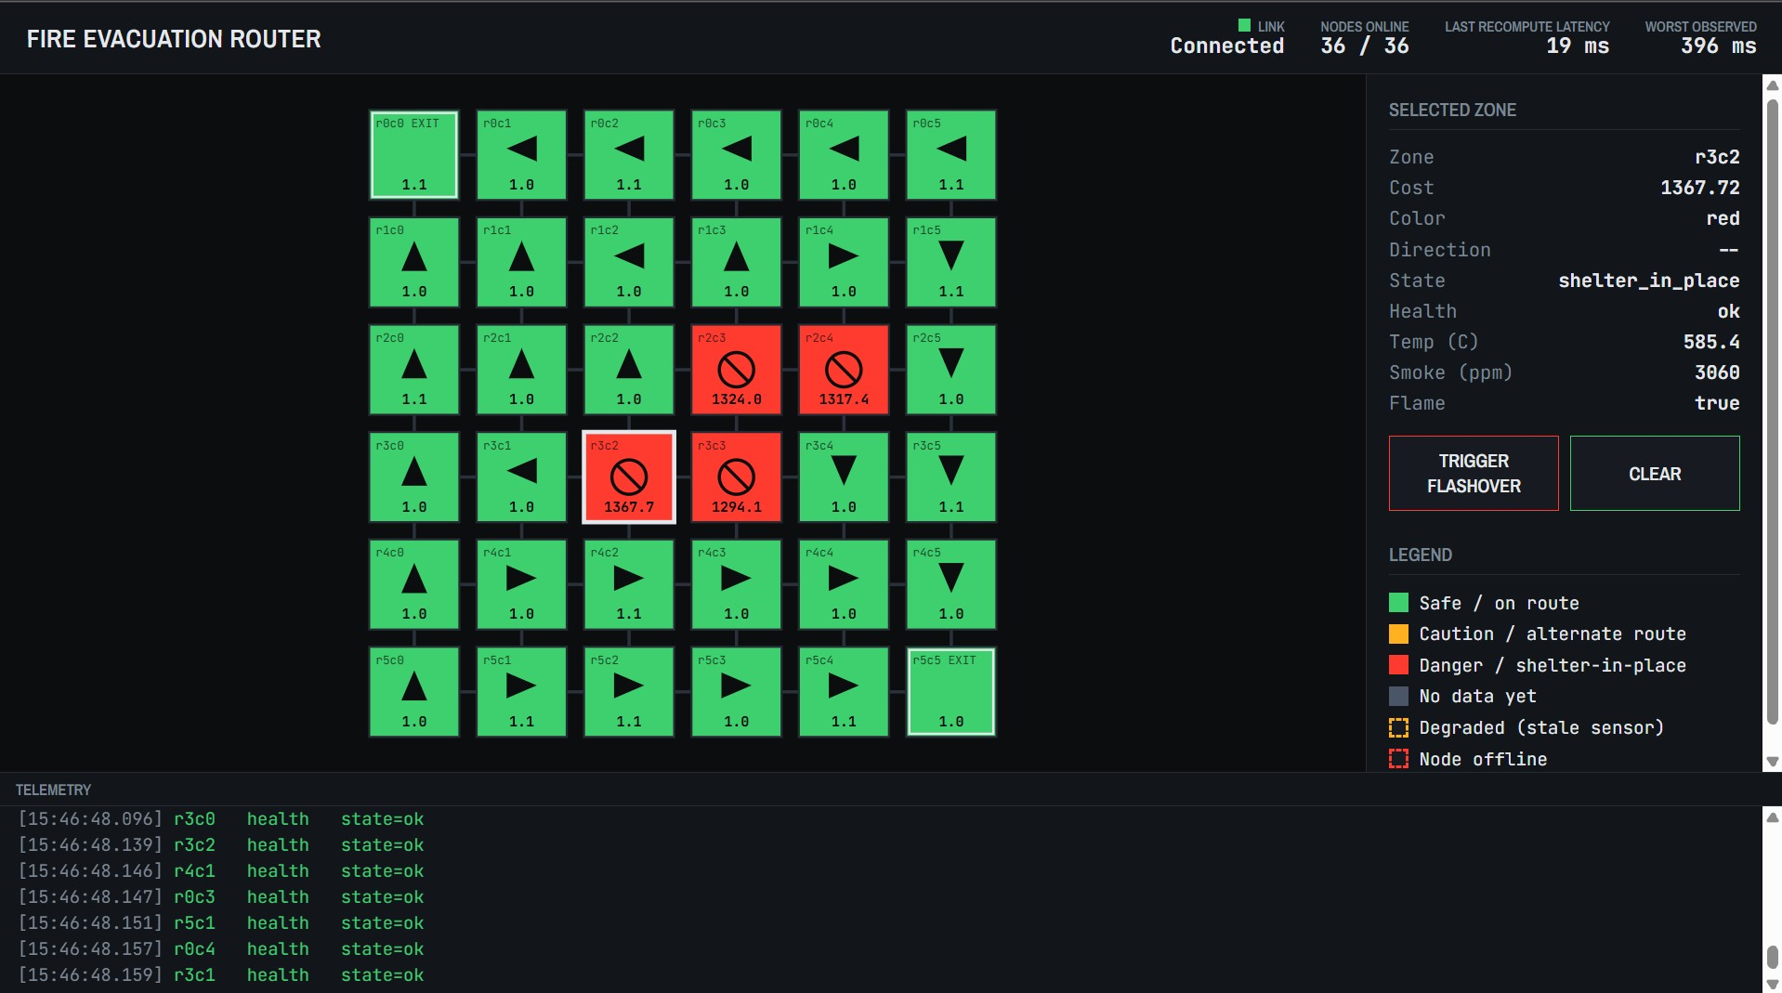
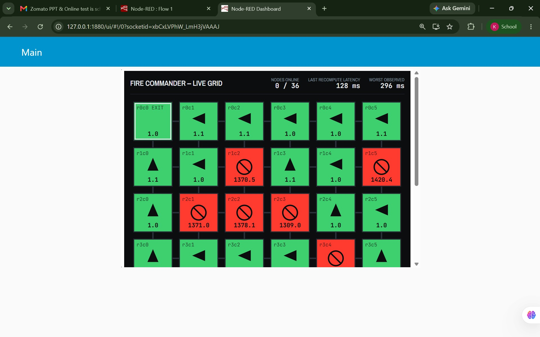
Artifacts
Source code: full repository publicly available at github.com/kishaunjith-S/fire-evac-router
Figure 2. Control-panel simulator
Figure 3. Fire Commander dashboard (Node-RED)
Dynamic Fire Evacuation Router
5

Slide 6
Research and references
Repository: github.com/kishaunjith-S/fire-evac-router
Debugging case study: docs/latency_debugging_notes.md
Libraries: NetworkX, Eclipse Mosquitto, paho-mqtt, Node-RED
Hardware validation: wokwi.com/projects/470617448491375617
Calibration sources: NIST fire data, Kaggle smoke datasets
Dynamic Fire Evacuation Router
6

