Slide 1


Department of Computer Science and Engineering
AI-DRIVEN SOLAR POWER FORECASTING AND LOAD SCHEDULING FOR SMART CAMPUS ENERGY OPTIMIZATION
Mrs. M. Divya Assistant Professor Department of Computer Science and Engineering, Rajalakshmi Engineering College, Chennai-602105.
SAIKRISHNA H
- 220701238

Slide 2
Problem Statement and Motivation
Educational and organizational campuses that deploy localized solar power systems often face challenges in effectively utilizing the energy generated due to unpredictable weather conditions and fluctuating power demands. Traditional scheduling methods are static and do not adapt to variations in generation or consumption, leading to energy wastage and increased reliance on grid electricity. There is a need for an intelligent system that can forecast solar energy availability and campus load demand, and dynamically align the two for efficient and sustainable energy management.

Slide 3
Problem Statement and Motivation
With the rising emphasis on green energy and cost-efficiency, campuses are turning to solar energy as a clean and renewable power source. However, the absence of adaptive scheduling and real-time forecasting tools limits the full potential of these systems. By integrating machine learning-based forecasting and optimization, this project aims to empower institutions with a smart decision-making framework that reduces energy costs, promotes sustainability, and minimizes dependency on non-renewable power sources.

Slide 4
Problem Statement and Motivation
Campuses use solar panels but often fail to utilize the generated power efficiently.
Weather variability makes solar generation unpredictable.
Campus power demand fluctuates daily based on usage patterns.
Traditional scheduling methods are manual, static, and inefficient.
There is no real-time system to align energy supply with operational demand.
Result: Increased reliance on grid electricity and wasted solar energy.

Slide 5
Existing System
Most existing campus energy systems rely on manual scheduling, timer-based automation, and real-time monitoring. While some use IoT-enabled dashboards for visualization, they lack predictive capabilities. These systems do not forecast solar generation or dynamically match energy supply with demand. As a result, they fall short in optimizing renewable energy use under varying conditions. Machine learning integration is largely absent in current solutions.

Slide 6
Existing System
Most campus energy systems focus on real-time monitoring and manual control.
Timer-based or rule-based mechanisms are common, lacking adaptability to dynamic usage or solar availability.
Some systems use IoT devices and dashboards for consumption visualization, but offer limited automation.
No integration of AI/ML for forecasting solar power or predicting load demand in most current setups.
Typically, they do not support dual-predictive scheduling for aligning generation and consumption.

Slide 7
Objectives
The system aims to reduce grid dependency and operational costs while promoting sustainable energy practices.
To design a modular energy optimization framework for campuses that can intelligently manage the power generated from locally deployed solar panels.
To develop machine learning models capable of accurately predicting solar energy generation using weather parameters such as sunlight hours, temperature, and humidity.

Slide 8
Objectives
To forecast campus power demand by analyzing historical energy consumption patterns across various rooms, departments, and functional units.
To implement a dual-predictive system that simultaneously estimates energy supply and demand to support dynamic and context-aware power scheduling.
To assist in generating optimized operational schedules for campus infrastructure by aligning dual-predictive modal

Slide 9
Objectives
To minimize reliance on conventional grid electricity, thus reducing energy costs and contributing to the campus's overall sustainability goals.
To build a scalable solution that can be adapted to other institutions or smart community setups with minimal customization.

Slide 10
Abstract
This project presents an AI-based framework to optimize solar energy usage in smart campus environments. By forecasting both solar power generation and campus load demand using machine learning models, the system dynamically schedules energy consumption across various zones. The dual-predictive architecture ensures better alignment between available power and operational requirements, reducing grid dependency and improving energy efficiency. The solution is scalable, sustainable, and supports real-time decision-making for energy management.

Slide 11
Proposed System
Dual-Predictive Modeling for solar generation and campus energy demand forecasting.
Intelligent Optimization aligns predicted supply with demand and suggests energy-saving actions.
Real-time Scheduling recommending optimal times for high-consumption activities.

Slide 12
Proposed System
Modular Six-Phase Architecture for structured data handling, modeling, and decision-making.
Data-Driven Approach leveraging historical data and machine learning for predictions.
Focus on Sustainability by reducing grid reliance and energy costs.

Slide 13
Proposed System
Scalable and Adaptable design for various campus and community applications.

Slide 14
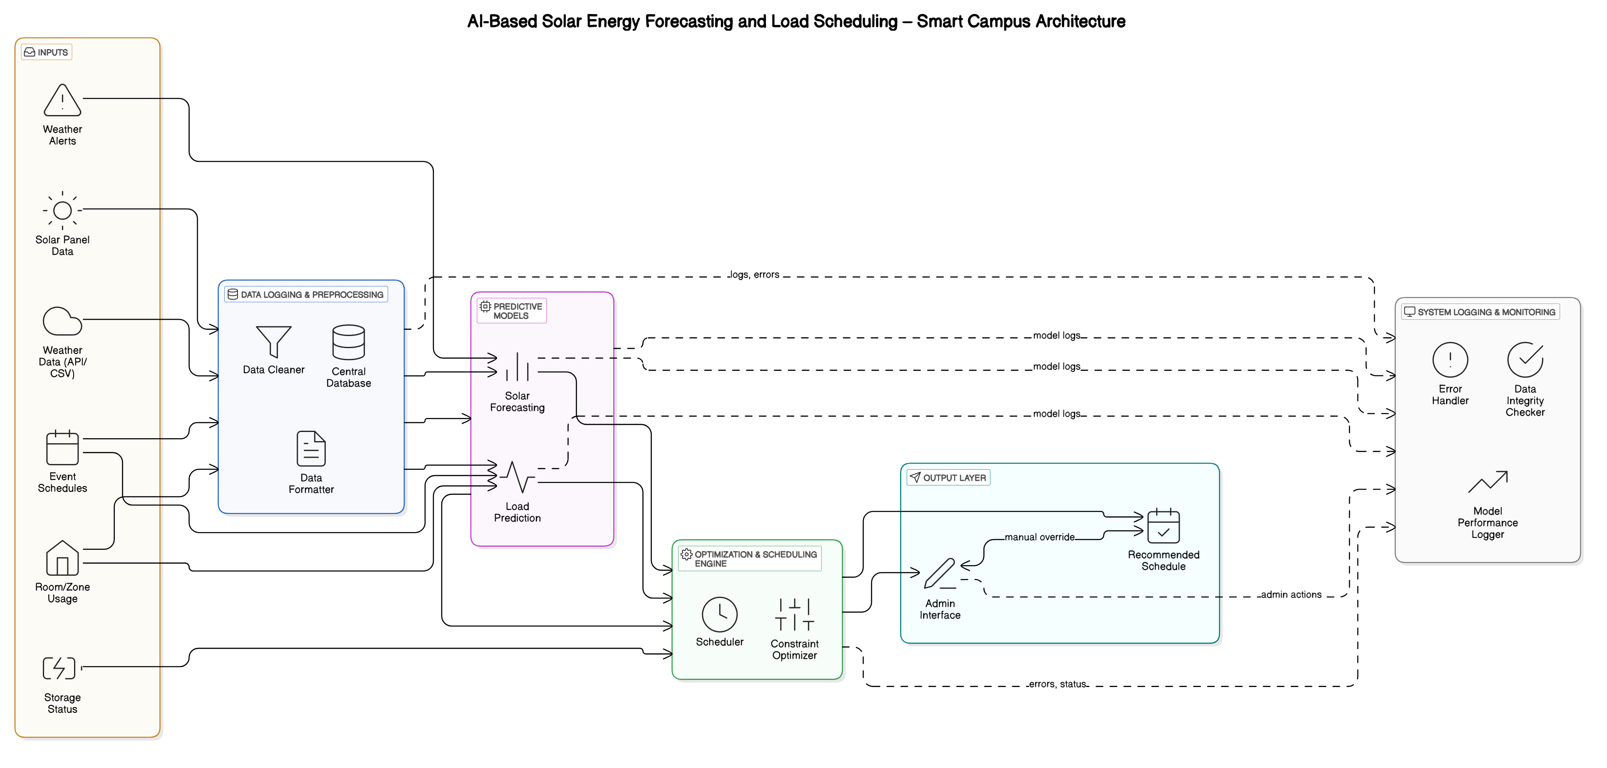
System Architecture

Slide 15
List of Modules
Phase 1: Campus Load Logging
Phase 2: Solar Energy Data Logging
Phase 3: Solar Power Forecasting
Phase 4: Load Demand Prediction
Phase 5: Energy Optimization and Scheduling
Phase 6: System Logging and Error Handling

Slide 16
Functional Description for each modules with DFD and Activity Diagram
Phase 1: Demand Data Acquisition Captures operational hours and energy usage patterns of power-consuming units such as rooms, labs, and staircases. Data is logged via structured forms or sensor-based inputs, tagged with timestamps and consumption metrics.
Phase 2: Energy Supply Monitoring Collects real-time and historical data from locally deployed solar panels, including timestamps and total energy generated. Ensures synchronization with demand data for accurate model training and energy balancing.

Slide 17
Functional Description for each modules with DFD and Activity Diagram
Phase 3: Solar Power Forecasting Implements machine learning models trained on weather data (e.g., temperature, sunlight hours, humidity) to predict daily solar energy output.
Phase 4: Load Demand Prediction Applies regression or classification models to estimate daily energy requirements across the campus. Historical consumption logs and contextual factors (e.g., weekday/weekend, event schedules) are used to forecast operational load.

Slide 18
Functional Description for each modules with DFD and Activity Diagram
Phase 5: Optimization and Scheduling Engine Aligns forecasted energy supply with predicted demand. Uses constraint-based optimization algorithms to generate feasible operational schedules, ensuring critical units remain active while minimizing grid dependence.
Phase 6: Logging and Error Handling (Future Phase) Introduces system monitoring and fallback mechanisms. Ensures data integrity, detects prediction errors, and maintains reliable operation under unexpected failures or data inconsistencies.

Slide 19
Implementation & Results of Module
Implementation of the Module
The system was developed using Python on Google Colab for flexibility and rapid prototyping.
Data ingestion was handled via CSV files containing historical weather data and room-wise energy usage logs.
Two separate machine learning models were implemented using scikit-learn:
A regression model (Random Forest & Linear Regression) for solar power forecasting.
A load prediction model for estimating power demand of various campus zones.
The optimization engine used conditional logic and threshold constraints to generate feasible schedules aligning demand with supply.
Error handling and logging were managed through Python’s built-in features.

Slide 20
Implementation & Results of Module
Results of the Module
Solar Forecasting Model achieved an R² score of 0.87, showing high correlation between predicted and actual solar generation.
Load Prediction Model consistently estimated zone-wise demand within a ±10% error margin.
The optimization module effectively generated energy-efficient operational schedules, prioritizing essential zones during limited energy availability.

Slide 21
Conclusion & Future Work
The Smart Campus Energy Optimizer is more than a forecasting tool—it is a practical step toward fully autonomous, AI-enabled sustainable infrastructure. As campuses worldwide adopt renewable energy systems, intelligent platforms like this will play a crucial role in ensuring that green power is not only generated but also utilized efficiently. The proposed framework sets the stage for scalable, adaptive, and intelligent energy ecosystems that align with global sustainability and net-zero goals.

Slide 22
Conclusion & Future Work
The system can be extended by integrating real-time weather APIs and IoT-based smart meters for live forecasting and consumption tracking. Deep learning models like LSTM can enhance long-term prediction accuracy. A web-based dashboard with user authentication can support continuous monitoring. The framework can also be adapted for hybrid energy systems including wind or biogas. Additionally, predictive maintenance alerts can be added to improve reliability.

Slide 23
References
[1] Y. Said and A. Alanazi, "AI-based solar energy forecasting for smart grid integration," Neural Computing and Applications, vol. 35, no. 11, pp. 8625–8634, 2023.
[2] H. Zhou, Q. Liu, K. Yan, and Y. Du, "Deep learning enhanced solar energy forecasting with AI‐driven IoT," Wireless Communications and Mobile Computing, vol. 2021, no. 1, p. 9249387, 2021.
[3] K. Barhmi, C. Heynen, S. Golroodbari, and W. van Sark, "A review of solar forecasting techniques and the role of artificial intelligence," Solar, vol. 4, no. 1, pp. 99–135, Feb. 2024.

Slide 24
Thank You

