Slide 1
TERRAFORM
VIKAS
Notes:
Introduction :
https://www.terraform.io/intro/index.html
https://registry.terraform.io/providers/hashicorp/aws/latest/docs/resources/instance
https://registry.terraform.io/ -- registery
Useful Commands
$ terraform plan # plan
$ terraform apply # shortcut for plan & apply - avoid this in production
$ terraform plan -out out.terraform # terraform plan and write the plan to out file
$ terraform apply out.terraform # apply terraform plan using out file
$ terraform show # show current state
$ cat terraform.tfstate # show state in JSON format
Reference Documentation
Download URL: https://www.terraform.io/downloads.html
AWS Resources: https://www.terraform.io/docs/providers/aws/
List of providers: https://www.terraform.io/docs/providers/index.html
List of AMIs for ubuntu: https://cloud-images.ubuntu.com/locator/ec2/ (hint: make sure not to pick arm64 if you're on amd64)
https://github.com/wardviaene/terraform-course

Slide 2
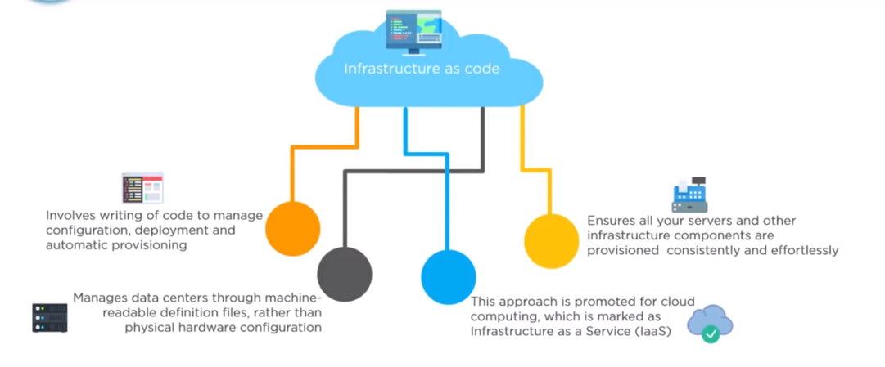
Notes:
Install on AWS : https://learn.hashicorp.com/tutorials/terraform/install-cli
Terraform is a tool for building ,changing & versioning infrastructure safely and effectively.
Open source
Declarative language
State complaint of IAAC and automation.

Slide 3
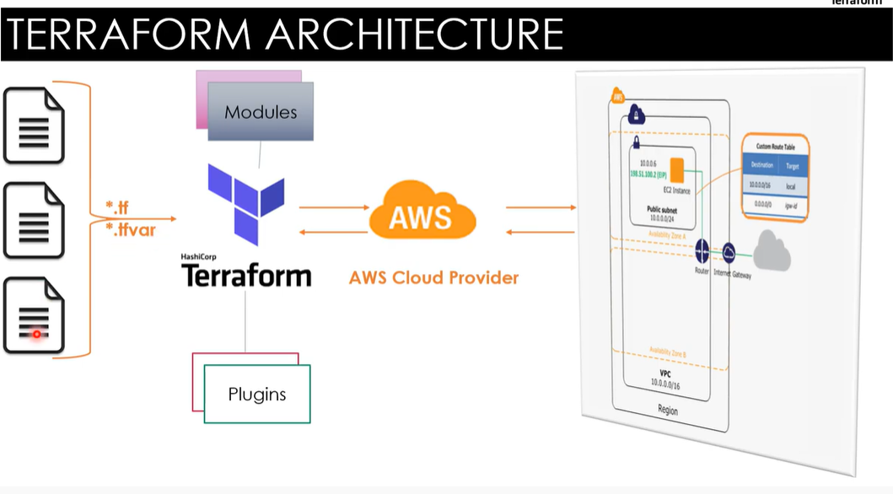

Slide 4
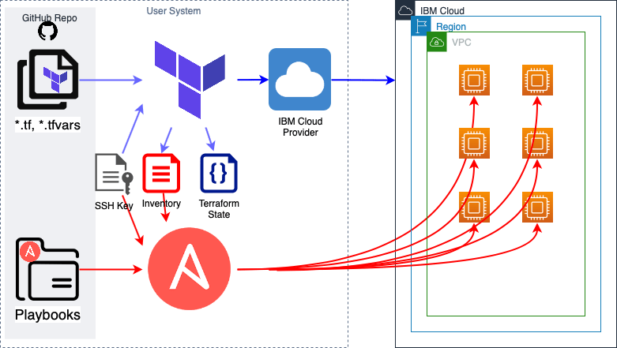

Slide 5
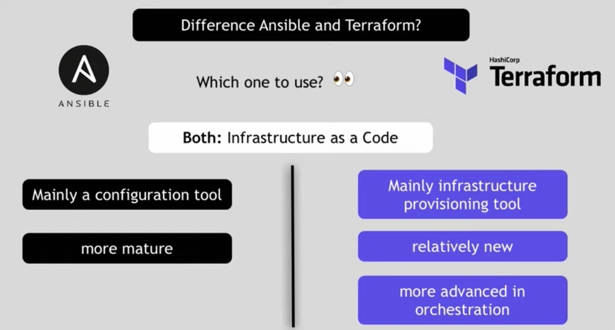
Notes:
sudo mv terraform /usr/local/bin

Slide 6
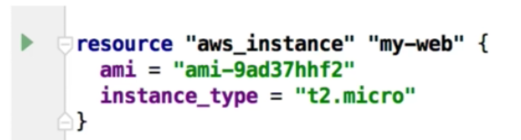
Terraform is a tool for building ,changing and versioning safely and efficiently .It can manage existing and popular service providers as well as customer in-house solutions .
Automate Infrastructure as code .Maintains infrastructure change history using version control like git .Does state management of infra structure .
Maintain system compliance with all Configuration Management tools .
Can automate all cloud providers like AWS, Azure, GCP etc .
Notes:
https://www.terraform.io/downloads.html
https://www.terraform.io/intro/index.html
https://www.terraform.io/docs/providers/aws/r/vpc.html
https://www.terraform.io/docs/state/index.html
https://www.terraform.io/docs/commands/apply.html
https://www.terraform.io/docs/configuration/variables.html
Cost
Speed
Reduced risk
Create a EC2:
https://www.terraform.io/docs/providers/aws/r/instance.html
Create SG
https://www.terraform.io/docs/providers/aws/r/security_group.html

Slide 7
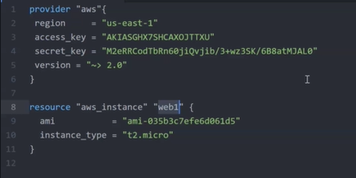
Notes:
Terraform plan ,terraform apply ,terraform destroy
Create AWS user and add him to administration group .
Get access key and secret access key
Download Terraform from official website <https://releases.hashicorp.com/terraform/0.11.14/>
Create a Ubuntu instance and start unzip and then the sudo mv terraform /usr/local/bin/
terraform --version
https://github.com/vikas99341/terraform-easy
terraform apply –auto-approve
terraform state show

Slide 8
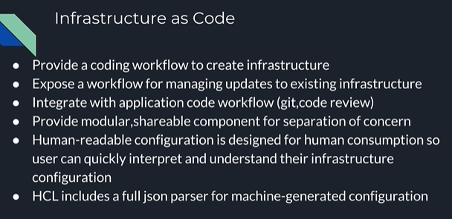
Notes:
https://www.terraform.io/downloads.html
Create a adminstrator with programatic access .Take his credentials .
Install unzip
sudo apt-get install unzip
Download Terraform Version 11.14
wget https://releases.hashicorp.com/terraform/0.11.14/terraform_0.11.14_linux_amd64.zip
Extract the downloaded file archive
unzip terraform_0.11.14_linux_amd64.zip
Move the executable into a directory searched for executables
sudo mv terraform /usr/local/bin/
Run it
terraform --version
Create a user give him admin right .Use his credentials .
https://code.visualstudio.com and add extension .
Terraform init
Terraform plan
Terraform apply
tf destroy

Slide 9
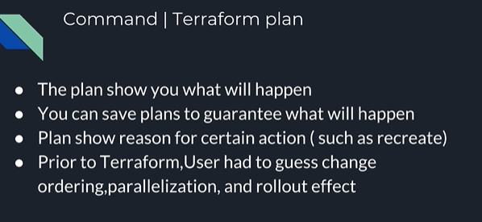
Notes:
bash function to install terrafrom:
TERRAFORM_ZIP_FILE=terraform_0.11.7_linux_amd64.zip
TERRAFORM=https://releases.hashicorp.com/terraform/0.11.7
TERRAFORM_BIN=terraform
function install_terraform {
if [ -z $(which $TERRAFORM_BIN) ]
then
wget ${TERRAFORM}/${TERRAFORM_ZIP_FILE}
unzip ${TERRAFORM_ZIP_FILE}
sudo mv ${TERRAFORM_BIN} /usr/local/bin/${TERRAFORM_BIN}
rm -rf ${TERRAFORM_ZIP_FILE}
else
echo "Terraform is most likely installed"
fi
}
install_terraform

Slide 10
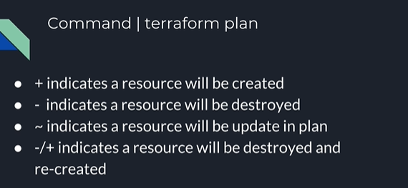

Slide 11
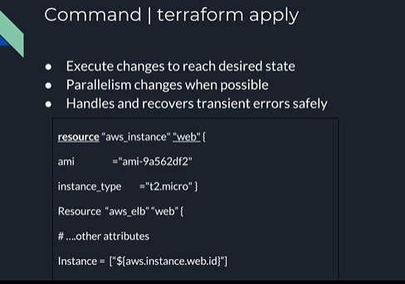
Notes:
Install and unzip the file .
Set path by the command “export PATH=<where you have unzipped>/terraform:$PATH
terraform -version
AWS EC2 AMI locator
terraform plan –out config.terraform
terraform apply config.terraform

Slide 12
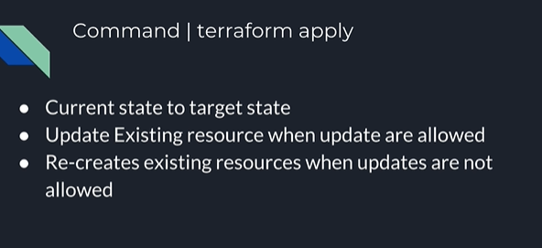

Slide 13
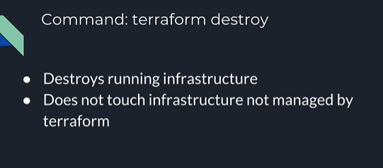

Slide 14
