Slide 1
Physiological Synchrony in music-making experiment research
Update - May 2021

Slide 2
Heart rate analysis - review
Interpolation
Breakdown into low-frequency (LF) and high-frequency (HF) band
Describe synchrony in group via angular distance between signals
...And map the triangle onto onto a 2D-grid
Plus: Suggested that a third signal existed, by taking “RMS” (local variance of the HF signal (but have not followed up with this analysis)

Slide 3
Heart rate analysis - progress
Used 6-seconds window (±3 secs)
Applied cross-correlation for best match (lowest distance)

Slide 4
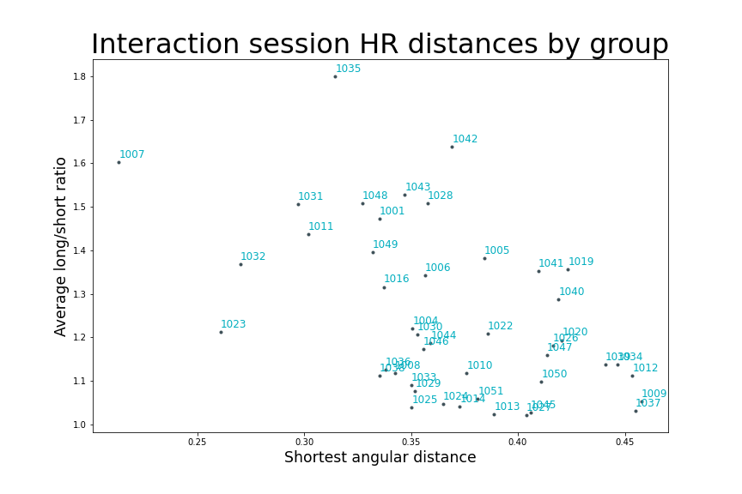
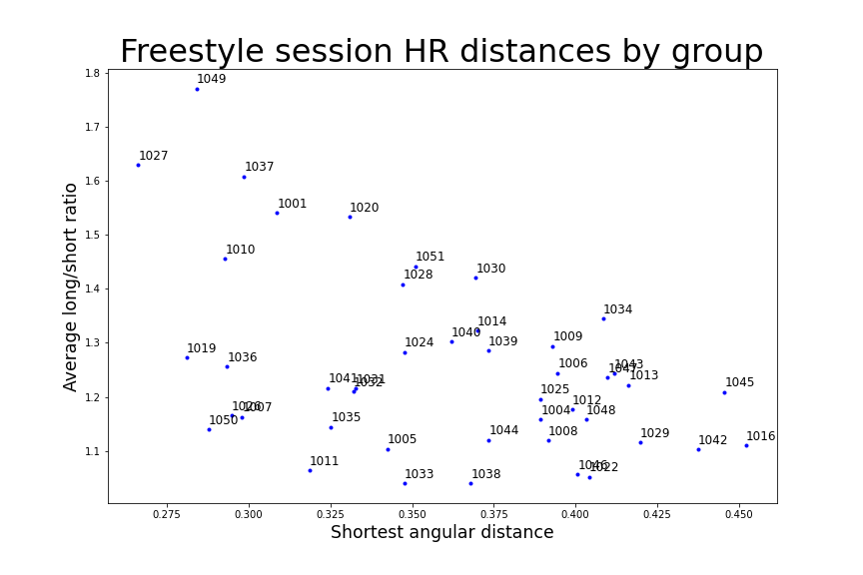
Revised plots for HR Synchrony, Interaction and Freestyle sessions

Slide 5
Drumming analysis - Review
Finding the ticks per seconds (TPS) in MIDI files
  In-depth analysis revealed many different TPSs were applied in the conversion process
  The TPS is not preserved MIDI
  Used heuristics to decide on TPS per file
  Failed to establish TPS based on experiment duration

Slide 6
Drumming analysis – progress
Map each MIDI track to participant ID
  Successfully mapped tracks to participants using seating maps

Slide 7
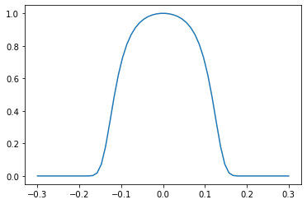
Drumming analysis progress (2):
Coordination-index calculation
The score works on a pair of signals
Each time-point where signals are exactly equal, gets a score of 1.0. The score drops to zero when the difference reaches 0.6Hz.
Pair score per session: average of instantaneous score

Slide 8
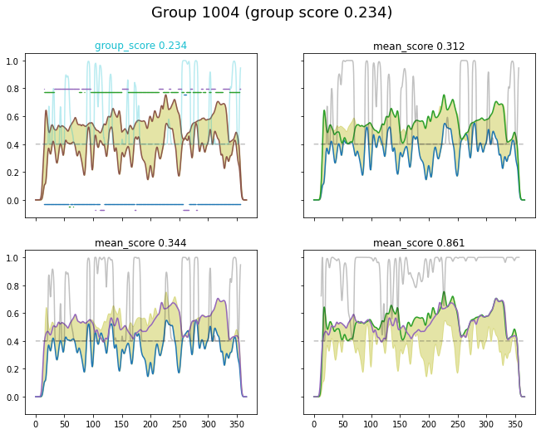
Drumming coordination index
Group score
Top left chart shows group scores
Instantenous scores are charted in background
Pair score
Blue and purple curves indicate participant’s drumming tempo
Yellowish shadow: the span of all three signals

Slide 9
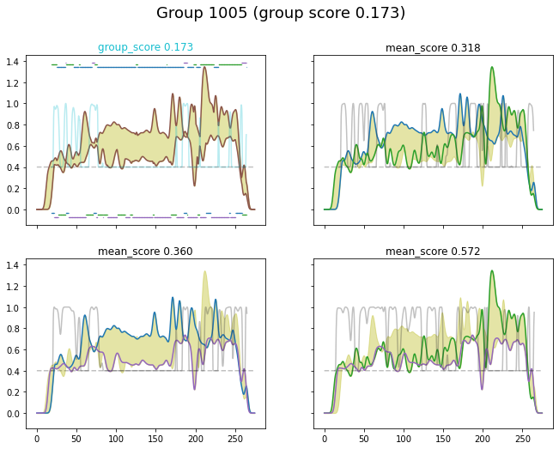
Drumming – some more results

Slide 10
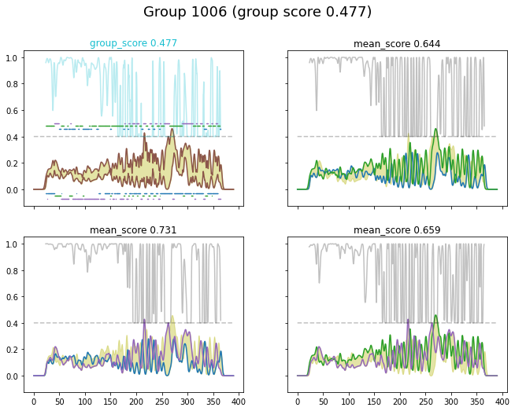

Slide 11
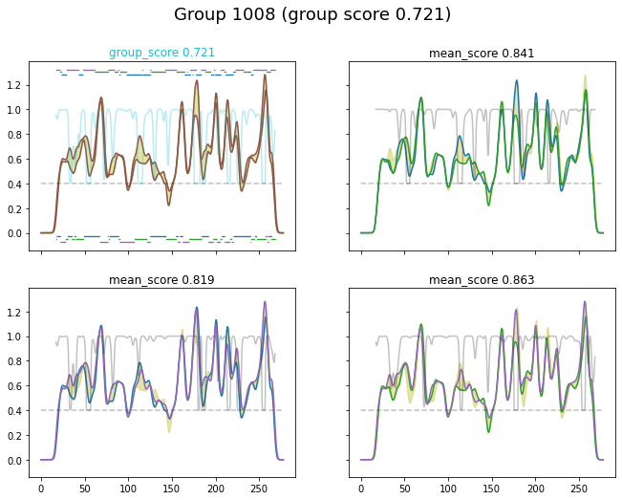

Slide 12
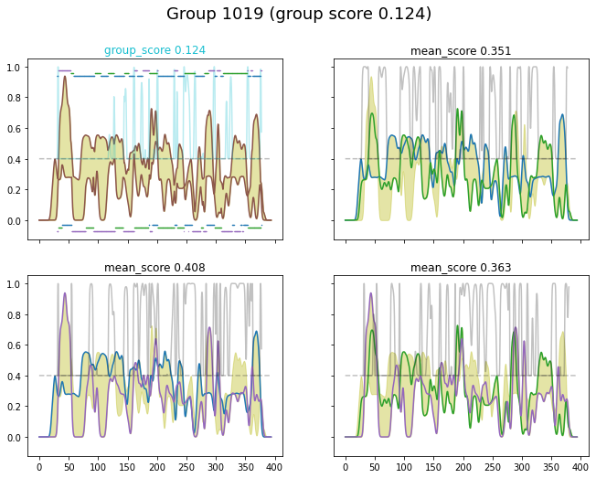

Slide 13

Progress - Other
Emoji source
Proposal
Data organization
  Discovered and utilized a “deep” data structure
  Already enjoying greater productivity following the change.

Slide 14
Next steps
Search matches (correlation) across aspects (features) of the drumming coordination and the heart-rate synchrony
Check whether CCA (canonical correlation analysis) can help with this

