Slide 2
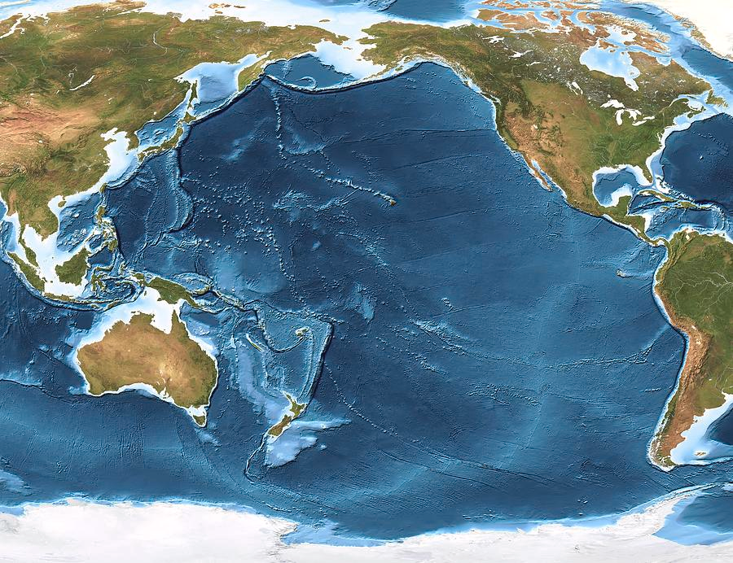
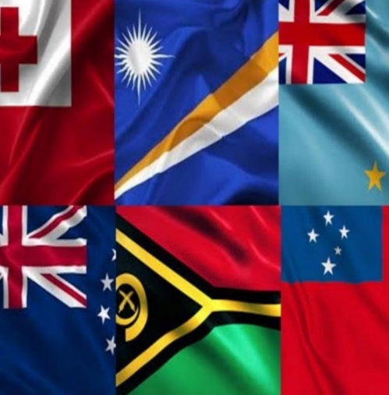


PARTneR-II
Pacific Risk Tool for Resilience (PARTneR) Project, Phase 2
Strengthening Resilience in Pacific Island Countries through the use of Climate Risk Decision Support Tools
Notes:
Hello everybody – today I’ll deliver a talk describing the Pacific Risk Tool for Resilience Phase-2 project (or PARTneR-2), as well as progress towards key outcomes to date which support Strengthening Resilience in Pacific Island Countries through the use of Climate Risk Decision Support Tools

Slide 3
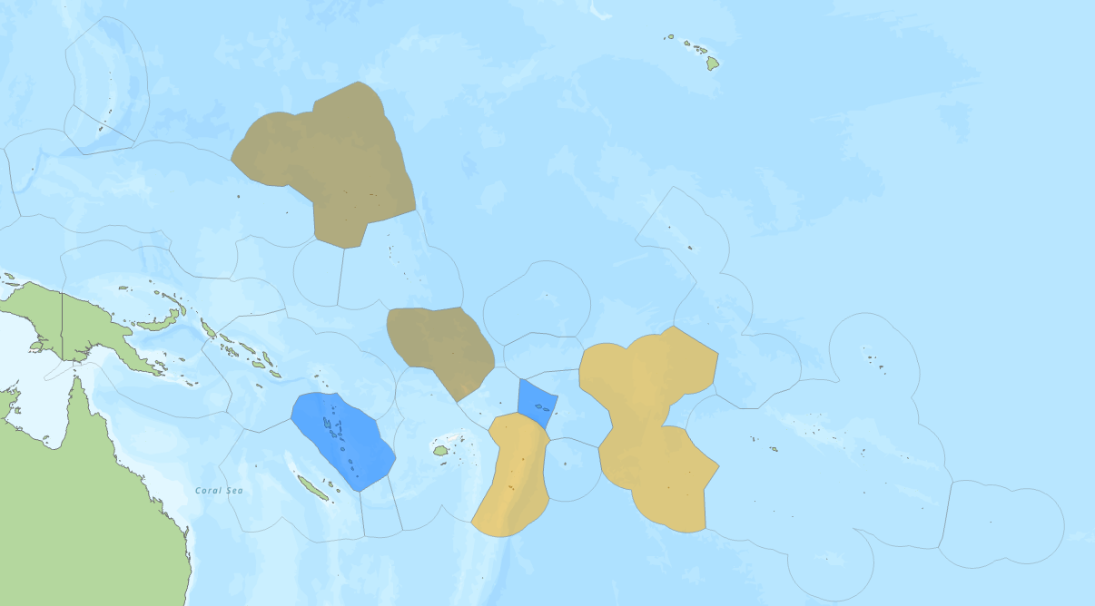

Objectives
Strengthen Disaster Risk Assessment capacity
Strengthen Institutional capacity to make risk informed decision
Republic of the Marshall Islands
Building national systems to strengthen Disaster risk knowledge
Tuvalu
Cook Islands
Samoa
Vanuatu
Foster peer to peer learning
Tonga
Notes:
The focus of the PARTneR-2 project is on climatic hazard risks with delivery framed around 3 key information decision-support use cases:
1. National Climate Risk Profiles for Sea Level inundation under a warming climate
2. Tropical Cyclone Exposure Risk Forecast and Post-event Damage Information support -- which includes “Rapid Exposure-based Forecasts” and “Post-event Assessments to support Disaster IDA’s and PDNA’s” – for specific decision-support usage by NDMO’s and EOC’s in response and recovery activities.
3. Drought risk monitoring to support water resources management in atoll nations – specifically Tuvalu and RMI.
For the tropical cyclone use case -- given the complexity of TC hazards (i.e., wind, storm surge, river and overland flooding, landsliding, etc), an initial focus on “wind” and “flood” exposure-risk forecasts are being progressed as starting points through PARTneR-2.

Slide 4
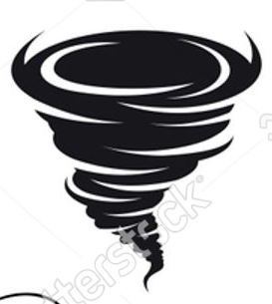

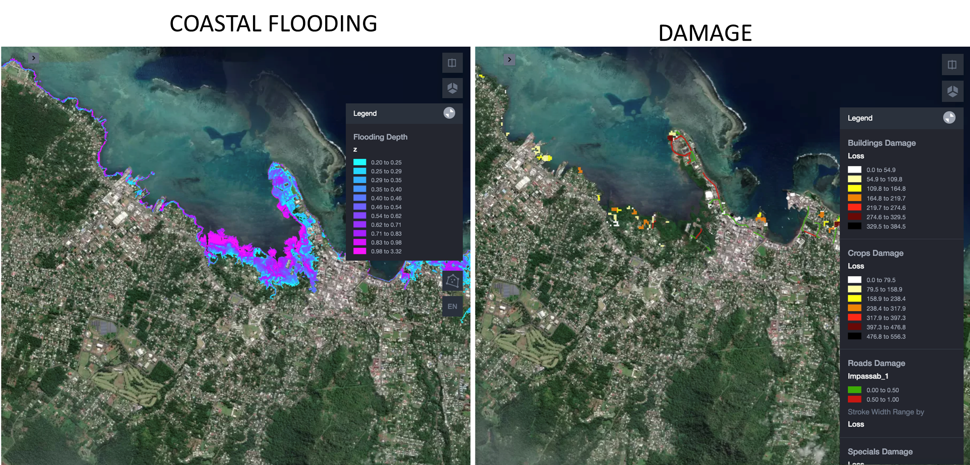
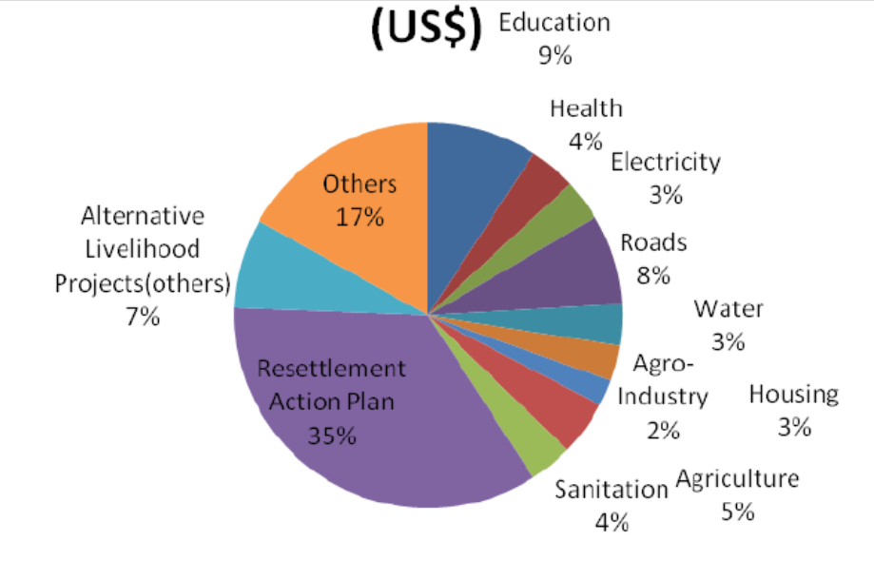

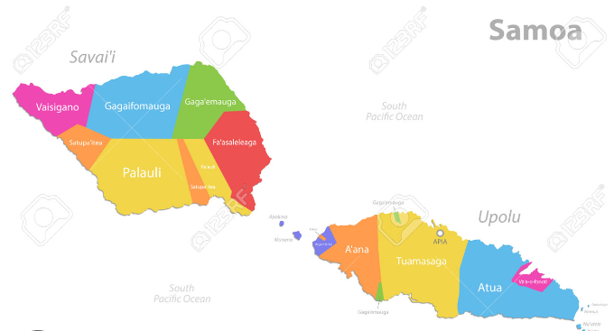
IDA/PDNA DASHBOARD
National level summary
TC EVENT current and archived (list)
- TC Lola – IDA 2023
- Estimated damage – USD $2000M
- People affected – 34K
Health sector
Agriculture
WASH
(Filter options)
Hazard
Wind
C Inundation
Map Box
Clusters
Agriculture
Social
Health
Interactive Exposure– based on filters (pie/bar)
Aggregation unit
Districts
Province
National
Interactive Eco Damage– based on filters (pie/bar)
Download Data
Generate PDF report
Upload Impact Evidences
excel spreadsheet
Country PDNA format
PCRAFI2 standards

Slide 5
Sea Level Rise DASHBOARD
upload Impact evidences
Generate PDF report
TC EVENT current and archived
upload Impact evidences
Generate PDF report
TC EVENT current and archived
Hazard
Wind
C Inundation
Pluvial
MAP
- OSM
- TC track intensity
PIE/BAR CHARTS:
Per hazard/sector/cluster/district
Clusters
Agriculture
Social
Health
Aggregation unit
Districts
Province
Nationsl
Result
Exposure
impact
District | Exposure | CI | Pluvial | Total | Economic damage
 | Building | Infra | Crops | Pop | Building | Infra | Crops | Pop | Total $USD
 |  |  |  | Telecom
Clusters proposed by the countries: Health, Education, Gender, Water and sanitation, Food security
District | Exposure | CI | Pluvial | Total | Economic damage
 | Wind | CI | Pluvial | Total | Wind | CI | Pluvial | Total $

Slide 6
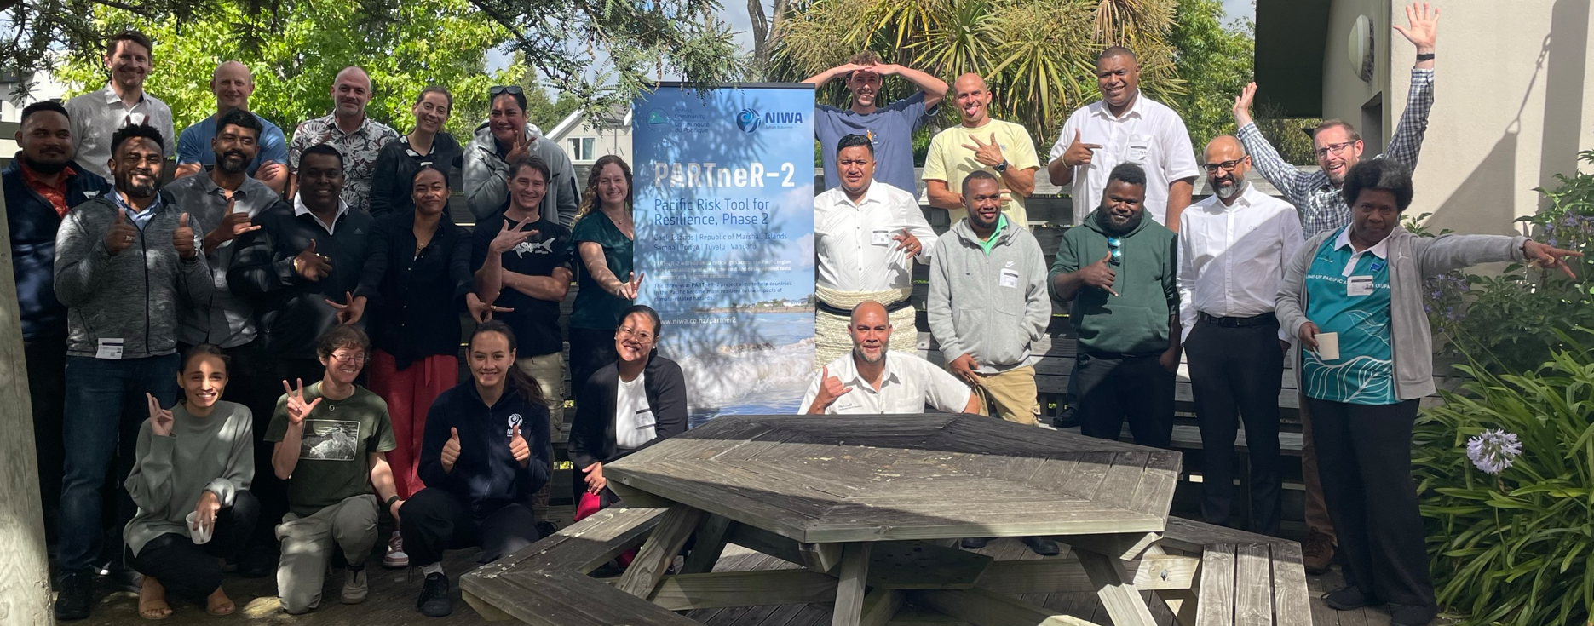
Sioeli Lolohea¹, Yvette Turua², Johnny Tari³, Malia Pisi⁴, Juli Ungaro⁵, Eileen Turare⁶, Shaun Williams⁵, Litea Biukoto⁶, Herve Damlamian⁶, Ryan Paulik⁵, Sachindra Singh⁶, Rebecca Welsh⁵, Judith Giblin⁶, Cyprien Bosserelle⁵, Rose Pearson⁵, Antonio Espejo⁶, Samantha Krawczyk⁶, Amit Singh⁷, Tim Beale⁸, Orisi Naivalurua⁶, Luisa Hosse⁵, Nicholas Metherall⁶, Thompson Auri⁶, Kaliopate Tavola⁶, James Battersby⁵, Merelita Lewabete⁶, Divesh Anuj⁶, Sione Sunia¹, Samisoni Waqavakatoga⁷, Andra Whiteside⁵, Rose Kuru⁵
1. National Disaster Risk Management Office, MEIDECC, Tonga
2. Climate Change Cook Islands, Office of the Prime Minister, Cook Islands
3. National Disaster Management Office, Ministry of Climate Change and Adaptation, Vanuatu
4. National Disaster Management Office, MNRE, Samoa
5. NIWA Taihoro Nukurangi, Aotearoa New Zealand
6. Geoscience, Energy and Maritime Division, The Pacific Community, Fiji
7. Regional Meteorological Services Centre for WMO Region-5, FMS, Fiji
8. Catalyst IT, Christchurch, Aotearoa New Zealand
Notes:
Acknowledging the project team…

