Slide 1
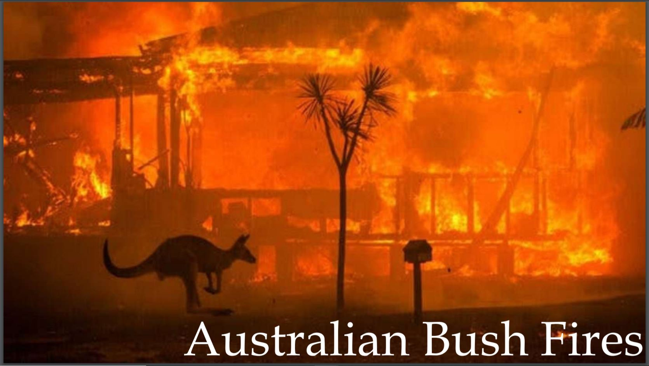

Slide 2
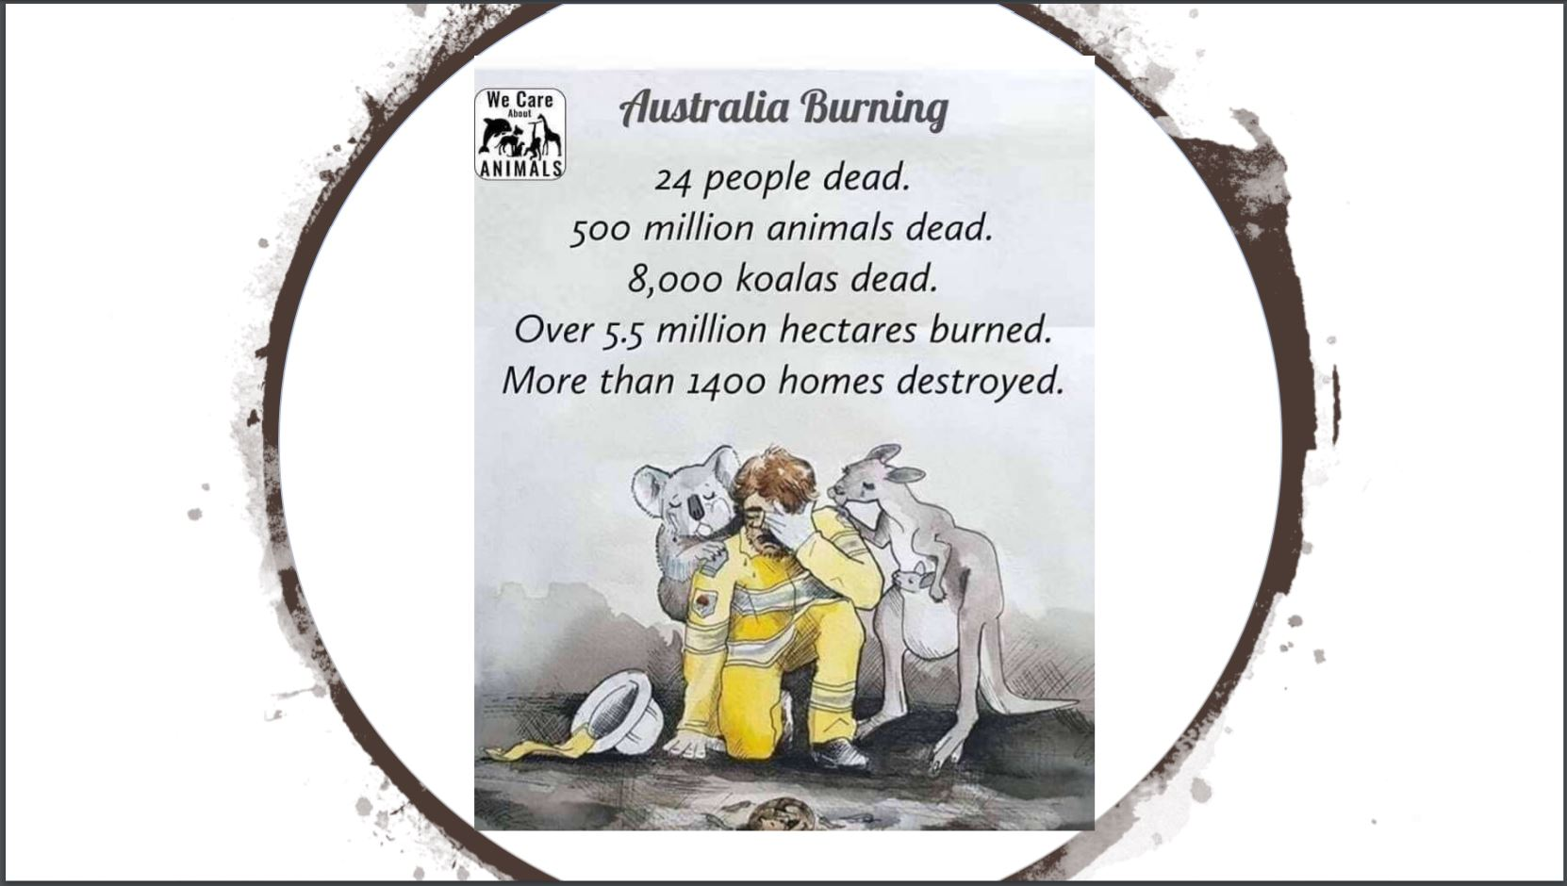

Slide 3
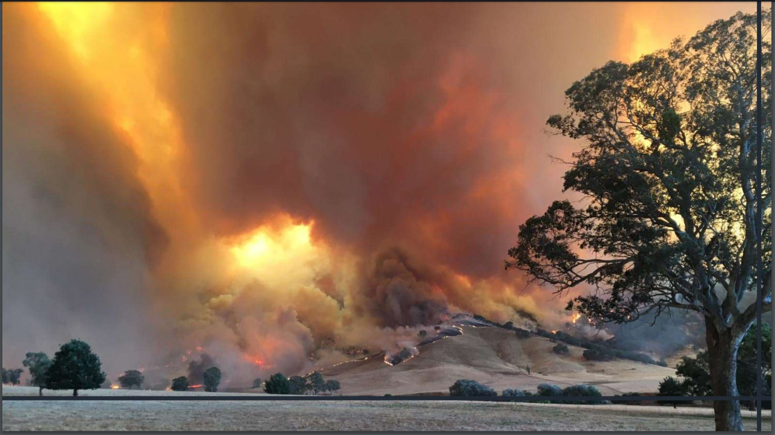
Australia was not unfamiliar with forest fires
But this time world saw destruction at a completely different level
Dozens of fires erupted in New South Wales, Australia, prompting the government to declare a state of emergency in November 2019. Fires rapidly spread across all states to become some of the most devastating on record. An area about the size of South Korea, roughly 25.5 million acres, has burned. At least 33 people are dead, including at least three volunteer firefighters, and more are missing. Around 3,000 homes have been destroyed or damaged. As blazes intensified in the days leading up to New Year’s Eve, thousands of people who were forced to evacuate sought shelter on beaches across New South Wales and Victoria.

Slide 4
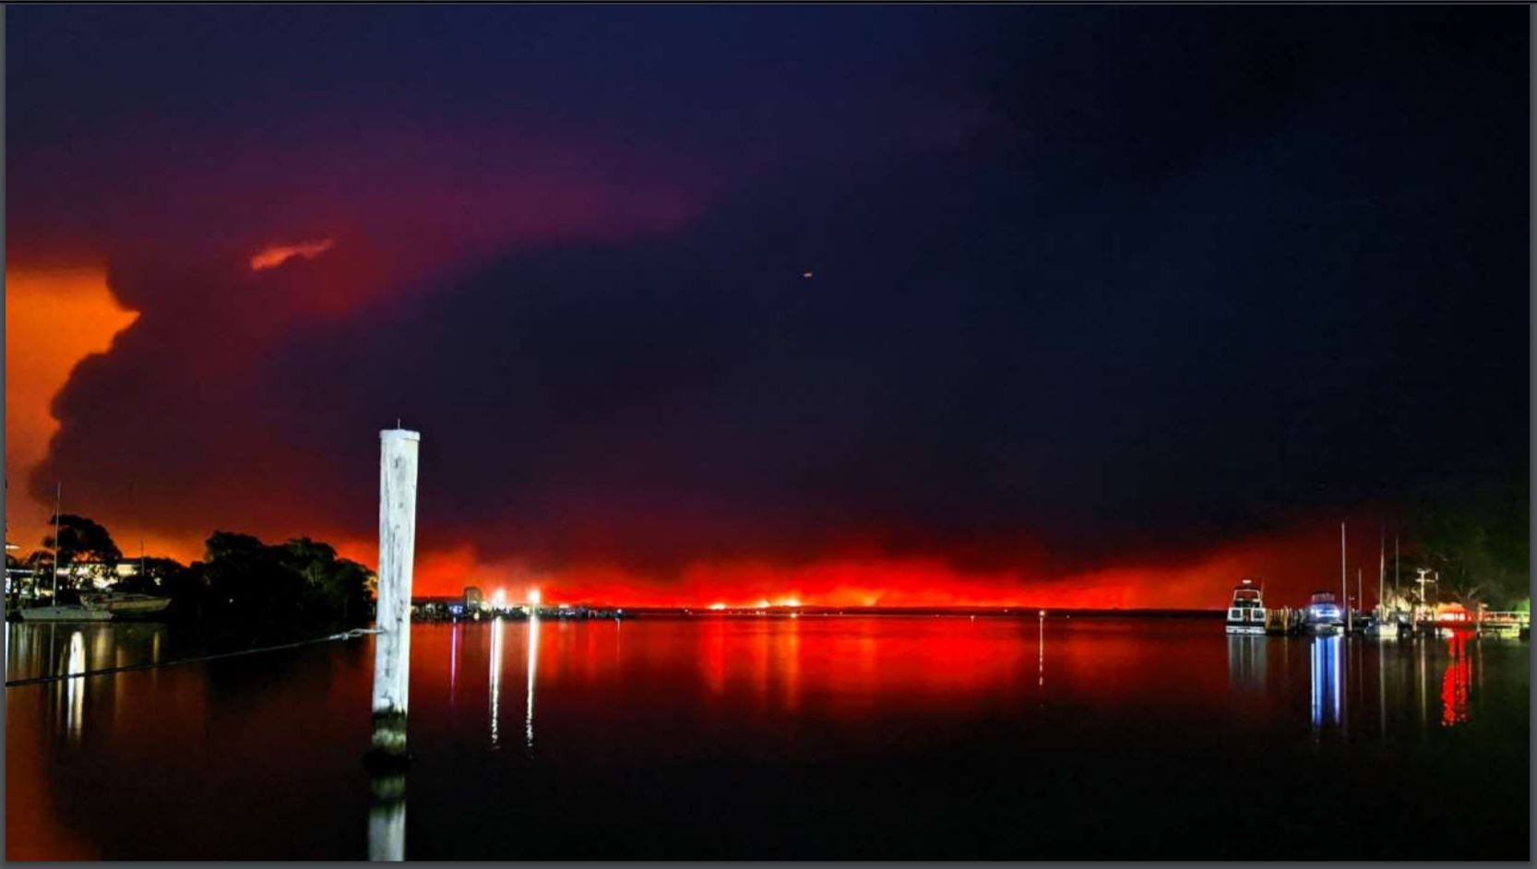
The fires reached an unprecidented scale
The fires reached an unprecedented scale. It’s effect were visible not only in the
North and Northwest Australia but even in southern regions.
This picture was taken at the Sydney port. The place famous for its beauty was
drowned in the red blooded sorrows. The extent of the horrors of this disaster were
Initially unfathomable.

Slide 5
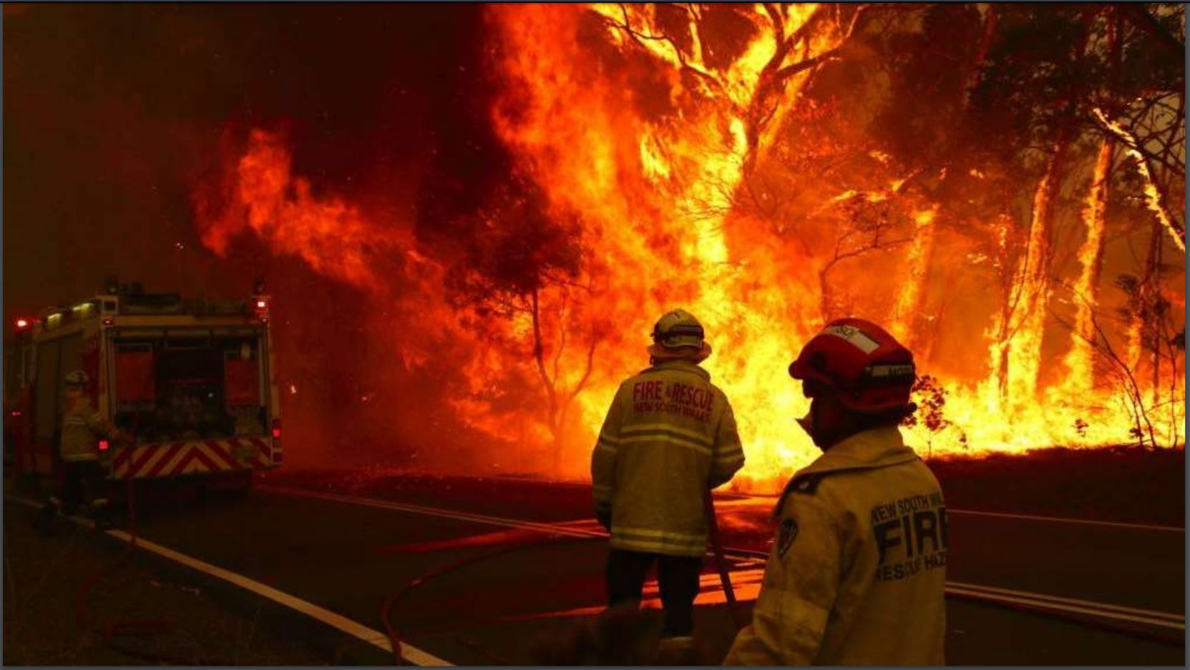

Slide 6
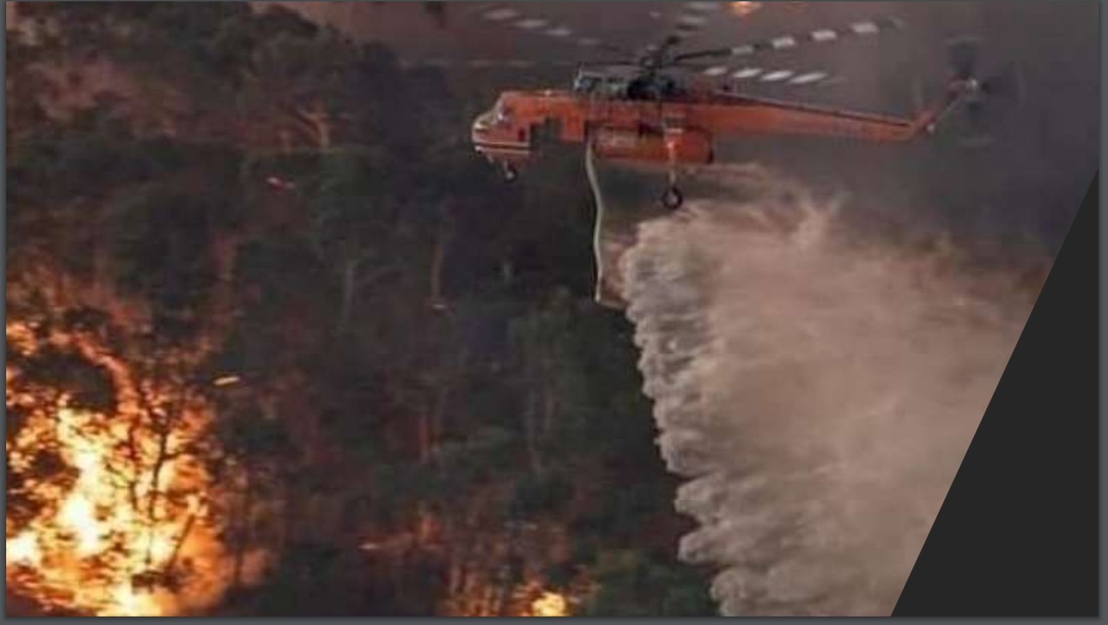

Slide 7
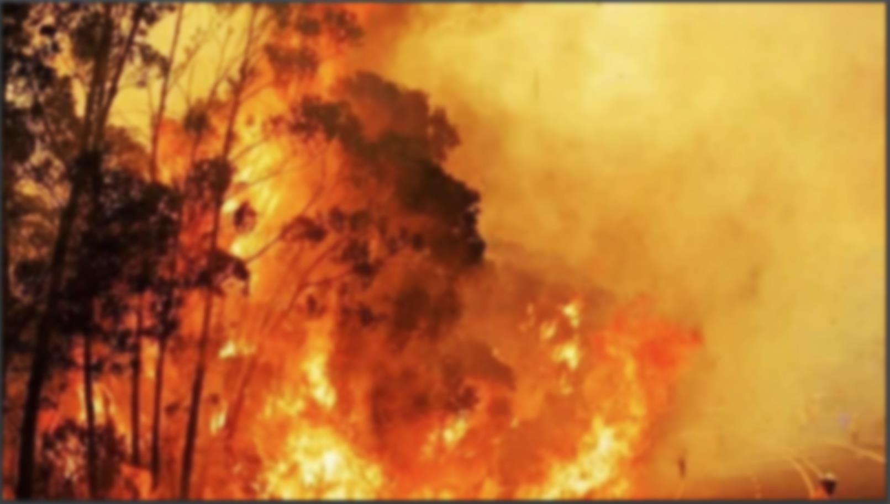
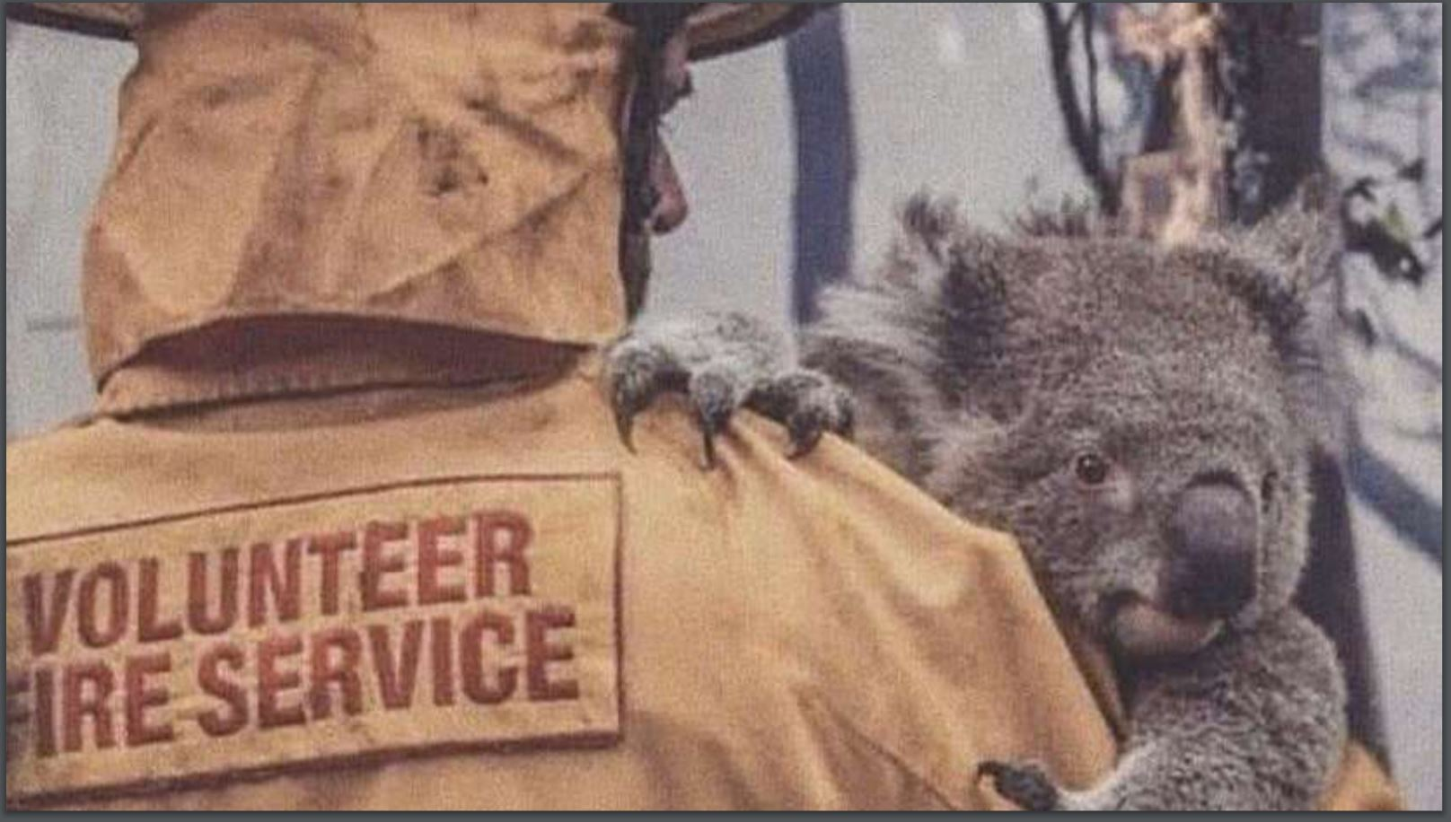
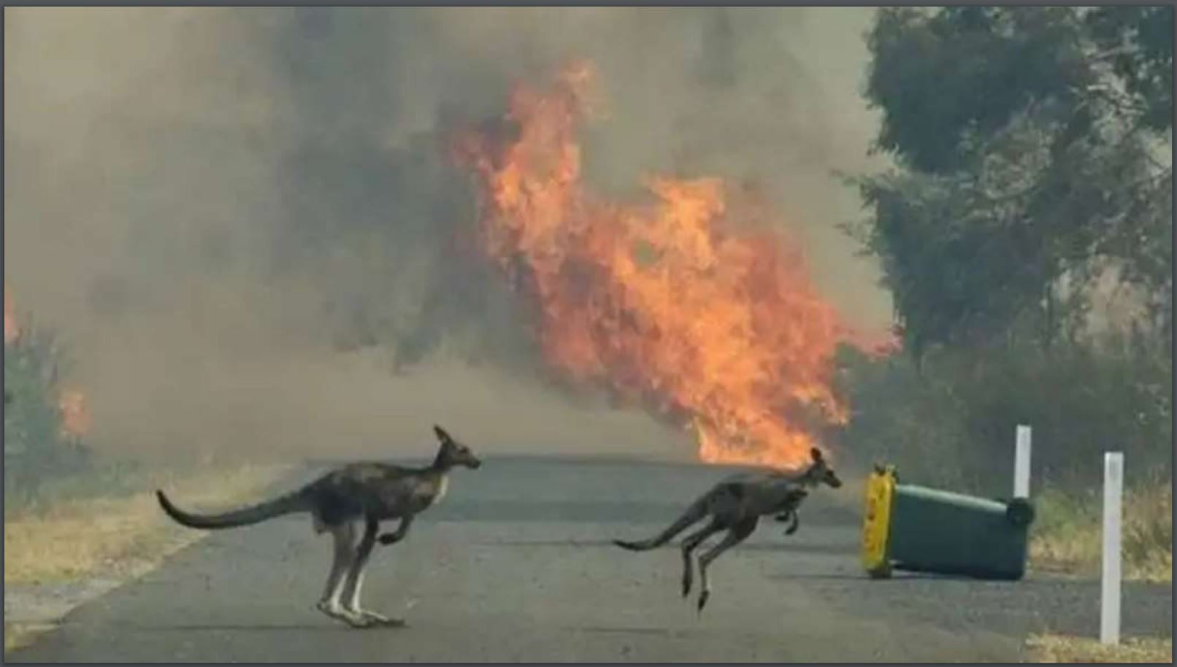
The worst hit were the Flora and Fauna of the region.
More than 1 billion mammals, birds, and reptiles likely lost their lives in the blazes, according
to one estimate from the University of Sydney. Around 25,000 koalas were feared dead on
Kangaroo Island. Eight thousand koalas, a third of all the koalas in New South Wales, are
believed to have perished, and about 30 percent of the koalas’ habitat has also been wiped
out. The devastation only adds to existing pressures on Australia’s unique ecosystems. The
continent is home to 244 species that are not found anywhere else. The region also has the
highest rate of native mammals becoming extinct over the past 200 years. The Department of
Agriculture, Water and the Environment published a list on February 11th of the 113 animal
species, including the platypus, that most urgently need help following the fires.

Slide 8
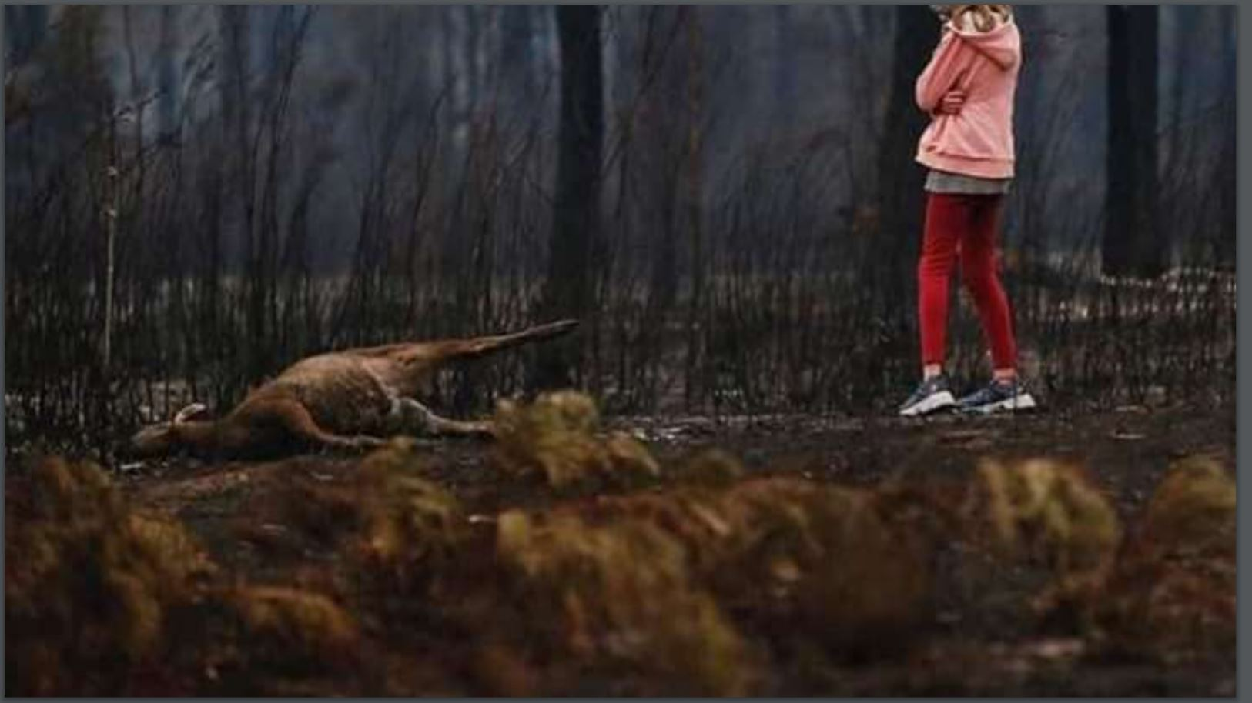

Slide 9
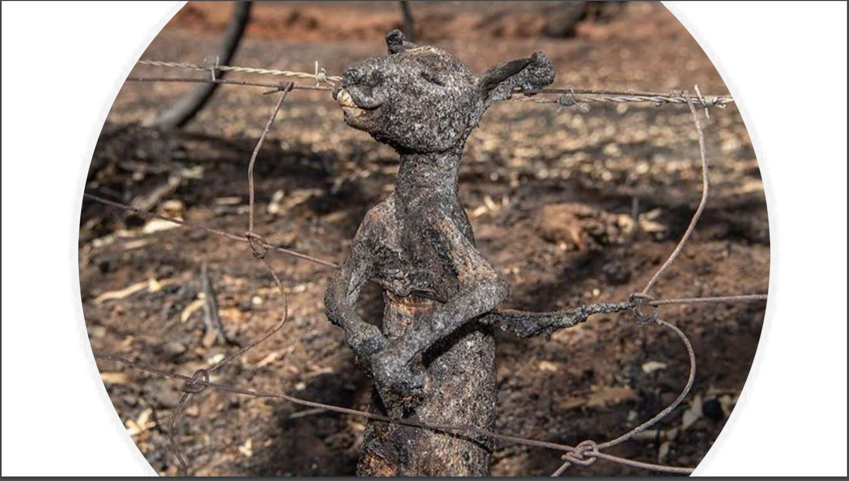

Slide 10
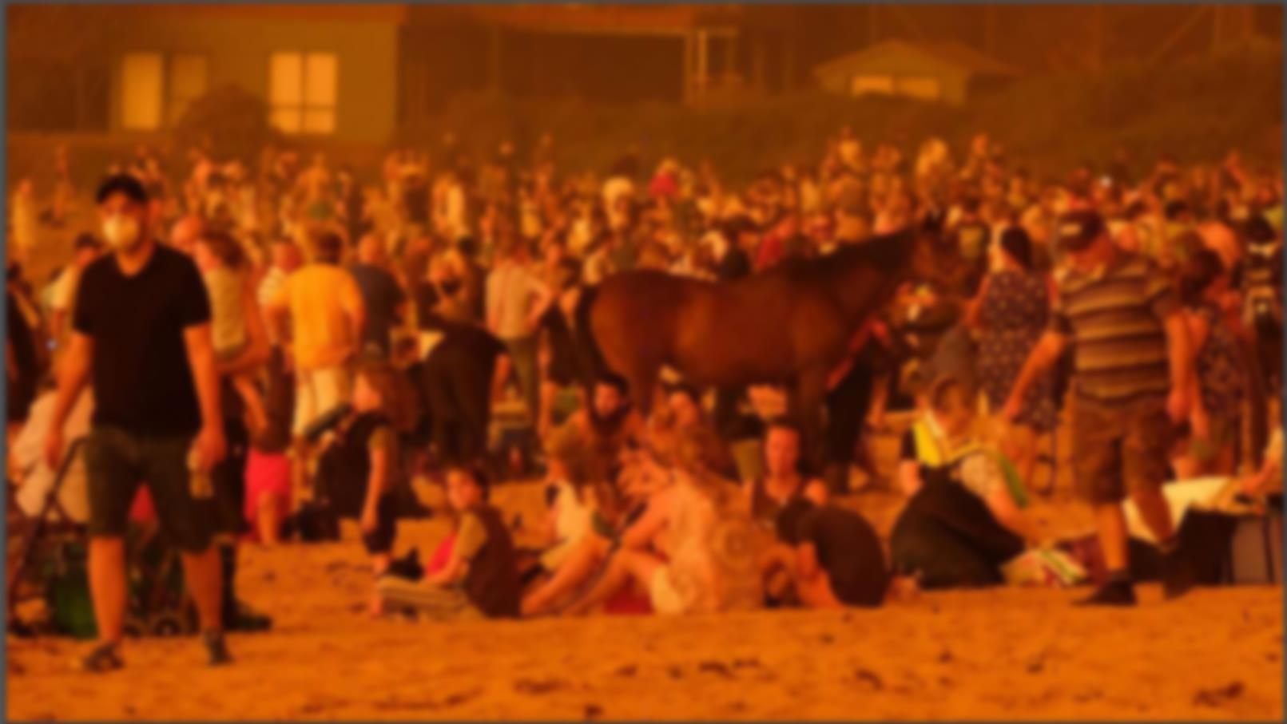
We Humans have also paid a huge price ---------
Approx. 800 people died in the fire
3500 homes destroyed.
Burned Area:- 18,636,079 hectares or 186,000 sq kilometers
This fire did approximately $4.4Billion more damage than
the second worst fire in the Australian history.

