Slide 1
Summer_Olympic_medallists_1896-2008
File created on: 4/22/2025 6:28:43 PM

Slide 2
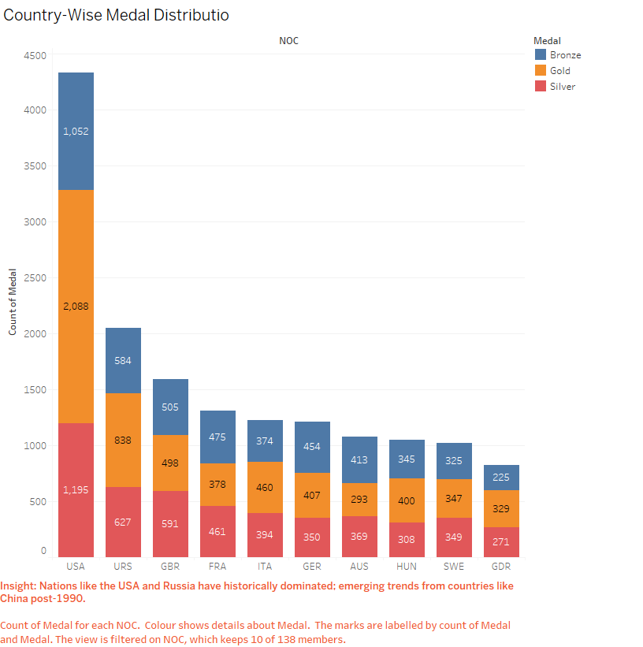

Slide 3
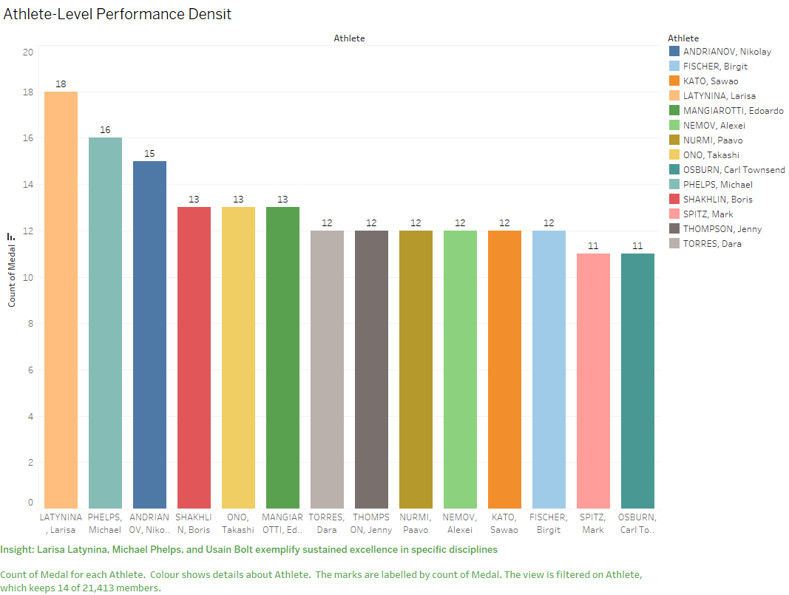

Slide 4
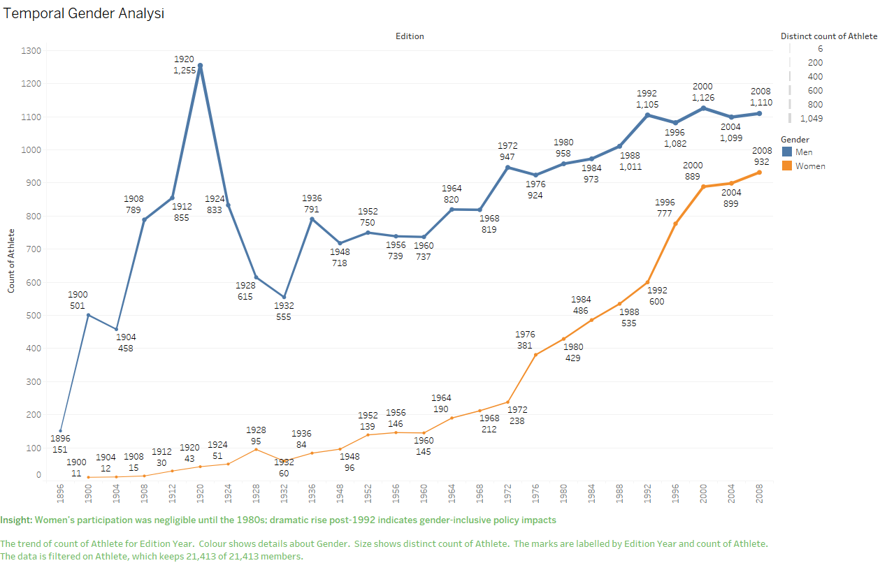

Slide 5
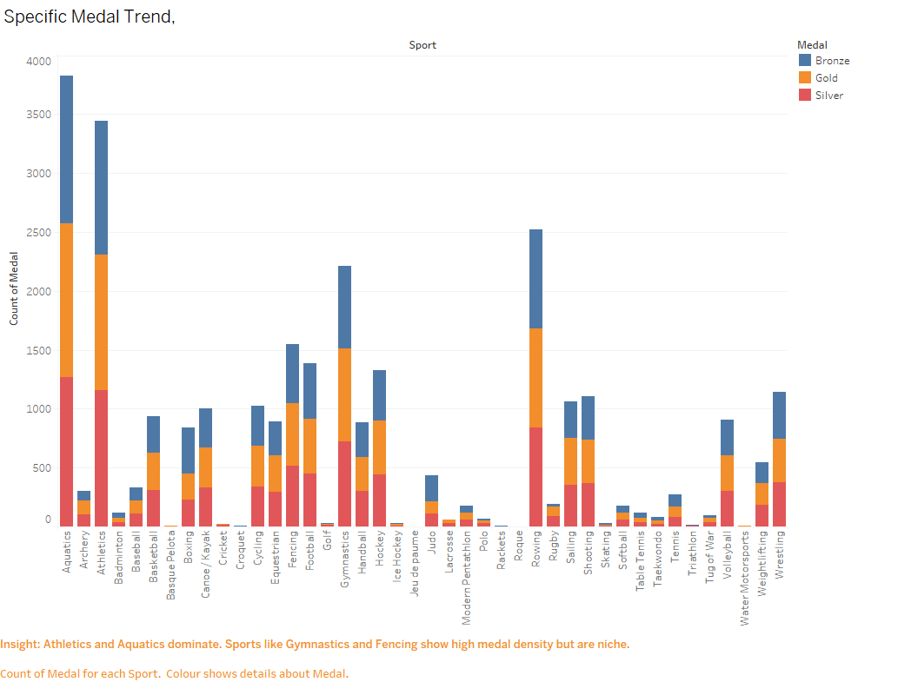

Slide 6
